Slide 1
Co-production
Week Two

Slide 2
What is co-production?
“The term ‘co-production’ describes working in partnership by sharing power between people who draw on care and support, carers, families and citizens.” Social Care Institute for Excellence (2022)
“The Act aims for people to be more involved in the design and provision of their care and support. It means organisations and professionals working with them and their family, friends and carers so their care and support is the best it can be.” Services and Well-being (Wales) Act 2014

Slide 3
Principles of co-production:
Empowering individuals
Collaborating with professionals
Community involvement
Social Services Wellbeing Act (2014)

Slide 4
Co-production has been broken down into the following activities:
co-design, including planning of services
co-decision making in the allocation of resources
co-delivery of services, including the role of volunteers in providing the service
co-evaluation of the service.

Slide 5
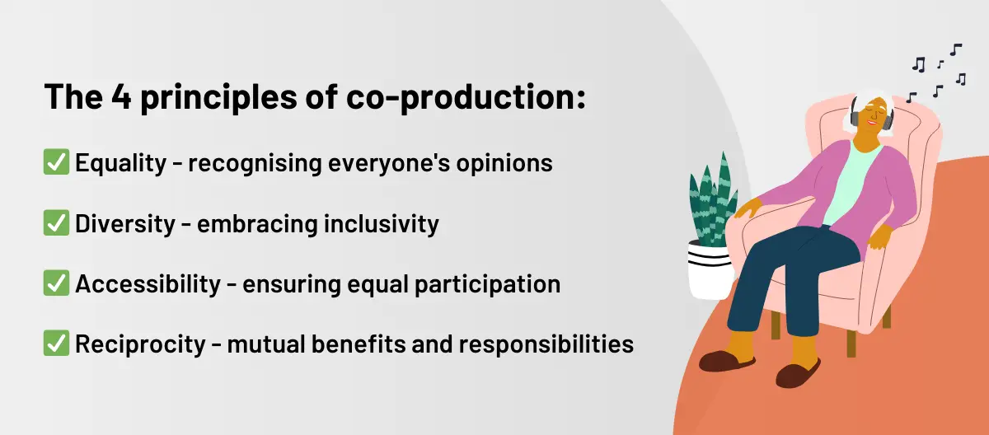
principles are expected within co-production

Slide 6
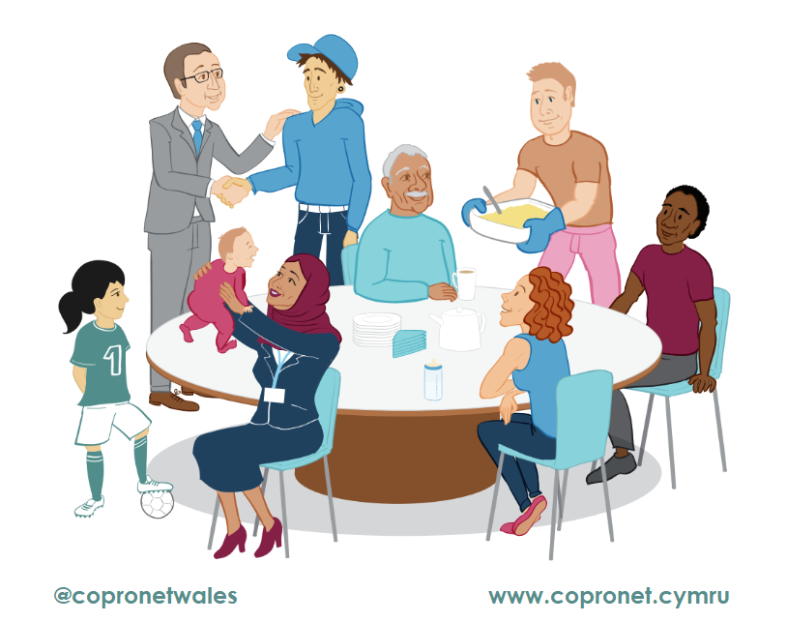
Examples of co-production

Slide 7

Barriers to co-production

Slide 8

Benefits of coproduction
https://www.scie.org.uk/co-production/what-how/

Slide 9
Care Act 2014
“Local authorities should, where possible, actively promote participation in providing interventions that are co-produced with individuals, families, friends, carers and the community.
“Co-production” is when an individual influences the support and services received, or when groups of people get together to influence the way that services are designed, commissioned and delivered.”

Slide 10
Social Care Institute for Excellence (2022)
Culture
Ensure that co-production runs through the culture of an organisation.
Structure
Involve everyone who will be taking part in co-production from the start.
Build on existing structures and resources.
Practice
Ensure that everything in the co-production process is accessible to everyone taking part and nobody is excluded.
Review
Conduct regular reviews to ensure that co-production is making a real difference and that the process is following the agreed principles.

Slide 11

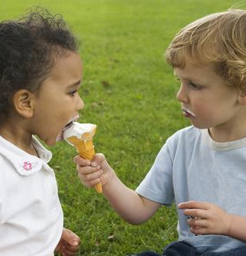

‘Doing to’, ‘Doing for’, or ‘Doing with'
This Photo by Unknown Author is licensed under CC BY-NC-ND
This Photo by Unknown Author is licensed under CC BY
This Photo by Unknown Author is licensed under CC BY-NC-ND

