Slide 1
BA Business Management
Management Accounting LCBB5002
Week 1 Lesson 2
Costs

Slide 2

By the end of this session you should be able to understand:
What a cost is
Cost classification

Slide 3
Definitions…
Cost – the amount of expenditure (actual/ notional) incurred or attributable to a specified activity or thing/ item
Cost Unit – a unit of an thing or activity to which costs can be calculated e.g kg/ tonne
Cost Object – anything that stakeholders/ users of accounting information want to know the cost of e.g product, sales area, SBU
Cost Centre – department, machine, project

Slide 4
Let’s model cost units in groups
Write down the appropriate cost units you would use for the following:
Road transport truck/ Cargo haulage
Maize/ Wheat grain production
Minerals extraction
Beer Brewing business
Electricity
Water
Healthcare/ Care Home

Slide 5
Let’s model cost units in groups
Write down the appropriate cost units you would use for the following:
Road transport truck/ Cargo haulage - tonne mile/ tonne per mile
Maize/ Wheat grain production – kg, tonne, metric tonne
Minerals extraction - kg, tonne, metric tonne, load
Beer Brewing business – Barrel, Gallon, Litres
Electricity - KWH
Water – Litres, Cubic litres
Healthcare/ Care Home - Bed night, procedure, bed night

Slide 6
Ways of measuring costs:
Historical cost (most popular) i.e how much did you buy an item for
Economic value – value that can be obtaining from the asset e.g rental income and property value appreciation/ capital gained
Net realisable value – value that can be obtained from selling the item
Replacement value – cost to replace the item

Slide 7
Definitions…
Cost Centre
a production or service location, activity or item where costs are accumulated.
Mine
Revenue Centre
a department or operations area with a revenue maximisation responsibility
Sales department
Profit Centre
a section of a business that contributes to overall company profits
(Strategic Business Unit – SBU)
Factory
Organisation function e.g finance, IT, HR
Sales centre

Slide 8
Why is there need to ascertain costs/ revenues/ profits
Refer definition of management accounting (objectives)
Control
Decision making
Planning

Slide 9
Why is there need to ascertain costs/ revenues/ profits
Refer definition of management accounting (objectives)
Control – control costs so they do not spiral out of control
Decision making – pricing and contract negotiation, product production stoppage,
Planning – strategy and competitive planning

Slide 10
Cost classification
Typically we can classify our costs by:
Nature – materials, labour, expenses
Function – departments etc HR, Finance…
Direct or indirect – Direct Costs (identifiable and increases as volume increases) – direct material, labour etc and the sum of all direct costs is Prime Costs.
Indirect costs – not identifiable but increases with volume (overheads) e.g electricity. Production or non-production overheads

Slide 11
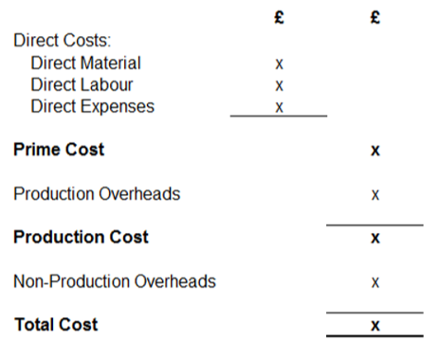
Calculating costs

Slide 12
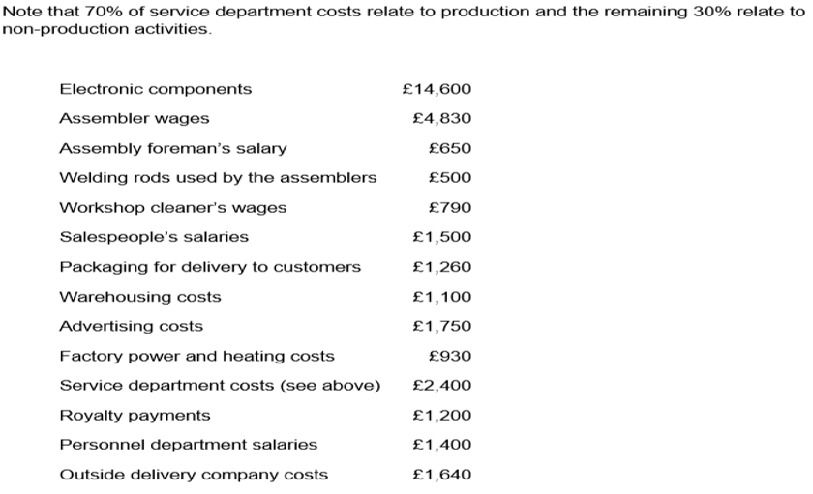
Calculating costs
York Engineering operates in central Birmingham producing Metal Clothes Frames. Prepare a cost summary using data below:

Slide 13
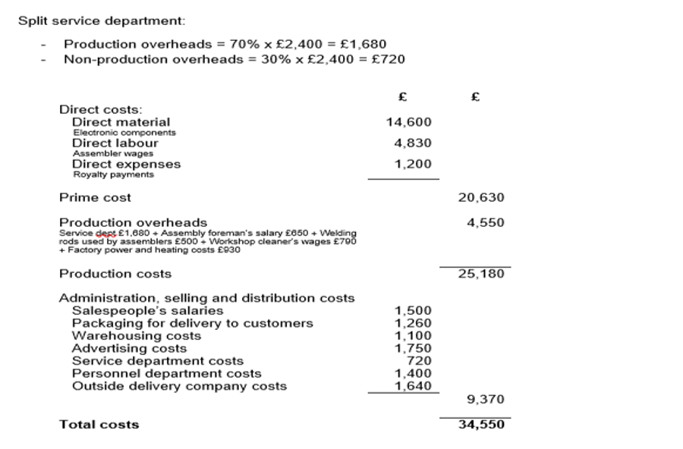

Slide 14
Pricing
After calculating total costs, companies can then set appropriate prices considering various factors including:
Cost, Volume, Government controls, Perceived value, Trade requirements, Competition
Pricing strategies
Penetration – low first then increase
Discount - tactically reducing prices to stimulate demand
Premium – high quality products e.g sport cars, etc
Price Skimming – high first then low
Odd number pricing – £0.99, £4.99
Price discrimination – different prices, different markets

Slide 15
Reading list
Essential reading
Drury, C., (2012) Management and Cost Accounting (8th edition) London: Thomson Business Press
Atrill, P., McLaney E., (2012) Management Accounting for Decision Makers, FT Prentice Hall
Seal W, Garrison R, Noreen, E., Rohde, C., (2014) Management Accounting. McGraw Hill Education
Further reading
Horngren, T., Forster, G., (2003) (11th edition) Cost Accounting, A Managerial Emphasis, London: Prentice Hall International
Noreen, E., (2011) Management Accounting, McGraw Hill

Slide 16
Next session:
Cost behaviour: fixed, variable, mixed, splitting mixed costs (graphical, High-Low Method)

