Slide 1
ECAD4017/C Assessment guidance / Canllawiau asesu
What do I need to include in my presentation to get a really good mark ?
?
ECAD4017/C
Assessment.

Slide 2
Aim –
To know how to get a good mark!
I wybod sut i gael marc da!
Notes:
Example 1 o

Slide 3
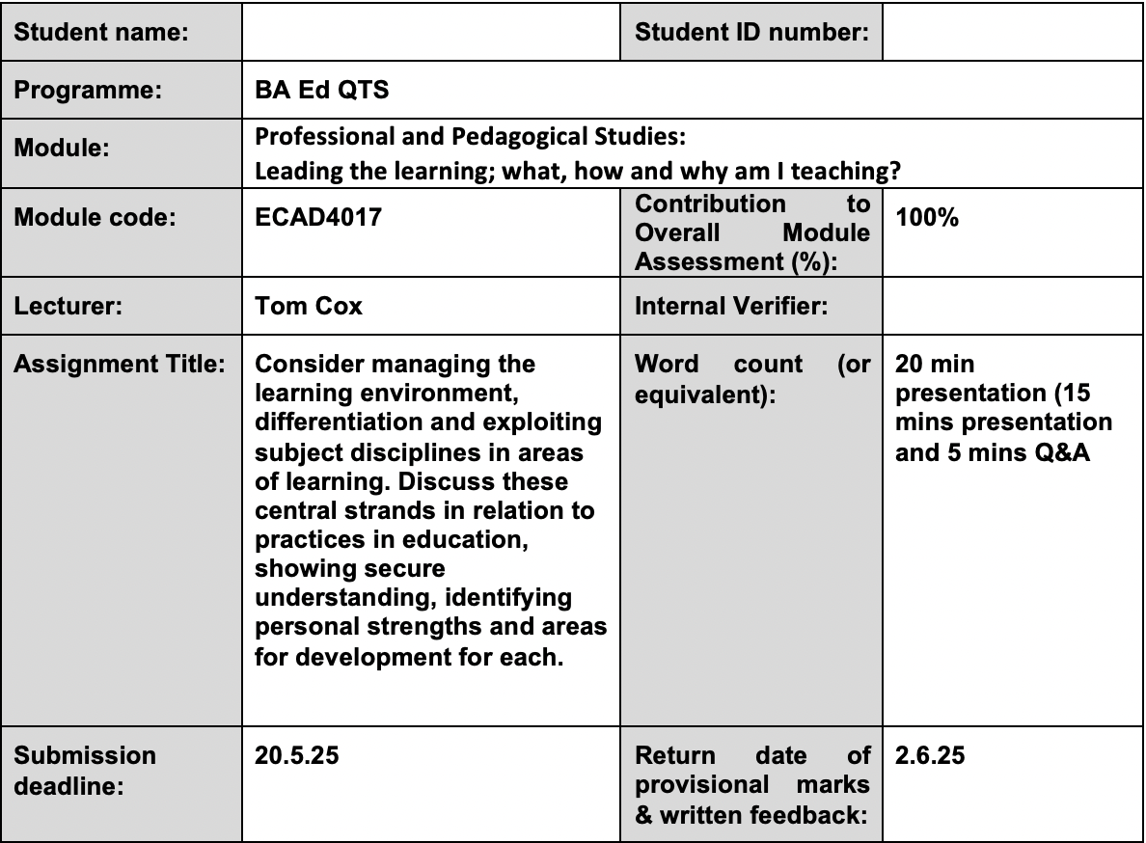
The overview
?
24/3/26
23/4/26
Notes:
Key point- pick your fights as a teacher because some we have control over, some so don’t. If you want QTS in Wales, this is the route.

Slide 4
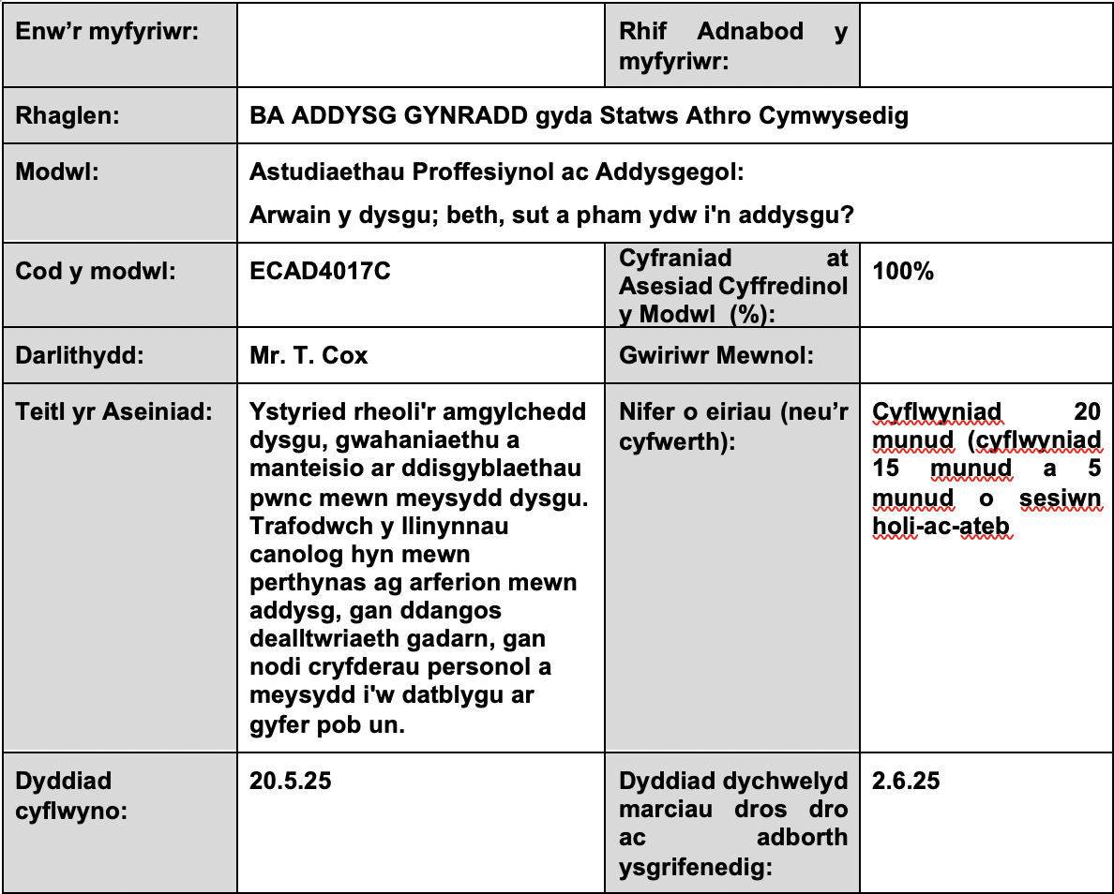
Y trosolwg
?
24/3/26
23/4/26
Notes:
Key point- pick your fights as a teacher because some we have control over, some so don’t. If you want QTS in Wales, this is the route.

Slide 5
The overview
A presentation that considers the three central strands of managing the learning environment, differentiation and exploiting subject disciplines in areas of learning. Discuss these central strands in relation to practices in education, showing secure understanding, identifying personal strengths and areas for development for each.
The duration of this presentation is 20mins
The assessment consists of an individual presentation of 15 mins and 5 mins of a related Q+A period.
Your response should reflect your understanding of the three central strands, the role of the professional teacher as being a reflective practitioner, the complex nature of the learning environment and reflect upon pedagogical choices.
?
Notes:
Key point- pick your fights as a teacher because some we have control over, some so don’t. If you want QTS in Wales, this is the route.

Slide 6
Y trosolwg
Cyflwyniad sy'n ystyried y tri llinyn canolog o reoli'r amgylchedd dysgu, gwahaniaethu a manteisio ar ddisgyblaethau pwnc mewn meysydd dysgu. Trafodwch y llinynnau canolog hyn mewn perthynas ag arferion mewn addysg, gan ddangos dealltwriaeth gadarn, gan nodi cryfderau personol a meysydd i'w datblygu ar gyfer pob un.
Hyd y cyflwyniad hwn yw 20 munud
Mae'r asesiad yn cynnwys cyflwyniad unigol o 15 munud a 5 munud o gyfnod cwestiwn ac ateb cysylltiedig.
Dylai eich ymateb adlewyrchu eich dealltwriaeth o'r tri llinyn canolog, rôl yr athro proffesiynol fel ymarferydd adfyfyriol, natur gymhleth yr amgylchedd dysgu a myfyrio ar ddewisiadau addysgeg.
?
Notes:
Key point- pick your fights as a teacher because some we have control over, some so don’t. If you want QTS in Wales, this is the route.

Slide 7
The overview
You will need to undertake an exploration of literature relating to managing the learning environment, differentiation and exploiting subject disciplines in areas of learning, and critically reflect on personal strengths utilising supporting evidence from PTE. The ability to identify areas for development is also required.
The assessment response should include:
An individual Microsoft PowerPoint presentation (or similar presentation software)
Reference to academic reading and an understanding of pedagogical choices to aid the teaching and learning;
Reflection of personal performance of managing the learning environment, differentiation and exploiting subject disciplines in areas of learning, with examples of creative and innovative practice from PTE
Considered opportunities for future development will inform practice and ensure professional progress.
?
Notes:
Key point- pick your fights as a teacher because some we have control over, some so don’t. If you want QTS in Wales, this is the route.

Slide 8
Y trosolwg
Bydd angen i chi wneud archwiliad o lenyddiaeth sy'n ymwneud â rheoli'r amgylchedd dysgu, gwahaniaethu a manteisio ar ddisgyblaethau pwnc mewn meysydd dysgu, a myfyrio'n feirniadol ar gryfderau personol gan ddefnyddio tystiolaeth ategol gan PTE. Mae angen y gallu i nodi meysydd i'w datblygu hefyd.
Dylai’r ymateb asesu gynnwys:
• Cyflwyniad Microsoft PowerPoint unigol (neu feddalwedd cyflwyno tebyg)
• Cyfeiriad at ddarllen academaidd a dealltwriaeth o ddewisiadau pedagogaidd i gynorthwyo'r addysgu a'r dysgu;
• Myfyrio ar berfformiad personol o reoli'r amgylchedd dysgu, gwahaniaethu a manteisio ar ddisgyblaethau pwnc mewn meysydd dysgu, gydag enghreifftiau o arfer creadigol ac arloesol gan PTE
• Bydd cyfleoedd a ystyriwyd ar gyfer datblygiad yn y dyfodol yn llywio ymarfer ac yn sicrhau cynnydd proffesiynol.
?
Notes:
Key point- pick your fights as a teacher because some we have control over, some so don’t. If you want QTS in Wales, this is the route.

Slide 9
Plan of attack / Cynllun ymosodiad……
Engage in wide and deep background reading related to the identified strands…ensure you have secure K&U of each.
Cymerwch ran mewn darllen cefndirol eang a dwfn sy'n ymwneud â'r llinynnau a nodwyd...sicrhewch fod gennych K&U diogel o bob un.
?
What are they?
Why are they important ?
Beth ydyn nhw?
Pam maen nhw'n bwysig?

Slide 10

Essential reading / Darllen hanfodol…
This assignment requires that you demonstrate knowledge and understanding of;
managing the learning environment / rheoli'r amgylchedd dysgu
Differentiation / gwahaniaethu
Exploiting subject disciplines in AoLEs. / Manteisio ar ddisgyblaethau pwnc mewn MDPh.
Use the key authors in the relevant fields.
You must use readings that you identify independently displaying an ability to go beyond the given content in the module.
?

Slide 11
Essential reading / Darllen hanfodol…
Throughout the presentation, it is essential that you support all aspects of your discussion and critical reflection from wide and deep background reading / darllen cefndir eang a dwfn.
What types of sources Tom?
Pa fathau o ffynonellau Tom?
Avoid making claims without supporting them from research.
?

Slide 12

Let’s work on your assignment now…
Gadewch i ni weithio ar eich aseiniad nawr…
?
?
?
?
Managing the learning environment Rheoli'r amgylchedd dysgu
Support and counterargument
?
?
?
?
What aspects of this strand might you start researching?

Slide 13
Possible aspects to consider / Agweddau posibl i'w hystyried...
Establishing Clear Expectations and Routines
Promoting Engagement and Motivation
Creating a Positive Classroom Climate
Building Positive Relationships and Student Well-being
Managing the learning environment
Support and counterargument
Organising the Physical Space
Managing Disruptions and Conflict
Adapting the Environment to Meet Diverse Needs
Managing Time and Resources Efficiently

Slide 14
Possible aspects to consider / Agweddau posibl i'w hystyried...
Sefydlu Disgwyliadau a Threfnau Clir
Hyrwyddo Ymgysylltiad a Chymhelliant
Creu Hinsawdd Ystafell Ddosbarth Gadarnhaol
Adeiladu Perthnasoedd Cadarnhaol a Llesiant Myfyrwyr
Rheoli'r amgylchedd dysgu
Cefnogaeth a gwrth-ddadleuon
Trefnu'r Gofod Corfforol
Rheoli Aflonyddwch a Gwrthdaro
Addasu'r Amgylchedd i gwrdd ag Anghenion Amrywiol
Rheoli Amser ac Adnoddau yn Effeithlon

Slide 15
Possible aspects to consider / Agweddau posibl i'w hystyried...
Varying the Process or Delivery of Learning
(Pace, time, scaffolding etc)
Adjusting Products or Outcomes
Differentiating for Diverse Learners (EAL, ALN, MAT)
Adjusting Content
Differentiation Gwahaniaethu
Support and counter
Adapting / organising the Environment to meet individual/ groups needs
Resources to support
Language / vocabulary

Slide 16
Possible aspects to consider / Agweddau posibl i'w hystyried...
Amrywio'r Broses neu'r Ddarpariaeth Dysgu (Cyflymder, amser, sgaffaldiau ac ati)
Addasu Cynhyrchion neu Ganlyniadau
Gwahaniaethu ar gyfer Dysgwyr Amrywiol (SIY, ADY, MATh)
Addasu Cynnwys
Gwahaniaethu
Cefnogaeth a gwrth-ddadleuon
Addasu / trefnu'r Amgylchedd i ddiwallu anghenion unigolion/grwpiau
Adnoddau i gefnogi
Iaith / geirfa

Slide 17
Possible aspects to consider / Agweddau posibl i'w hystyried...
Engaging Students with Active Learning and appropriate pedagogy
Using Wide and Deep Subject Knowledge
Making Cross-Curricular Links
Understanding of how a Topic is Situated Within a Particular AoLE and/or Subject.
Exploiting subject disciplines in AoLEs
Support and counter
Developing lessons which achieve the four purposes.
Develop Learners’ Digital Competence, Literacy and
Numeracy
Keeping Current with the Discipline

Slide 18
Possible aspects to consider / Agweddau posibl i'w hystyried...
Ymgysylltu Myfyrwyr â Dysgu Gweithredol a phedegogiaeth briodol
Defnyddio Gwybodaeth Pwnc Eang a Dwfn
Creu Cysylltiadau Trawsgwricwlaidd
Dealltwriaeth o sut mae Pwnc wedi'i Leoli o fewn Maes Dysgu a/neu Bwnc Penodol.
Manteisio ar ddisgyblaethau pwnc mewn MDPh.
Cefnogaeth a gwrth-ddadleuon
Datblygu gwersi sy'n cyflawni'r pedwar diben.
Datblygu Cymhwysedd Digidol, Llythrennedd a Rhifedd Dysgwyr
Cadw'n Gyfredol gyda'r Ddisgyblaeth

Slide 19
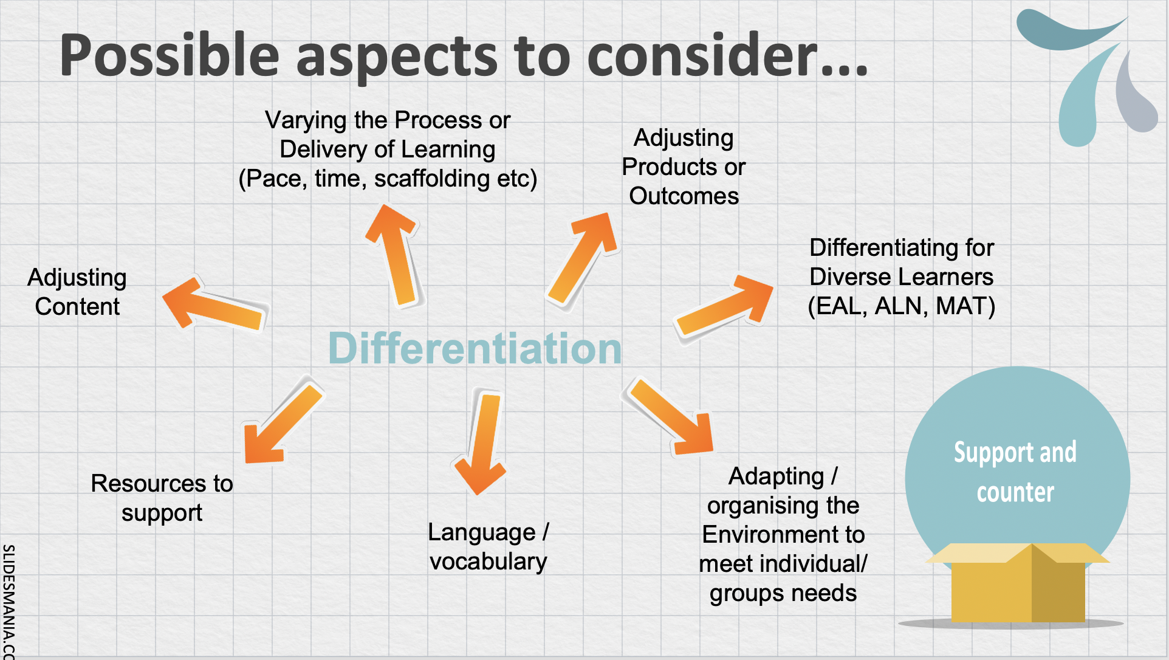
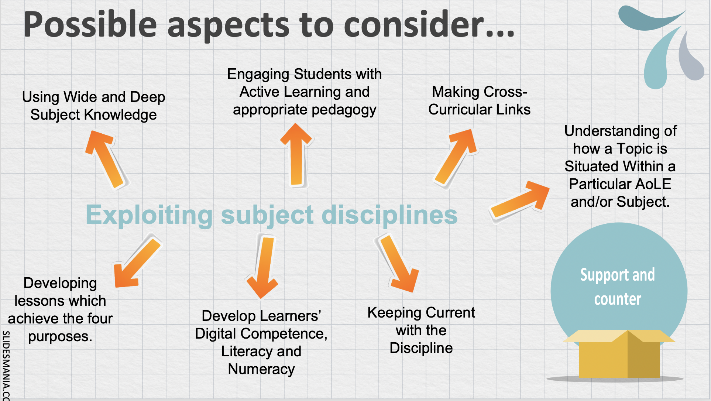
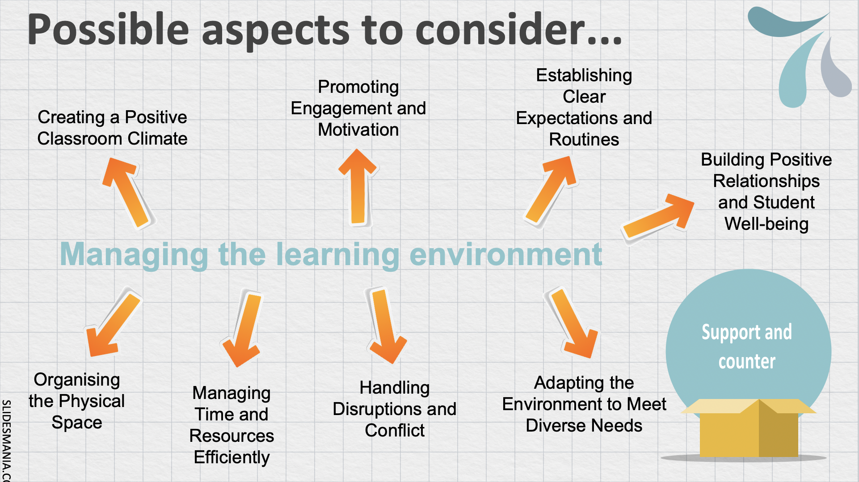
Wow…am I expected to talk about them ALL?!
NO!
You only have 15 mins.
Choose aspects of each strand you would like to discuss and that you have EVIDENCE for your judgements of strength and development.
?
agweddau ar bob llinyn

Slide 20

Plan of attack…
Engage in wide and deep background reading
?

Slide 21
Plan of attack…
Plan for approaches / pedagogy/ strategies that demonstrate your understanding and engagement with each strand
Engage in wide and deep background reading
?

Slide 22
Plan of attack…Cynllun ymosodiad…
Plan for approaches / pedagogy/ strategies that demonstrate your understanding and engagement with each strand
Teach on PTE and collect evidence of your strengths in each strand
Engage in wide and deep background reading
?

Slide 23
Plan of attack…
Plan for approaches / pedagogy/ strategies that demonstrate your understanding and engagement with each strand
Teach on PTE and collect evidence of your strengths in each strand
Engage in wide and deep background reading
?
Reflect on your development of each strand weekly, set targets, ask for advice, seek opportunities for professional development

Slide 24
Plan of attack…
Plan for approaches / pedagogy/ strategies that demonstrate your understanding and engagement with each strand
Teach on PTE and collect evidence of your strengths in each strand
Engage in wide and deep background reading
?
Reflect on your development of each strand weekly, set targets, ask for advice, seek opportunities for professional development
Reflect on your strengths and aspects you wish to develop…present!

Slide 25
Cynllun ymosodiad…
Cynllunio ar gyfer dulliau / addysgeg / strategaethau sy'n dangos eich dealltwriaeth a'ch ymgysylltiad â phob llinyn
Addysgwch ar PAP a chasglwch dystiolaeth o'ch cryfderau ym mhob llinyn
Cymryd rhan mewn darllen cefndir eang a dwfn
?
Myfyriwch ar eich cryfderau a'r agweddau yr hoffech eu datblygu…cyflwynwch!
Myfyriwch ar eich datblygiad o bob llinyn yn wythnosol, gosodwch dargedau, gofynnwch am gyngor, chwiliwch am gyfleoedd ar gyfer datblygiad proffesiynol

Slide 26
Consider why the assignment has been set…
(Introduction)
Why is it important that a teacher reflects on their strengths and areas of development?
Pam ei bod yn bwysig bod athro yn myfyrio ar ei gryfderau a’i feysydd datblygu?
?

Slide 27
Possible presentation structure…
Strwythur posib ar gyfer y cyflwyniad …
This presentation has some distinct elements.
Introduction / Rhagymadrodd
Briefly outline what you will discussing and ensure that the audience fully understands the purpose of the assignment and WHY it is important.
Literature Review / Adolygiad Llenyddiaeth
The literature provides the background context for the discussion of your personal reflection. You should demonstrate that you understand the key ideas, background research, principles, theories, benefits and concepts associated with each strand.
What evidence in literature support this view? Does anyone disagrees with aspects of a strand?
In this section, remember to use tentative language and try to explore and discuss ideas rather than simply describe. (The literature suggests…)
Why is it important a teacher reflects on their strengths and areas for development?
Who agrees?
?
General / Cyffredinol

Slide 28
Reflective discussion / Trafodaeth fyfyriol (approx. 10mins)
In this section you will need to discuss your STRENGTHS with EACH strand.
Provide an informed account of the where you think you currently are with aspects of each strand. YOU CAN’T TALK ABOUT EVERYTHING! / NI ALLWCH SIARAD AM BOPETH!
Ensure that clear EVIDENCE / TYSTIOLAETH of your identified strengths are shared
to support your discussion (PTE).
This evidence may take the form of lesson plans,
pictures, outcomes of learners work, displays,
resources created, feedback comments, targets etc.
Choose aspects that you have particular strengths in and have evidence for!
?

Slide 29
Reflective discussion / Trafodaeth fyfyriol (approx. 10mins)
It is in this section that you examine in detail the SPECIFIC approaches you have selected to aid aspects of managing the learning environment, differentiation and exploiting subject disciplines in AoLEs. For example, you may have provided a group of students with a different resource to aid differentiation.
Justify / Cyfiawnhau why you have chosen a certain strategy / approach who agrees? What are the benefits of each approach?
What are the aspects to be cautious with? Does anyone disagree
with you choice of strategy?
Support your pedagogical choices from wide and deep research,
providing evidence of your own practice from PTE.
MAIN FOCUS!
PRIF FFOCWS!

Slide 30
Conclusion / Casgliad
In this section, you should discuss your conclusions and recommendations for your own future practice.
There is a requirement to clearly identify what aspects of EACH strand you would like to develop further and why?
You might include an explanation of the benefits you have experienced in engaging in this assessment,
This conclusion should be drawn form your reflective discussion of your strengths and the supporting literature and evidence from PTE.
?

Slide 31

Take a break…
Cymerwch seibiant…
Notes:
1 hour in all before you see them back in your channel. Put the interview questions in the Teams channel files.
Check against PLP for examples.
You will need to close this meeting and restart a new for their return- this is so that they can break into pairs next time.

Slide 32

How will it get marked?
Sut bydd yn cael ei farcio?

Slide 33
Let’s look at each aspect of the marking criteria
03
Cognitive and Intellectual
Gwybyddol a Deallusol
01
Engagement with Literature
Ymwneud â Llenyddiaeth
04
Practical Application
Cymhwysiad Ymarferol
02
05
Transferable Skills (Presentation focused)
Sgiliau Trosglwyddadwy (canolbwyntio ar y cyflwyniad)
Knowledge and Understanding
Gwybodaeth a Dealltwriaeth

Slide 34
01
Engagement with literature Ymwneud â Llenyddiaeth
.
Focus your reading on a variety of reliable academic literature
(Books, journals, case studies, articles, websites, WG documentation, Estyn reports etc)
Support, support and then support!
Include a synthesis of key writers
Try to develop the quality of discussion rather than the quantity. Engage with your sources!
Provide a Reference list slide at the end of the ppt, following the guidance within the UWTSD Harvard Referencing handbook. (Include references of sources used on slides + spoken)
Notes:
10-15 mins discussing this. APK – Use Chat/ Hands up/ Mentimeter/
Eg: clunky
Difficult to organise and see what you have done
Need more support
Engagement problems.
Linking to what they have done – not familiar with standards

Slide 35
01
Engagement with literature Ymwneud â Llenyddiaeth
.
Canolbwyntiwch eich darllen ar amrywiaeth o lenyddiaeth academaidd ddibynadwy (llyfrau, cyfnodolion, astudiaethau achos, erthyglau, gwefannau, dogfennaeth LlC, adroddiadau Estyn ac ati)
Cefnogaeth, cefnogaeth ac yna cefnogaeth!
Cynnwys synthesis o awduron allweddol
Ceisiwch ddatblygu ansawdd y drafodaeth yn hytrach na'r maint. Ymgysylltwch â'ch ffynonellau!
Darparwch sleid rhestr gyfeiriadau ar ddiwedd y ppt, gan ddilyn y canllawiau yn llawlyfr Cyfeirio Harvard UWTSD. (Cynnwys cyfeiriadau at ffynonellau a ddefnyddiwyd ar sleidiau + llafar)
Notes:
10-15 mins discussing this. APK – Use Chat/ Hands up/ Mentimeter/
Eg: clunky
Difficult to organise and see what you have done
Need more support
Engagement problems.
Linking to what they have done – not familiar with standards

Slide 36
02
Knowledge and Understanding / Gwybodaeth a Dealltwriaeth
…
Demonstrate accurate and deep knowledge and understanding of managing the learning environment, differentiation and exploiting subject disciplines within AoLEs.
(You may include related principles, research, best practice, under pinning learning theory etc)
Link strategies used in the classroom to each strand.
Why the evidence presented exemplifies a particular strength in an aspect of a strand.
Your response should demonstrate accurate knowledge and understanding of the chosen pedagogical approaches utilised to aid the effective engagement with each strand.
Notes:
Break out rooms. Interview Q&A.
Go into a few breakout rooms.
Select a few to try it at the end to the class if you are happy with that and/or what I need to improve on for interviews.
30 mins in breakout rooms.

Slide 37
02
Knowledge and Understanding / Gwybodaeth a Dealltwriaeth
…
Dangoswch wybodaeth a dealltwriaeth gywir a dwfn o reoli'r amgylchedd dysgu, gwahaniaethu a manteisio ar ddisgyblaethau pwnc o fewn Meysydd Dysgu a Phrofiad (AoLE).
(Gallwch gynnwys egwyddorion cysylltiedig, ymchwil, arfer gorau, sail damcaniaeth ddysgu ac ati)
Cysylltwch strategaethau a ddefnyddir yn yr ystafell ddosbarth â phob llinyn.
Pam mae'r dystiolaeth a gyflwynir yn enghreifftio cryfder penodol mewn agwedd ar linyn.
Dylai eich ymateb ddangos gwybodaeth a dealltwriaeth gywir o'r dulliau addysgeg a ddewiswyd a ddefnyddir i gynorthwyo'r ymgysylltiad effeithiol â phob llinyn.
Notes:
Break out rooms. Interview Q&A.
Go into a few breakout rooms.
Select a few to try it at the end to the class if you are happy with that and/or what I need to improve on for interviews.
30 mins in breakout rooms.

Slide 38
03
Cognitive and Intellectual
You need to show that you can use your reading to make informed decisions.
Be explicit about why you have selected a particular approach for a particular aspect of a strand based on your understanding and supporting literature.
Your response should include critical evaluation of any supporting theories/ principles relating to the chosen pedagogical approaches utilised within your class that develop each strand.
Notes:
Talk to the group about these issues.
Don’t forget your hard work and notes from lectures. Don’t need to reinvent the wheel each time. Start building up a catalogue of resources and file them clearly to be used later.

Slide 39
03
Cognitive and Intellectual
Mae angen i chi ddangos y gallwch ddefnyddio'ch darllen i wneud penderfyniadau gwybodus.
Byddwch yn glir ynglŷn â pham rydych chi wedi dewis dull penodol ar gyfer agwedd benodol ar linyn yn seiliedig ar eich dealltwriaeth a'r llenyddiaeth ategol.
Dylai eich ymateb gynnwys gwerthusiad beirniadol o unrhyw theorïau/egwyddorion ategol sy'n ymwneud â'r dulliau addysgeg a ddewiswyd a ddefnyddir yn eich dosbarth sy'n datblygu pob llinyn.
Notes:
Talk to the group about these issues.
Don’t forget your hard work and notes from lectures. Don’t need to reinvent the wheel each time. Start building up a catalogue of resources and file them clearly to be used later.

Slide 40
03
Cognitive and Intellectual Gwybyddol a Deallusol
Clearly identify the potential benefits and possible challenges that may occur when discussing the strategies adopted in the classroom.
Where appropriate, the presentation should include critical analysis and evaluation of wide, deep and background reading.
Ensure you support and justify the choices of teaching approach undertaken for each strand with reference to research and theory where possible.
Notes:
Talk to the group about these issues.
Don’t forget your hard work and notes from lectures. Don’t need to reinvent the wheel each time. Start building up a catalogue of resources and file them clearly to be used later.

Slide 41
03
Cognitive and Intellectual Gwybyddol a Deallusol
Clearly identify the potential benefits and possible challenges that may occur when discussing the strategies adopted in the classroom.
Where appropriate, the presentation should include critical analysis and evaluation of wide, deep and background reading.
Ensure you support and justify the choices of teaching approach undertaken for each strand with reference to research and theory where possible.
Notes:
Talk to the group about these issues.
Don’t forget your hard work and notes from lectures. Don’t need to reinvent the wheel each time. Start building up a catalogue of resources and file them clearly to be used later.

Slide 42
03
Cognitive and Intellectual Gwybyddol a Deallusol
Gwnewch yn siŵr eich bod yn cefnogi ac yn cyfiawnhau'r cryfderau posibl rydych chi wedi'u nodi ym mhob llinyn. Sut ydych chi'n gwybod bod yr agwedd benodol ar 'reoli amgylchedd yr ystafell ddosbarth' rydych chi wedi darparu tystiolaeth ar ei chyfer mewn gwirionedd yn gryfder? Pa feini prawf wnaethoch chi eu defnyddio? Pwy sy'n cytuno bod y dull a ddefnyddiwyd gennych chi mewn gwirionedd yn gryfder?
Cryfhewch eich trafodaeth academaidd drwy ystyried safbwyntiau gwrthwynebol a allai fodoli mewn perthynas â'r strategaethau addysgu arfaethedig.
Notes:
Talk to the group about these issues.
Don’t forget your hard work and notes from lectures. Don’t need to reinvent the wheel each time. Start building up a catalogue of resources and file them clearly to be used later.

Slide 43
04
Practical Application Cymhwysiad Ymarferol
The teaching and planning decisions that you explore in this assignment should demonstrate your ability to make informed, justified decisions in the classroom that are suitable to the class and the development of each strand.
Include a detailed discussion of your teaching approaches that clearly outlines the practical application of the activities, tasks, experiences and strategies that will be used to develop each strand.
Ensure that the practical approaches planned have no glaring errors in understanding.
Notes:
Self
Classroom environment
Subject knowledge
PLP
Marry up with personal tutor task.

Slide 44
04
Practical Application Cymhwysiad Ymarferol
Dylai'r penderfyniadau addysgu a chynllunio rydych chi'n eu harchwilio yn yr aseiniad hwn ddangos eich gallu i wneud penderfyniadau gwybodus, cyfiawn yn yr ystafell ddosbarth sy'n addas i'r dosbarth a datblygiad pob llinyn.
Cynnwys trafodaeth fanwl o'ch dulliau addysgu sy'n amlinellu'n glir y cymhwysiad ymarferol o'r gweithgareddau, y tasgau, y profiadau a'r strategaethau a fydd yn cael eu defnyddio i ddatblygu pob llinyn.
Gwnewch yn siŵr nad oes unrhyw wallau amlwg o ran dealltwriaeth yn y dulliau ymarferol a gynlluniwyd.
Notes:
Self
Classroom environment
Subject knowledge
PLP
Marry up with personal tutor task.

Slide 45
05
Transferable skills / Sgiliau Trosglwyddadwy
The structure of the presentation you deliver should be well thought out and logical in approach.
Ensure effective communication, the use of professional academic language and appropriate vocabulary.
Include accurate referencing on slides.
keep to the allocated time frame.
Take care with academic phrasing and ensure that the tone of the writing is appropriate.
Engage with your audience.
Notes:
Self
Classroom environment
Subject knowledge
PLP
Marry up with personal tutor task.

Slide 46
05
Transferable skills / Sgiliau Trosglwyddadwy
Dylai strwythur y cyflwyniad a gyflwynwch fod wedi'i ystyried yn dda ac yn rhesymegol o ran dull.
Sicrhewch gyfathrebu effeithiol, defnydd o iaith academaidd broffesiynol a geirfa briodol.
Cynnwys cyfeiriadau cywir ar sleidiau.
Cadwch at yr amserlen a neilltuwyd.
Byddwch yn ofalus gyda'ch ymadrodd academaidd a sicrhewch fod tôn yr ysgrifennu yn briodol.
Ymgysylltwch â'ch cynulleidfa.
Notes:
Self
Classroom environment
Subject knowledge
PLP
Marry up with personal tutor task.

Slide 47
I know what you are thinking…
Do I have to submit my presentation via Turnitin?
Is there a word count for my presentation?
Can I use pictures or video of my class?
Who will I be presenting to?
How long is the Q+A?
How many questions will I be asked and what will their focus be?
?
Notes:
Marks will be returned for ECAD6008 after Easter.

Slide 48
I know you are thinking about…
How will I receive my final mark?
Can I start again if I want to?
Am I allowed to use prompt cards?
Will the presentation be recorded?
Will I get time to set up and how do I get my presentation on screen?
?
Notes:
Marks will be returned for ECAD6008 after Easter.

Slide 49
I know you are thinking about…
How will I know where to go and at what time?
Can I present in the language of my choice?
What are the reasonable adjustments made for students who require them?
How do you ensure marking is fair?
?
Notes:
Marks will be returned for ECAD6008 after Easter.

Slide 50
What are your questions?
Oes gennych cwestiynau?
?
Notes:
Marks will be returned for ECAD6008 after Easter.

