Slide 1
Roman Dining and Banqueting
Convivia
Presented by: Angela, Claire, Jodie and Niamh

Slide 2
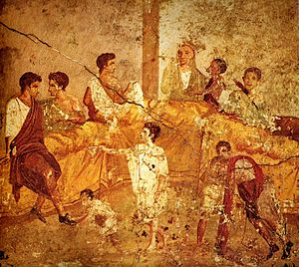
Introduction
To explore how extremely important social status was within Rome.
Compare and contrast dining and banqueting amongst the ‘ordinary’ Roman family and the ‘elite’ Roman family.
A multigenerational banquet depicted on a mural from Pompeii (1st century AD)

Slide 3
General Dining/Banqueting
“The Romans…. are fond of quoting a witty and sociable person who said, after a solitary meal, ‘I have eaten, but not dined today,’ implying that a dinner always requires friendly sociability for seasoning.” – Plutarch, Table Talk

Slide 4
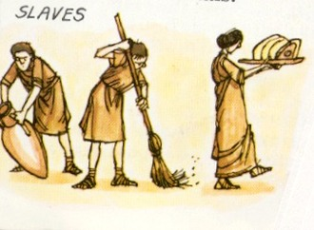
Meal Preparation
Within a banquet, slaves were essential for preparations.
Some well off ‘elite’ families, are have said to hire outside staff (outside caterers).
Athy College History

Slide 5
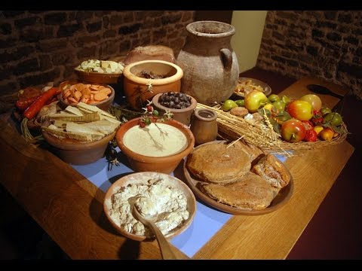
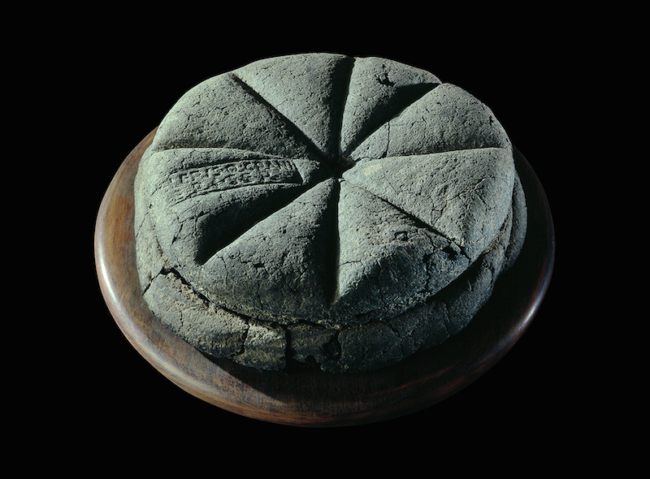
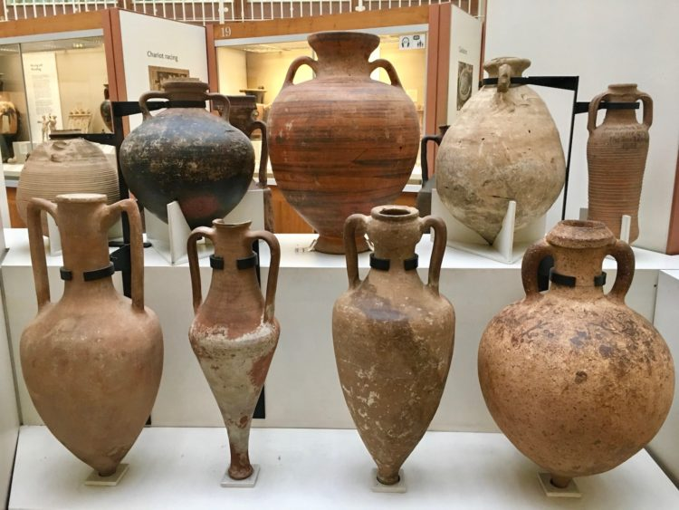
Menu Comparisons
Standard menu for the 'ordinary' family.
Bread found in an oven at Pompeii.
Mainly consisted of: Cheeses, fruits, bread and cheese.
Wine vases.

Slide 6
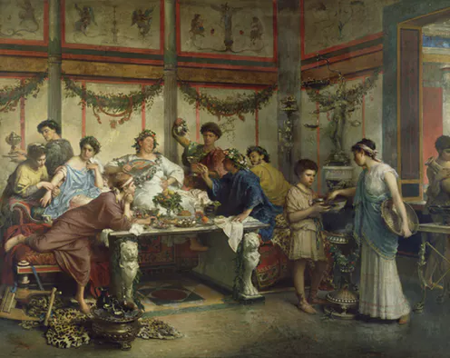
Menu comparisons
Version of an ‘elite’ dining/banqueting menu
Gustatio (Appetizer): Raw vegetables, several fish and egg dishes.
Mensa Prima (Main course): Fattened chicken, wild boar, roe deer, peacock and more seafood.
Secunda Mensa (Dessert): Fresh fruit, exotic fruits.
LOADS OF WINE! - The commissatio. The drinking after party!
A Roman Feast by Roberto Bompiani (late 19th century).

Slide 7
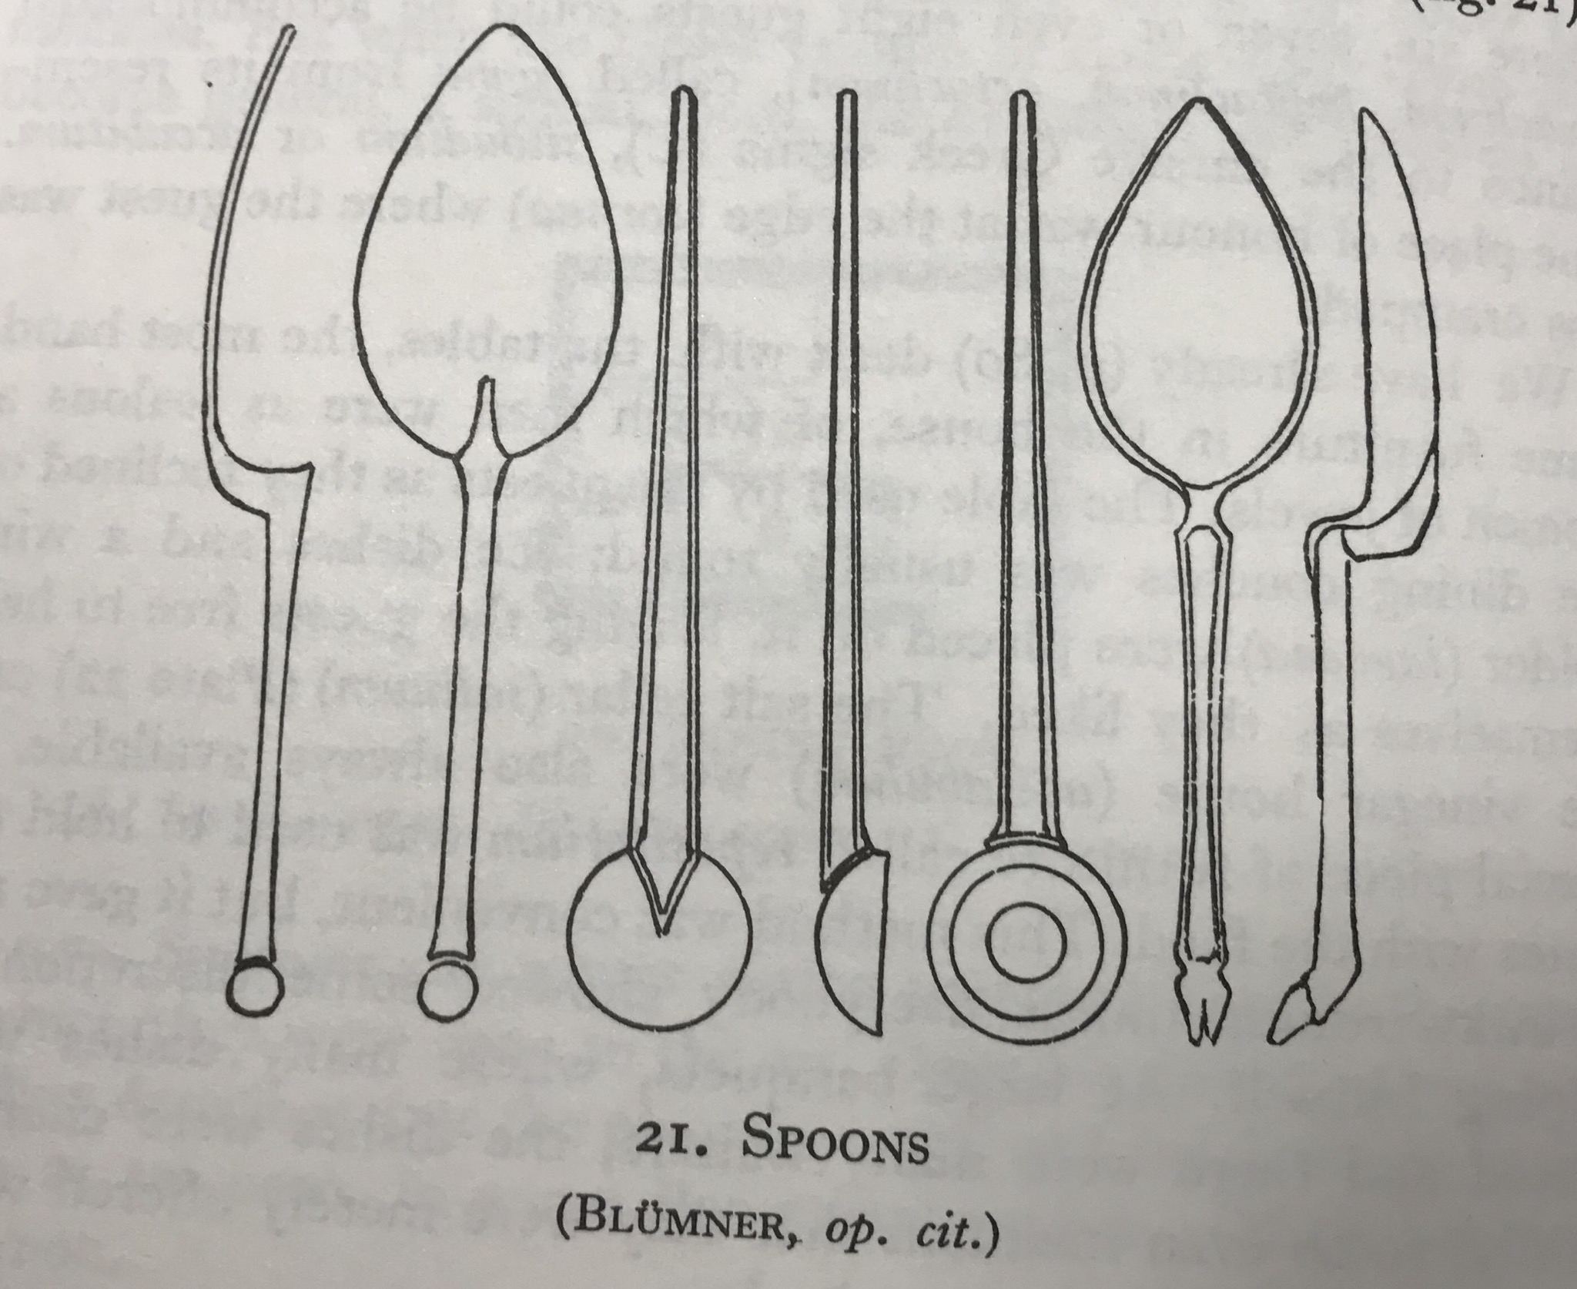
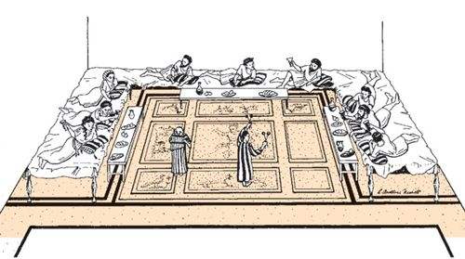
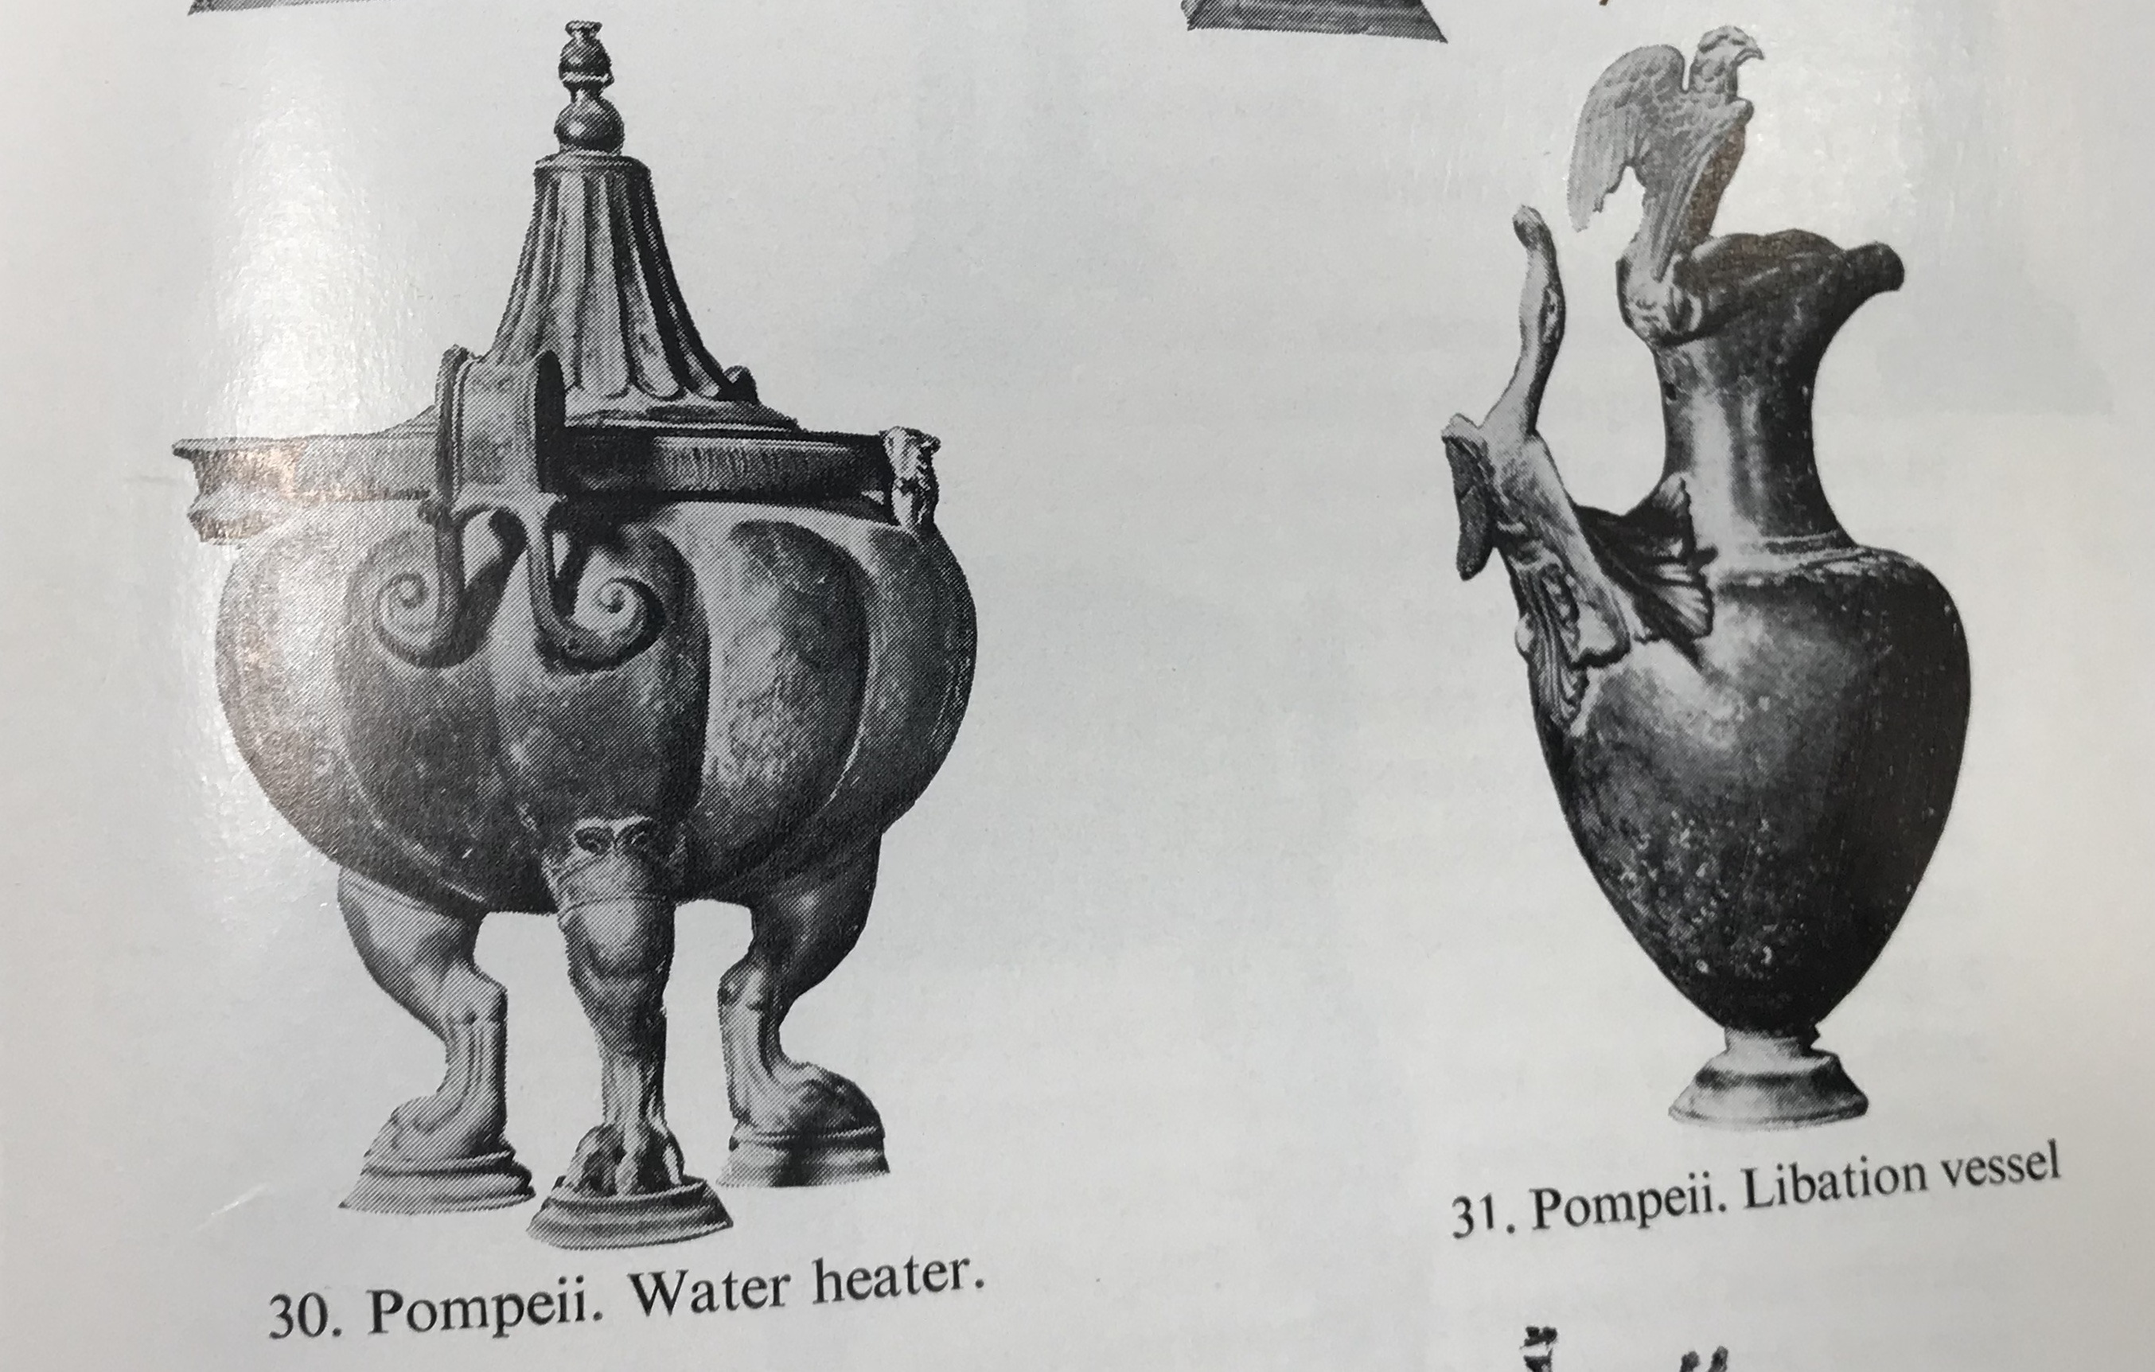
Triclinium – The Dining Room
Reconstruction of a Roman Banquet in a Triclinium – From Symposium to Eucharist.
21. Spoons (Blumner, op. Cit.)
30. Pompeii. Water heater.
31. Pompeii. Libation vessel.

Slide 8
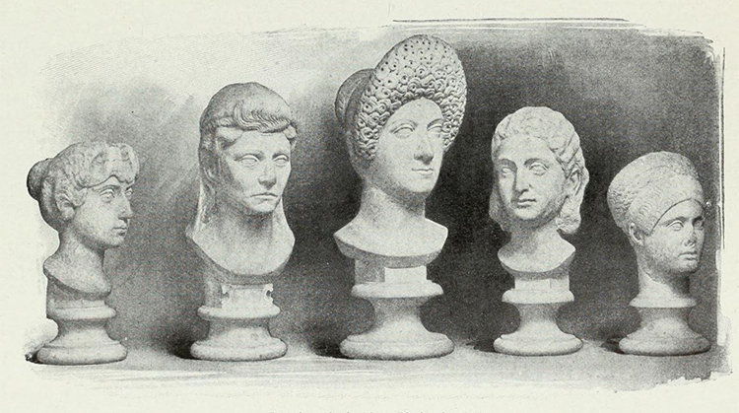
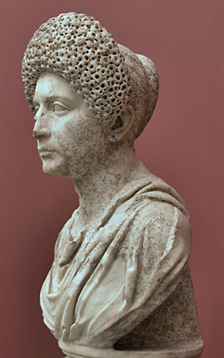
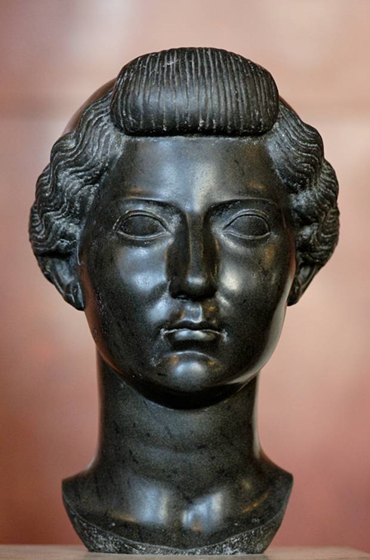
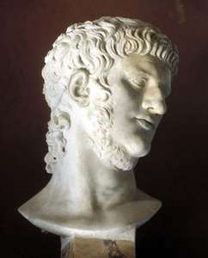
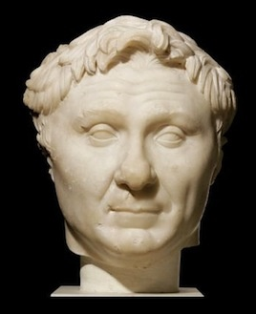
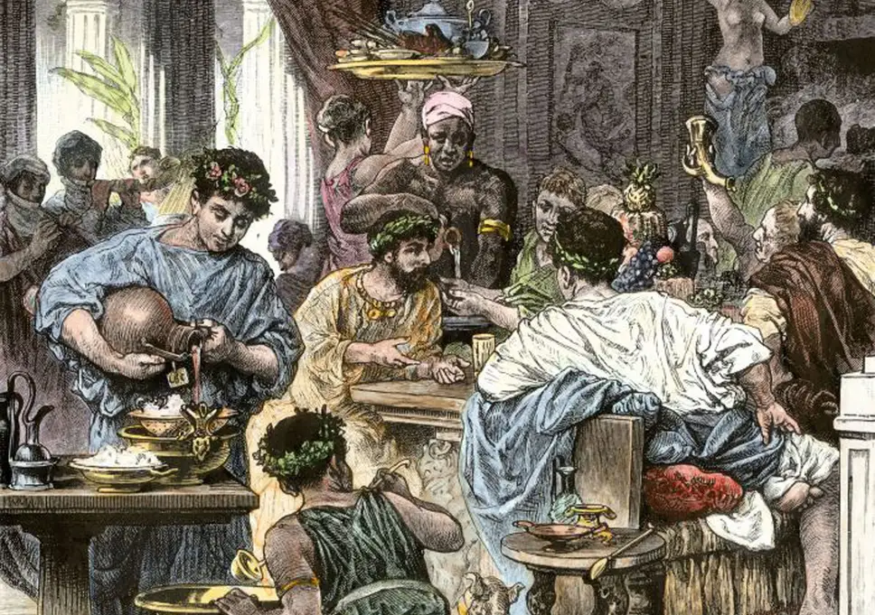
Dress Code
Ornatrix – Barber.
Hair Style - Hairstyle fashion in Rome was ever changing.
Changed both for men and women.
Changes in ladies hairstyle, throughout different periods in Rome.
Flavian Style – Imperial Period.
Imperial Roman hairstyle.
Late Roman Republic style.
Nice coloured togas.

Slide 9
Etiquette
Let the slave wash and dry the feet of the guests, and let him be mindful to spread a linen cloth on the cushions of the couches.
Spare thy neighbours wife lascivious glances and ogling flatteries, and let modesty dwell in thy mouth.
Be amiable and abstain from odious brawling's if thou canst. If not, let thy steps bear thee back again to thine own home.
Painted on the walls by a townsman in Pompeii, in his triclinium, his wise mottos.

Slide 10
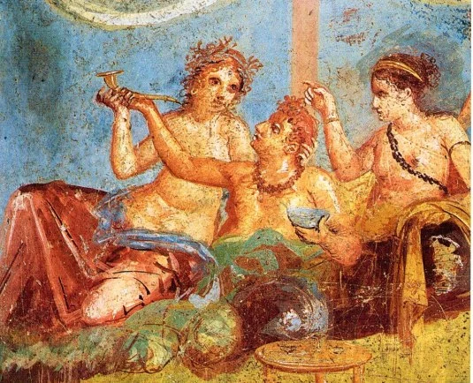
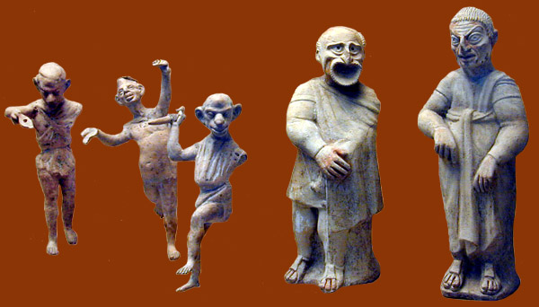
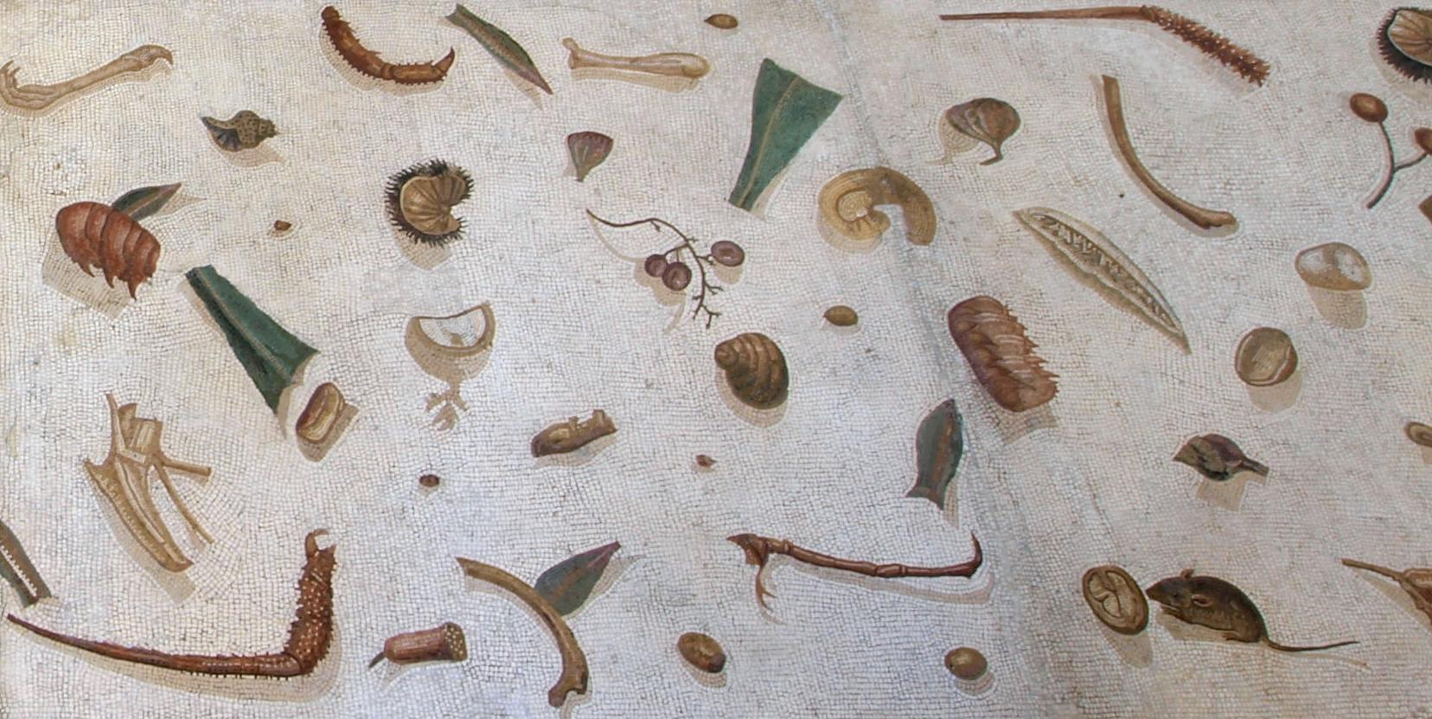
Entertainment
“You would have heard comic actors or a poetry reader or a lyrist, or, such is my generosity, all three. But you chose to go to someone else’s for oysters, sows’ wombs, sea urchins, and dancing girls from Cadiz.” – In a letter, Pliny the Younger (61-112 AD)
Girls present at a banquet.
Detail from the famous "messy floor" mosaic showing kitchen and dining detritus with a feasting mouse (Vatican Museum).
Terracotta Figurines of comic actors.

Slide 11
Conclusion

Slide 12
Bibliography
Filius, C. (1963) Rome: Its Life and Customs, Norfolk: Lowe & Brydone Ltd.
Carcopino, J. (1991) Daily Life in Ancient Rome: The People and the City at the Height of the Empire, London: Penguin Books Ltd.
Matyszak, P. (2017) 24 Hovrs In Ancient Rome: A Day in the Life of the People who Lived there, London: Michael O’Mara Books Ltd.
Stambaugh, J. E. (1992) The Ancient Roman City, London: The John Hopkins University Press.
Shelton, J. (1988) As the Romans Did: A Sourcebook in Roman Social History, New York: Oxford University Press.
Dunbabin, K. M. D. (2003) The Roman Banquet: Images of Conviviality, Cambridge: Cambridge University Press.

Slide 13
Bibliography
Toner, J. P. (1995) Leisure and Ancient Rome, Cambridge: Polity Press.
Smith, D. E. (2003) From Symposium to Eucharist, Minneapolis: Augsburg Fortress.
Gibbs, M. and Nikolic, M. and Ripat, P. (2014) Themes in Roman Society and Culture: An Introduction to Ancient Rome, Canada: Oxford University Press.
Angela, A. (2009) A Day in the Life of Ancient Rome, New York: Europa Editions.
Nielsen, I. and Nielsen, H. S. (1998) Meals in a Social Context: Aspects of the Communal Meal in the Hellenistic and Roman World, Langelandsgade: Aarhus University Press.
Dalby, A. (2002) Empire of Pleasures: Luxury and Indulgence in the Roman World, London: Routledge.

