Slide 1
Entrepreneurship findings
Steluta-Ionela Pascuta- 1816339
Lecturer: David Jenkins

Slide 2
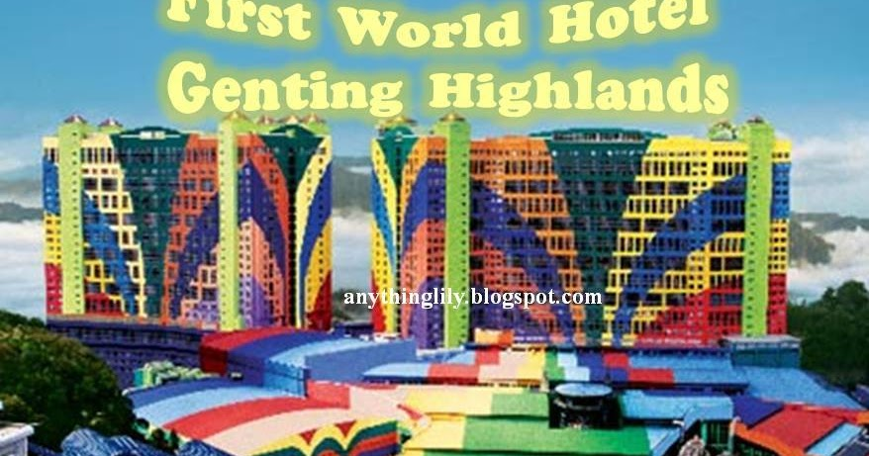
Genting resort
This is how Genting hotel looked when Lim Gon Tong first opened the resort. He did do it in the way he wanted and he did invest a lot of money to ensure that the resort has got advanced services and modern elements to attract the customers as much as possible.
He did also invest for the products and for the branding as he did not want to provide the cheapest products to the guests

Slide 3
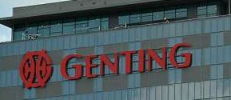
Genting hotels now
Genting hotels now are considered are being high rated hotels and this because of the fact that they do offer great services the members of staff are continuously cooperating one with another to do everything right.
The statistics are showing that Genting hotel from the world’s resort in Birmingham is one of the most visited hotels in the Genting Highlands, this proves that is the most effective working one in terms of services, cleanliness, food, staff

Slide 4
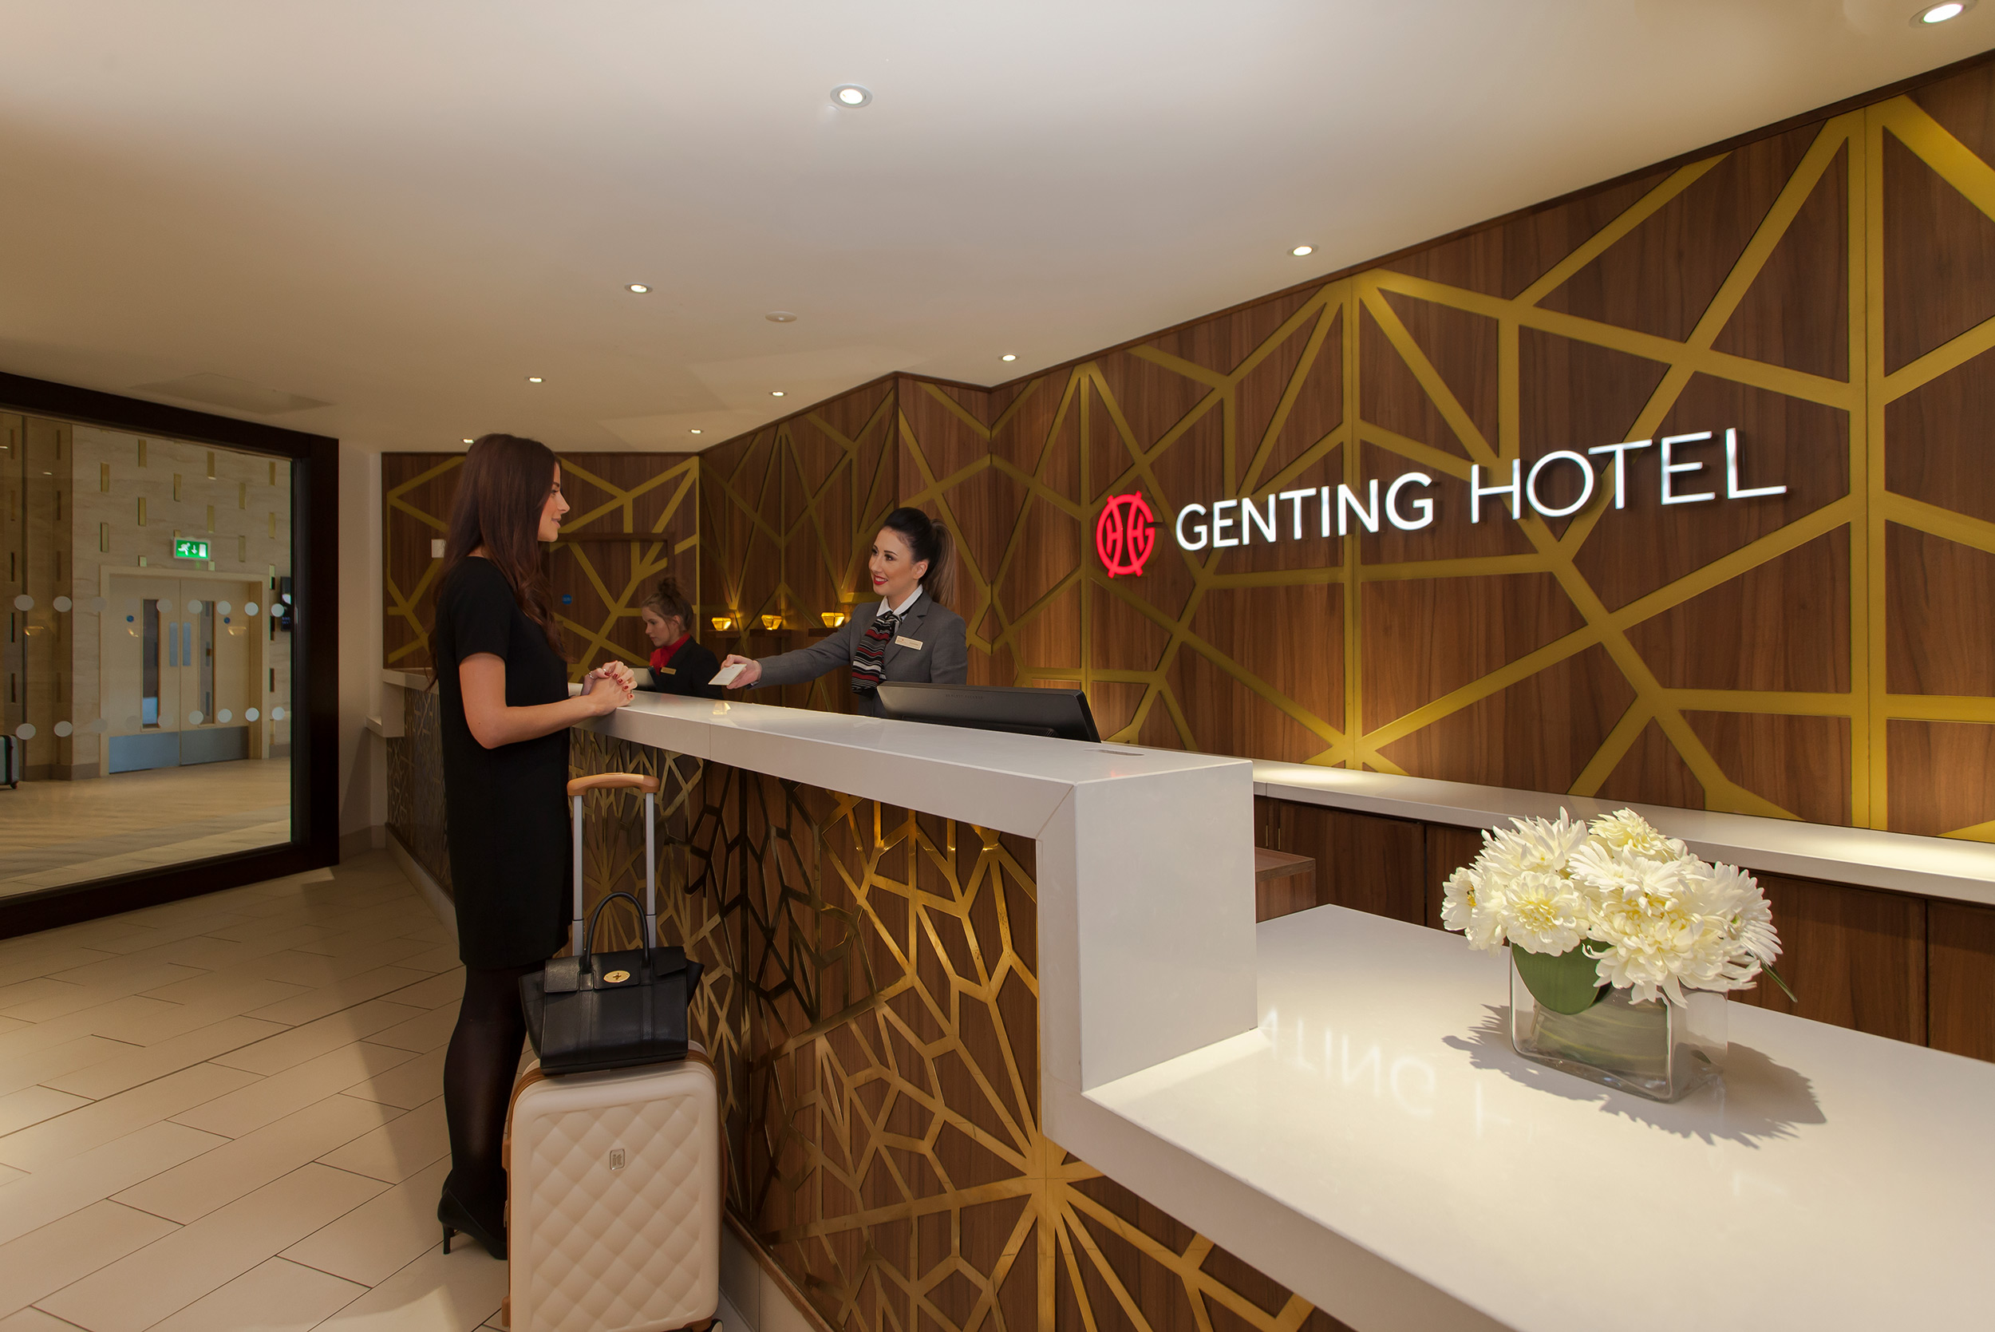
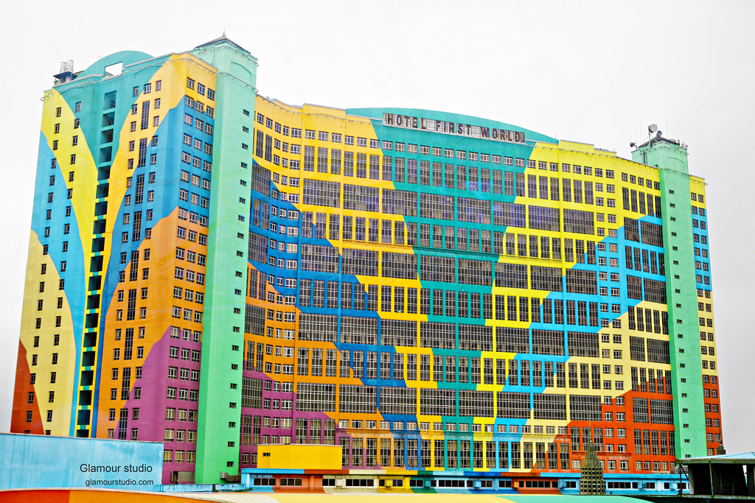
The entrepreneur’s implications
The entrepreneur of Genting highlands has been so implicated even from the start and this because he wanted to become successful by doing what he likes and satisfying other people as well during the holidays they will undertake internationally.
Therefore, the entrepreneur has opened 6 resorts that are part of Genting highlands and all of them are being so successful and appreciated.

Slide 5

Entrepreneurs character
Lim Gon Tong has been that kind of entrepreneur that has know from the begging what it wants, it was the entrepreneur that has everything planned before starting the project and it did know from the start how the resorts are about to make progressions and because he was sure about it and because he was financially stable to maintain this project, he put his entrepreneurship characteristics in practice and started.
He focused on guests even from the start and this was in his advantage for the design of the hotel and the services that were implemented to satisfy the guests.

Slide 6

CONCLUSION
As a conclusion, the entrepreneur showed effective knowledge and effective planning as well as suitable characteristics when starting the project and this was in his advantage even from the start as he was financially more than stable and all the infestations he needed to make were made with no doubt and at some point it did make the process of development of the company more rapid.
Currently Genting hotel’s reputation has been maintained and it keeps progressing.

Slide 7
REFERENCES
Daisyme, P. (2015), “Five characteristics of successful entrepreneurs”, [online] available on: https://due.com/blog/7-characteristics-of-successful-entrepreneurs/last accessed on: 19/ 06/2020
Genting Group, (2019), “Our history”, [online] found on: https://www.genting.com/history2/ last accessed on: 19/06/2020
Wikipedia, (2020), “Lim Goh Tong”, [online] found on: https://en.wikipedia.org/wiki/Lim_Goh_Tonglast accessed on: 19/06/2020

