Slide 1
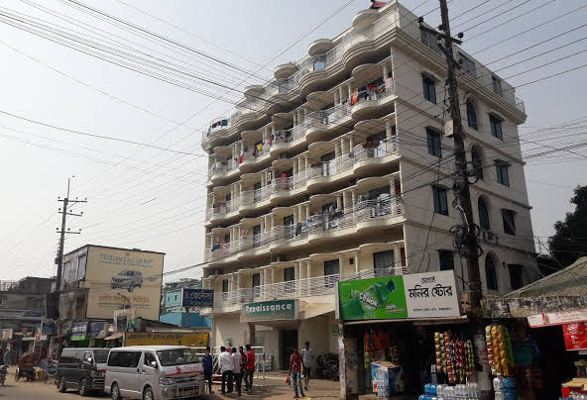
Presentation for the brand new Renaissance Hotel In Bangladesh presented by : Mohammed FARUKI/ ABDUL KHALIQUE/ MUZAFFOR ALI

Slide 2
Pestle Analysis: Bangladesh

Slide 3
Topics:
PESTLE analysis
Importance of an effective recruitment process to sustain competitive advantage.
Principal factors that affect the culture, equality and diversity of an organisation.
Recommendations on issues raised in the presentation.

Slide 4
Introduction
Hello everyone
Today me and my partner, will present a PESTLE analysis and the importance and significance of effective recruitment process in Hotel Industry. The PESTLE analysis will be solely on the brand new Renaissance Hotel due to open Chittagong division in Bangladesh in December 2019.
we will discuss pestle analysis on external environment related to hotel. Then I will show you the competitive advantage of an effective recruitment and selection process. We will see the principal factors affecting the culture, equality and diversity of an organization. I will also present recommendations on the issues raised.
To do pestle analysis at first we have to know what is pestle analysis. A pestel analysis is a framework or tool used to analyze and monitor the macro-environmental factors that may have a profound impact on an organization’s performance. This tool is especially useful when starting a new business or entering a foreign market.
PESTLE is an acronym that stand for political, economical, social, technological, legal and environmental factors.

Slide 5
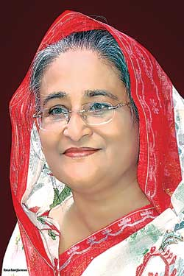

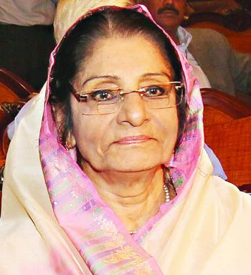
Political
Bangladesh became independent in 1971
It is a parliamentary democracy with a free market enconomy
Two main parties – The Awami League and the Bangladesh Nationalist Party dominate local politics. (Gov.uk, 2019)
Political system – confrontational

Slide 6
Politics continued
5 January 2014 – BNP decided to not participate
Controversial constitutional amendment – June 2011 (Gov.co.uk, 2019)
New opposition – Jatiya Party
Government’s ”Vision 2021” aims to elimate extreme poverty completely and achieve Middle Income Country state by the 50th anniversary of the country’s birth (gov.co.uk, 2019).

Slide 7
Political
At first we will look into the political conditions. Bangladesh is a developing country. Government has allowed every type of investment easier. There’s almost no difference between a domestic or overseas investor. That is attracting a lot of foreign people to come here. So, international hotel chains are now attracted to enter the market. Bangladesh government has created National Hospitality and Tourism Institute to train people for hotel management. Though Bangladesh is not famous for it’s political stability in the past but slowly gained a stability in the recent time. So, it is understood that the political side is more suitable for hotels now in Bangladesh

Slide 8
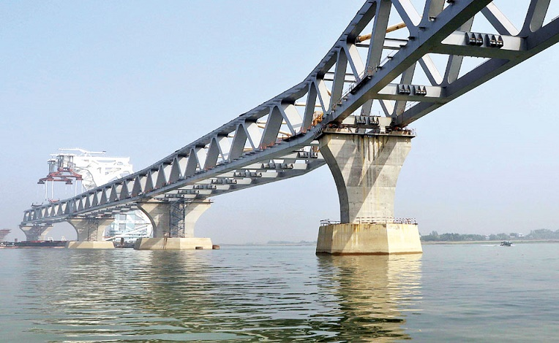
Economic
Things have moved. Bangladesh now has an average growth rate of 8% – well above the Asian average, Asian Development Bank figures show. (Rooney, 2019)
Dhaka and Chittagong are the principal financial centres of the country. The financial sector of Bangladesh is the second largest in the subcontinent. Bangladesh is one of the world’s fastest growing economy. (Wikipedia, 2019)

Slide 9
Economic continued
Poor infrastructure, corruption, not enough power supplies, slow economic reforms (heritage.org, 2019)
Political instability undermine economic development
Corruption and weak enforcement of property rights
Uncertain regulatory environment

Slide 10
economical
Over the years, it has been observed that the GDP of the country has been increasing at a healthy pace. According to WTTC report 2019 (World Travel and Tourism Council), the growth rate of the global hotel industry would increase by 4.07% annually. During that time, Bangladesh will host 5.7 million tourists. Hence, around 56 hotels are in the pipeline to start operations in the country in the coming 5 years. The Hospitality industry of Bangladesh is currently at a very good status even though it is at a growing stage. It is estimated that in the next five years, 8-10 five-star hotels will be established. Bangladesh has been practicing floating exchange rate. The Bangladesh Bank sets the weighted average rate of the foreign currencies by calculating the rates set by the scheduled banks. The exchange rates of major currencies against taka are published every day by Bangladesh Bank based on scheduled banks’ previous day’s weighted average exchange rates.

Slide 11
Bangladesh mega project
Bangladesh is introducing 10 mega projects that will change the country’s economy. 1) Nuclear Power Plant, 2) Rampal Power Project 3) Metro Rail, 4) Padma Bridge, 5) Chattogram-Cox’s Bazar Rail Link, 6) Padma Rail Link, 7) Paira Deep Sea Port (Byron and Adikhary, 2019)

Slide 12
References
Heritage.org. (2019). Bangladesh Economy: Population, GDP, Inflation, Business, Trade, FDI, Corruption. [online] Available at: https://www.heritage.org/index/country/bangladesh [Accessed 24 Nov. 2019].
En.wikipedia.org. (2019). Economy of Bangladesh. [online] Available at: https://en.wikipedia.org/wiki/Economy_of_Bangladesh#Modern_Bangladesh [Accessed 24 Nov. 2019].
GOV.UK. (2019). Overseas Business Risk - Bangladesh. [online] Available at: https://www.gov.uk/government/publications/overseas-business-risk-bangladesh/overseas-business-risk-bangladesh [Accessed 24 Nov. 2019].
Rooney, K. (2019). Bangladesh’s economy is soaring - here's why. [online] World Economic Forum. Available at: https://www.weforum.org/agenda/2019/11/bangladesh-gdp-economy-asia/ [Accessed 24 Nov. 2019].
Byron, R. and Adhikary, T. (2019). 10 Mega Projects: Five pick up pace, finally. [online] The Daily Star. Available at: https://www.thedailystar.net/supplements/news/10-mega-projects-five-pick-pace-finally-1774909 [Accessed 24 Nov. 2019].

Slide 13
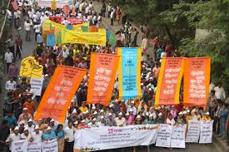
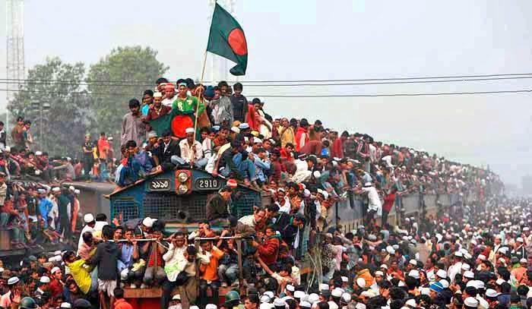
Social
Population growth rate
1.03% annual change (Source: World Bank)
Age distribution
0-14 yrs: 27.76%
15-64 yrs: 66.02%
65 and above: 6.22%
(Source: Bangladesh Bureau of Statistics)

Slide 14
social
Bangladesh is a hugely populated country. It’s 8th most populated country in the world. Annual growth rate was higher in past. Now it’s around 1% annual growth according to the report of world bank.Bangladesh has a huge number of people ready for work as working class aged 15-64 is more than 66% of the total population.
An effective recruitment and selection process gives an hotel a competitive advantage than others hotels. It helps the particular hotel to get quality and loyal employees. With a particular mindset and training the hotel would get a chance to create a culture in it’s system which would give the hotel a unique presence.
There are some factors that affect the Organizational culture. Leadership is a key to run a hotel smoothly. The management team is key to maintain this. Workload is another important factor. Capability of the employees need to be known by the leaders to engage and distribute works accordingly. Relationships and control over the employees is a key factor which helps a organization ti develop a culture within the hotel.
It is very important to maintain equality and diversity at the same time for an organization. It helps to recruit workers from different mindsets which covers people from diverse mentality.

Slide 15


Technology
Technology incentives
Level of innovations

Slide 16
technological,
As Bangladesh is going towards a digital country, it is welcoming technological progresses. Incentives are there form the Government side to encourage technological progresses.

Slide 17
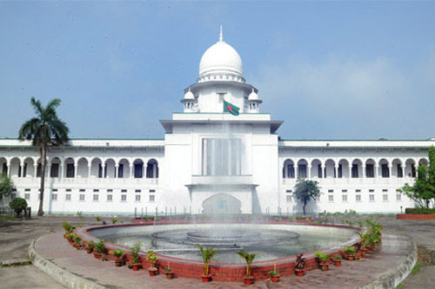

Legal
Discrimination
Antitrust laws

Slide 18
Legal
The country’s Ministry for Labour and Employment is quoted by Reuters as saying. According to the news agency, the new minimum wage has been set at 8,000 taka (approximately 95 dollars) a month,
Section 201 of the Bangladesh Labour Law, according to Dhaka Tribune, says that the working week should not exceed 48 hours, in exceptional circumstances 60 hours.
In 2006, Bangladesh-passed a Labour Law setting the minimum legal age for employment as 14.
The Constitution of Bangladesh say that women have equal footing with men in all spheres of public life, it also recognises religious personal laws, which are unequal to women.
The dedicated government policy, has contributed to the increase in female employment. On top of that, the enrolment of women in educational institutions has expedited female participation in the country’s job market.
Though discrimination is seen in Bangladeshi culture, government has taken steps to stop it. Article 28 (1) which provides that the State shall not discriminate against any citizen on grounds of religion, race, caste, sex, or place of birth. But within a proper system the hotel staff should not face any discrimination. In 2012, the Competition Act was enacted in Bangladesh. The Act is made to promote, ensure and sustain a congenial atmosphere for the competition in trade, and to prevent, control and eradicate collusion, monopoly and oligopoly, combination or abuse of dominant position or activities adverse to the competition.
Importance of an effective recruitment and selection process is huge in hotel industry. It helps in finding skillful workers, save training time and money for the Organization and reduce the chance of potential legal ramifications of employees.
Building a good reputation is necessary to attract quality employees and guests to the hotel. The work environment is necessary for the employees to perform at the highest level. It is important to build a generous, helpful bunch of employees for the highest satisfaction of the visitors of the hotel.

Slide 19
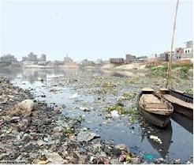

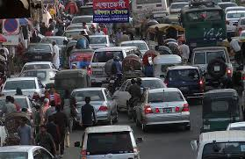
Environment
Weather climate
Climate change

Slide 20
Environment
Chittagong has a subtropical monsoon climate characterized by wide seasonal variations in rainfall, high temperatures and humidity. There are three distinct seasons in Bangladesh: a hot, humid summer .According to National Geographic, chittagong is one the most vulnerable nations to the impacts of climate change. Bangladesh being located on the Tropic of Cancer receives fairly direct radiation throughout the year and maintains relatively high temperature.
In April 2016, the Asian Development Bank estimated of the 157.90 million people living in Bangladesh,in Chittagong division 4.90 millions people. 31.5% live below the national poverty line. In Chittagong 13.1%.
Poverty in Bangladesh has declined remarkably since the 2000. According to the World Bank, Bangladesh's poverty rate fell from 82% in 1972, to 18.5% in 2010, to 13.8% in 2016, and below 9% in 2018,Based on the current rate of poverty reduction, Bangladesh is projected to eliminate extreme poverty by 2021, first nation in South Asia to do so.
The major environmental issues and problems in chittagong are climate change, natural calamities (cyclone , flood , flash flood , drought , earthquake, riverbank erosion, ), environmental pollutions (air pollution, water pollution, soil pollution, and noise pollution).
Waste Disposal In Bangladesh there is no good waste recycle system. The average person generates 4.6 pounds of trash per day. But good news is There have been recent developments in Bangladesh to improve waste management, especially in urban cities. Japan International Corporation Agency Cities Corporation with support from the Japan International Corporation Agency (JICA) has a master plan underway to better handle the solid waste management in Maga cities . UNICEF has also initiated recycling programs and waste control with the city corporations and municipalities

Slide 21
Source
(wikipedia.org/bangladesh)
(Dhaka Tribune.c Source om)
(link.springer.com)
(atlas.d-waste.com)

Slide 22
Conclusion
Chittagong is the biggest port in Bangladesh. It has immense cultural and natural diversity in the forest region. It is a popular destination for both tourists and professionals. People from foreign countries also come and visit this place. They visit basing on commercial importance as well. Opening a hotel in such a port city with natural and cultural diversity is a great decision, indeed. If it can be managed properly, it shall be a great venture for sure.
With this I like to conclude my presentation. I hope my analysis and discussion will help the hotel staff and management to understand the insight of hospitality industry of Bangladesh and help the Renaissance Hotel to have a competitive advantage than the other hotels.
Thank you
all for you for patient hearing.

