Slide 1
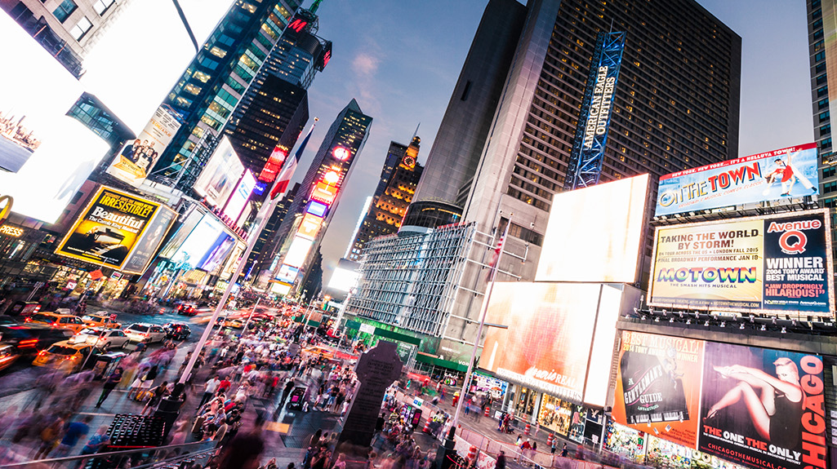
Current Issues and Future Developments in Marketing
Marketing Management
By: Davina Evans

Slide 2

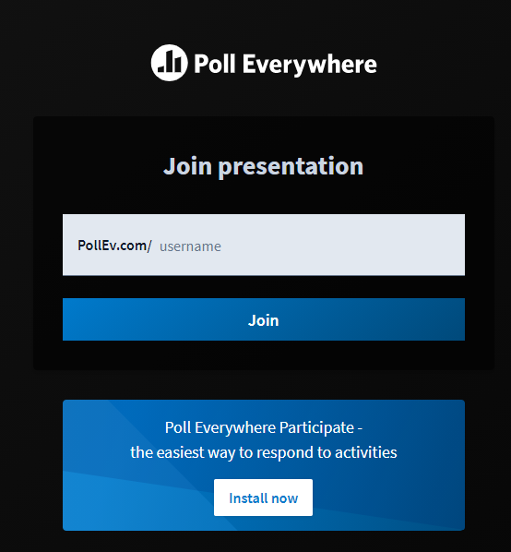
Pollev.com
PollEv.com / davinaevans654

Slide 3


Slide 4

Introduction
Developments in communications technology in recent years have led to increasing use of the term ‘Digital Marketing ‘. Yet in some ways, this is not necessarily such a new phenomenon in terms of the scale of social change it may be causing across the globe. Consider for example, the impact that cinema, radio or even television had on society when they were introduced or were still new. Changes in consumer behaviour and buying patterns may have been directly influenced and altered by the changes affecting social patterns as the speed of communications increased.

Slide 5

Introduction
Yet these technological developments do not exist on their own, independent of other things. In marketing terms, many digital marketing activities can in fact be considered to be improvements on existing marketing activities, making them more efficient and effective through improved communications – such as feedback from consumers via email, blogs or forums. In this way, although there many significant developments, the digital area can be seen as complimentary to existing activities, perhaps simply another channel or method of communication, rather than being wholly independent of existing marketing theories and models.

Slide 6
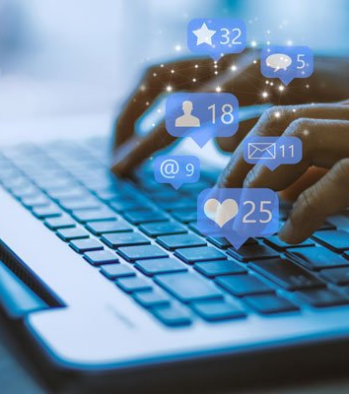
Introduction
However, as more and more people across the globe use Facebook, Twitter, Google, msn, wikis and so on, there is no doubt that the way people communicate will continue to have a huge impact and change on marketing activities at all levels.

Slide 7
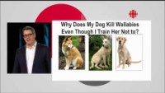
Why Social Media is Over-rated

Slide 8
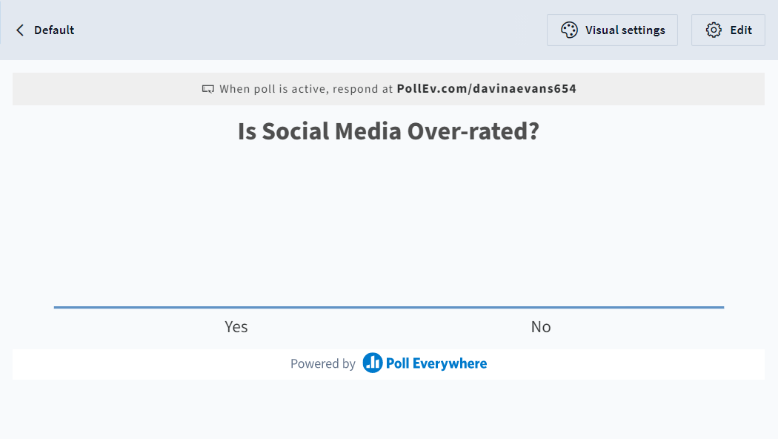

Slide 9
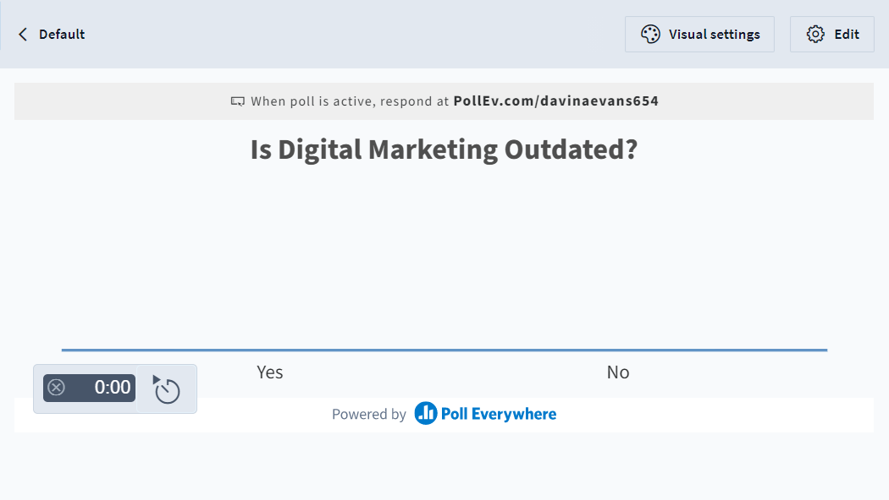

Slide 10
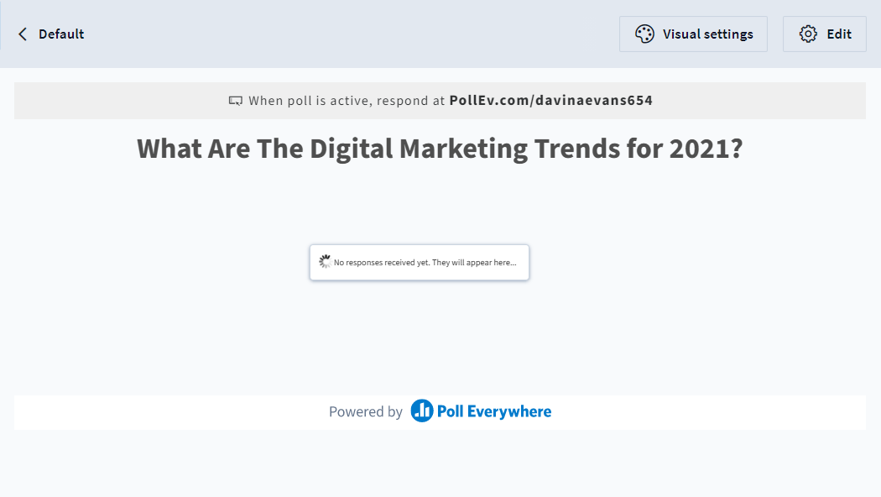

Slide 11
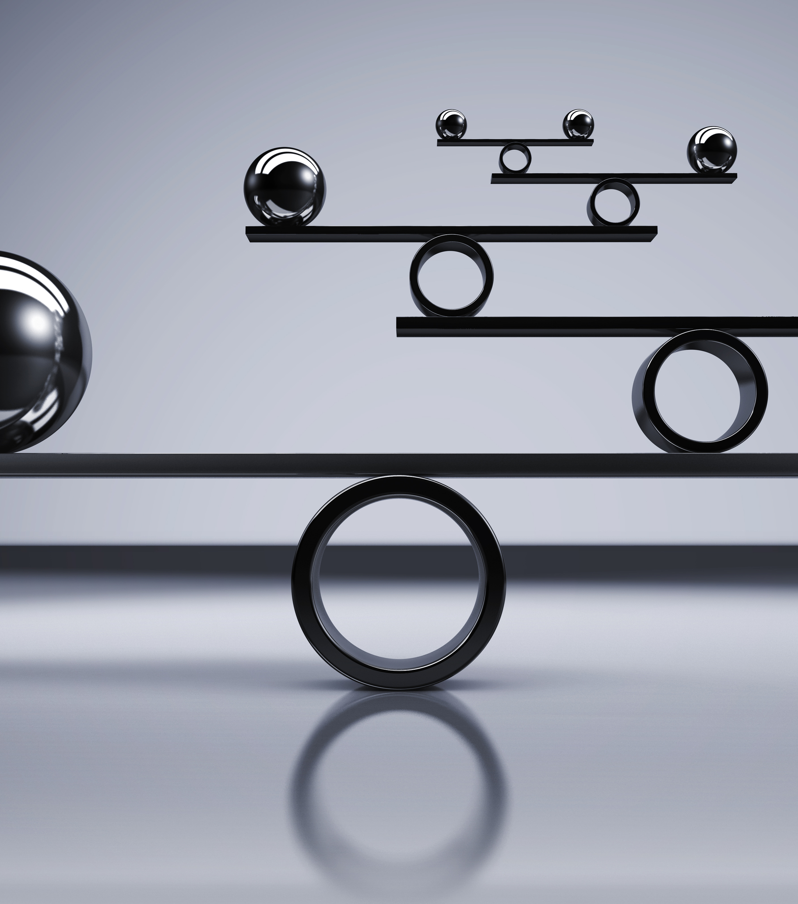
Digital Marketing Trends
AI – Artificial Intelligence
Chatbots
VR - Virtual Reality
Video Marketing
Influencer Marketing
Smart Speakers / Voice Search
Big Data
Better Analytics
  Search Engine Optimisation
  Pay Per Click

Slide 12
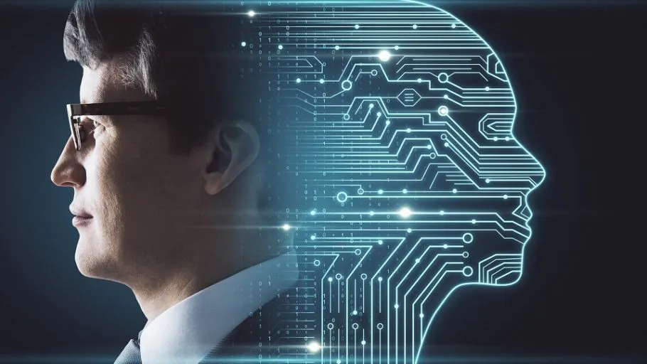
AI
Artificial Intelligence

Slide 13
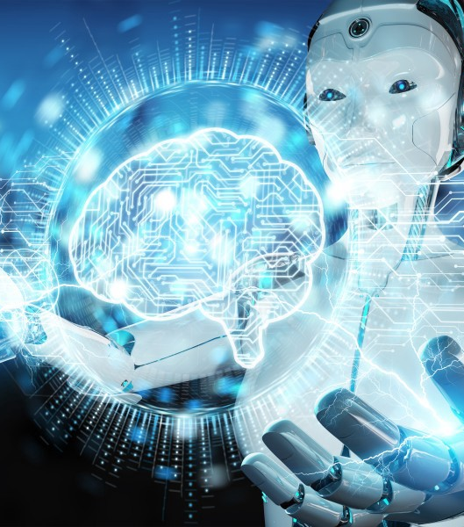
Artificial intelligence
Q - What is it?
According to IMB (2021)
“Artificial intelligence enables computers and machines to mimic the perception, learning, problem-solving, and decision-making capabilities of the human mind”
https://www.ibm.com/uk-en/cloud/learn/what-is-artificial-intelligence

Slide 14
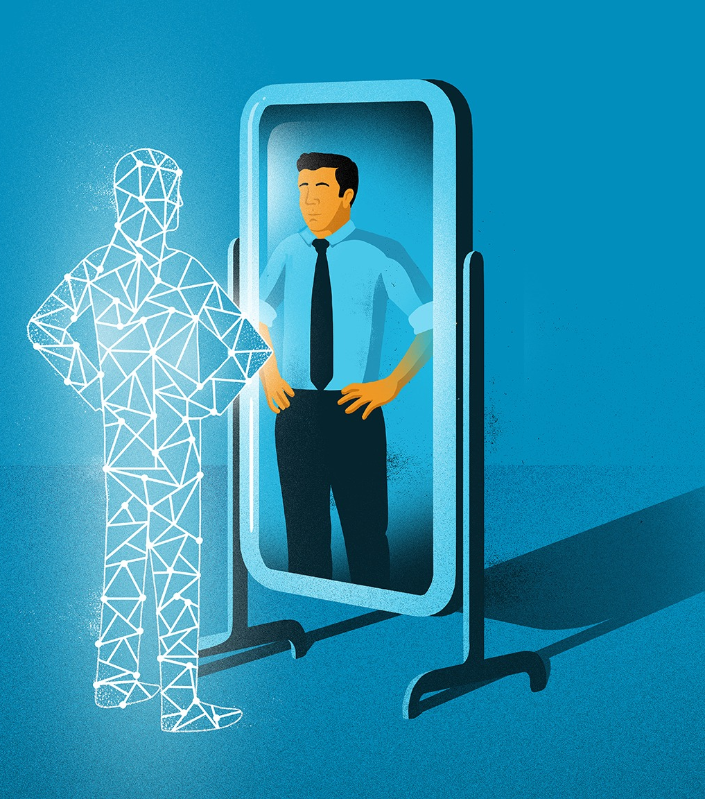
Artificial intelligence
According to Chief Marketer (2021)
“42% of marketers believe they are not very good at segmentation for digital experiences”
Q – What’s the difference?
The preference of people are difficult to track.
Important for marketeers to know their audience.

Slide 15
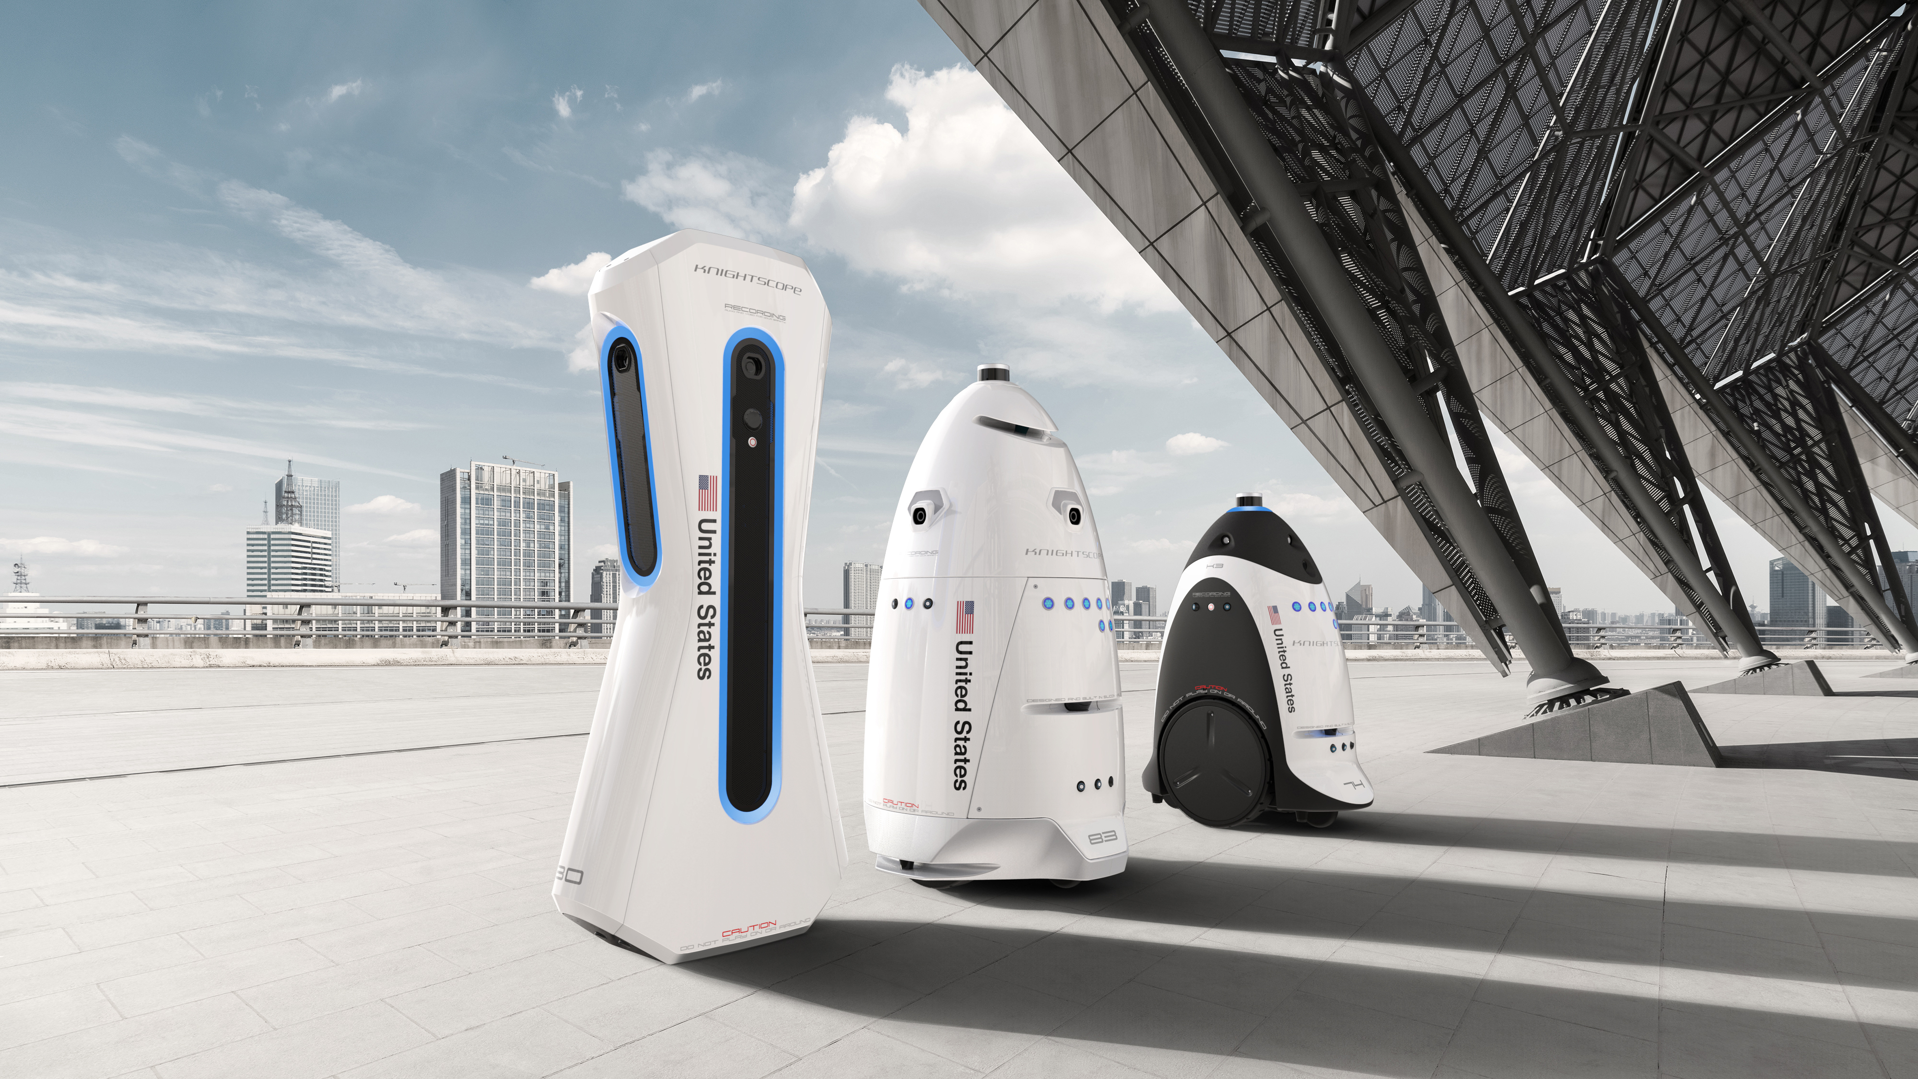
Example

Slide 16
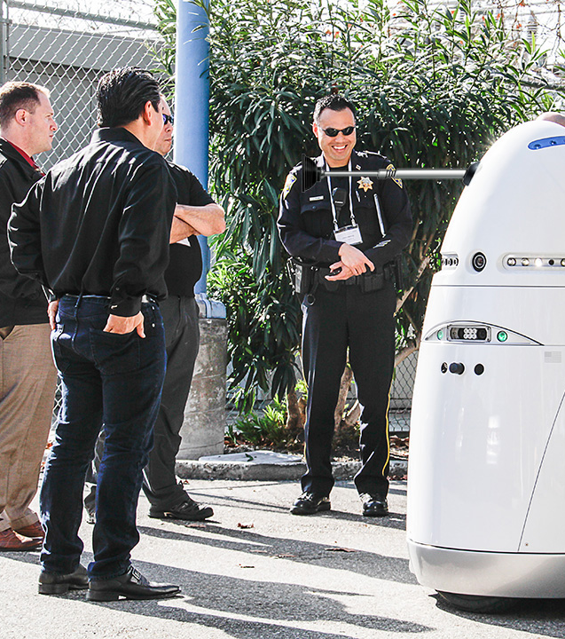
K5 Robots
Microsoft and Uber use K5 robots to car parks and large outdoor areas to predict and prevent crime.
The robots can read license plates, report suspicious activity, and collect data to report to their owners.
You can rent these R2-D2-like robots for $7 an hour – which is less expensive than a human security guard's wage.

Slide 17
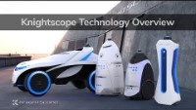

Slide 18
According to Techgrabyte (2021):
“Artificial intelligence is the biggest commercial opportunity for companies, industries, and nations over the next few decades” and “will increase global GDP by up to 14% between now and 2030,” which means that “AI latecomers will find themselves at a serious competitive disadvantage within the next several years.”

Slide 19
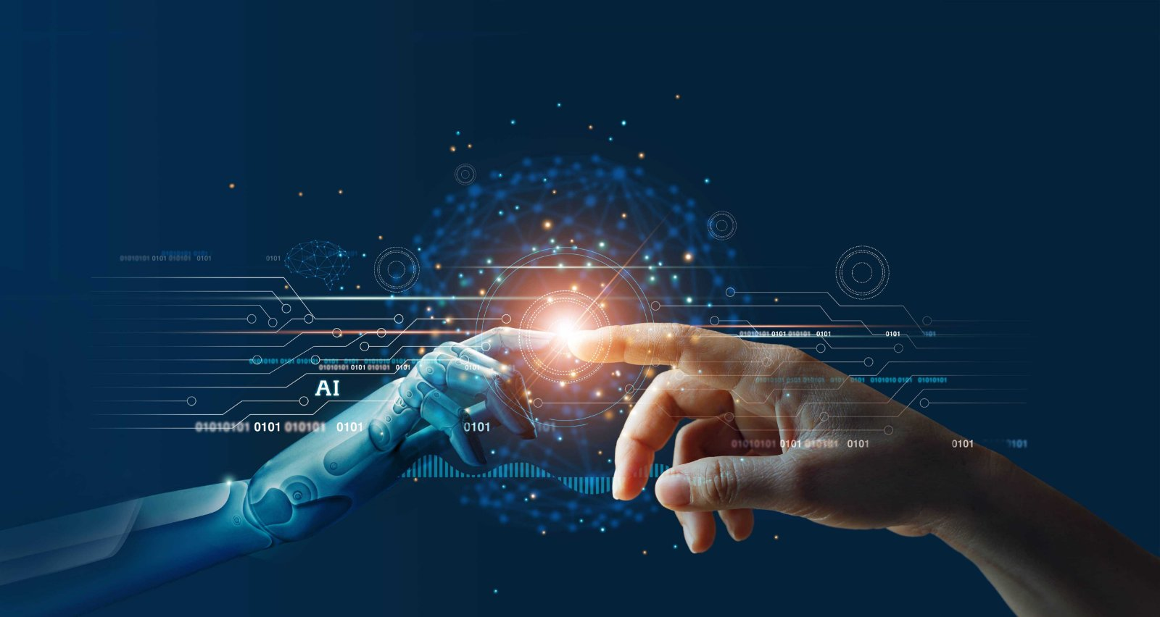
Artificial intelligence
AI can separate and analyse behavioural and demographic data much more efficiently than humans doing it manually.
AI can learn about every detail of the personal preference of a user:
  Your profile information
  purchases,
  demographic information
  browsing history

Slide 20
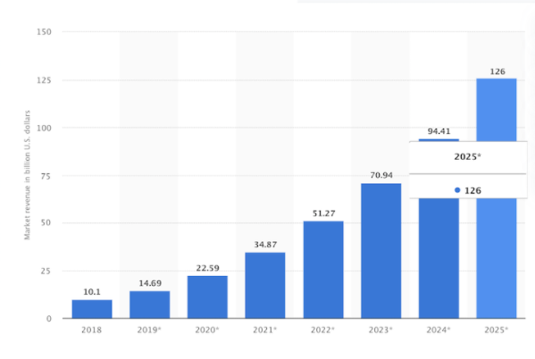
Revenue from AI
As illustrated by Statistica (2021):
Revenue from AI software market worldwide from 2018 – 2025.
Q – What is the trend?

Slide 21
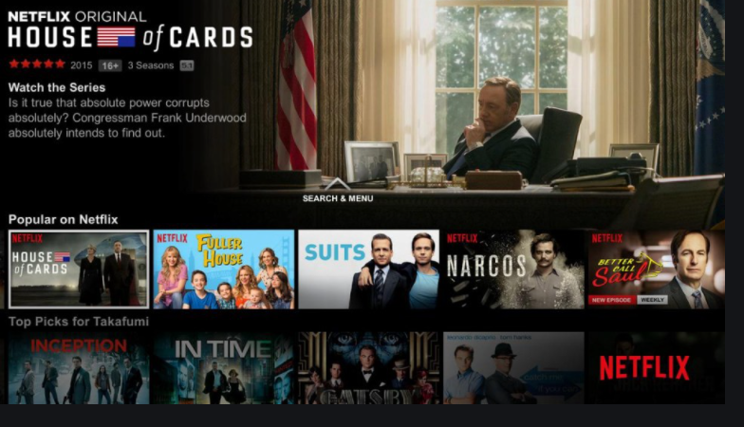
Personalisation
Key to driving engagement
AI can digest and crunch large amounts of data per user to personalize content for them.
Look at Netflix, for example. Each user is shown video content based on their interest and history.

Slide 22
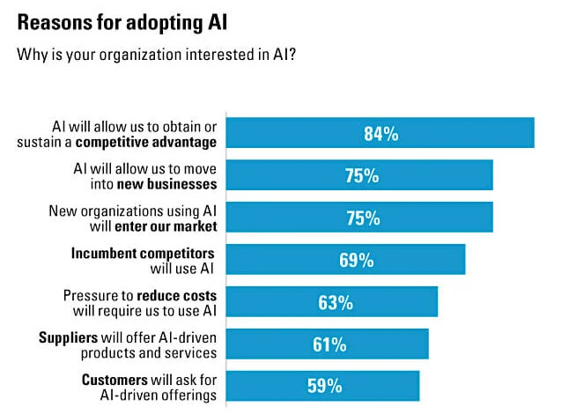
Therefore……..
AI can analyse consumer behaviour and search patterns and use data from social media platforms and blog posts to help businesses understand how customers find their products and services.

Slide 23
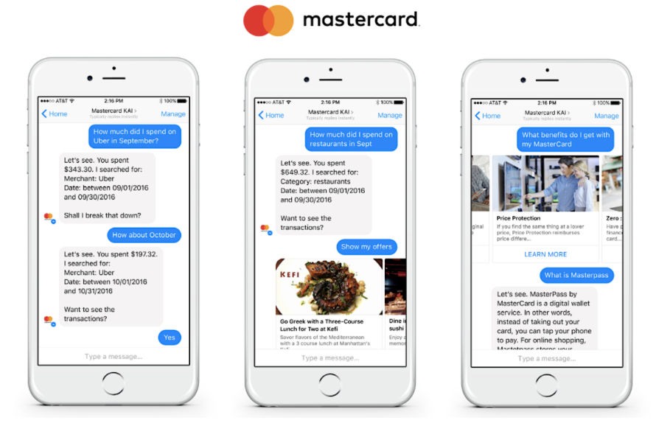
Example
One example of AI in practice is Chatbots.
Mastercard created a Facebook messenger bot – which uses natural language processing software to decipher what the customer wants and respond as if it were a real person.

Slide 24
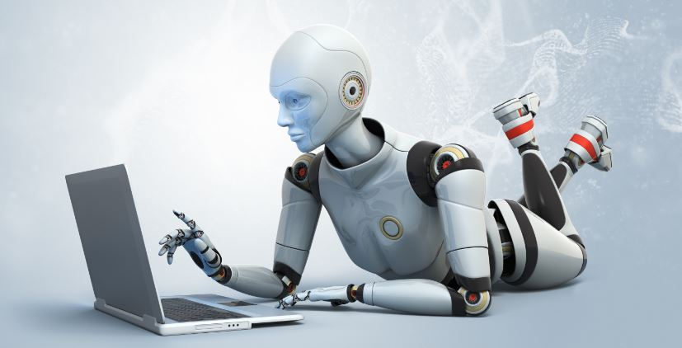
AI & Marketing
Will soon be the driving force behind many services:
Basic communication
Product recommendations
Email personalization
E-commerce transactions
Content creation

Slide 25
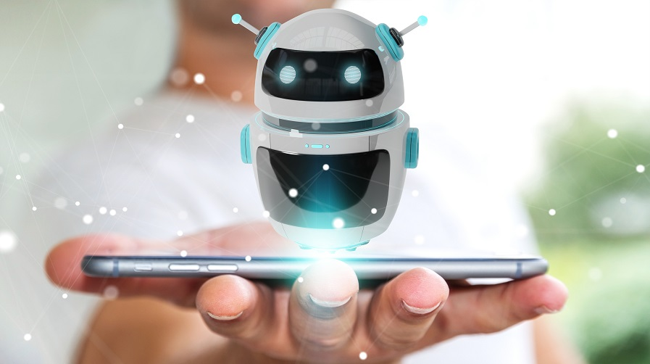
Chatbots

Slide 26
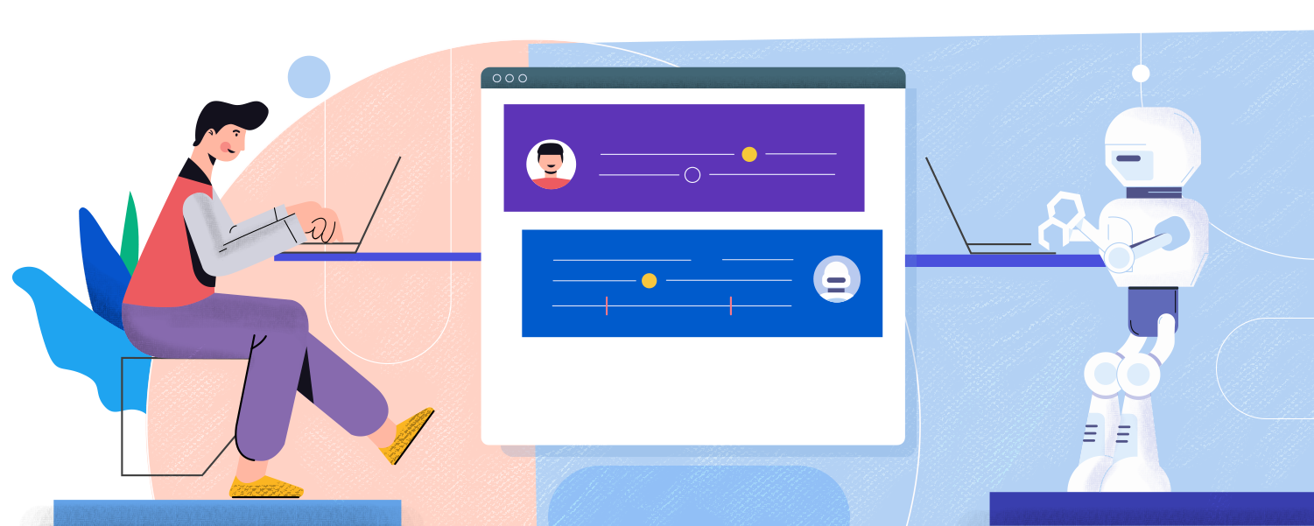
Chatbots
AI-based technology uses instant messaging to chat in real-time, day or night, with your customers or site visitors.
Chatbots will continue to be an important part of digital marketing in 2021.
Chatbots will power 85% of customer service by 2020.

Slide 27
What are the Benefits?
According to G2 (2021):
24-hour service (64%),
instant responses to inquiries (55%),
and answers to simple questions (55%)

Slide 28
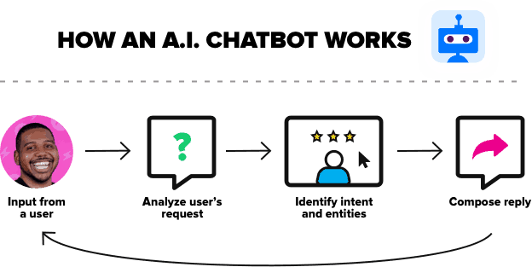

Slide 29
Why are Chatbots & AI the future of marketing?

Slide 30

Additional Reading
https://hbr.org/sponsored/2019/02/ai-is-not-just-getting-better-its-becoming-more-pervasive
https://www.imd.org/contentassets/0e76bd212b13481798750714b1c326cf/tc078-16_seven-trends-that-will-affect-the-future-of-marketing_turpin.pdf
https://www.accenture.com/_acnmedia/Accenture/Designlogic/16-3360/documents/Accenture-2017-Top-10-Challenges-Introduction.pdfla=en-GB
https://www.ibm.com/uk-en/cloud/learn/what-is-artificial-intelligence

