Slide 1
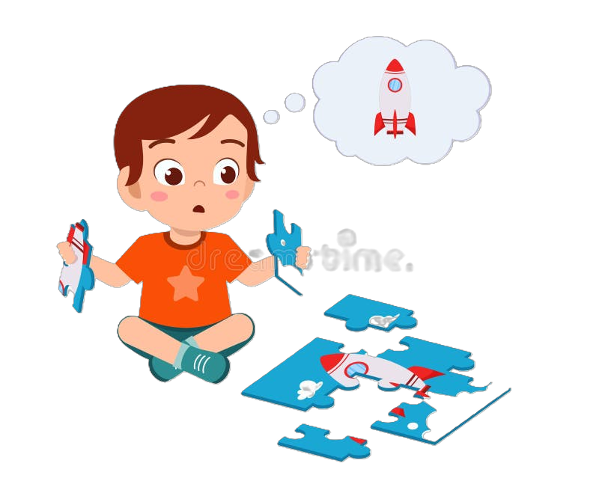
Understanding Isaac’s Development Using Erikson’s Psychosocial Theory
Name: Aqsa Ejaz
Student Number:
Module:

Slide 2

Erikson’s Psychosocial Theory
Development happens in stages
Emotional and social growth
Ages 3 – 5: Initiative vs Guilt
Confidence, independence and encouragement
(Erikson, 1963)

Slide 3
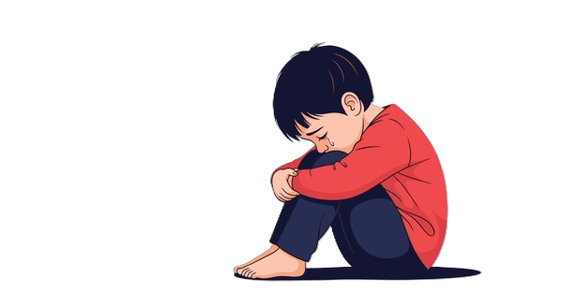
Why Erikson’s Theory is Useful?
Isaac:
avoids group play
becomes upset separating from mother
has language delays
struggles with confidence
is quiet and withdrawn
(Berk, 2018)

Slide 4

Factors Affecting Isaac’s Development
Family Factors
Child Factors
Mother has post-natal depression
Limited social support
Recent move to London
Disrupted childcare
Limited social interaction
Emotional difficulties
(Bowlby, 1988)

Slide 5

Nature and Nurture
NATURE | NURTURE
Temperament | Parenting
Emotional sensitivity | Social interaction
 | Childcare experience
 | Emotional environment
(Bee and Boyd, 2020)

Slide 6
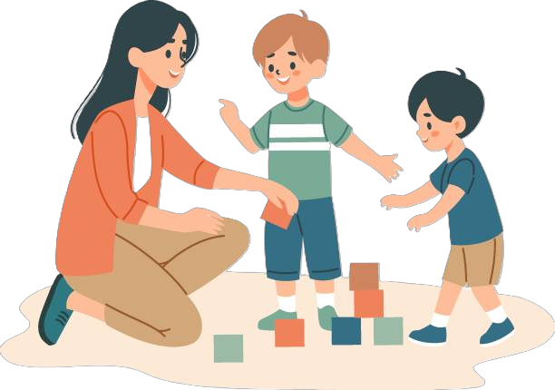
Support Plan for Isaac
Emotional Support
key worker relationship
emotional regulation support
positive praise and encouragement
Learning Support
play-based learning
language-rich activities
support for mother
multi-agency working
(Bronfenbrenner, 1979)

Slide 7

Strengths and Limitations of Erikson’s Theory
Strengths
focuses on emotional development
useful in early years practice
explains confidence and social behaviour
Limitations
stages may be too general
children develop differently
culture and family differences matter
(Shaffer and Kipp, 2014)

Slide 8
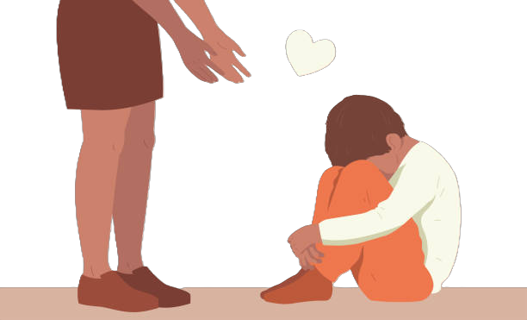
Conclusion
Isaac’s experiences affect his emotional and social development
Erikson’s theory helps explain his behaviour
Early support can improve confidence and wellbeing
Multi-agency support is important

Slide 9
References
Bee, H. and Boyd, D. (2020) The Developing Child. 14th edn. Harlow: Pearson.
Berk, L. (2018) Development Through the Lifespan. 7th edn. Harlow: Pearson.
Bowlby, J. (1988) A Secure Base: Parent-Child Attachment and Healthy Human Development. London: Routledge.
Bronfenbrenner, U. (1979) The Ecology of Human Development. Cambridge, MA: Harvard University Press.
Erikson, E.H. (1963) Childhood and Society. 2nd edn. New York: Norton.
Shaffer, D. and Kipp, K. (2014) Developmental Psychology: Childhood and Adolescence. 9th edn. Belmont: Wadsworth.

