Slide 1
Assessment component 3 my reflection on my digital development

Slide 2
Agenda
In my reflection today in want to recap on all the digital skills ive learned in the first term of my digita skills modual , ill cover
Jisk
Linktin certificates
How my powerpont and skills are important in the modern workplace
Refrances
Qr coode and questionair

Slide 3
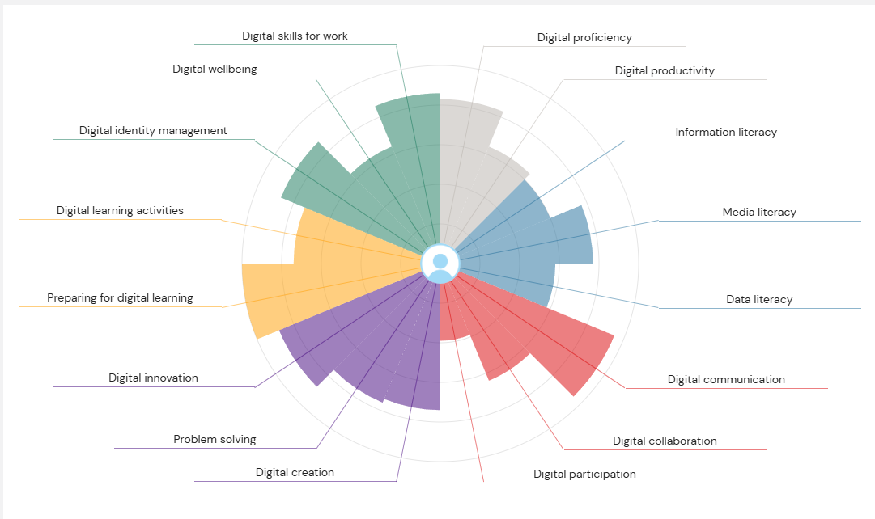
Overcoming nervousness
Confidence-building strategies

Slide 4
Engaging the audience
Make eye contact with your audience to create a sense of intimacy and involvement
Weave relatable stories into your presentation using narratives that make your message memorable and impactful
Encourage questions and provide thoughtful responses to enhance audience participation
Use live polls or surveys to gather audience opinions, promoting engagement and making sure the audience feel involved

Slide 5
Effective delivery techniques
This is a powerful tool in public speaking. It involves varying pitch, tone, and volume to convey emotion, emphasize points, and maintain interest.
  Pitch variation
  Tone inflection
  Volume control
Effective body language enhances your message, making it more impactful and memorable.
  Meaningful eye contact
  Purposeful gestures
  Maintain good posture
  Control your expressions

Slide 6
Thank you

Slide 7
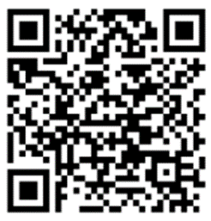

Feedback
Thank you for your participation and patience.
Your feedback will be greatly appreciated and valued.
www.linkedin.com/in/zara-bailey-263a2b1ab
https://forms.office.com/e/T94t1yB2cg?origin=lprLink

Slide 8
references

