Slide 1
Student name: | Zobia Riaz | Student ID: 2226851
Programme: | MSc Public Health and Social Care in Practice
Module: | Quality Assurance and Service Improvements
Module code: | LCHS7006
Lecturer: | Dr Fahad Khan
Assignment Title: | Component 1 Individual Presentation

Slide 2
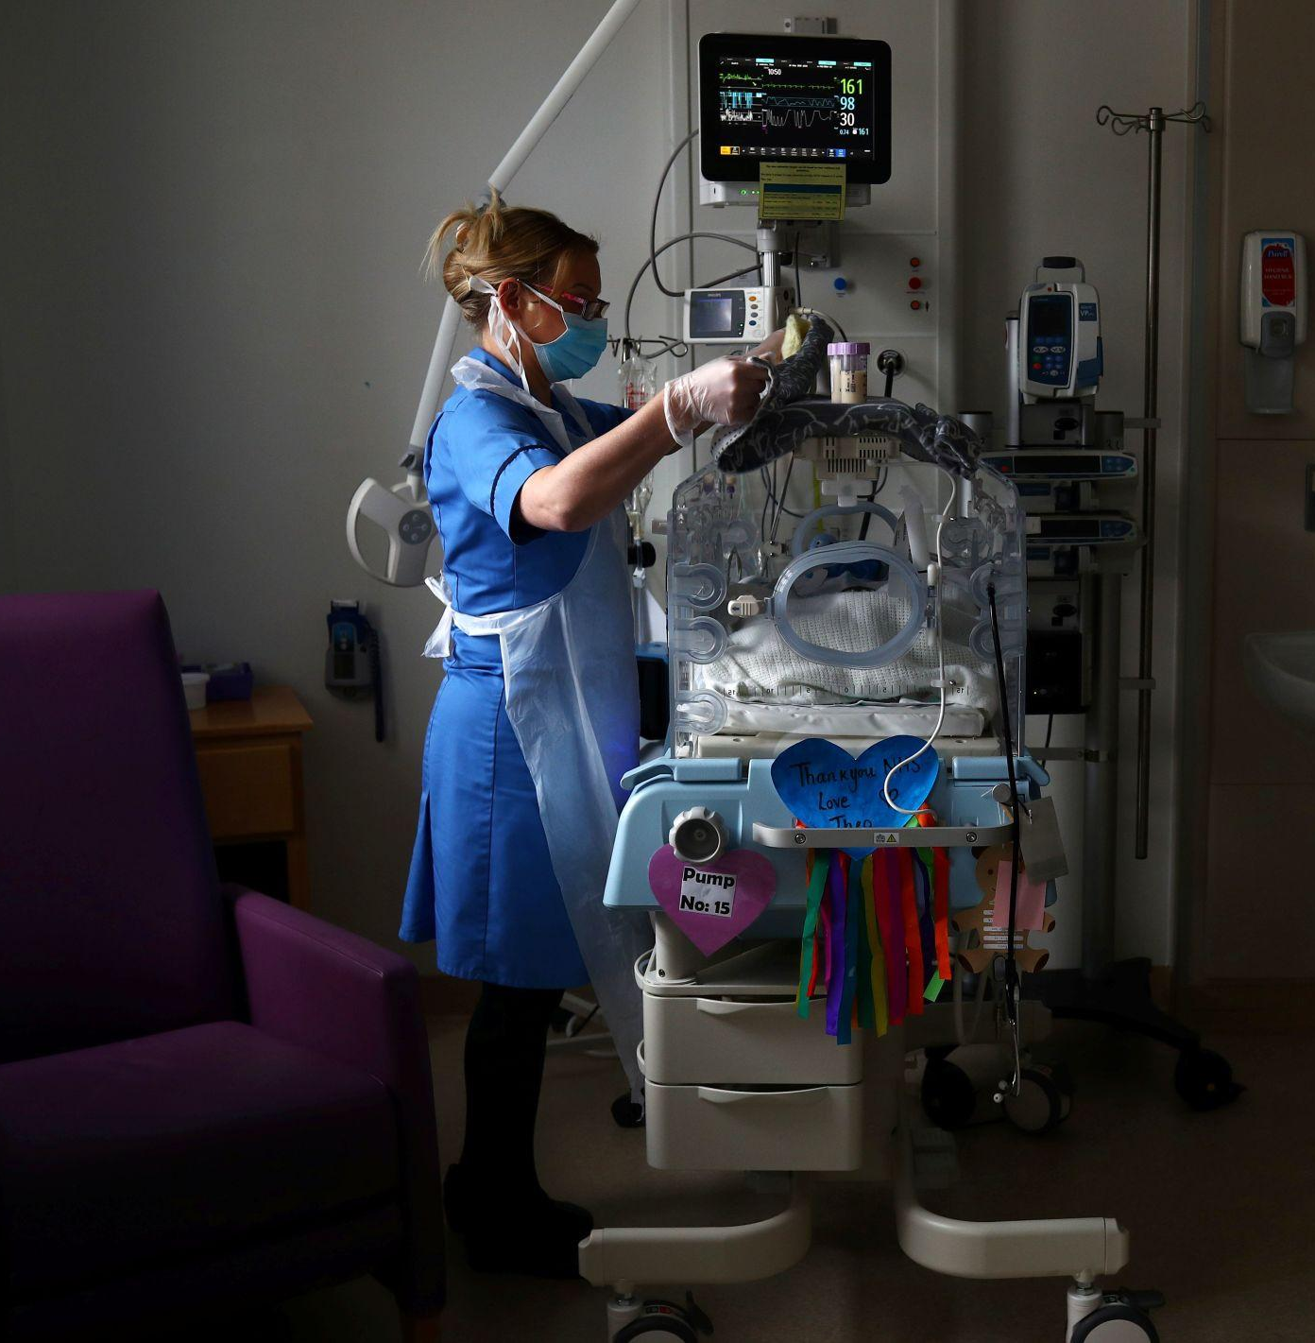
PRESENTATION TITLE
Quality Management Failures in the Lucy Letby Case

Slide 3


Aim of Presentation
Aim of Presentation is to examine quality management failures associated with the Lucy Letby case at Countess of Chester Hospital NHS Foundation Trust (Thirlwall Inquiry, 2024).
It will: Explore the background of the case.
Apply the Swiss Cheese Model to identify root causes.
Analyse policy and governance failures.
Evaluate impacts on quality, efficiency and equity.
Provide recommendations for quality improvement.
Outline the structure of the Component 2 Report.
Learning Outcome Understand how organisational failures contribute to patient harm and how quality management systems can prevent similar incidents.

Slide 4

Background of the Case Study:
Lucy Letby Case
Lucy Letby was convicted of murdering seven babies and attempting to murder seven others while working in the neonatal unit between 2015 and 2016 (BBC News, 2023).
Key concerns identified:
Consultants repeatedly raised concerns about increased infant deaths (Thirlwall Inquiry, 2024).
Hospital management delayed investigations (The Guardian, 2024).
Incident reporting systems failed to identify patterns of harm (NHS Improvement, 2018).
Leadership failed to respond effectively (Francis, 2013).
Why It Matters:
The case exposed significant weaknesses in governance, patient safety systems and organisational culture (CQC, 2016).

Slide 5

Why This Is a Quality Management Issue
According to NHS England (2023), quality healthcare must deliver:
Safety: Avoiding preventable harm to patients.
Clinical: Effectiveness Providing evidence-based care.
Patient Experience: Delivering compassionate and responsive services.
Failures in the Letby case included:
✓ Weak governance (CQC, 2016)
✓ Poor risk management (NHS Improvement, 2018)
✓ Failure to investigate mortality trends (The Guardian, 2024a)
✓ Lack of effective whistleblowing culture (NHS England, 2022)

Slide 6
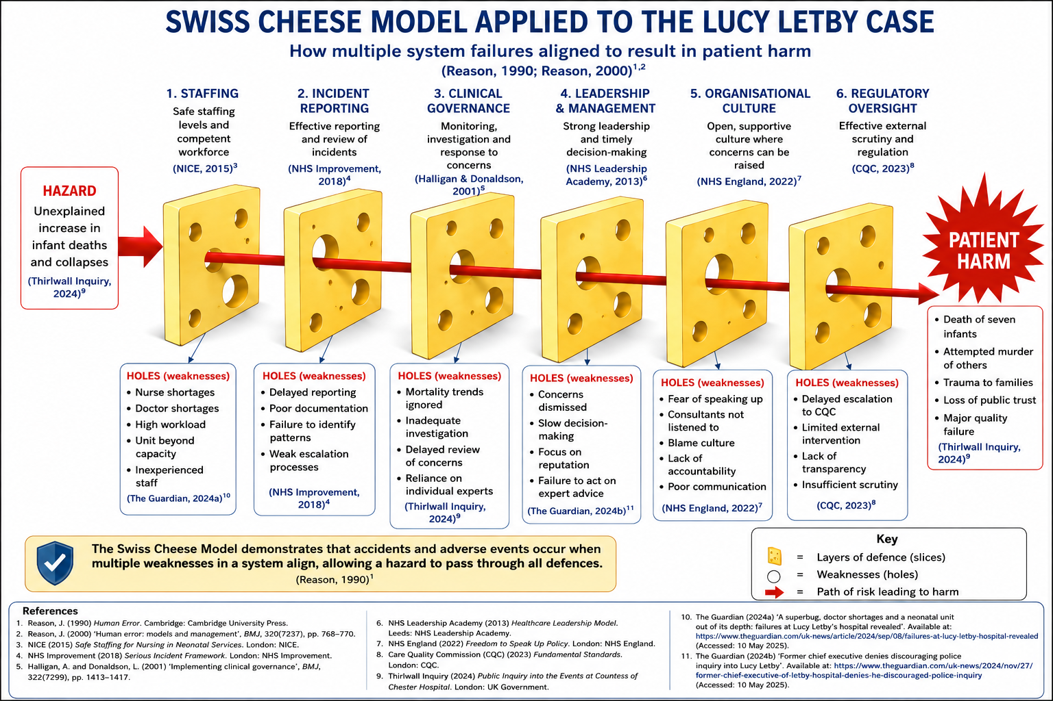
Swiss cheese model

Slide 7
Table: Applying the Swiss Cheese Model to the Lucy Letby Case
The Swiss Cheese Model suggests accidents occur when multiple system failures align and allow hazards to reach patients (Reason, 1990; Reason, 2000).
Swiss Cheese Layer (Defence/Slice) | Purpose of the Defence | Holes (Weaknesses) Identified | Evidence from Lucy Letby Case | Contribution to Patient Harm
Staffing | Ensure adequate staffing levels, supervision and safe patient care (NICE, 2015) | • Nurse shortages • Doctor shortages • High workload • Unit operating beyond capability • Limited specialist expertise | The neonatal unit experienced staffing pressures and was caring for increasingly complex cases (The Guardian, 2024; Thirlwall Inquiry, 2024) | Reduced ability to monitor patients effectively and identify emerging risks, increasing the likelihood of unsafe care (WHO, 2021).
Incident Reporting Systems | Detect unusual incidents and trigger investigations (NHS Improvement, 2018) | • Delayed reporting • Poor documentation • Failure to identify patterns • Weak escalation procedures | Multiple infant collapses and deaths occurred without timely investigation into recurring patterns (NHS Improvement, 2018; Thirlwall Inquiry, 2024) | Opportunities to identify and address safety concerns were missed, allowing harm to continue.
Clinical Governance | Monitor patient safety, investigate concerns and ensure quality assurance (Halligan and Donaldson, 2001) | • Mortality trends ignored • Delayed reviews • Inadequate investigations • Lack of systematic monitoring | Consultants repeatedly raised concerns about increased deaths but management delayed action (Thirlwall Inquiry, 2024; The Guardian, 2024) | Opportunities to identify and address safety concerns were missed, allowing harm to continue.
Leadership & Management | Make timely decisions and prioritise patient safety (NHS Leadership Academy, 2013) | • Concerns dismissed • Slow decision-making • Focus on organisational reputation • Failure to act on expert advice | Senior clinicians requested Letby's removal from clinical duties, but management delayed action (The Guardian, 2024; Francis, 2013) | Delayed decision-making prolonged patient exposure to risk and compromised safety.

Slide 8
Benchmark table
Benchmarking Countess of Chester Hospital Against NHS Quality Standards
Quality Domain | Benchmark Standard | Expected Practice | What Happened in Lucy Letby Case | Gap Identified | Impact on Service Delivery
Patient Safety | NHS Patient Safety Strategy (NHS England, 2023) | Rapid identification and management of patient safety risks | Increased infant deaths and collapses were not promptly investigated (Thirlwall Inquiry, 2024) | Failure to recognise emerging risks | Increased patient harm and preventable deaths (WHO, 2021).
Clinical Governance | Clinical Governance Framework (Halligan and Donaldson, 2001) | Continuous monitoring of quality and safety indicators | Consultants repeatedly raised concerns, but management failed to act (The Guardian, 2024) | Weak governance processes | Delayed corrective action and prolonged exposure to risk (Francis, 2013).
Incident Reporting | NHS Serious Incident Framework (NHS Improvement, 2018) | Effective reporting and investigation of adverse events | Patterns of deaths were not identified through reporting systems | Inadequate incident review procedures | Missed opportunities for learning and prevention (Reason, 2000)
Staffing Levels | NICE Safe Staffing Guidelines (NICE, 2015) | Appropriate nurse-to-patient ratios and specialist staffing | Neonatal unit experienced staff shortages and workload pressures (The Guardian, 2024) | Workforce planning failures | Reduced supervision and increased patient safety risks (WHO, 2021)
Leadership & Accountability | NHS Leadership Framework (NHS Leadership | Leaders should prioritise patient safety and transparency | Concerns were dismissed and action delayed (The Guardian, 2024) | Poor leadership response | Unsafe conditions remained in place for an extended period (Francis, 2013).

Slide 9

Structure of Component 2 Report
Introduction
Main body
Donabedian model
Fishbone diagram
Swot Analysis
Recommendations
Strengthening healthcare workforce capacity
Improving emergency obstetric services
Strengthening governance and accountability
Community awareness and access to care
Benchmark table – before vs after
Conclusion
Reference list
Kotter’s 8 step change model

Slide 10
Recommendations
Recommendation | Actions | Supporting Evidence
1. Strengthen Clinical Governance | • Mandatory escalation procedures for unusual mortality trends •Real-time mortality monitoring systems | Effective clinical governance improves patient safety through early identification and management of risks (Halligan and Donaldson, 2001; NHS England, 2023).
2. Improve Whistleblowing Systems | • Independent reporting channels • Greater protection for staff raising concerns | A strong whistleblowing culture enables staff to report safety concerns and supports organisational learning (NHS England, 2022; Francis, 2013).
3. Workforce Planning | • Safe staffing levels • Recruitment of specialist neonatal staff | Adequate staffing levels are associated with improved patient outcomes and reduced risk of adverse events (NICE, 2015; WHO, 2021).
4. Stronger Regulatory Oversight | • Earlier external reviews • Improved communication with regulators and CQC | Independent oversight helps identify quality failures and ensures accountability within healthcare organisations (CQC, 2023; Thirlwall Inquiry, 2024)
5. Safety Culture Development | • Leadership training • Adoption of a Just Culture approach | A positive safety culture encourages learning from errors and reduces blame-focused responses (Reason, 2000; NHS England, 2023).

Slide 11

Conclusion
The Lucy Letby case highlights how multiple organisational failures can align to create catastrophic patient harm.
Using the Swiss Cheese Model demonstrates that:
Staffing shortages
Poor governance
Weak leadership
Inadequate reporting systems
Regulatory failures all contributed to a breakdown in patient safety.
Healthcare organisations must strengthen quality assurance systems, improve transparency and promote a culture of safety to prevent similar events in the future.

Slide 12
Thank you for watching!

Slide 13
Reference list
BBC News (2023) Lucy Letby found guilty of murdering seven babies. Available at: https://www.bbc.co.uk/news/uk-england-merseyside-66160514 (Accessed: 12 June 2026).
Care Quality Commission (CQC) (2016) Countess of Chester Hospital NHS Foundation Trust Quality Report. Newcastle upon Tyne: Care Quality Commission.
Care Quality Commission (CQC) (2022) Regulation 20: Duty of Candour. Available at: https://www.cqc.org.uk (Accessed: 10 June 2026).
Care Quality Commission (CQC) (2023) Fundamental Standards. Newcastle upon Tyne: Care Quality Commission.
Department of Health and Social Care (2023) NHS Patient Safety Strategy. London: DHSC.
Francis, R. (2013) Report of the Mid Staffordshire NHS Foundation Trust Public Inquiry. London: The Stationery Office.
Halligan, A. and Donaldson, L. (2001) ‘Implementing clinical governance: turning vision into reality’, BMJ, 322(7299), pp. 1413–1417.
Health Foundation (2023) Quality Improvement Made Simple. London: Health Foundation.
Institute of Medicine (2000) To Err Is Human: Building a Safer Health System. Washington, DC: National Academy Press.
National Institute for Health and Care Excellence (NICE) (2015) Safe Staffing for Nursing in Neonatal Services. London: NICE.
NHS England (2022) Freedom to Speak Up Policy. London: NHS England.
NHS England (2023) NHS Patient Safety Strategy. London: NHS England.
NHS Improvement (2018) Root Cause Analysis Framework. London: NHS Improvement.
NHS Leadership Academy (2013) Healthcare Leadership Model. Leeds: NHS Leadership Academy.

Slide 14
Reason, J. (1990) Human Error. Cambridge: Cambridge University Press.
Reason, J. (2000) ‘Human error: models and management’, BMJ, 320(7237), pp. 768–770.
The Guardian (2024) ‘A superbug, doctor shortages and a neonatal unit out of its depth: failures at Lucy Letby’s hospital revealed’, The Guardian, 8 September. Available at: https://www.theguardian.com/uk-news/article/2024/sep/08/a-superbug-doctor-shortages-and-a-neonatal-unit-out-of-its-depth-failures-at-lucy-letby-hospital-revealed (Accessed: 13 June 2026).
The Guardian (2024) ‘Former chief executive of Letby hospital denies discouraging police inquiry’, The Guardian, 27 November. Available at: https://www.theguardian.com/uk-news/2024/nov/27/former-chief-executive-of-letby-hospital-denies-he-discouraged-police-inquiry (Accessed: 13 June 2026).
The Guardian (2024) ‘Hospital bosses failed to report concerns over baby deaths, inquiry hears’, The Guardian, 15 November. Available at: https://www.theguardian.com/uk-news/2024/nov/15/lucy-letby-inquiry-hospital-bosses-not-reporting-baby-deaths (Accessed: 11 June 2026).
The King's Fund (2022) Leadership and Patient Safety. London: The King’s Fund.
Thirlwall Inquiry (2024) Public Inquiry into the Events at the Countess of Chester Hospital. London: UK Government.
Vincent, C. (2010) Patient Safety. 2nd edn. Oxford: Wiley-Blackwell.
World Health Organization (WHO) (2021) Global Patient Safety Action Plan 2021–2030: Towards Eliminating Avoidable Harm in Health Care. Geneva: World Health Organization.
World Health Organization (WHO) (2023) Quality of Care Framework. Geneva: World Health Organization.
Waring, J. (2005) ‘Beyond blame: cultural barriers to medical incident reporting’, Social Science & Medicine, 60(9), pp. 1927–1935

