Slide 1

Data Centre Virtualisation (ACUA6001_LON)
Aleksandar Andonov -1813107

Slide 2

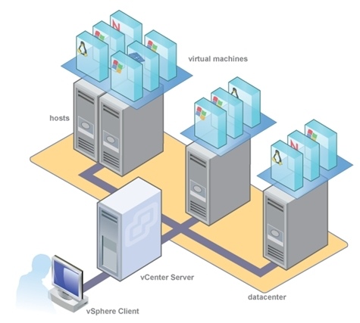
VMware
Virtualization software provides an abstraction layer over computer hardware, allowing a single computer's hardware elements— processors, memory, storage, and other components— to be separated into several virtual computers, also known as virtual machines (VMs). Each virtual machine runs its own operating system (OS) and behaves like an independent computer, even though it is running on a portion of the actual underlying computer hardware.[2]
VMware is perhaps best known for its hypervisor products. In a traditional virtualization scheme, virtual machines were run by hypervisors which operated as host machines.[10]
The following diagram from [15] shows the components of a VMware and ThoughtSpot architecture

Slide 3
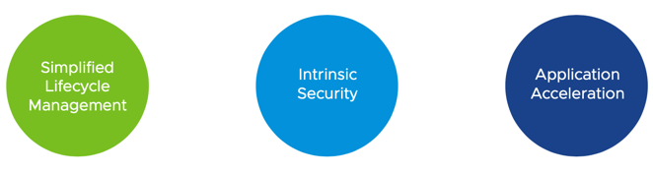
What VMWARE include ?
What is HYPERVISOR?
Kubernetes as hypervisor.
vSphere 7.0 explanation
vSphere 7.0 major areas
vSphere 7.0 major areas
For more details see [5],[4],[3],[11]

Slide 4
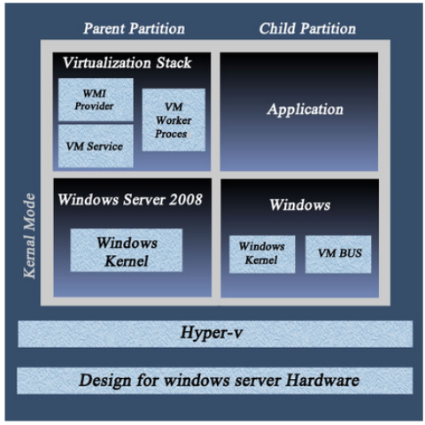
Microsoft Hyper-V
Hyper-V specifically provides hardware virtualization. That means each virtual machine runs on virtual hardware. Hyper-V lets you create virtual hard drives, virtual switches, and a number of other virtual devices all of which can be added to virtual machines.[12]
The following diagram from [17] shows Hyper-V Architecture

Slide 5
Hyper-V features
Features and Benefits
Hyper-V is Microsoft's hardware virtualization product. It will assist you in creating and even running any machine version. Since virtual machines work similarly, they are often referred to as the same. Any virtual machine will act as a computer with an operating system and all other programmes installed. When you need to use computing power, virtual machines come in handy, and they give you more versatility.[1]
Advantages of Hyper – V[8]
Security
More stable
Replica
Hyper-V is Windows based

Slide 6
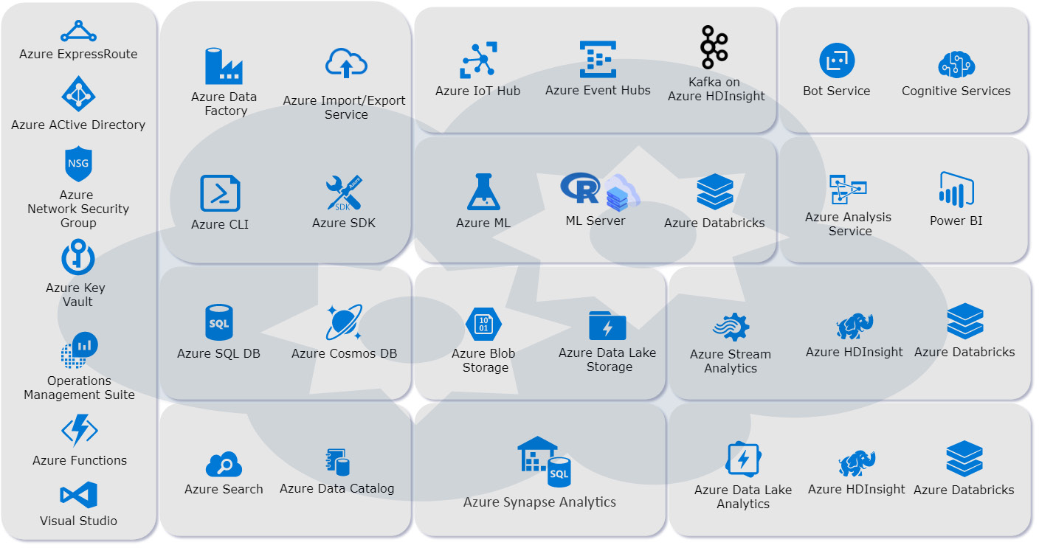

Microsoft Azure
Azure is a cloud computing platform that can provide everything a business needs to run all or part of its computing operations virtually—including servers, storage, databases, networking, analytics and more.[7]
The following figure from [16] shows the wide range of data-specific Azure tools and services

Slide 7
Benefits of Microsoft Azure
On – demand scalability
No hardware required
Cost – effective
High availability
Enterprise development tools
Security
For more details see [13]

Slide 8
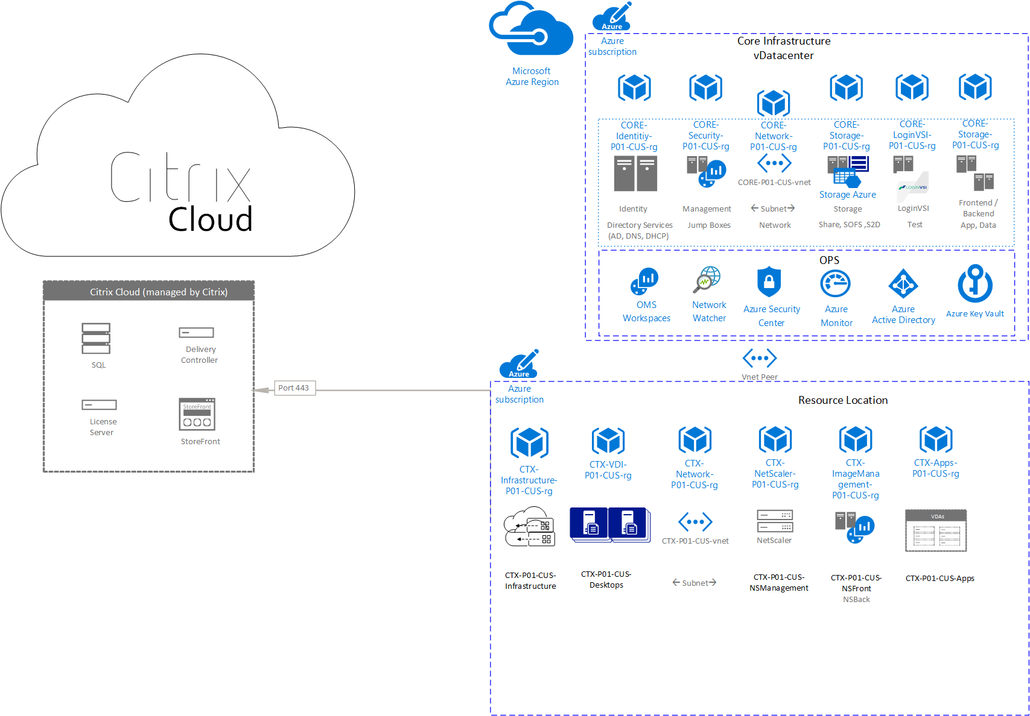
CitrIx
Citrix Systems Inc is an American cloud software company specialising in developing cloud computing software and applications.
Citrix is a piece of software that allows you to run programmes on a remote device while interacting with them on your local machine. It also helps you to log into a remote machine as though you were sitting in front of it, just through a browser.[6]
Citrix's line of products is classified into three groups.
The following diagram from [18] Architecture

Slide 9
Citrix product
Workspace
Networking
Analytics
For more details see [9] ,[14]

Slide 10
References
[1] Brown, A. (2019, July 31). Advantages And Features of Microsoft Hyper-V. Retrieved from https://preemo.com: https://preemo.com/advantages-and-features-of-microsoft-hyper-v
[2] Education, I. C. (2019, June 7). VMware. Retrieved from https://www.ibm.com: https://www.ibm.com/cloud/learn/vmware
[3] Ellingwood, J. (2018, May 2). An Introduction to Kubernetes. Retrieved from https://www.digitalocean.com: https://www.digitalocean.com/community/tutorials/an-introduction-to-Kubernetes
[4] https://susedefines.suse.com. (n.d.). Definition hypervisor. Retrieved from https://susedefines.suse.com: https://susedefines.suse.com/definition/hypervisor/
[5] https://susedefines.suse.com. (n.d.). Definition of VMWARE. Retrieved from https://susedefines.suse.com: https://susedefines.suse.com/definition/vmware/
[6] https://vbrick.com. (n.d.). Understanding Citrix in the Workplace. Retrieved from https://vbrick.com: https://vbrick.com/understanding-citrix-in-the-workplace/
[7] https://www.acronis.com. (2018, March). What is Azure - A Complete Guide. Retrieved from https://www.acronis.com: https://www.acronis.com/en-gb/articles/what-is-microsoft-azure/
[8] https://www.backupassist.com. (n.d.). Five advantages of Hyper-V over other virtualization platforms. Retrieved from https://www.backupassist.com: https://www.backupassist.com/blog/five-advantages-of-hyper-v-over-other-virtualization-platforms
[9] https://www.citrix.com. (n.d.). Digital Workspaces. Retrieved from https://www.citrix.com: https://www.citrix.com/en-gb/solutions/digital-workspace/
[10] https://www.techopedia. (n.d.). What does VMware mean? Retrieved from https://www.techopedia.com: https://www.techopedia.com/definition/16053/vmware-virtual-machine
[11] Lee, B. (2020, March 24). VMware VSphere 7 – What’s New. Retrieved from https://www.vembu.com: https://www.vembu.com/blog/vmware-vsphere-7-whats-new/
[12] Microsoft. (2018, June 25). Introduction to Hyper-V on Windows 10. Retrieved from https://docs.microsoft.com: https://docs.microsoft.com/en-us/virtualization/hyper-v-on-windows/about/
[13] Moore, M. (n.d.). What are the business benefits of Microsoft Azure Cloud? Retrieved from https://www.actsolution.net: https://www.actsolution.net/blog/what-are-the-business-benefits-of-microsoft-azure-cloud/
[14] team, I. P. (2020, Feb 11). Everything you need to know about Citrix. Retrieved from https://www.itpro.co.uk: https://www.itpro.co.uk/saas/28932/everything-you-need-to-know-about-citrix
[15} Software, T. (2021, Jan 6). VMware configuration overview. Retrieved from docs.thoughtspot.com: https://docs.thoughtspot.com/5.2/appliance/vmware/vmware-intro.html
[16] Has Altaiar,Jack Lee ,Michael Peña. (2009). Cloud Analytics with Microsoft Azure. In J. L. Has Altaiar, Why Microsoft Azure? Packt.
[17] N, A. (2014, December 2). Hyper-V: Overview of Architecture and Consistent Backups. Retrieved from www.vembu.com: https://www.vembu.com/blog/hyper-voverview-architecture-consistent-backups/
[18] Shbeilat, L. (2021, February 9). Citrix Virtual Apps and Desktops Service on Azure. Retrieved from docs.citrix.com: https://docs.citrix.com/en-us/tech-zone/design/reference-architectures/virtual-apps-and-desktops-azure.html

