Slide 1
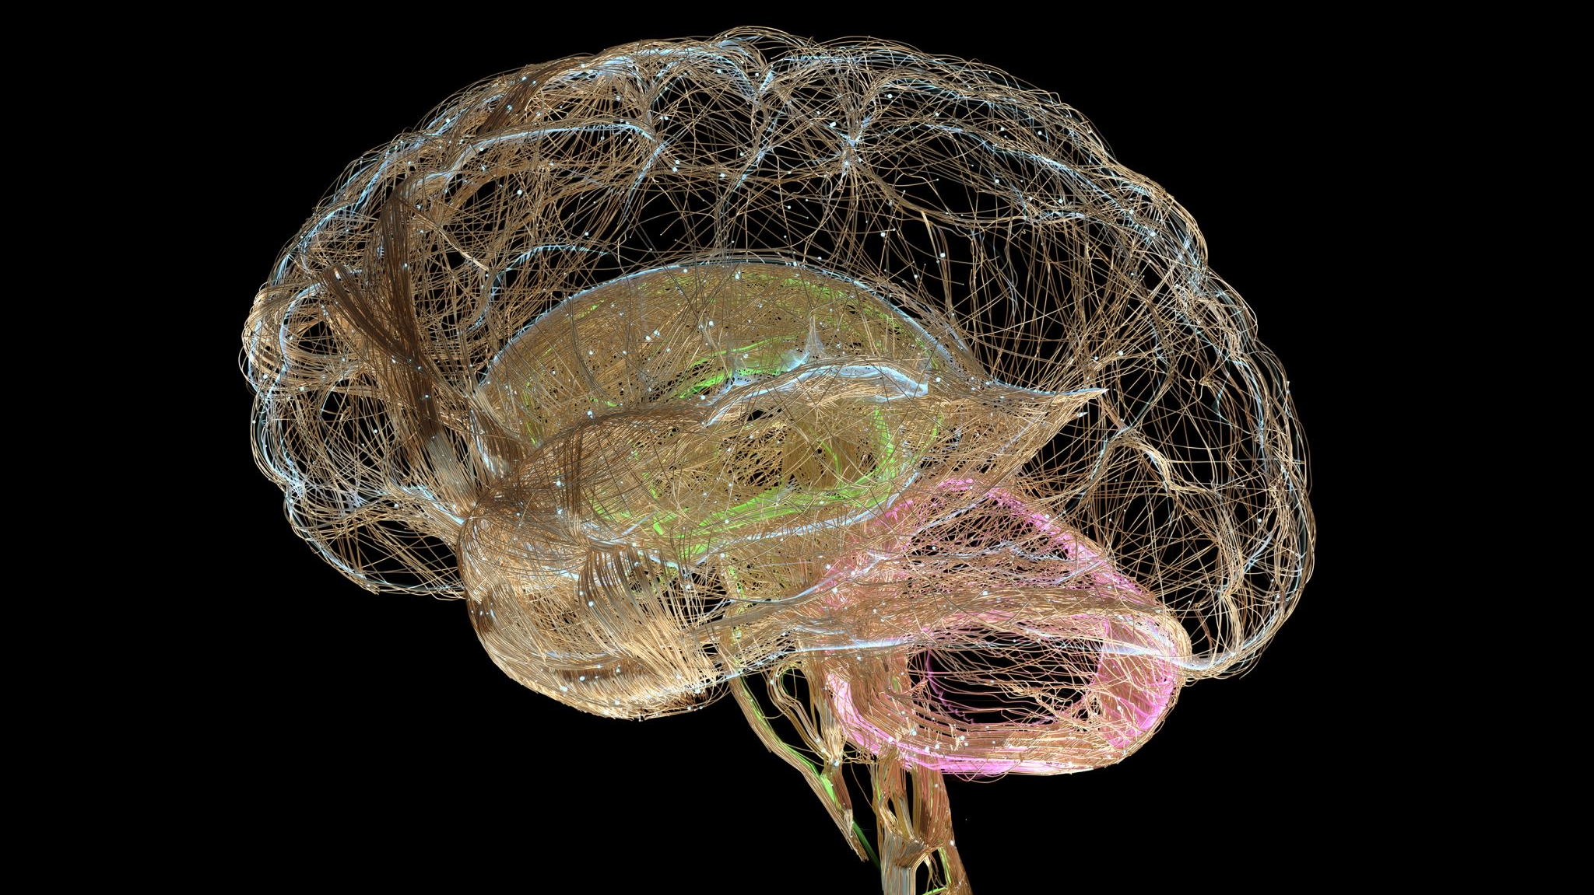
Contemporary Mental Health

Slide 2
Aims and Objectives
Aim: To understand the classification of mental health in contemporary society.
1
Define mental health.
2
Describe the DSM-5 and the ICD 11.
3
Discuss current mental health statistics.
4
Highlight key issues in the sector.
5
Hypothesise the aetiology of conditions.
6

Slide 3
Mental Health: Definitions
How do we define mental health?
How do YOU define it?

Slide 4

Mental Health: Definitions
The World Health Organisation defines mental health as a state of mental well-being that enables people to cope with the stresses of life, realise their abilities, learn well and work well, and contribute to their community.
Let's break this to pieces.

Slide 5
A State of Mental Wellbeing
What is mental wellbeing?
What contributes positively?
What negatively affects this?
Quality of life

Slide 6
Cope With the Stresses of Life
Stresses?
Do we all have the same?
Do we all cope the same way?
How do we cope with stress?

Slide 7
Realise Their Abilities
What are our abilities?
How did you realise you were good at something?
Did this link to your mental health?

Slide 8
Learn Well and Work Well
Do we all need to learn/work?
Can we all?
Does this link to mental health?

Slide 9
Contribute to Their Community
Do you do this?
How?
What is community to us?

Slide 10
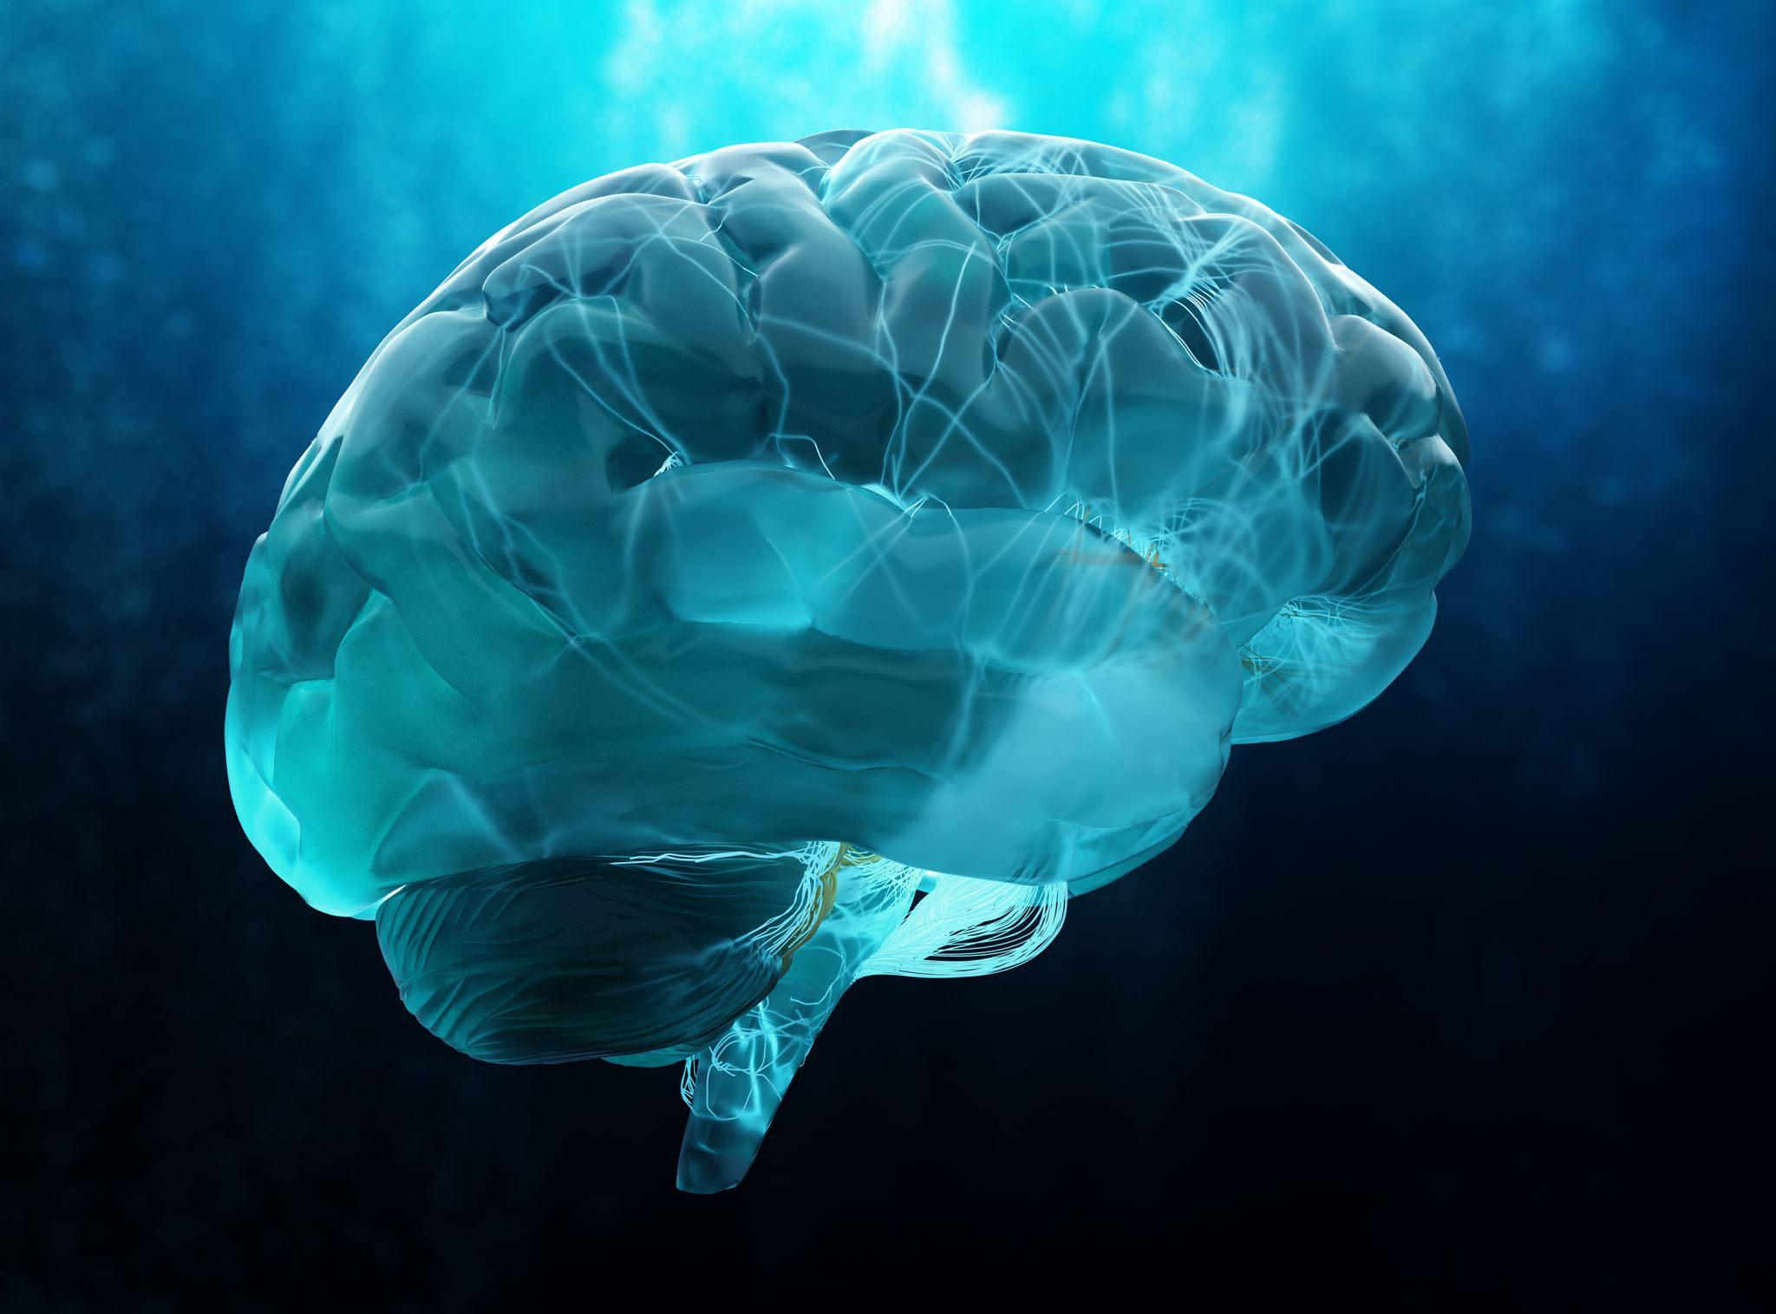
Mental Health Conditions
What are some of the most common mental health conditions?

Slide 11
Mental Health Conditions
Common Mental Disorders – CMD – depression, anxiety, panic disorder, phobias and OCD.
One in six people aged 16+
More common in those of an ethnic minority, specifically, Black and Asian British
More common in those who are economically inactive or unemployed.

Slide 12
Mental Health Conditions
These conditions are all grouped under certain 'features' or characteristics.
How can we classify these diagnoses?
Similarities?
Differences?

Slide 13
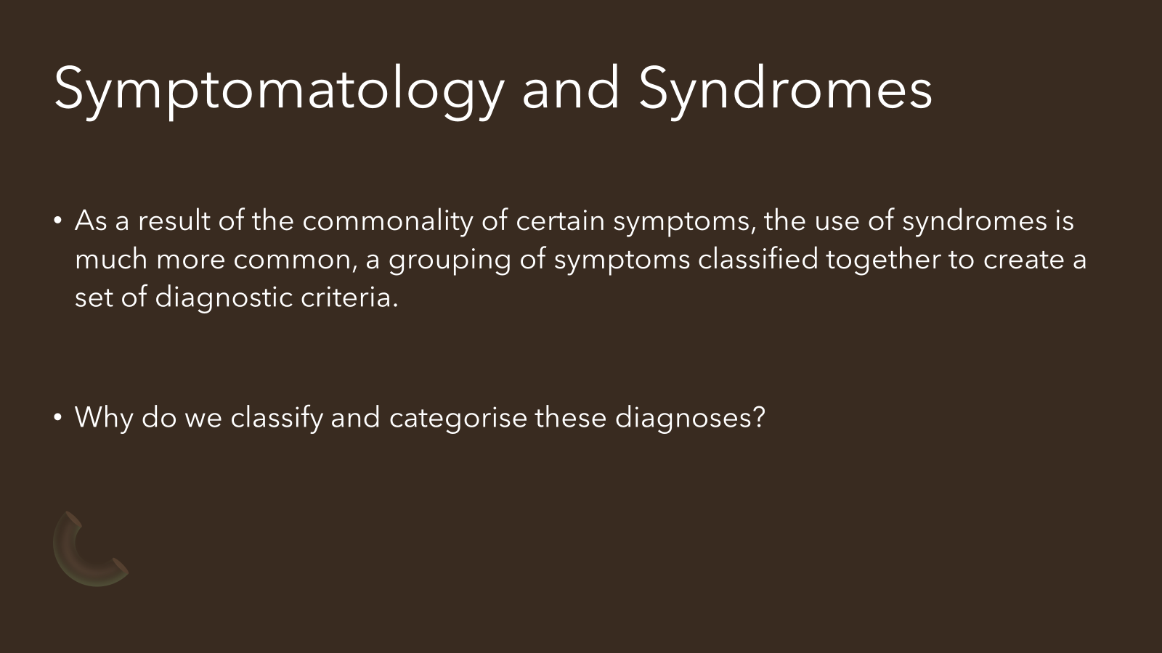
Classification of Mental Health
Why do we do this?

Slide 14
Reasons for Classification: Treatment
Without a classified diagnosis, we cannot treat the individual!
Once we understand what is going on with the person, then we can follow a prescribed pathway for recovery and treatment.
Identification -> Diagnosis -> Treatment

Slide 15

Reasons for Classification: Research
By identifying symptoms, we can then ascribe a name to the syndrome itself. Only then can we research new and innovative treatments. We then know what we are observing a reduction/elimination of through the treatment.
Notes:
Image taken from: https://www.fda.gov/files/Drugs-Img-Regulatory-Science-Research-Regulatory-Science-at-CDER-Scientists-Using-Computer-1600x900.png
Copyright of FDA.

Slide 16
Reasons for Classification: The Person
How would you feel carrying around all these symptoms all day, every day, with no diagnosis?
Now how about if we gave it a name?
By naming the condition, we can alleviate some of the anxiety, some of the stress behind the condition. It can reassure someone that they're not imagining things.
Person-centred approaches

Slide 17
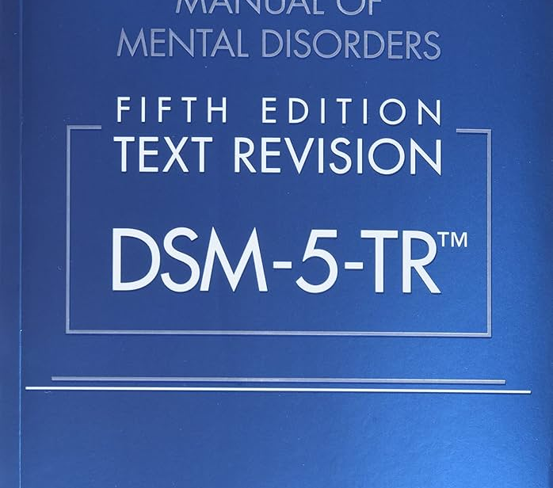
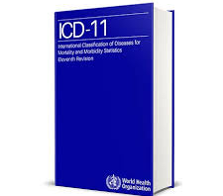
Classification of Mental Health
Mental Health is classified into categories using two main texts around the world
Diagnostic and Statistical Manual 5th Edition Text Revision (DSM 5 TR)
International Classification of Diseases 11th Edition (ICD 11)

Slide 18
DSM 5
Definition of abnormality:
syndrome[s] characterized by clinically significant disturbance[s] in an individual’s cognition, emotion regulation, or behavior that reflects a dysfunction in psychological, biological, or developmental processes underlying mental functioning. Mental disorders are usually associated with significant distress or disability in social, occupational, or other important activities. An expectable or culturally approved response to a common stressor or loss, such as the death of a loved one, is not a mental disorder. Socially deviant behavior (e.g. political, religious, or sexual) and conflicts that are primarily between the individual and society are not mental disorders unless the deviance or conflict results from a dysfunction in the individual, as described above” (American Psychiatric Association, 2013, p. 20).
Notes:
https://www.youtube.com/watch?v=UiY6wr--0dE

Slide 19
DSM 5
The DSM has undergone a number of revisions:
The first version of DSM was published in 1952.
DSM II was published in 1968.
DSM III was published in 1980 and then revised in 1987 (DSM III-R)
DSM-IV was published in 1994.
DSM 5 was published in 2013.
DSM 5 Text Revision was published in 2022.
The first three versions of the manual were criticised for being unreliable!

Slide 20
DSM 5
Within the DSM 5, there are 3 main sections
Section I provides an introduction and information regarding organizational features of the text, revisions, field trials, and public, professional, and expert review.
Section II includes diagnostic criteria and codes. Disorders are coded based on the ICD-10, which we will cover shortly.

Slide 21
DSM 5
Section III addresses assessment measures, cultural formulations, a glossary, and conditions that warrant further study, such as Internet gaming disorder, suicidal behavior disorder, and neurobehavioral disorder due to prenatal alcohol exposure (ND-PAE).

Slide 22

DSM 5
Previously, there was an axis system for the DSM-IV, which has been removed in this iteration. The previous axis system was used to categorise mental health conditions, but now they are listed within the different chapters as syndromes instead.

Slide 23
Section II
Neurodevelopmental Disorders
Schizophrenia Spectrum and other Psychotic Disorders
Bipolar and Related Disorders
Depressive Disorders
Anxiety Disorders
Obsessive-Compulsive and Related Disorders
Trauma and Stressor-Related Disorders
Dissociative Disorders

Slide 24
Section II
Somatic Symptoms and Related Disorders
Feeding and Eating Disorders
Elimination Disorders
Sleep Wake Disorders
Sexual Dysfunctions
Gender Dysphoria
Disruptive, Impulse-Control and Conduct Disorders

Slide 25
Section II
Substance-Related and Addictive Disorders
Neurocognitive Disorders
Personality Disorders
Paraphilic Disorders
Other Mental Disorders and Additional Codes
Medication-Induced Movement Disorders and Other Adverse Effects of Medication
Other Conditions That May Be a Focus of Clinical Attention

Slide 26
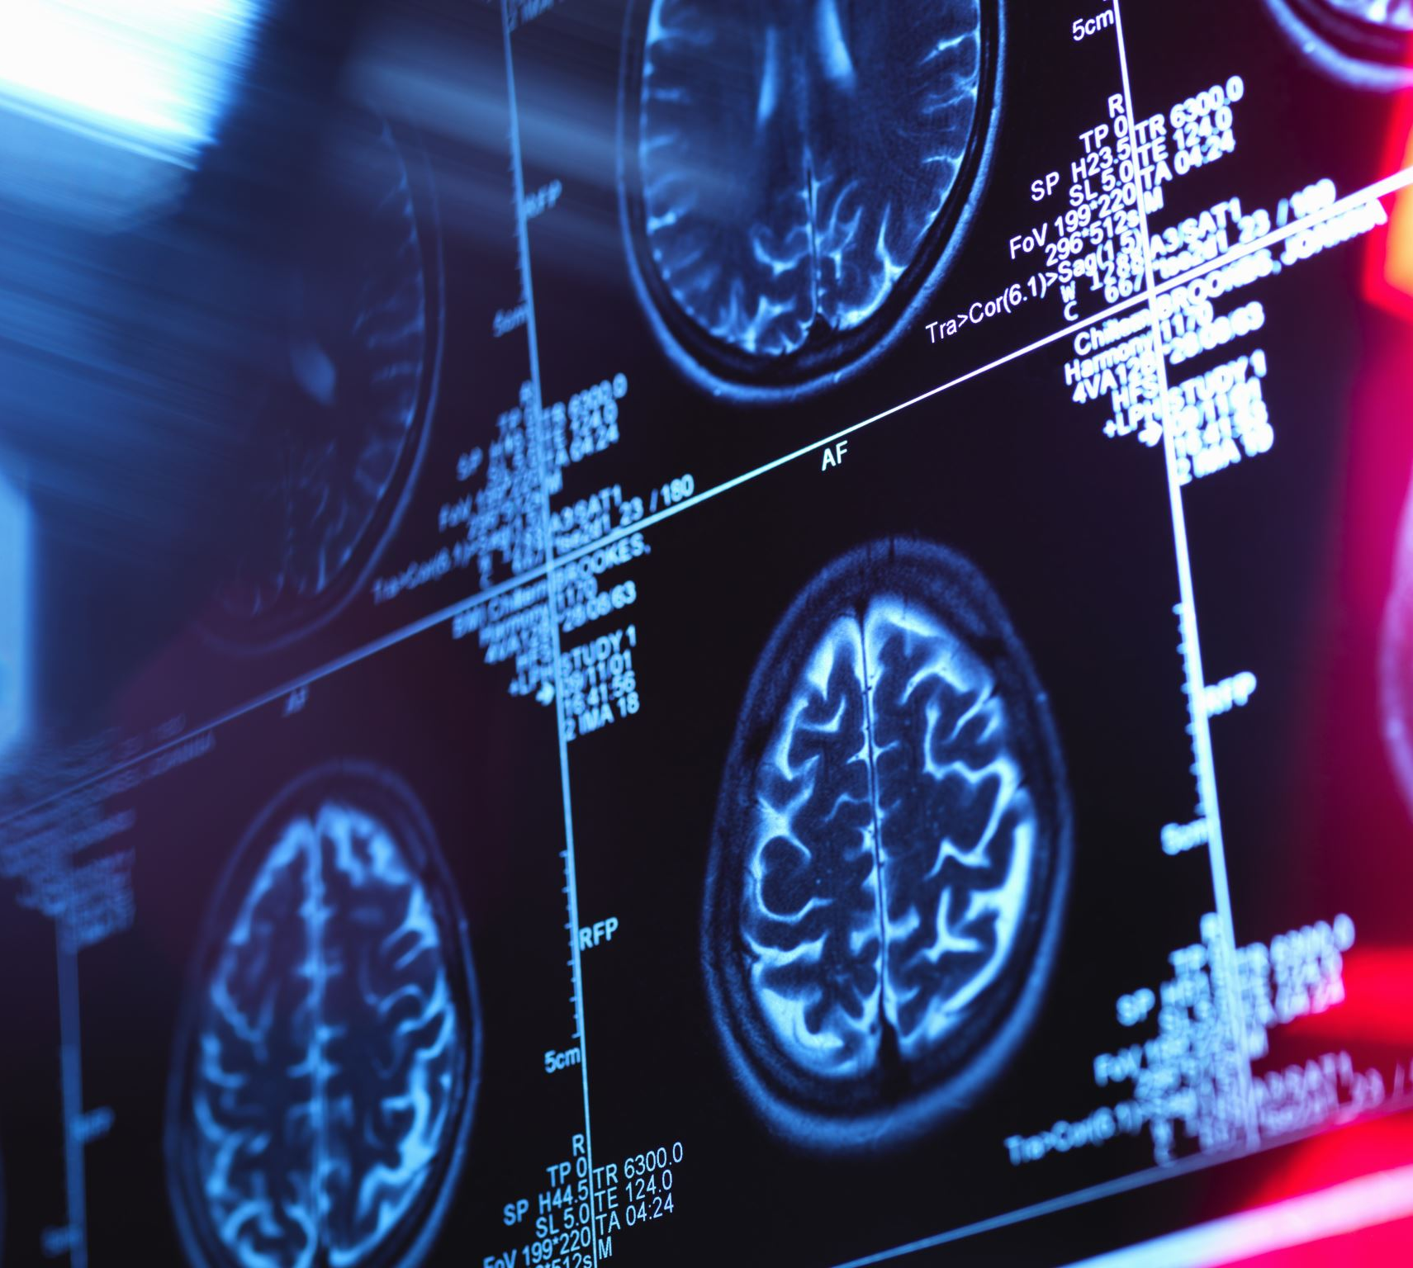
DSM 5
The DSM 5 is organised with the diagnoses more commonly seen earlier in the lifespan listed first. Those seen later in life are seen further into the DSM 5.

Slide 27
Critique of the DSM 5
Biomedical models- The DSM 5 commonly refers to biomedical models, which utilise the term diagnosis frequently.
Can anyone see a downside to this?

Slide 28
Critique of the DSM 5
Another major criticism concerns the categorical nature of classification.
A person's problems are better described dimensionally (Markon, Chmielewski, & Miller, 2011), however, the DSM is a categorical system (in or out).
This categorical system is maintained because it is a traditional form of classification in medicine and because it is easier for clinicians to understand and use (American Psychiatric Association, 2013; Widiger & Shea, 1991).

Slide 29
Critique of the DSM 5
This categorical model DOES increase inter-rater reliability but does have issues in relation to validity.
This can exacerbate secondary labelling, and schematic creation from the label itself.
Schemata/Schemas are patterns of thought/behaviour.

Slide 30
Critique of the DSM 5
Categories do not explain problems, they describe them.
Bulimia nervosa, what is it?

Slide 31
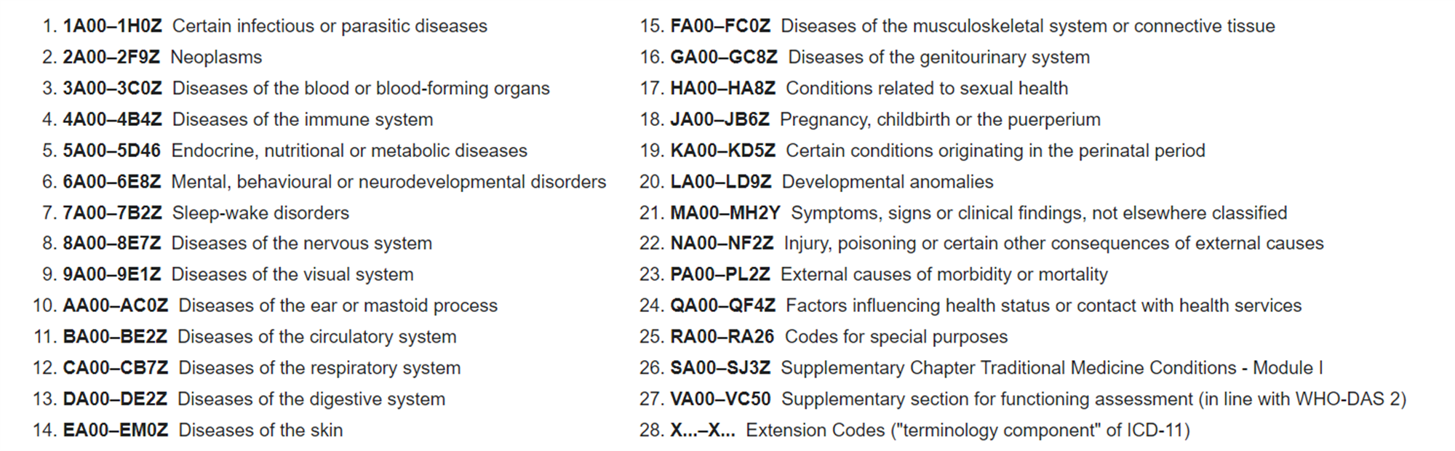
ICD-11
The International Classification of Diseases 11th Edition replaced ICD 10 in January 2022.
It is fully available to peruse online.

Slide 32
ICD-11
Research has found that the ICD is the most commonly used manual for diagnosis (Mezzich, 2002), out of the two.
However, the ICD-10 and ICD-11 rely upon the implied causality model, that there are causes behind these symptoms, but they do not count for all of the variance in causes and explanations.

Slide 33

ICD-11
There are, as with the DSM-5, challenges and controversies in the ICD-11.
Linearity of diagnoses in textbooks (Eisma, 2023).
Societal consequences of diagnosis (Cacciatore and Francis, 2022)
Emphasis on pharmacotherapy (Lacasse and Cacciatore, 2014)

Slide 34
ICD-11
There are also concerns with some of the social relevance of the ICD-11 when considering personality disorders (Pan and Wang, 2024).
However, there are a great deal of different models drawn together for this manual, making it very scientifically sound (Bach et al., 2018)
One example is eliminating psychopathy from PD's, a key issue with previous manuals (Zajenkowska et al, 2024).

Slide 35
Consequences of Classification
What could be a positive or negative aspect of classifying a mental health condition?
Labelling
Treatment
Institutionalisation

Slide 36
Labelling
A powerful argument against classifying mental disorders was provided by Scheff (1966).
He argued that someone who acquires the stigma of a psychiatric diagnosis or label will be treated as a mentally ill person.
Labels create expectations on the part of the patient and others. These labels may lead to behaviours that confirm the original diagnosis.

Slide 37
Practicality and Ethics
Sadly, within psychology, straightforward answers are few and far between.
This was demonstrated by Rosenhan's (1973) experiment.

Slide 38

Rosenhan (1973): On Being Sane in Insane Places
Rosenhan criticised the medical model deeply and wanted to test whether psychiatric professionals could determine the difference between sane and insane people.

Slide 39
The Participants
Eight sane people:
a psychology graduate
three psychologists
a Paediatrician
a Psychiatrist
a painter
a housewife

Slide 40
Procedure (Admission)
They attempted to gain admission to 12 different hospitals, in 5 different states.
The pseudo-patients telephoned the hospitals for an urgent appointment.
They arrived at admissions and gave false names, addresses and job titles.
All other details were true including general ups and downs in life.

Slide 41
The Possible Outcomes
The pseudo-patients would be identified as sane, and be discharged. If this were the case, we can assume:
The pseudo-patients would not be identified as sane, and/or labelled as insane.

Slide 42

Results
What do you think will happen?

Slide 43
Procedure (Classification)
They complained of hearing an indistinct and unclear voice in their head saying “empty, hollow, thud’.
Even though this was the only symptom they claimed to have, they were admitted to hospital.
Once they were admitted to the psychiatric ward, the pseudo-patients stopped simulating any symptoms of abnormality.
However, the patients were nervous because of fear of being exposed, so took part in ward activities.

Slide 44
Procedure (Discharge)
All pseudo-patients wished to be discharged immediately.
BUT- they waited until they were diagnosed as ‘fit to be discharged’.
If they approached staff with simple requests:
Nurses and attendants ignored them 88% of the time.
Psychiatrists ignored them 71% of the time.

Slide 45
Results
None of the pseudo-patients were detected.
All of the patients except one were admitted with a diagnosis of schizophrenia.
The diagnosis was made without one clear symptom.
Pseudo-patients were given a total of 2100 medication tablets which they flushed down the toilets.
They remained in hospital between 7 and 52 days (average 19 days).
When discharged, they were diagnosed with “Schizophrenia in remission”.

Slide 46
Rosenhan (1973) Videos
https://www.youtube.com/watch?v=j6bmZ8cVB4o
https://www.youtube.com/watch?v=D8OxdGV_7lo

Slide 47

Just a Thought?
Do we need to rethink our classification models?
Notes:
https://www.ncbi.nlm.nih.gov/pmc/articles/PMC7365292/

Slide 48
Aetiology of Mental Health
Aetiology - the cause or set of causes of a disease or condition.
So, what causes mental health conditions to develop?

Slide 49
Depression
Comorbidity with obesity (Gibson-Smith et al., 2018), diabetes (Bădescu et al., 2016), Alzheimer's (Ryu et al., 2017) and schizophrenia (Sansom and Wong, 2015).
Current literature points to a psycho-neuro-immuno-endocrinological explanation.
Which means there are lots of reasons...
Biological – dopamine, serotonin, noradrenaline (Bernaras, Jaureguizar and Garagordobil, 2019)
Stress-induced overactivity of HPA Axis (Qin et al., 2016; Herbert, 2013)

Slide 50
Depression
Brain damage due to long-term, low level body inflammation (Lee and Giuliani, 2019)
Neurotransmitter issues due to secondary disturbances – sociability dysfunction due to lower dopamine levels (Beurel, Toups and Nemeroff, 2020)
Menopause (Bromberger et al., 2010) - does this mean differences between sexes?
Genetics? Brain derived neurotrophic factor abnormalities appear to play a role (Krishnan and Nestler, 2008)
However, this BDNF theory is debated in animal studies (Monteggia et al., 2007)
Social issues? Psychological problems? Schemas and attachment? (Bernaras, Jaureguizar and Garaigordobil, 2019)

Slide 51
Depression
Complex and incompletely understood psychological and social maladjustment can result in:
There are also studies focusing on the importance of circadian rhythms and its main mediator, melatonin, in the onset and development of depression.
Anaclitic depression, which arises from feelings of loneliness and abandonment
Introjective depression, which stems from a sense of failure and worthlessness.

Slide 52
References
Bach, B., Sellbom, M., Skjernov, M. and Simonsen, E. (2018) ICD-11 and DSM-5 personality trait domains capture categorical personality disorders: finding a common ground. Aust N Z J Psychiatry. 52(5) pp.425–34.
Bădescu, S.V., Tătaru, C., Kobylinska, L., Georgescu, E.L., Zahiu, D.M., Zăgrean, A.M. and Zăgrean, L., (2016). The association between diabetes mellitus and depression. Journal of medicine and life, 9(2), p.120.
Bernaras, E.; Jaureguizar, J.; Garaigordobil, M. (2019) Child and Adolescent Depression: A Review of theories, evaluation instruments, prevention programs, and treatments. Front. Psychol. 10, pp. 543
Beurel, E.; Toups, M.; Nemeroff, C.B. (2020) The bidirectional relationship of depression and inflammation: Double trouble. Neuron, 107, pp.234–256
Bromberger, J.T. Schott, L.L. Kravitz, H.M. Sowers, M. Avis, N.E. Gold, E.B. Randolph, J.F. and Matthews, K.A. (2010) Longitudinal change in reproductive hormones and depressive symptoms across the menopausal transition: Results from the Study of Women’s Health Across the Nation (SWAN). Arch. Gen. Psychiatry , 67, pp.598–607.
Cacciatore, J. and Francis, A. (2022) DSM-5-TR turns normal grief into a mental disorder. The Lancet. Psychiatry 9: e32
Eisma, M.C., (2023). Prolonged grief disorder in ICD-11 and DSM-5-TR: Challenges and controversies. Australian & New Zealand Journal of Psychiatry, 57(7), pp.944-951.
Gibson-Smith, D., Bot, M., Snijder, M., Nicolaou, M., Derks, E.M., Stronks, K., Brouwer, I.A., Visser, M. and Penninx, B.W., (2018). The relation between obesity and depressed mood in a multi-ethnic population. The HELIUS study. Social psychiatry and psychiatric epidemiology, 53, pp.629-638.
Krishnan, V. and Nestler, E.J. (2008) The molecular neurobiology of depression. Nature , 455, pp.894–902
Lacasse, J.R. and Cacciatore, J. (2014) Prescribing of psychiatric medication to bereaved parents following perinetal/neonatal death: An observational study. Death Studies 38, pp. 589–596.

Slide 53
References
Lee, C.H. and Giuliani, F. (2019) The Role of Inflammation in Depression and Fatigue. Front. Immunol, 10, pp.1696.
Mezzich J.E. (2002). "International surveys on the use of ICD-10 and related diagnostic systems". Psychopathology. 35 (2–3): 72–5.
Monteggia, L.M.; Luikart, B.; Barrot, M.; Theobold, D.; Malkovska, I.; Nef, S.; Parada, L.F.; Nestler, E.J. (2007)Brain-derived neurotrophic factor conditional knockouts show gender differences in depression-related behaviors. Biol. Psychiatry. 15, pp. 187–197.
Pan, B. and Wang, W., (2024). Practical implications of ICD-11 personality disorder classifications. BMC psychiatry, 24(1), p.191.
Qin, D.D.; Rizak, J.; Feng, X.L.; Yang, S.C.; Lü, L.B.; Pan, L.; Yin, Y.; Hu, X.T. (2016) Prolonged secretion of cortisol as a possible mechanism underlying stress and depressive behaviour. Sci. Rep. 6, pp. 30187.
Rosenhan, D.L., (1973). On being sane in insane places. Science, 179(4070), pp.250-258.
Ryu, S.H., Jung, H.Y., Lee, K.J., Moon, S.W., Lee, D.W., Hong, N., Kee, B.S., Kim, D.H., Han, C. and Lee, C.U., (2017). Incidence and course of depression in patients with Alzheimer's disease. Psychiatry Investigation, 14(3), p.271.
Samsom, J.N. and Wong, A.H., (2015). Schizophrenia and depression co-morbidity: what we have learned from animal models. Frontiers in psychiatry, 6, p.13.
Scheff, T. J. (1974). The Labelling Theory of Mental Illness. American Sociological Review, 39(3), 444–452.
Zajenkowska, A., Nowakowska, I., Cieciuch, J., Gawęda, Ł., Rogoza, R., Pinkham, A. and Czajkowska-Łukasiewicz, K., (2024). Towards the understanding of the core of general personality disorder factor: g-PD and its relation to hostile attributions. Development and Psychopathology, pp.1-9.

