Slide 1

19.3
BMHP6030 — COMPONENT 1
CAN PREVENTION
CLOSE THE GAP?
A critical analysis of SDG 3 and healthy life expectancy through the lens of the NHS Diabetes Prevention Programme in England.
SHAREEN BI — 2318894
NOVEMBER 2026
Notes:
SCRIPT: Good morning. A child born in the most deprived tenth of England today faces a gap of nearly twenty years in healthy life expectancy compared with one born in the least deprived tenth. My question is simple: can prevention close that gap? I will use SDG 3 as the measure of how healthy we are, and SDG 10 as the measure of who benefits. The evidence runs through the NHS Diabetes Prevention Programme and the local case of Birmingham.

Slide 2

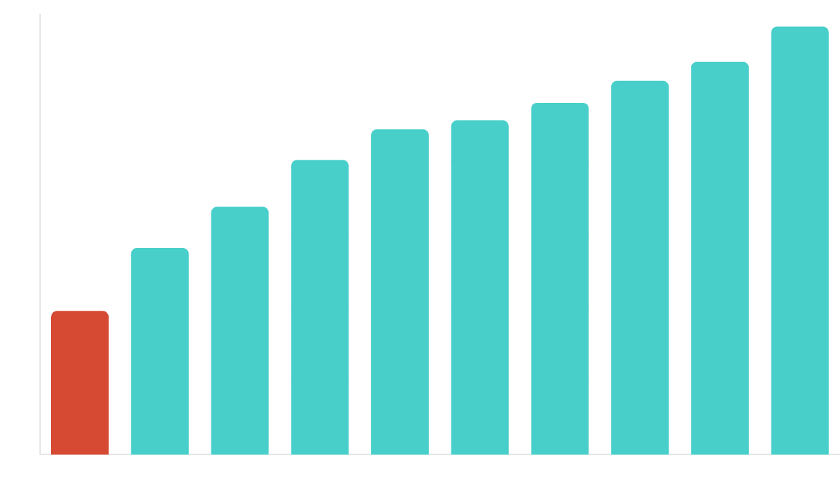
01 — THE GAP
Start with the number
19.3
YEARS OF LIFE LOST IN GOOD HEALTH
Prevention only works if the most deprived can enter, complete, and benefit.
SOURCE: ONS (2026) HEALTHY LIFE EXPECTANCY BY DEPRIVATION DECILE
Notes:
SCRIPT: Start with the gap, not the programme. For children born between 2022 and 2024, the male healthy life expectancy gap was 19.3 years. For women, it was 20.1 years. Note the slope index for life expectancy is only 10.4 and 8.0 years: this is not about dying early, but about living longer in poor health. Prevention only counts if the people facing that need can enter the programme, stay in it, and benefit.

Slide 3

02 — CONCEPTS
Health is lived in bodies,
shaped by systems.
01
02
03
Health
Wellbeing
Sustainability
Physical, mental and social wellbeing—not merely the absence of disease.
Both subjective experience and objective capability: what people feel, do and are able to become.
Meeting present needs without compromising the ability of future generations to meet theirs.
Whitehead’s test: a difference becomes an inequity when it is avoidable, unfair and therefore correctable.
BMHP6030 — SHAREEN BI, 2318894
03
Notes:
SCRIPT: Health is lived in bodies but shaped by systems. The WHO 1948 definition reminds us that health is wellbeing, not just the absence of disease. Sustainable development adds a temporal test: meeting present needs without compromising the future. We judge these through Whitehead’s test: a difference becomes an inequity when it is avoidable, unfair, and therefore correctable. A programme reaching only the already-advantaged fails the model that justified it.

Slide 4

03 — GLOBAL GOALS
SDG 3 asks how healthy.
SDG 10 asks who benefits.
The global goals are complementary, not interchangeable. Health improvement is not equity improvement unless the distribution of benefit is visible.
17%
197
4.6bn
52.6%
of SDG targets on track in the
maternal deaths per 100,000 live
people lacking essential health
labour’s share of global income
2026 stocktake
births
services
Shared test: not only “did the average improve?” but “who was left behind?”
UNITED NATIONS (2026) SDG REPORT
04
Notes:
SCRIPT: At the global level, SDG 3 and SDG 10 ask different questions. SDG 3 asks how healthy populations are; SDG 10 asks who benefits. The 2026 stocktake is sobering: only 17% of targets are on track. Maternal mortality is nearly 200 per 100,000, and 4.6 billion people lack essential services. The goals meet in distribution—progress on SDG 3 cannot stand in for SDG 10. We must watch who is left behind.

Slide 5

04 — POLICY
Four frameworks.
One unresolved question.
What England has
What remains unresolved
Health in All Policies — health considered across sectors.
Voluntary adoption is vulnerable to competing priorities.
Plans cite inequalities frameworks but rarely test outcomes.
NHS Long Term Plan — prevention inside the service.
Health and Social Care Act — public health in local government.
Capacity and funding are not aligned with ambition.
A duty to consider health is not a duty to close the gradient.
10 Year Health Plan — sickness to prevention.
Policy language has shifted faster than delivery conditions.
BMHP6030 — SHAREEN BI, 2318894
05
Notes:
SCRIPT: England has the frameworks. Health in All Policies asks every sector to consider health. The NHS Long Term Plan and the new 10 Year Health Plan move the focus from sickness to prevention. So why does the gap remain? Because HiAP is voluntary, plans often lack outcome measures, and public health funding is 26% lower in real terms than a decade ago. Policy language has moved faster than delivery conditions.

Slide 6

05 — THE PROGRAMME
How the DPP is designed to work
A nine-month group-based behaviour-change programme for adults with non-diabetic hyperglycaemia, delivered nationally since 2016.
01
02
03
04
05
Identify
Refer
Educate
Support
Prevent
Blood test in general practice identifies risk.
Referral creates the cue to action.
Structured learning makes risk legible.
Goals, group contact and behaviour change.
Slower progression to type 2 diabetes.
The Health Belief Model treats barriers as beliefs. Many barriers are material: cost, shift work, childcare, transport and food environment.
NHS ENGLAND — DIABETES PREVENTION PROGRAMME
06
Notes:
SCRIPT: Here is the programme itself. The NHS Diabetes Prevention Programme is a nine-month behaviour-change course for adults at high risk. It follows five stages: identify, refer, educate, support, and prevent. It is built on the Health Belief Model, which assumes people can act on what they know. But its weakness is material: the barriers that predict non-attendance are cost, shift work, childcare, and transport—things a belief model cannot fix.

Slide 7

06 — EVIDENCE
The programme works.
The pathway leaks.
0.80
Of 4.61 million people registered with NDH
Registered
100%
Adjusted hazard ratio for progression to type 2 diabetes after referral
(95% CI 0.73–0.87)
Offered a course
59.4%
An observational association—not proof that referral alone caused the reduction. The equity question is who gets far enough to benefit.
Offered and not recorded as declining
42.6%
773,350 people declined: 28.2% of offers, not of everyone registered. Uptake and completion estimates come from a different evaluation cohort.
Count offer, attendance, dose and outcome separately.
NHS ENGLAND (2026) NATIONAL DIABETES AUDIT; BOWER ET AL. (2025) DIPLOMA
07
Notes:
SCRIPT: Does it work? Yes. The DIPLOMA evaluation found a hazard ratio of 0.80—a significant reduction in the risk of progressing to type 2 diabetes. Crucially, the effect is about the same for deprived and affluent attendees. But look at the pathway: of 4.6 million people at risk, only 60% were offered a course, and a quarter declined. The programme works, but the pathway leaks before the benefit can be realised.

Slide 8

07 — EQUITY OF ACCESS
An offer is not access.
Access is not benefit.
Each stage filters the population. The people facing the greatest risk can be least able to convert an offer into attendance, dose and completion.
01
02
03
04
Offer
Attend
Complete
Benefit
What routine data currently make visible.
Where cost, work, childcare and transport matter.
Where unequal dose can widen unequal return.
The outcome we should publish and test.
Most deprived areas supplied 14% of people reaching eight sessions, against about 20% of the eligible population.
CHATZI ET AL. (2023); NHS ENGLAND AUDIT LIMITATIONS
08
Notes:
TSCRIPT: An offer is not access, and access is not benefit. Each stage filters the population, and each filter removes a share of those at greatest risk. The most deprived areas supplied only 14% of people reaching eight sessions, against 20% of the eligible population. Ethnic-minority representation falls from 35% at offer to 19% by the eleventh session. We record an offer, but we don’t routinely publish who actually benefited.

Slide 9

08 — BIRMINGHAM
Birmingham makes
the gradient local.
42.8%
9.34×
of small areas in the most deprived decile
higher odds for Asian attendees in the most deprived areas
Area-level deprivation is not the same as individual experience—but it tells us where universal provision must be made proportionately easier to use.
Among 91,711 NHS Health Check attendees, the diabetes signal is sharply patterned by ethnicity and deprivation.
The local audit can count an offer. It cannot yet tell us who attended, who completed or who benefited.
BIRMINGHAM CITY OBSERVATORY (2025); LOCAL NHS HEALTH CHECK ANALYSIS
09
Notes:
SCRIPT: Birmingham makes that gradient local. Over 40% of the city’s small areas are in the most deprived decile in England. Among Health Check attendees, Asian residents in those areas face nearly ten times the odds of having a diabetes signal. Universal provision is not enough; it must be made proportionately easier to use in these neighbourhoods. We cannot yet tell from local data whether we are closing that specific gap.

Slide 10

09 — RECOMMENDATIONS
Four recommendations,
each appraised.
01
Publish the pathway dashboard
IMMEDIATE
AUDITABILITY
Offer, decline, attendance, dose and completion by deprivation and PLUS group.
02
Make support proportionate
HIGHEST
EQUITY POTENTIAL
Flexible appointments, community venues, language and digital alternatives.
03
Stop counting offers as outcomes
LOW-COST
CLARITY
Align the DPP dashboard with Core20PLUS5 and measure benefit, not contact.
04
Evaluate upstream action distributionally
LONG-TERM
CONDITION
Pre-specify equity measures for the food, work, housing and transport environment.
The central move: from “how many were offered?” to “who completed, and who benefited?”
BMHP6030 — SHAREEN BI, 2318894
10
Notes:
SCRIPT: Four recommendations follow. First, publish an equity-disaggregated dashboard so we can see the pathway attrition. Second, make support proportionate to need—flexible times, community venues, and language support. Third, stop counting offers as outcomes; align the DPP with Core20PLUS5. And fourth, evaluate cross-sector action distributionally. The central move is from measuring how many were offered support to who completed it and benefited.

Slide 11

10 — CONCLUSION
Not yet.
?
Prevention lowers individual risk. It does not close the gradient unless the people facing the greatest need can enter, complete and benefit—and unless we publish who did.
CAN PREVENTION CLOSE THE GAP?
11
Notes:
SCRIPT: Can prevention close the gap? Not yet. Prevention lowers individual risk, and the DPP does that effectively. But it does not close the gradient unless the people facing the greatest need can enter, stay, and benefit. Until we publish who benefited, and until departments beyond health are held to account for their impact on these lives, that twenty-year gap will remain the true measure of what policy has yet to achieve.

Slide 12

11 — SOURCES
References
Alderwick et al. (2024) BMJ Open.
Finch et al. (2025) The Health Foundation.
Rosenstock (1974) Health Belief Model.
Au-Yeung et al. (2024) Frontiers in Public Health.
Great Britain (2012) Health and Social Care Act.
United Nations (2015) 2030 Agenda.
Birmingham City Observatory (2025) Indices of deprivation.
Marmot et al. (2020) Marmot Review.
United Nations (2026) SDG Report.
Bower et al. (2025) DIPLOMA evaluation. NIHR.
NHS England (2019) NHS Long Term Plan.
Whitehead (1992) Equity and health.
Bronfenbrenner (1979) The ecology of human development.
NHS England (2026) National Diabetes Audit.
WHO (1948) Constitution.
Chatzi et al. (2023) Journal of Epidemiology and Community Health.
NHS England (n.d.) Core20PLUS5.
WHO (2017) Shanghai Declaration.
Office for National Statistics (2026) Healthy life expectancy by deprivation.
World Commission on Environment and Development (1987) Our common future.
DHSC (2025) Fit for the Future.
Engel (1977) Science.
Ravindrarajah et al. (2025) Diabetic Medicine.
BMHP6030 — SHAREEN BI, 2318894
12
Notes:
SCRIPT: These findings are grounded in the latest evidence from the ONS, the Health Foundation, and clinical evaluations of the DPP. The full Harvard reference list is included in the written report, and I have taken responsibility for all judgements and conclusions presented. Thank you.

