Slide 1


Support & Feedback:
Log-in to MS-Teams
  Open MS-Teams
  Any Questions, either:
  Msg tutor with Qs
  Or Ask out loud
  Or 1-2-1 call via Teams

Slide 2

PEST analysis
Leadership, Management and Ethics (ACCA7044)

Slide 3

Introduction to Change
In order to sustain and survive, most Businesses, especially in the Tech & Design sectors, need to adapt/change/repond to changes in the business environment i.e. changes in customer needs/wants, changes in competitor’s products & activities and government regulations.
To achieve this, Leaders and Managers need to know how to manage and respond to change.
For change to be successful.
To implement changes and for new projects to be successful, Leaders & Managers need to carefully consider the human & business aspects of change, to carefully consider how it affects people/employees and to manage resources effectively & efficiently for new projects to be successful.

Slide 4
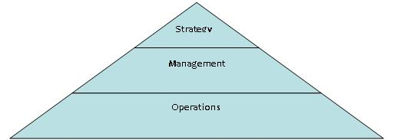
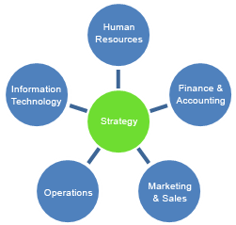
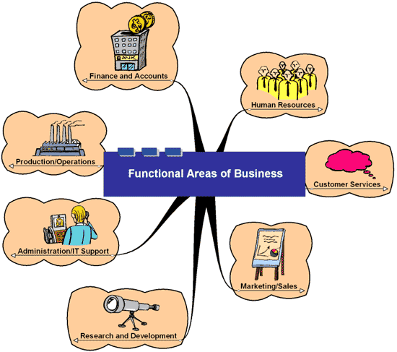
Holistic View of Organisations
Environment:
+ Customers
+ Suppliers
+ Competitors
Depts
Departments
+Government & Legal regulations

Slide 5
Business Strategy & Change
Organisations need to produce & keep up-to-date with the needs wants and expectations of customers/people/society to survive.
For Organisation/Business success, Strategic thinking must be aligned to the changing world, within and around us.
Leaders & Managers scan the environment to keep up to date with industry and society changes. This is called ‘Environmental scanning’.
Intuition and trusting one’s own inner guidance is also important as we will learn as the module progresses.
Scanning, Observing & acquiring feedback (from employees & customers) help to discover what changes are needed.
It is important for Senior Management and employees to keep up to date with industry and society changes.
Management Tools such as a PEST Analysis are useful for this purpose.
New Objectives and plans/strategies can then be created from this analysis.

Slide 6
PEST Analysis
A ‘PEST Analysis’ is a tool/method/technique for understanding the external ‘environment’ in which a Studio/Organisation operates and is used to assess the ‘changing nature’ of the environment.
The acronym stands for Political, Economic, Social and Technological issues.
A PEST analysis today, also includes Environmental and Ethical considerations, and the updated acronym often appears as: PESTEL / PEEEST / STEEPLED.
Notes:
Bg. PEST Extended / Updated
Some analysts have added Legal and rearranged the acronym to SLEPT.
The PEST model has been extended to include Environmental & Ethical considerations, and has expanded PEST and SLEPT to PESTLE / PEEEST / STEEPLED which is more popular in the UK.
The simple acronym ‘PEST’ is still widely used with Legal, Ethical & Environmental factors included under the Political category.

Slide 7
PEST: Political & Economic considerations
When completing a PEST analysis. Here are some examples of the questions we can ask and considerations we can document:
P - Political & Legal: What are the key political and legal factors that may influence an Organisation?
  E.g. The Data Protection Act 2018 (Companies need to keep personal data private and confidential), Employment law (e.g. Time off & Holidays, Minimum wage), Health & Safety at Work Act, Equal Opportunities, Sale of Goods Act, IP [Patent product design, Copyright software/text and/or Trademark design work].
E - Economic & Competition: Can you identify any Competitors?
What are some economic factors that may influence the Organisation, such as: what is the availability and cost of resources required to create new and existing products. What are the required Hardware and software resources and the availability of required skilled personnel.
Notes:
Complicated charts and diagrams are not required but can be created and included if you feel it necessary.

Slide 8
PEST: Social & Technology considerations
S - Social & Customers: What are some of the social/customer or community factors that may influence the Studio Organisation?
  E.g. Potential market size i.e. amount of potential customers to reach (look at the demographic statistics of the country/countries where the products will be sold), Customers e.g. What is the likely income / disposable income of the target market. Look at Trend stats e.g. such as sales of similar/existing games/titles/films/products and reviews of existing or similar competitor titles/products.
T - Technology: What are some of the tech factors that may influence the Studio Organisation?
  E.g. What technology does the Organisation need to create the games/titles/products, to promote, sell and distribute it. Also, what new technology could allow the Organisation to further enhance and differentiate itself / it’s games/animation/titles.

Slide 9
Activity: PEST Analysis
Document and save your answer to the following question:
Research and discover a PEST analysis for your favourite Studio Company? Or
1. Generate a PEST analysis using an AI tool of your choice for
your favourite Studio Company?
Read through the PEST Analysis and make a note of some key points from each P, E, S, T category.
Share: Different student to share each section P, E, S, T for their chosen
Studio/Company.
The answer to this activity can be included in the appendix of the assignment report.
Notes:
Share your answer. * Or 2/3 students will be selected at random.

Slide 10
Activity: PEST Analysis
Document and save your answer to the following question:
AI: Using an AI tool of your choice and 1/2 additional sources, generate and create a brief bullet-pointed PEST analysis for your Enterprise?
Share: Something of interest from your PEST Analysis.
The answer to this activity can be included in the main body of your assignent report (Task 1 Q.2).
Notes:
Share your answer. * Or 2/3 students will be selected at random.

Slide 11
Questions?
Any questions?

Slide 12
Register & Thanks
Register reminder
Thanks to D.
End.

Slide 13
The end.

Slide 14
Archive slides…

Slide 15
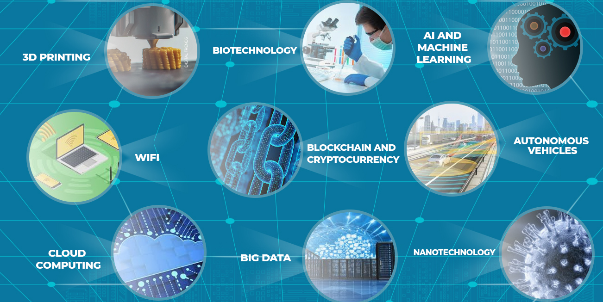
Bg. Example New & Future Technologies

Slide 16
SOAC Blog: Project profiles
We'd like to create some student 'Project profiles’
To showcase the good work of our students
Here: www.UWTSDComputing.blog
Opportunity for you to showcase your good work
It could be module work or the final year project work
If you would like us to create a project profile please let me know: james.Williams@uwtsd.ac.uk
These profiles help to inspire current and future students.
I would particularly like to create some Games & Animation profiles🙂

