Slide 1

Student Name : Anthonia Akpan
Student ID : 2026998
Module : BMSW4004
Lecturer : Besty Jose

Slide 2


REDUCING LONG TERM ABSENTEEISM
Topic

Slide 3

Mid Cheshire Hospitals NHS Foundation Trust is having problems of staff absenteeism, which has affected the quality of service provided to their patients as well as costing the Trust millions of pounds each year.
Absenteeism is defined as inability of a staff to show up at workplace irrespective of the reasons (Yende,2005).
When employees work lesser hours or days than usual in a workplace due to sickness, injury or medical issues, this is known as absenteeism ( Harter,2001).
This presentation discusses on how to help Mid Cheshire Hospital in remedying the problem of long-term absenteeism amongst staff, thereby improving the quality of care providing to patients and serving money for the Trust.
INTRODUCTION

Slide 4

The Scope
According to Vulpen (2022),Absenteeism in the workplace is a daily affair costing the US economy $84 billion yearly.
Absenteeism is a serious predicament faced by institution worldwide.
As predicted by the Bureau of Labour Statistics, yearly 2.8 million days of work are missed due to the problem of absenteeism.(Kokaculah, Kelly, Mitchell, and Ruggien, 2016).
21 billion pounds lost yearly by UK employers due to staff absenteeism.(Johnson, 2020).
Absenteeism affects, the patients, the staff, the management.

Slide 5
The Impact
On the patients – poor quality of service
Impacts negatively on staff psyche (Harter, 2001).
Dismissal from work (Collier,2018).
Management- financial loss , bad reputation

Slide 6
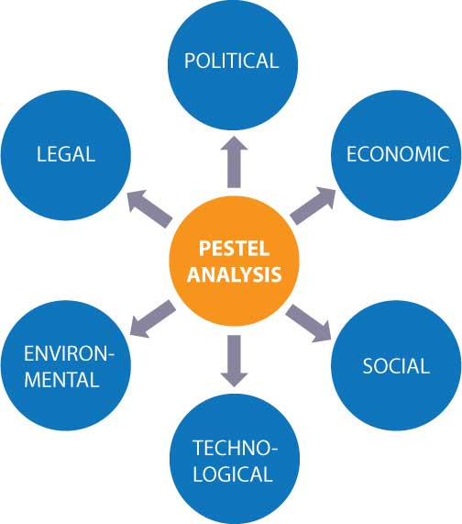
Pestel Analysis
Pestel analysis is a model used by marketers to assess and observe the macro-environmental elements that influences an organization.
It is used in determining the hazards and faults to be used in a Swot analysis(Ay,2017).
The acronym Pestel was first used in Professor Aguilar's 1967 book.
Pestel is an acronym which means Political, Economic, Social, Technological, Environmental and Legal.(Hardy,2022).

Slide 7


Political
Economic
Social
Political : Brexit , tax, Corruption
Economy :Exchange rate, inflation, low income
Social :Relationship, attitude, cultural

Slide 8
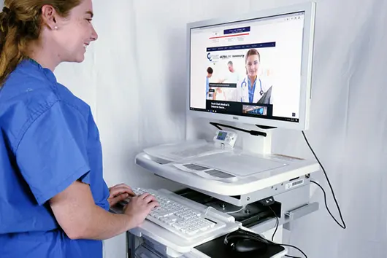

Technological
Environment
Legal
Technological : Equipment
Environment :Climate change, parking sites,
Legal : Discrimination, law, unemployment.

Slide 9
Fishbone or Ishikawa diagram
Fishbone diagram, otherwise known as Ishikawa diagram is an invention tool that helps to discover faults or differences within a process.
It helps to realize the main courses that possibly adds to an effect (Trout,2022).
This concept was popularized by a Japanese Professor of Engineering, Kaoru Ishikawa.

Slide 10
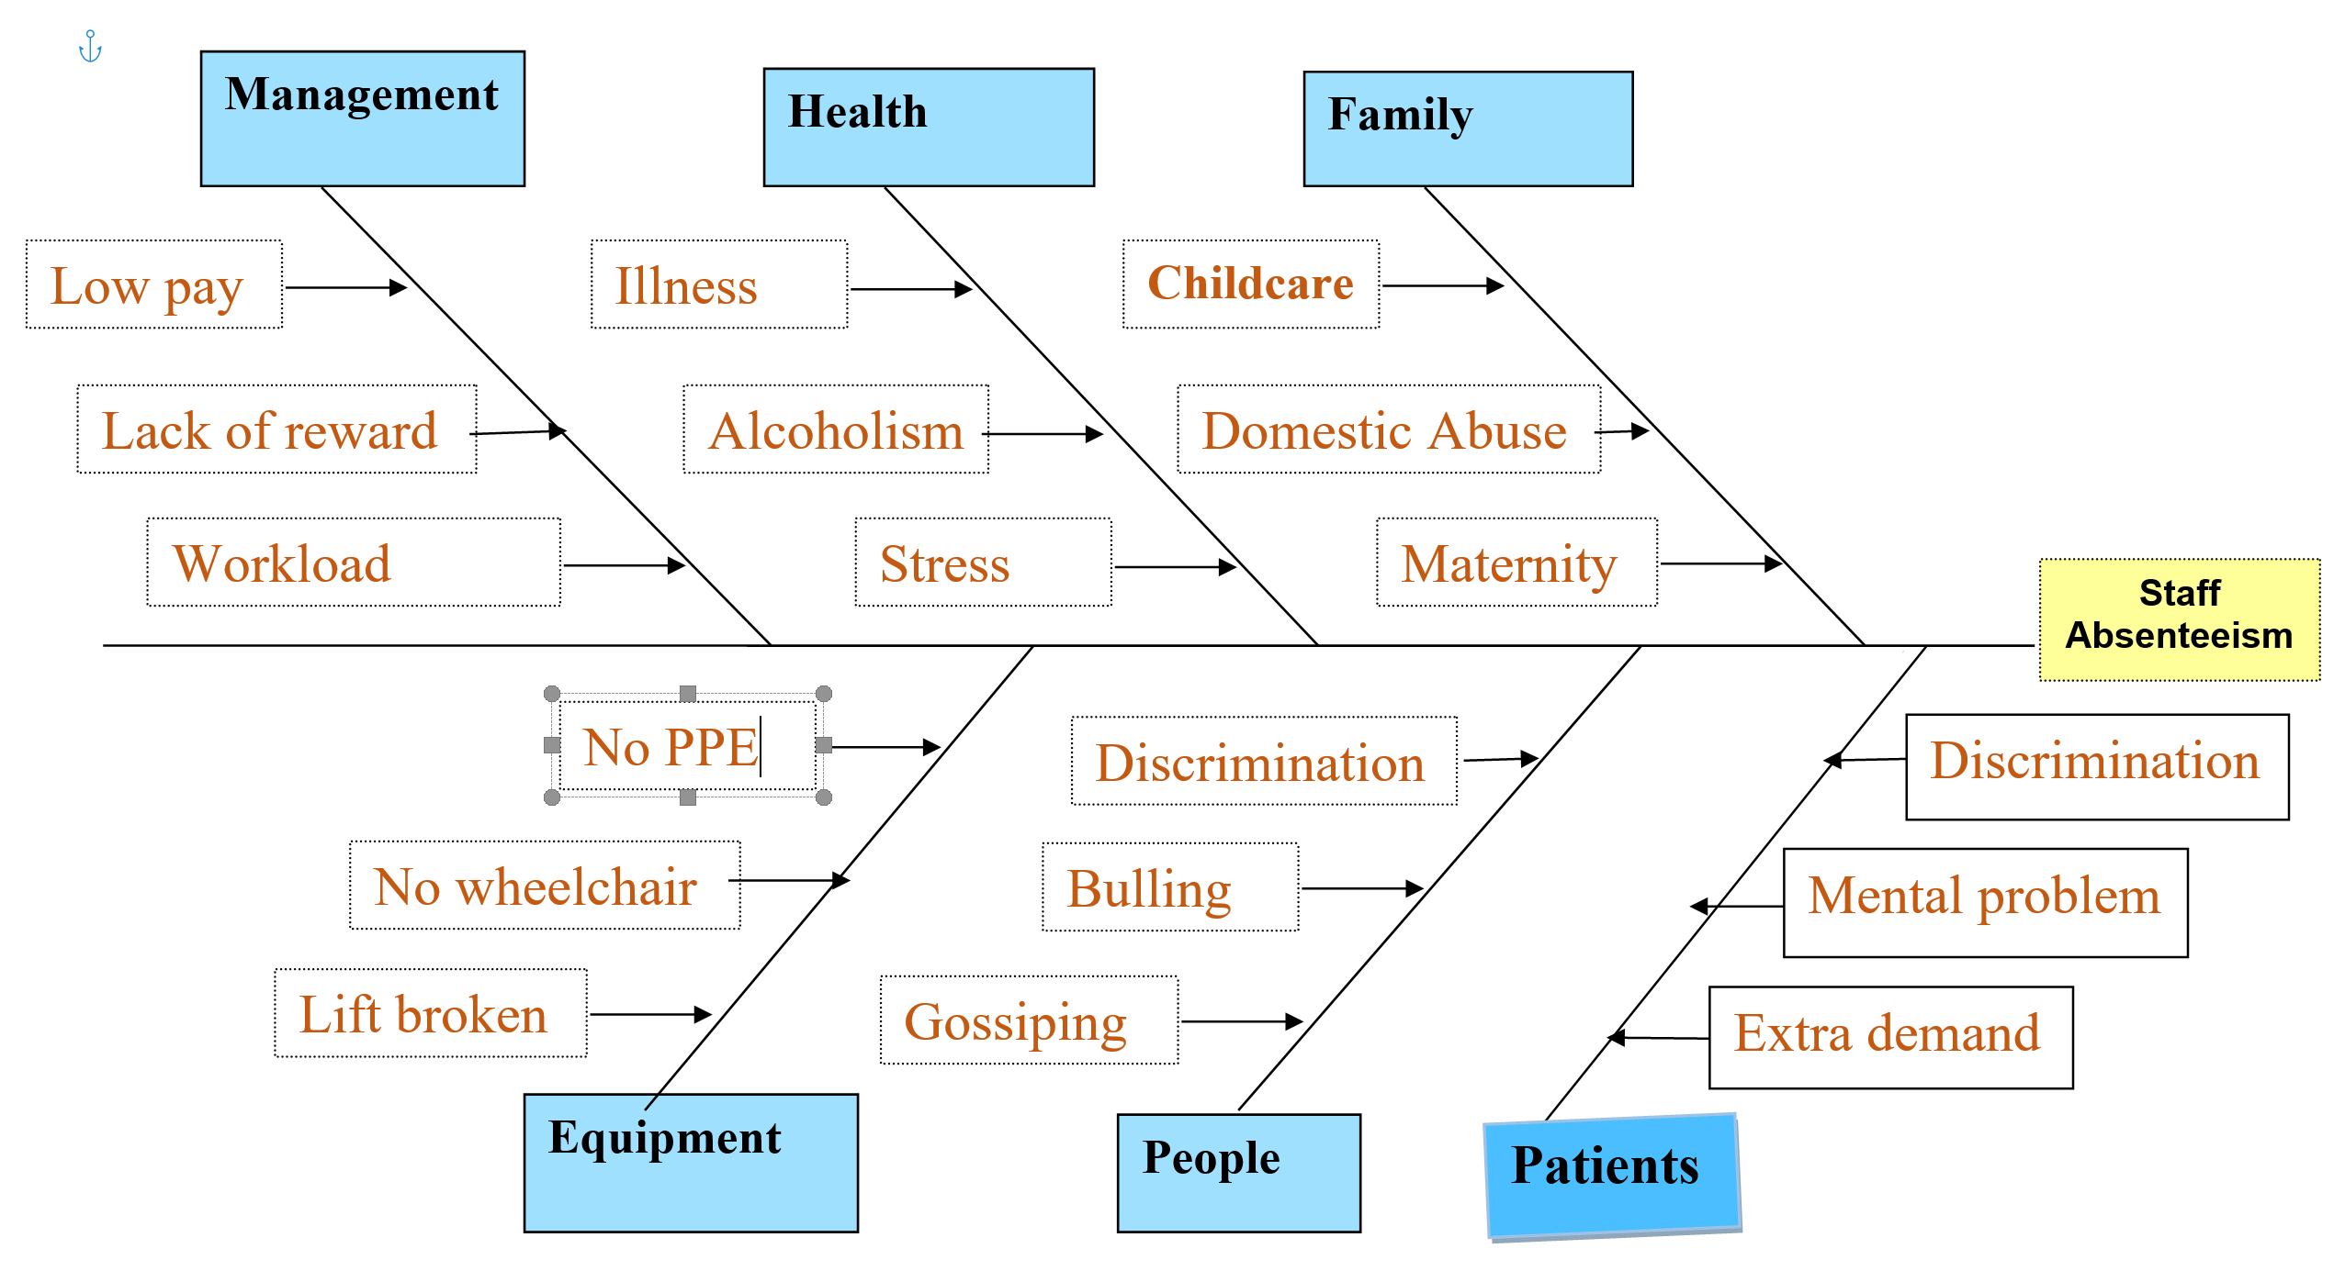
Fishbone diagram

Slide 11

Solution
Rewards and recognition program for good attendance should be offered by employers.(Collier, 2018).
Emphasize on attendance policy in a meeting continuously. Mention the negative impact on productivity.(Mason,(2015).
Reduce workplace stress. Factors in workplace that cause stress should be rectified.(Collier,(2018).
Create and enforce absenteeism policies especially during employment.(Stets,2019).

Slide 12
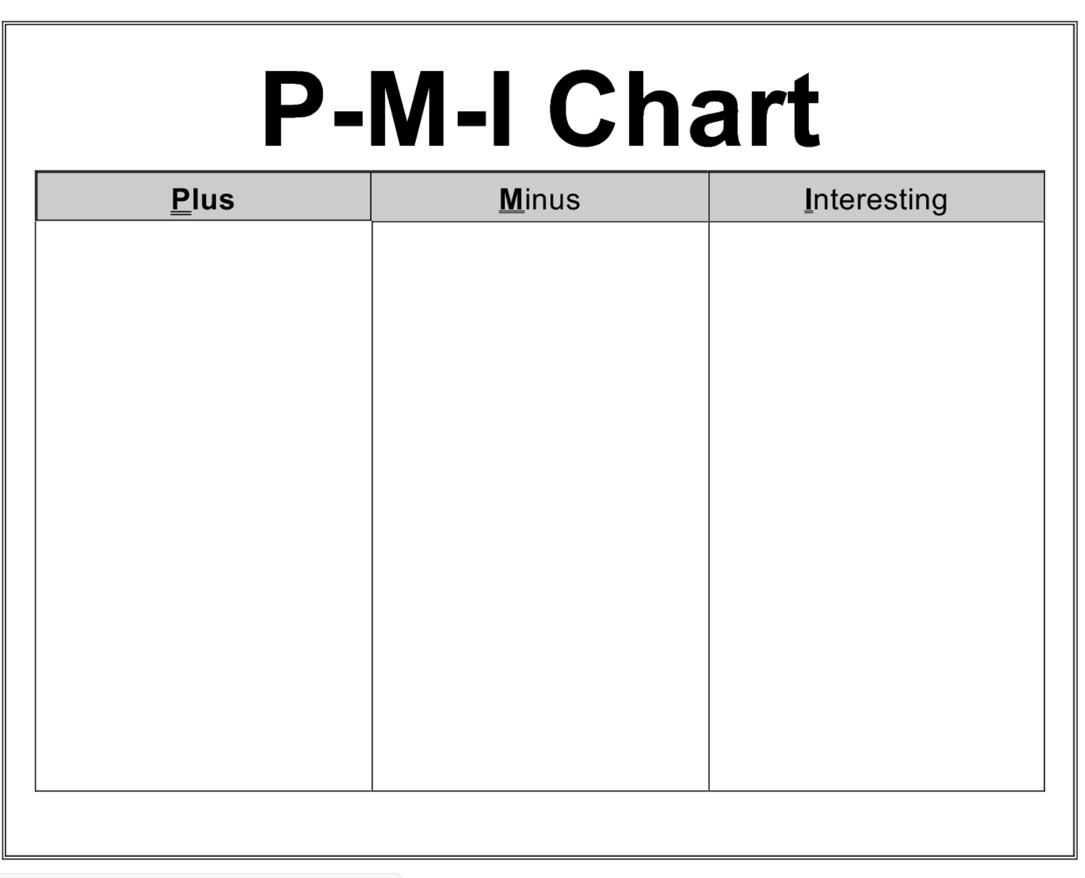
PMI
After weighing the outcome of PMI, the positive outcome is encouraging.
Staff training (4 )
High cost (8)
Less skilled staff(-3)
Total=15
Reducing work stress (10)
Increase cohesiveness among team (8)
Recruiting more staff (10)
Total=28
Staff work with ease (4)
More confidence and trust (6)
High quality service(10)
Total=20

Slide 13
PMI
The outcome of staff absenteeism is positive and can be applied.
Good working environment (10)
Shift Pattern (10)
New Staff (6)
Total= 26
Racism (3)
High Cost (8)
Training (9)
Total= -2
Reduce workload(9)
Demoralised Staff ( - 4)
Staff and Patients contented (10)
Total=15

Slide 14
PMI With the outcome ,this can be applied to reduce absenteeism at workplace.
Reward for hard work (10)
Call for regular meeting(6)
More customers (10)
Total =26
Lossing funds (3)
Time consuming (6)
Need more resources (-2 )
Total= 11
Happy employees (9)
More knowledge
(8)
Good quality care (10)
Total= 27

Slide 15
PMI
The Plus and Interesting is good to applied at workplace.
Conducive environment(10)
Equipment (9)
Total= 19
Unconducive environment (2)
Cost (7)
Total= -9
Staff are safe (9)
Less stress (9)
Total=18

Slide 16
Conclusion
Completely erasing absenteeism from workplace as employees will always have reason for unscheduled absences.
Therefore, to improve employee's attendance organizations should create healthy working environments for workers and state clear attendance roles.

Slide 17
References
Åkerlund, M., Jacobsson, C. and Tilin, F.( 2020). The Legacy of Susan Wheelan. Small Group Research, 52(1), pp.103-109.
Collier, E.( 2018). Reducing Absenteeism in the Workplace. [online] Linkedin.com. Available at: <https://www.linkedin.com/pulse/reducing-absenteeism-workplace-kamran-hussain-> (Accessed 9 March 2022).
Corporate Finance Institute.( 2017). PESTEL Analysis. [online] Available at: <https://corporatefinanceinstitute.com/resources/knowledge/strategy/pestel-analysis/> (Accessed 9 March 2022).
Harter, T.W., 2001. Minimizing absenteeism in the workplace: Strategies for nurse managers. Nursing Economics, 19(2), p.53.
Johnson, E.,( 2020). Reducing absenteeism in the workplace. [online] CPD Online College. Available at: <http://cpdonline.co.uk/knowledge> (Accessed 4 March 2022).
Kokaculah , M., Kelley, A., Mitchell, K. and Ruggieri, M.( 2016). Absenteeism Problems And Costs: Causes, Effects And Cures. International Business & Economics Research Journal (IBER), 15(3), pp.89-96.
Stets, R.( 2019). Absenteeism: definition, causes, solutions. (online) Available at: <https://www.legit.ng/1226439-absenteeism-definition-solutions.html> (Accessed 9 March 2022).
Yende, P.(2005). Utilising employee assistance programmes to reduce absenteeism in the workplace. Johannesburg, University of Johannesburg.

