Slide 1
BSc Professional Investigation
16.02.22
Workbook 2 Overview

Slide 2
Workbook 2
5 Tasks:
Information and intelligence gathering
Safeguarding and risk assessment
Interview and custody processes
Investigation documentation processes
Personal study/learning plan
Submission
23:59hrs
May 10th, 2022

Slide 3
Understanding the Assignment
Read the assignment brief
Underline words that guide you on the subject/topic information you need ( i.e. content related)
Underline words that are process related known as Directive Words (i.e. what to do with the subject - instructions)
Underline limiting words (i.e. word count, specific instruction)
Content words – are specific to the module
Process/instruction words – may be used in any module

Slide 4
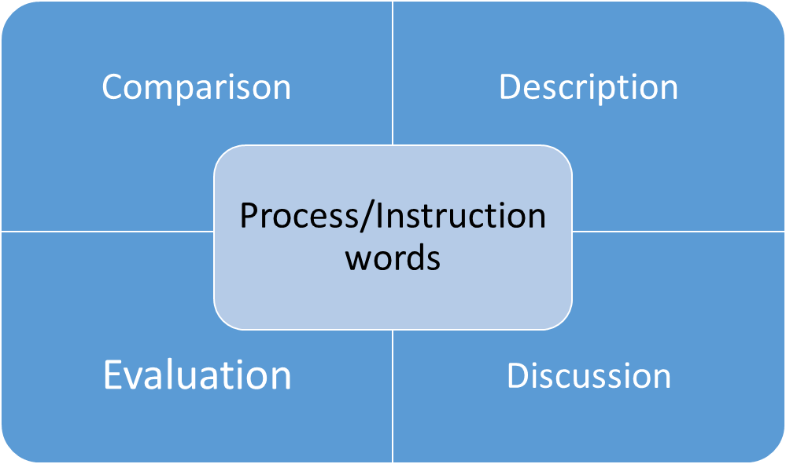
Directive Words
Directive words –
tell you what to do

Slide 5
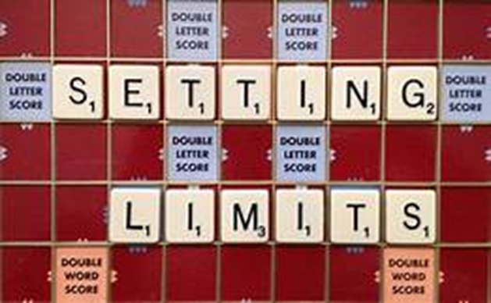
Limiting words
Words which provide boundaries or constrains for your assignment
e.g. word count or subject specific

Slide 6
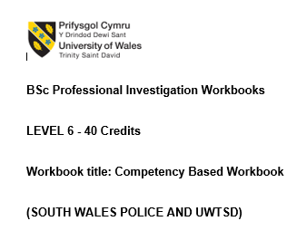

Workbook 2 – Identifying key words
Directive Words
Topic
Limiting words

Slide 7
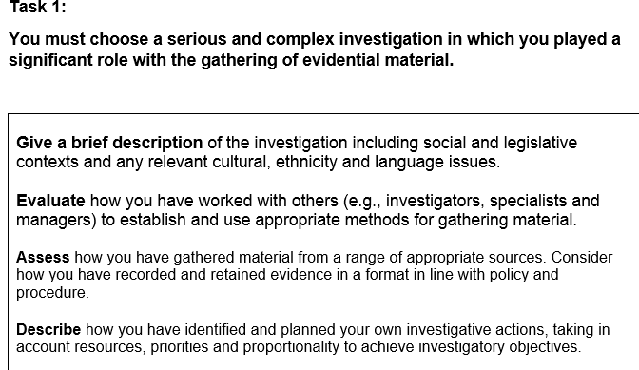
Workbook 2 – Task 1

Slide 8
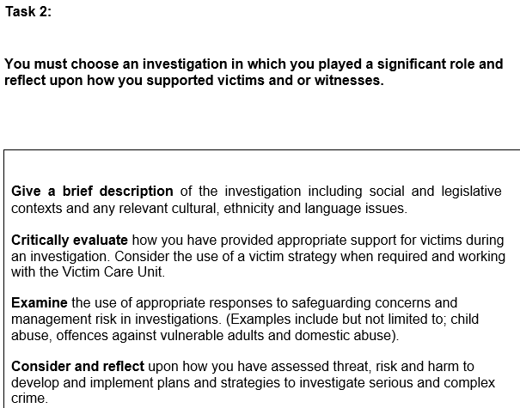
Workbook 2 – Task 2

Slide 9

Extra – tips - Paragraphs
Building blocks of the essay
Each paragraph should contain:
  A topic sentence ( or idea) that states your point
  An explanation of the point you are making
  Evidence – support your point with evidence from reading/example

Slide 10

Extra tips - Signposting
Paragraphs will require signposts/linking – these are words you use to join sentences
Will make your essay flow
Academic language

Slide 11
Library Resources
Use the library – staff welcome enquiries
College of policing library

Slide 12
Draft submissions
Draft submissions are welcome
One draft submission per task
Cut off date will be provided nearer the submission date in May
Turnitin open
Word document or workbook template can be submitted.

Slide 13

Any questions?

