Slide 1
Instructor Materials lecture 2: The Cybersecurity Sorcery Cube
Cyber Security Essentials
Lecture 7
Cloud Security
Lecturer: Assoc. Professor Carlene Campbell
Email: carlene.campbell@uwtsd.ac.uk
Website: https://www.knowledgewithprofit.com

Slide 2
Virtualization and Cloud Computing
Cloud Computing
Cloud computing classifications are based on how the service models are deployed.
Private Cloud:
  Also called an internal, corporate, or enterprise cloud, a private cloud is hosted on a private platform.
  A private cloud offers an organization more control over its data, but it may be more expensive than other cloud services due to infrastructure, maintenance, and administration costs.
Public Cloud:
  A public cloud is hosted by a service provider at an offsite facility.
  Users pay a monthly or yearly usage fee to access the cloud. This option costs the organization less for infrastructure, maintenance, and administration — however, the organization has less control over its data.
Notes:
17: Cloud Security
17.1: Virtualization and Cloud Computing
17.1.5: Cloud Computing

Slide 3
Virtualization and Cloud Computing
Cloud Computing (Cont.)
Hybrid Cloud:
  A hybrid cloud combines the private and public cloud by offering control of organizational data, which is still hosted in a public cloud.
Community Cloud:
  A community cloud is a collaborative effort in which more than one organization share and use the same platform.
  This type of cloud is geared toward the needs of an industry such as healthcare or energy.
Notes:
17: Cloud Security
17.1: Virtualization and Cloud Computing
17.1.5: Cloud Computing (Cont.)
17.1.6: Avatar

Slide 4
Virtualization and Cloud Computing
Top Threats to Cloud Computing
Cloud computing is susceptible to many of the same threats that affect physical enterprise networks. However, the cloud environment also introduces unique threats.
For instance, if a threat actor successfully compromises a cloud resource, they could do the following:
  Use the cloud computing resources to target other online entities.
  Host malware on respected cloud providers that will appear harmless or even legitimate.
  Abuse the cloud services to launch DDoS attacks, host pirated contents, send email spam, and conduct phishing campaigns.
Notes:
17: Cloud Security
17.1: Virtualization and Cloud Computing
17.1.7: Top Threats to Cloud Computing

Slide 5
Virtualization and Cloud Computing
Top Threats to Cloud Computing
The following lists some threats associated with cloud computing.
Threat | Description
Data breaches | These occur when protected sensitive data is accessed by an unauthorized entity.
Cloud misconfiguration | This occurs when the cloud computing resource is set up incorrectly, making it vulnerable to attacks.
Poor cloud security architecture strategy | Private cloud security is the responsibility of the organization. However, security for public clouds, hybrid clouds, and community clouds becomes a shared responsibility between the organization and the provider. This can introduce vulnerabilities if the cloud security architecture is not fully understood or correctly implemented.
Compromised account credentials | This occurs when user accounts or access privileges are not properly secured and are hijacked by threat actors. This can lead to a major security threat if the account has high privileges. For example, in public clouds a service account has the highest privilege for accessing and managing cloud assets. A hijacked service account would enable a threat actor to control all cloud resources.
Notes:
17: Cloud Security
17.1: Virtualization and Cloud Computing
17.1.7: Top Threats to Cloud Computing

Slide 6
Virtualization and Cloud Computing
Top Threats to Cloud Computing (Cont.)
The following lists some threats associated with cloud computing.
Threat | Description
Insider threat | This occurs when an employee, contractor, or business partner maliciously or unintentionally compromise the cloud service.
Insecure software user interface (UI) or application programming interface (API) | Cloud computing uses software UIs and APIs for customers to interact with their cloud services. These interfaces are the most exposed points to the internet and therefore, they are targets for threat actors.
Limited cloud usage visibility | This occurs when the cloud client does not have full visibility into the cloud service, making the identification of safe or malicious files more difficult.
Notes:
17: Cloud Security
17.1: Virtualization and Cloud Computing
17.1.7: Top Threats to Cloud Computing (Cont.)
17.1.8: Check Your Understanding - Virtualization and Cloud Computing

Slide 7
The Domains of Cloud Security
Domains of Cloud Security
Domain Title | Description
Cloud Computing Concepts and Architectures | The domain defines cloud computing terminology and details the overall logical and architectural frameworks used in the Security Guidance document.
Governance and Enterprise Risk Management | The domain describes four areas impacted by cloud computing: Governance Enterprise Risk Management Information Risk Management Information Security
Legal Issues, Contracts, and Electronic Discovery | The domain describes legal issues associated with cloud computing including the moving of data to the cloud, contracting with cloud service providers, and handling electronic discovery requests in litigation.
Compliance and Audit Management | The domain describes challenges of delivering, measuring, and communicating compliances when organizations migrate from traditional data centers to the cloud.
Information Governance | The domain describes the need to ensure that the use of data and information complies with organizational policies, standards, and strategy including regulatory, contractual, and business objectives.
Notes:
17: Cloud Security
17.2: The Domains of Cloud Security
17.2.1: Domains of Cloud Security

Slide 8
The Domains of Cloud Security
Domains of Cloud Security (Cont.)
Domain Title | Description
Management Plane and Business Continuity | The domain describes the need to secure the cloud computing management plane (i.e., the protocols and resources used to manage the cloud). It also describes business continuity and disaster recovery procedures to be used by the cloud provider and the cloud client.
Security as a Service | The domain covers the continually evolving security services delivered from the cloud.
Infrastructure Security | The domain describes cloud-specific aspects of infrastructure security and the foundation for operating securely in the cloud.
Virtualization and Containers | The domain describes the need to secure the virtualization technology and virtual assets which are the foundation for cloud computing.
Incident Response | The domain describes the critical aspects of incident response (IR) including the Incident Response Lifecycle and considerations for responders as they work in a cloud environment.
Application Security | The domain provides guidance on how to securely build and deploy applications in cloud computing environments, specifically for PaaS and IaaS.
Notes:
17: Cloud Security
17.2: The Domains of Cloud Security
17.2.1: Domains of Cloud Security (Cont.)

Slide 9
The Domains of Cloud Security
Domains of Cloud Security (Cont.)
Domain Title | Description
Data Security and Encryption | Data Security should be risk-based since it is not appropriate to secure everything equally. The domain describes those controls related to securing the data itself, of which encryption is one of the most important.
Identity, Entitlement, and Access Management (IAM) | The domain describes how cloud identity is different than traditional identity management.
Related Technologies | The domain provides background and recommendations for technologies that rely nearly exclusively on cloud computing to operate and for technologies that do not necessarily rely on cloud but are commonly seen in cloud deployments.
Notes:
17: Cloud Security
17.2: The Domains of Cloud Security
17.2.1: Domains of Cloud Security (Cont.)

Slide 10
Cloud Infrastructure Security
Cloud Security Responsibilities
Cloud computing involves cloud clients and Cloud Service Providers (CSPs). Therefore, cloud security works in a shared responsibility model.
A CSP is responsible for the cloud services to the client, but the client is responsible for the rest of services. The sharing of responsibilities varies according to the type of cloud deployment.
.
Notes:
17: Cloud Security
17.3: Cloud Infrastructure Security
17.3.2: Cloud Security Responsibilities

Slide 11
Cloud Infrastructure Security
Cloud Security Responsibilities (Cont.)
The following table displays the security implementation responsibility between a client and a CSP in different cloud service models.
Security Responsibility | On-premise | IaaS | PaaS | SaaS
Data | Client | Client | Client | Client
Endpoints | Client | Client | Client | Shared
Identity Management | Client | Client | Shared | Shared
Application | Client | Client | Shared | CSP
Network Control | Client | Client | Shared | CSP
Operating System | Client | Client | CSP | CSP
Physical Infrastructure | Client | CSP | CSP | CSP
Notes:
17: Cloud Security
17.3: Cloud Infrastructure Security
17.3.2: Cloud Security Responsibilities (Cont.)

Slide 12
Cloud Application Security
Securing Coding Techniques
When coding applications, developers use several techniques to validate that all security requirements have been met.
Normalization is used to organize data in a database and help maintain data integrity. Normalization converts an input string to its simplest known form to ensure that all strings have unique binary representations and that any malicious input is identified.
Stored Procedure: A stored procedure is a group of precompiled SQL statements stored in a database that execute a task. If you use a stored procedure to accept input parameters from clients using different input data, you will reduce network traffic and get faster results.
Notes:
17: Cloud Security
17.4: Cloud Application Security
17.4.2: Securing Coding Techniques

Slide 13
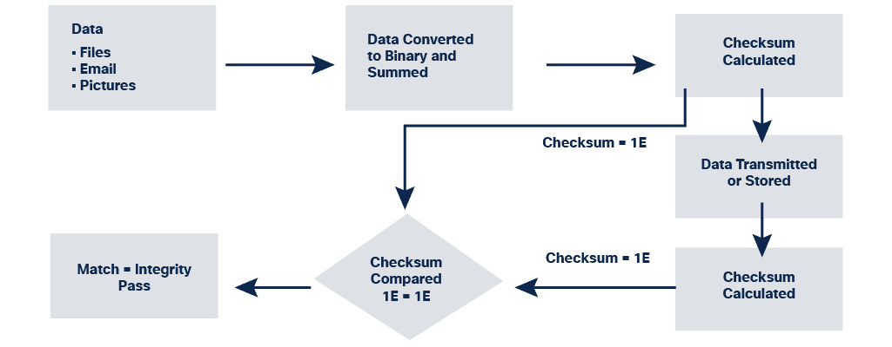
Cloud Application Security
Integrity Checks
Compromised data can threaten the security of your devices and systems.
An integrity check can measure the consistency of data in a file, picture, or record to ensure that it has not been corrupted. The integrity check performs a hash function to take a snapshot of data and then uses this snapshot to ensure data has remained unchanged. A checksum is an example of a hash function.
Notes:
17: Cloud Security
17.4: Cloud Application Security
17.4.5: Integrity Checks

Slide 14
Protecting VMs
Protecting VMs from VM Sprawl Attacks
Creating VM instances in a cloud is a relatively easy process.
  This may lead to a VM Sprawl issue, where an organization has many VM instances that are not properly managed.
  If these running instances are not monitored and maintained, they eventually become outdated and vulnerable to attacks.
A cloud computing client should implement policies to log and audit cloud resources being used.
  VM sprawl not only presents potential risks, but it also consumes cloud services unnecessarily, such as VM instances, storage, and unassigned public IP addresses.
  By logging the use of cloud resources, monitoring the running VMs, and auditing the actual usage, an organization can better manage and protect the VMs they really need.
Notes:
17: Cloud Security
17.6: Protecting VMs
17.6.2: Protecting VMs from VM Sprawl Attacks

Slide 15
Questions?

Slide 16


