Slide 1


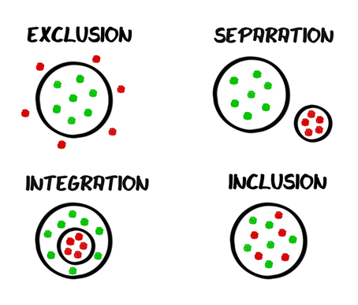
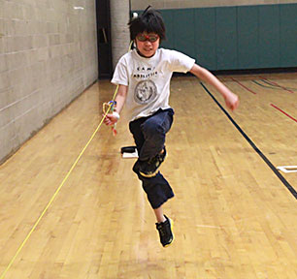
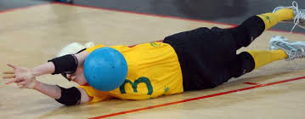
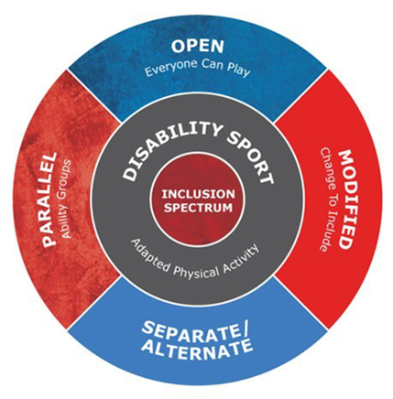

The attitudes of students with visual impairments can also be a major barrier to their successful inclusion in general physical education. Many of them arise solely from lack of knowledge and opportunities and from the attitudes of peers, teachers, and parents.
(Lieberman & Houston- Wilson 1999)
“Under the Equality Act 2010, it is unlawful for any education provider, including a private or independent provider, to discriminate between pupils on grounds of disability, race, sex, gender reassignment, pregnancy and maternity, religion or belief, or sex.” (Csie.org.uk, 2017)
“Teachers with direct or indirect experience with students with low vision or students who are blind appeared to hold a more positive attitude toward inclusion than randomly selected teachers, but only toward students with low vision. The three groups of teachers demonstrated similar attitudes and reactions to the inclusion of students who are blind” (Wall 2002)
Individuals with visual impairments have the same potential for developing motor skills and fitness as their peers, yet lack of opportunities, limited expectations, and lack of training lead to developmental delays and decreased fitness levels (Adelson & Fraiberg, 1976; Shephard, Ward & Lee, 1987; Sherrill, 1998).
S2.6 – “They understand their responsibilities under the SEN Code of Practice for Wales and know how to seek advice from specialists on less common types of special educational needs.” (QTS Standards Wales, 2009)
Visually
impaired
There is also a growing concern and recognition of the necessity of developing specific skills for those with particular needs. As suggested by Lewis and Collis (1997) “the focus needs to shift from the individual performance of the blind child to the forming of relationships between the child and the social environment.”

Slide 2
References
Adelson, E., & Fraiberg, S. (1976). Sensory deficits in motor development in infants from birth. In Z. Jastrzembrska (Ed.), The effects of blindness and other impairments on early development. (pp. 1-15). New York: American Foundation for the Blind.
Csie.org.uk. (2017). Equality Act 2010. [online] Available at: http://www.csie.org.uk/inclusion/equality-act-2010.shtml [Accessed 8 Nov. 2017].
Gov.wales. (2017). Welsh Government|The Qualified Teacher Status Standards Wales 2009 (2009 No.25). [online] Available at: http://gov.wales/legislation/subordinate/nonsi/educationwales/2009/3220099/?lang=en [Accessed 9 Nov. 2017].
Lewis. V., Collis. G.M. (1997) (ed) Blindness and psychological development in young children. Leicester: BPS Books
LIEBERMAN, L.J. and HOUSTON-WILSON, C., 1999. Overcoming the barriers to including students with visual impairments and deaf-blindness in physical education. RE:view, 31(3), pp. 129.
WALL, R., 2002. Teachers' exposure to people with visual impairments and the effect on attitudes toward inclusion. RE:view, 34(3), pp. 111-119.

