Slide 1

Module | Digital Skills and research methods
Module code | LCHS4002_BIRM
Student name/id | Nasreen Akhtar- 2132945 Shazia Malik- 2129745
Lecturer | Munozinesa Zuwirai
(1)

Slide 2

Introduction
The day and age we will live in is where social media /networking is transforming.
We can use this type of technology in different ways.
We can find a wide range of information that we can use in different ways.
Research Question
Which digital tool is most used by students at UWTSD to collaborate?

Slide 3

Figure 1: digital tools used for collaboration at UWTSD
The specific UWTSD tools we use are Moodle, Microsoft teams, one drive, Office 365 (which includes PowerPoint, word, excel etc.)
Notes:
As you can see in figure 1: there is a variety of digital tools which may be used for socialising like twitter or Facebook, find information like google chrome or even to store work like dropbox or to collaborate and communicate like gmail or skype.

Slide 4

Literature (rationale)
Due to the high usage of digital technology, young people are frequently referred to as digital natives (Muñoz et al., 2021).
Technology facilitation enables collaboration to reach a wider audience, Learners are increasingly recognized as being able to convey ideas with the help of technology (Hammond, 2016).
Wastiau et al (2013) found that using digital technologies both at home and at school together leads to higher levels of confidence in one's ability to perform digital tasks (Schmid et al, 2019).

Slide 5

Proposed Method
The proposed method of the research can be quantitative or qualitative, but I choose a quantitative method.
The audience, who will be asked the questions are students.
We will ask questions, in which the responses were strongly agree, agree, neither, disagree and strongly disagree.
We will be asking questions through questionnaires, which were tick boxes.
We included an 'I consent to take part voluntarily' tick box.
We will also be doing informal interviews, which will give us extra information and we will also asking open ended questions.

Slide 6
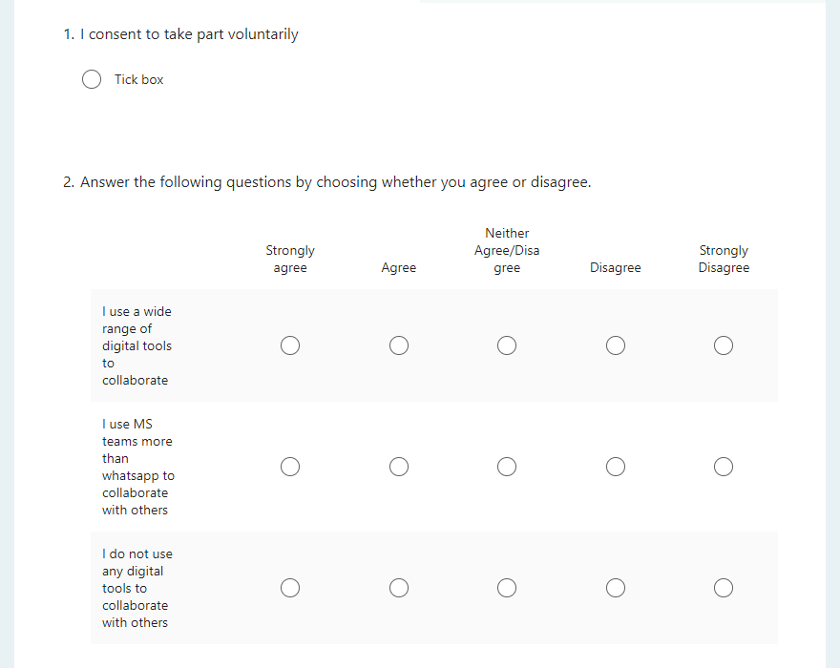
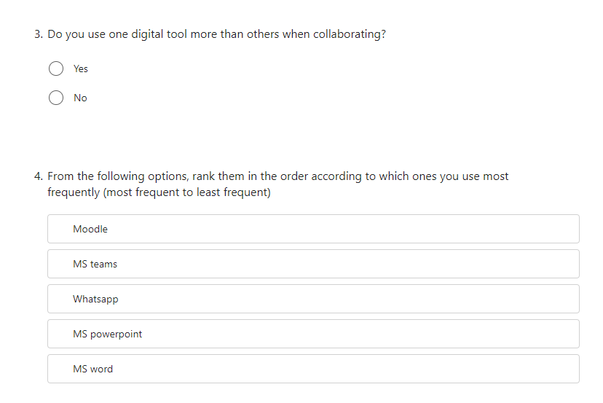
Questionnaire we will use to collect information from students at the University. The students at the university were also the students we used for informal interviews.

Slide 7

Ethical consideration
Ethics are moral concepts that determine how a person, or a group of people will act or behave (Haddad and Geiger, 2018).
Through this research the following principles should be followed:
Informed consent
Confidentiality
Right to withdraw
Anonymity
Ensuring that the research is understood and what is expected from participants.

Slide 8
Research timeline
Week 5- 28th June 2022 | Week 6- 5th July 2022 | Week 7- 12th July 2022 | Week 8- 19th July 2022 | Week 9- 26th July 2022 | Week 10- 2nd August 2022
In this week we will be carrying out our survey. A wide range of students will answer the questionnaire. Also, writing a proposal. | During this week we will be carrying out informal interviews and presenting the presentation. | During this week we will look over our results from the interview and questionnaires. Also, learn about data collection and advanced MS word . | We will be learning about the digital skills, MS Excel and research skill analysis. | During this week we will be researching how to structure a report. | Following the previous week, we will be writing up the report the way we learnt how to.
‌
‌

Slide 9

Hypothesis
From this research, we expect to find out what tool students use most for collaborating.
From previous studies we assume the most used collaborating tool would be the Microsoft tools, as majority students use them to complete their studies.

Slide 10
Refences
(1) Brafton. (2013). Digital tools are not the death of writing [study]. [online] Available at: https://www.brafton.co.uk/news/digital-tools-are-not-the-death-of-writing-study/ [Accessed 22 Jun. 2022].
(7)Anon, (n.d.). 6 Hypothesis Examples in Psychology – StudiousGuy. [online] Available at: https://studiousguy.com/hypothesis-examples-in-psychology/ [Accessed 22 Jun. 2022].
Castaño Muñoz, et al. “Teacher Collaboration and Students’ Digital Competence - Evidence from the SELFIE Tool.” European Journal of Teacher Education, 13 June 2021, pp. 1–22, 10.1080/02619768.2021.1938535.
Hammond, Michael. “Online Collaboration and Cooperation: The Recurring Importance of Evidence, Rationale and Viability.” Education and Information Technologies, vol. 22, no. 3, 22 Feb. 2016, pp. 1005–1024, 10.1007/s10639-016-9469-x.
Geiger Ra. Et al “Nursing Ethical Considerations.” PubMed, 1 Jan. 2020, https://pubmed.ncbi.nlm.nih.gov/30252310/
Paulus, Trena M, et al. Digital Tools for Qualitative Research. Los Angeles, Sage, 2014.
Said Nazarov, et al (2022). USING DIGITAL TOOLS TO ENCOURAGE LEARNER AUTONOMY IN THE CLASSROOM. BARQARORLIK VA YETAKCHI TADQIQOTLAR ONLAYN ILMIY JURNALI, 2(3), pp.314-319.
Schmid, Regina, et al “Does the Use of Educational Technology in Personalized Learning Environments Correlate with Self-Reported Digital Skills and Beliefs of Secondary-School Students?” Computers & Education, vol. 136, July 2019, pp. 75–86, 10.1016/j.compedu.2019.03.006. Accessed 14 Sept. 2019.

