Slide 1
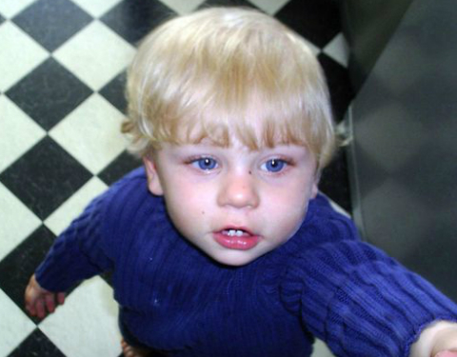
Investigate comprehensively a real-life case of abuse and analyse the victim’s journey, the support they received or not and the outcomes of the case
Matthew Rees, Edward Stannard, Hannah Jones and Courtney Curtis-Collins

Slide 2
Objectives
Brief History of Baby P's Case
Parents Involvement
How Social Services Were Involved
What Did The Police Do
Laws and Policies Surrounding the Case
Notes:
This presentation is going to cover the following:
Ed – This presentation will start of with a brief history of Baby P.
Courtney – The background and involvement of the parents.
Ed – How social services were involved with Baby P and his family.
Hannah – How the police were involved.
Matt – Laws and policies surrounding the case and what has changed.

Slide 3
Baby P
March 2006
Baby Peter is Born
November 2006
Steven Barker Moves In
August 2007
Baby P Found Dead
November 2008
2 Men Found Guilty of Murder
Notes:
Ed – Baby Peter was born to Tracy Connelly on 1st March 2006.
Courtney – Steven Barker moved in with Baby P and his mother in November 2006.
Hannah – Baby P was found dead in August 2007.
Matt – 2 Men found guilty for the death of Baby P in November 2008.

Slide 4

How the police failed Baby P

Slide 5






Timeline of the polices involvement
December 11th
December 22nd
June 1st
July
August 3rd
2006
2007

Slide 6
December 11th
Baby P was admitted to Whittington Hospital in north London
bruising to his forehead, nose, sternum, and right shoulder
Medical staff suspected abuse
His mother and grandmother are arrested
December 22nd
June 1st
July
August 3rd
2006
2007

Slide 7
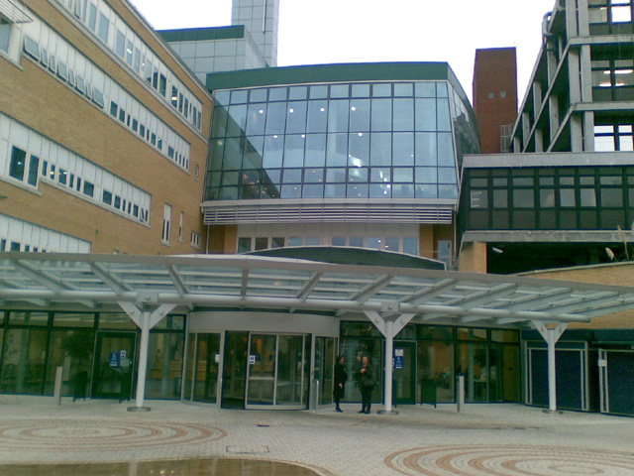
December 22nd
Baby p was placed on a child protection register
The police, social workers and health professionals were tasked to safeguard him
They failed to do follow up checks
December 11th
June 1st
July
August 3rd
2006
2007

Slide 8
June 1st
Unannounced visit from social worker
She discovered more bruising on baby P
Informed the police who deferred to social services
Failed to investigate further
December 11th
December 19th
July
August 3rd
2006
2007

Slide 9
July
Reports of escalating injuries
Potential spinal damage
This information reach the police
No action was taken
December 11th
December 19th
June 1st
August 3rd
2006
2007

Slide 10
August 3rd
Baby p passed away
The police arrested the mother, steven barker and their lodger
Suspicion of murder
Multiple warnings and opportunities had been ignored
December 11th
December 19th
June 1st
July
2006
2007

Slide 11

Systematic failures
Failure to Investigate Abuse
Over-reliance on Social Services
Inadequate Background Checks
Poor Communication Between Agencies

Slide 12
Impact and reform
Policy Changes
Enhanced Training
Cultural shifts
Clear and Consistent Communication Between Agencies

Slide 13


Slide 14
SUMMARY
In Summary, Baby Peter was Let Down by Multiple People and Agencies.
The Parents failed due to withholding information and lying about their involvement of the case.
The Social Services failed to place Baby P in custody of someone safer and failed to understand the seriousness of the injuries found all over his body.
The police failed Baby P by not effectively collaborating with social services and health professionals and missing clear signs of sustained abuse despite multiple interactions with the family.
The Legislation failed by not ensuring sufficient oversight, accountability, and interagency collaboration to prevent neglect despite multiple warnings and interventions.
Notes:
Ed –
Courtney –
Hannah –
Matt –

Slide 15
References
Hannah Jones
Batty, D. (2009) Timeline: Baby P Case. Available at: https://www.theguardian.com/society/2009/may/22/baby-p-timeline. (Accessed: 28th December 2024).
British Association of Social Workers. (2023) The untold story behind Baby P tragedy. Available at: https://basw.co.uk/articles/untold-story-behind-baby-p-tragedy#:~:text=The%20Metropolitan%20Police%20delayed%20an,record%20interviews%20with%20family%20members. (Accessed: 28th December 2024).
Children Act 1989
Jones, R. (2014) The Story of Baby P. Available at: https://books.google.co.uk/books?hl=en&lr=&id=f2c5BAAAQBAJ&oi=fnd&pg=PR7&dq=baby+p+law+enforcement+failure&ots=RX0iaozAI4&sig=xKrj4C8AuesgORZAgyQyLmSA1dk&redir_esc=y#v=onepage&q&f=false. (Accessed: 1st January 2025)
Mcshane, J. (2010). It must never happen again : the lessons learned from the short life and terrible death of Baby P. England: John Blake Pub.

Slide 16
References
Hannah Jones
Metropolitan Police Authority (2008) MPS response to the death of baby p. Available at: http://policeauthority.org/metropolitan/committees/sop/2008/081204/12/index.html. (Accessed: 6th January 2025)
NGTC GROUP Training (2024) Baby P report. Available at: https://www.ngtc.co.uk/baby-p-report/. (Accessed: 06 January 2025).
Parish, E. (2014) 'who should we blame for the death of baby P', British Medical Interview, 349, pp. 1-2. Available at: https://www.jstor.org/stable/26518599. (Accessed: 6th January 2025)
Shoesmith, S. (2016) Learning From Baby P. Available at: https://books.google.co.uk/books?hl=en&lr=&id=TXieDAAAQBAJ&oi=fnd&pg=PA11&dq=baby+p+police+failure&ots=CIBOnb_ygk&sig=WD4HyvYkVGxqFWZ-6nJ5IEclW6c&redir_esc=y#v=onepage&q=baby%20p%20police%20failure&f=false. (Accessed: 1st January 2025)
Virtual College (2019) Serious Case Review: Baby P (2009). Available at: https://www.virtual-college.co.uk/resources/serious-case-review-baby-p-(2009)#:~:text=Findings&text=Lack%20of%20professional%20curiosity%3A%20The,nature%20of%20her%20friendship%20network. (Accessed: 5th January 2025)

