Slide 2
Access Control Lists
ENSA
(ACCA6023)
Applied Computing - WISA

Slide 3
Today’s objectives
Access Control Lists Concepts
Purpose of ACL
Wildcard Mask
Guidelines
Types
Access Control Lists Configurations
Configure Standard ACLs
Modify ACLs
Secure VTY Ports
Configure Extended ACLs

Slide 4
ACL Concepts: Purpose
An ACL is a series of IOS commands that are used to filter packets based on information found in the packet header.
By default, a router does not have any ACLs configured.
When an ACL is applied to an interface, the router performs the additional task of evaluating all network packets as they pass through the interface to determine if the packet can be forwarded.
An ACL uses a sequential list of permit or deny statements, known as access control entries (ACEs).
Note: ACEs are also commonly called ACL statements.
When network traffic passes through an interface configured with an ACL, the router compares the information within the packet against each ACE, in sequential order, to determine if the packet matches one of the ACEs. This process is called packet filtering.

Slide 5
ACL Concepts: Purpose
Several tasks performed by routers require the use of ACLs to identify traffic:
  Limit network traffic to increase network performance
  Provide traffic flow control
  Provide a basic level of security for network access
  Filter traffic based on traffic type
  Screen hosts to permit or deny access to network services
  Provide priority to certain classes of network traffic

Slide 6
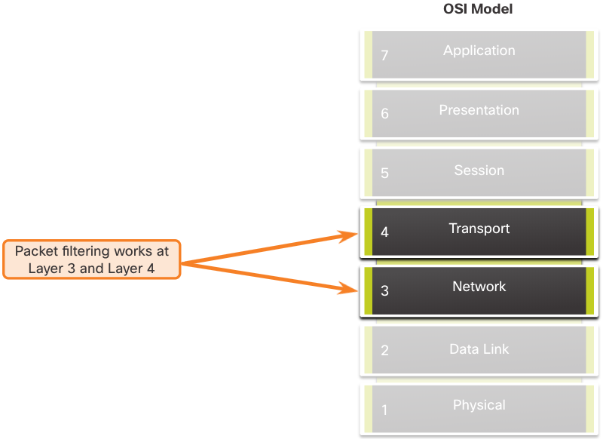
ACL Concepts: Purpose
Packet filtering controls access to a network by analyzing the incoming and/or outgoing packets and forwarding them or discarding them based on given criteria.
Packet filtering can occur at Layer 3 or Layer 4.

Slide 7
ACL Concepts: Purpose
When an ACL is applied to an interface, it follows a specific operating procedure. Here are the operational steps used when traffic has entered a router interface with an inbound standard IPv4 ACL configured:
    The router extracts the source IPv4 address from the packet header.
    The router starts at the top of the ACL and compares the source IPv4 address to each ACE in a sequential order.
    When a match is made, the router carries out the instruction, either permitting or denying the packet, and the remaining ACEs in the ACL, if any, are not analyzed.
    If the source IPv4 address does not match any ACEs in the ACL, the packet is discarded because there is an implicit deny ACE automatically applied to all ACLs.
The last ACE statement of an ACL is always an implicit deny that blocks all traffic. It is hidden and not displayed in the configuration.
  Note: An ACL must have at least one permit statement otherwise all traffic will be denied due to the implicit deny ACE statement.

Slide 8
ACL Concepts: Wildcard Mask
A wildcard mask is similar to a subnet mask in that it uses the ANDing process to identify which bits in an IPv4 address to match.
Unlike a subnet mask, in which binary 1 is equal to a match and binary 0 is not a match, in a wildcard mask, the reverse is true.
An IPv4 ACE uses a 32-bit wildcard mask to determine which bits of the address to examine for a match.
Wildcard masks use the following rules to match binary 1s and 0s:
    Wildcard mask bit 0 - Match the corresponding bit value in the address
    Wildcard mask bit 1 - Ignore the corresponding bit value in the address

Slide 9
ACL Concepts: Wildcard Mask
Wildcard Mask | Last Octet (in Binary) | Meaning (0 - match, 1 - ignore)
0.0.0.0 | 00000000 | Match all octets.
0.0.0.63 | 00111111 | Match the first three octets Match the two left most bits of the last octet Ignore the last 6 bits
0.0.0.15 | 00001111 | Match the first three octets Match the four left most bits of the last octet Ignore the last 4 bits of the last octet
0.0.0.248 | 11111100 | Match the first three octets Ignore the six left most bits of the last octet Match the last two bits
0.0.0.255 | 11111111 | Match the first three octet Ignore the last octet
Wildcard to Match a Host:
Assume ACL 10 needs an ACE that only permits the host with IPv4 address 192.168.1.1. Recall that “0” equals a match and “1” equals ignore. To match a specific host IPv4 address, a wildcard mask consisting of all zeroes (i.e., 0.0.0.0) is required.
access-list 10 permit 192.168.1.1 0.0.0.0
Wildcard Mask to Match an IPv4 Subnet
access-list 10 permit 192.168.1.0 0.0.0.255
Wildcard Mask to Match an IPv4 Address Range
access-list 10 permit 192.168.16.0 0.0.15.255

Slide 10
ACL Concepts: Wildcard Mask
Calculating wildcard masks can be challenging. One shortcut method is to subtract the subnet mask from 255.255.255.255. Some examples:
Assume you wanted an ACE in ACL 10 to permit access to all users in the 192.168.3.0/24 network.
  To calculate the wildcard mask, subtract the subnet mask (255.255.255.0) from 255.255.255.255. This produces the wildcard mask 0.0.0.255. The ACE would be access-list 10 permit 192.168.3.0 0.0.0.255.
Assume you wanted an ACE in ACL 10 to permit network access for the 14 users in the subnet 192.168.3.32/28.
  Subtract the subnet (i.e., 255.255.255.240) from 255.255.255.255. This produces the wildcard mask 0.0.0.15. The ACE would be access-list 10 permit 192.168.3.32 0.0.0.15.
Assume you needed an ACE in ACL 10 to permit only networks 192.168.10.0 and 192.168.11.0. These two networks could be summarized as 192.168.10.0/23 which is a subnet mask of 255.255.254.0.
  Subtract 255.255.254.0 subnet mask from 255.255.255.255. This produces the wildcard mask 0.0.1.255. The ACE would be access-list 10 permit 192.168.10.0 0.0.1.255.

Slide 11
ACL Concepts: Wildcard Mask
The Cisco IOS provides two keywords to identify the most common uses of wildcard masking. The two keywords are:
host - This keyword substitutes for the 0.0.0.0 mask. This mask states that all IPv4 address bits must match to filter just one host address.
any - This keyword substitutes for the 255.255.255.255 mask. This mask says to ignore the entire IPv4 address or to accept any addresses.

Slide 12
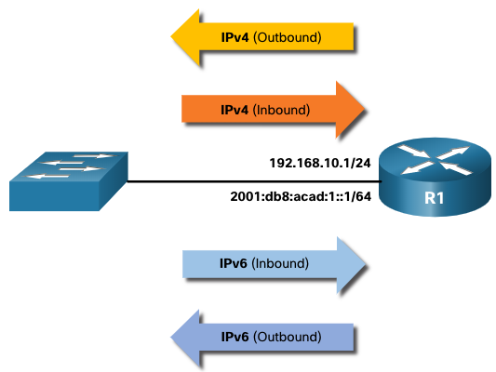
ACL Concepts: Guidelines
There is a limit on the number of ACLs that can be applied on a router interface.
For example, a dual-stacked (i.e, IPv4 and IPv6) router interface can have up to four ACLs applied, as shown in the figure.
Specifically, a router interface can have:
  One outbound IPv4 ACL.
  One inbound IPv4 ACL.
  One inbound IPv6 ACL.
  One outbound IPv6 ACL.
Note: ACLs do not have to be configured in both directions. The number of ACLs and their direction applied to the interface will depend on the security policy of the organization.

Slide 13
ACL Concepts: Guidelines
Using ACLs requires attention to detail and great care.
Mistakes can be costly in terms of downtime, troubleshooting efforts, and poor network service.
Basic planning is required before configuring an ACL.
Guideline | Benefit
Base ACLs on the organizational security policies. | This will ensure you implement organizational security guidelines.
Write out what you want the ACL to do. | This will help you avoid inadvertently creating potential access problems.
Use a text editor to create, edit, and save all of your ACLs. | This will help you create a library of reusable ACLs.
Document the ACLs using the remark command. | This will help you (and others) understand the purpose of an ACE.
Test the ACLs on a development network before implementing them on a production network. | This will help you avoid costly errors.

Slide 14
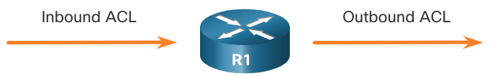
ACL Concepts: Types
Cisco routers support two types of ACLs:
  Standard ACLs ACLs only filter at Layer 3 using the source IPv4 address only.
  Extended ACLs ACLs filter at Layer 3 using the source and / or destination IPv4 address. They can also filter at Layer 4 using TCP, UDP ports, and optional protocol type information for finer control.
ACLs are rule sets that control which packets are allowed or denied as traffic enters, passes through, or exits a router interface.
ACLs can be configured to apply to inbound traffic and outbound traffic.
Note: ACLs do not act on packets that originate from the router itself.
An inbound ACL filters packets before they are routed to the outbound interface. An inbound ACL is efficient because it saves the overhead of routing lookups if the packet is discarded.
An outbound ACL filters packets after being routed, regardless of the inbound interface.

Slide 15
ACL Concepts: Types
R1(config)# access-list ?
<1-99> IP standard access list
<100-199> IP extended access list
<1100-1199> Extended 48-bit MAC address access list
<1300-1999> IP standard access list (expanded range)
<200-299> Protocol type-code access list
<2000-2699> IP extended access list (expanded range)
<700-799> 48-bit MAC address access list
rate-limit Simple rate-limit specific access list
template Enable IP template acls
Router(config)# access-list
Numbered ACLs
ACLs numbered 1-99, or 1300-1999 are standard ACLs,
while ACLs numbered 100-199, or 2000-2699 are
extended ACLs.
Named ACLs
Named ACLs are the preferred method to use when configuring ACLs.
Specifically, standard and extended ACLs can be named to provide information about the purpose of the ACL.
The ip access-list global configuration command is used to create a named ACL:
This ACL allows only FTP traffic (control + data) from the 192.168.10.0/24 network to any destination, and blocks everything else.
R1(config)# ip access-list extended FTP-FILTER
R1(config-ext-nacl)# permit tcp 192.168.10.0 0.0.0.255 any eq ftp
R1(config-ext-nacl)# permit tcp 192.168.10.0 0.0.0.255 any eq ftp-data R1(config-ext-nacl)#

Slide 16
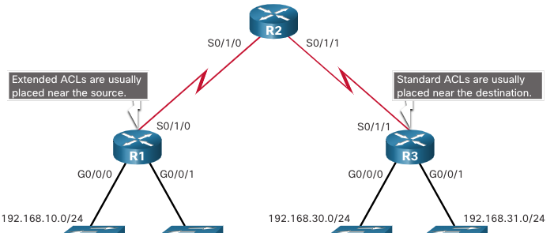
ACL Concepts: Types
Every ACL should be placed where it has the greatest impact on efficiency.
Extended ACLs should be located as close as possible to the source of the traffic to be filtered.
Standard ACLs should be located as close to the destination as possible.
Factors Influencing ACL Placement | Explanation
The extent of organizational control | Placement of the ACL can depend on whether or not the organization has control of both source and destination networks.
Bandwidth of the networks involved | It may be desirable to filter unwanted traffic at the source to prevent transmission of bandwidth-consuming traffic.
Ease of configuration | It may be easier to implement an ACL at the destination, but traffic will use bandwidth unnecessarily. An extended ACL could be used on each router where the traffic originated. This would save bandwidth by filtering the traffic at the source, but it would require creating extended ACLs on multiple routers.

Slide 17
ACL Configurations: Initial Steps
All access control lists (ACLs) must be planned. When configuring a complex ACL, it is suggested that you:
Use a text editor and write out the specifics of the policy to be implemented.
Add the IOS configuration commands to accomplish those tasks.
Include remarks to document the ACL.
Copy and paste the commands onto the device.
Always thoroughly test an ACL to ensure that it correctly applies the desired policy.

Slide 18
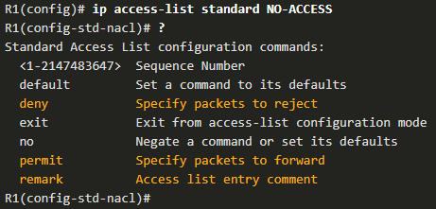
ACL Configurations: Standard ACL
To create a numbered standard ACL named standard ACL
To create a named standard ACL, use the ip access-list standard command ACL names are alphanumeric, case sensitive, and must be unique
Capitalizing ACL names is not required but makes them stand out when viewing the running-config output.
Use the no access-list access-list-number global configuration command to remove a numbered standard ACL.
Parameter | Description
access-list-number | Number range is 1 to 99 or 1300 to 1999
deny | Denies access if the condition is matched
permit | Permits access if the condition is matched
remark text | (Optional) text entry for documentation purposes
source | Identifies the source network or host address to filter
source-wildcard | (Optional) 32-bit wildcard mask that is applied to the source
log | (Optional) Generates and sends an informational message when the ACE is matched

Slide 19
ACL Configurations: Standard ACL
To APPLY ACL
After a standard IPv4 ACL is configured, it must be linked to an interface or feature.
The ip access-group command is used to bind a numbered or named standard IPv4 ACL to an interface.
To remove an ACL from an interface, first enter the no ip access-group interface configuration command.

Slide 20
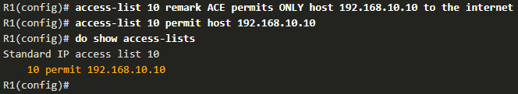
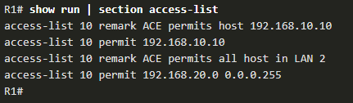
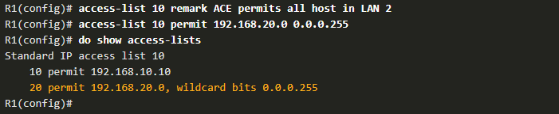
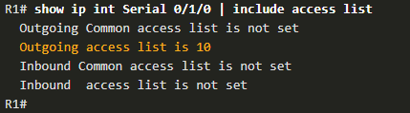

ACL Configurations: Standard Numbered ACL
Example:
The example ACL permits traffic from host 192.168.10.10 and all hosts on the 192.168.20.0/24 network out interface serial 0/1/0 on router R1.
show running-config review the ACL
show ip interface verify if applied in interface

Slide 21
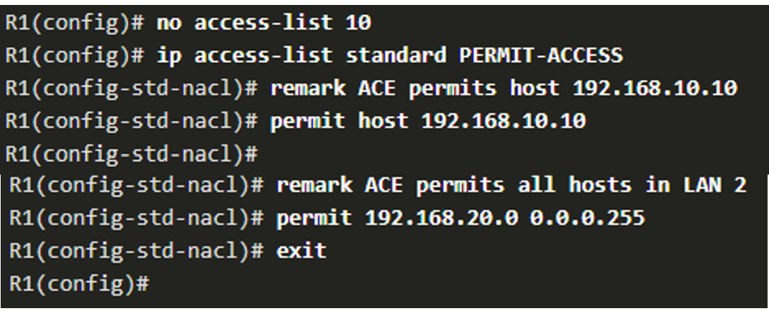
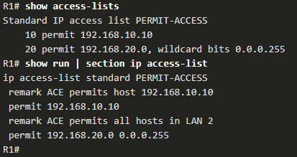

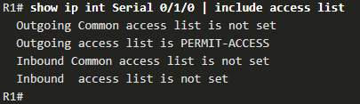
ACL Configurations: Standard Named ACL
Example:
The example ACL permits traffic from host 192.168.10.10 and all hosts on the 192.168.20.0/24 network out interface serial 0/1/0 on router R1.
show access-list review the ACL
show ip interface to verify the ACL is applied to the interface.

Slide 22

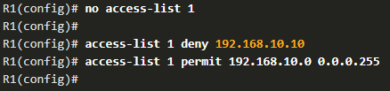
ACL Configurations: Modify ACL
After an ACL is configured, it may need to be modified. ACLs with multiple ACEs can be complex to configure. Sometimes the configured ACE does not yield the expected behaviors.
There are two methods to use when modifying an ACL:
  Use a text editor
ACLs with multiple ACEs should be created in a text editor.
This allows you to plan the required ACEs, create the ACL, and then paste it into the router interface.
It also simplifies the tasks to edit and fix an ACL.
To correct an error in an ACL:
  Copy the ACL from the running configuration and paste it into the text editor.
  Make the necessary edits or changes.
  Remove the previously configured ACL on the router.
  Copy and paste the edited ACL back to the router.

Slide 23
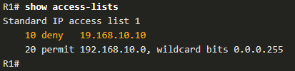
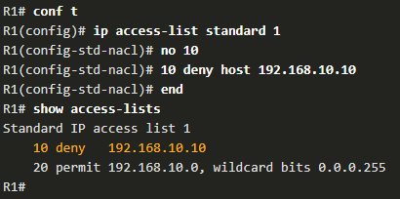
ACL Configurations: Modify ACL
After an ACL is configured, it may need to be modified. ACLs with multiple ACEs can be complex to configure. Sometimes the configured ACE does not yield the expected behaviors.
There are two methods to use when modifying an ACL:
  Use sequence numbers
An ACL ACE can be deleted or added using the ACL sequence numbers.
Use the ip access-list standard command to edit an ACL.
Statements cannot be overwritten using an existing sequence number. The current statement must be deleted first with the no 10 command. Then the correct ACE can be added using sequence number.

Slide 24

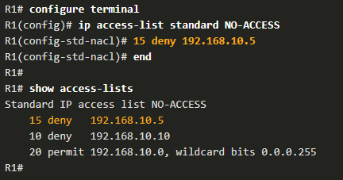
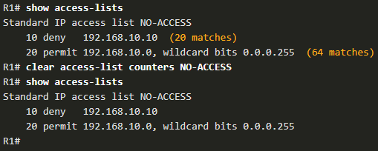
ACL Configurations: Modify ACL
  Modify Named ACLs
Named ACLs can also use sequence numbers to delete and add ACEs.
In the example an ACE is added to deny hosts 192.168.10.5
The show access-lists command in the example shows statistics for each statement that has been matched.
Use the clear access-list counters command to clear the ACL statistics.

Slide 25
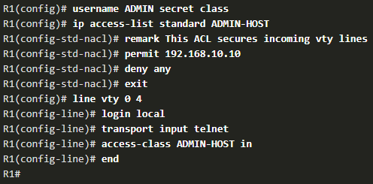
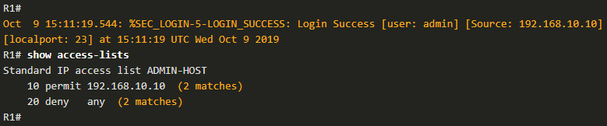
ACL Configurations: Access-class Command
A standard ACL can secure remote administrative access to a device using the vty lines by implementing the following two steps:
  Create an ACL to identify which administrative hosts should be allowed remote access.
  Apply the ACL to incoming traffic on the vty lines.
To verify the ACL statistics, issue the show access-lists command.
  The match in the permit line of the output is a result of a successful SSH connection by host with IP address 192.168.10.10.
  The match in the deny statement is due to the failed attempt to create a SSH connection from a device on another network.

Slide 26
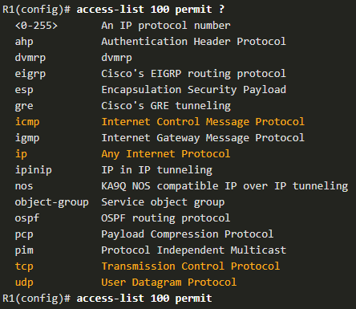
ACL Configurations: Extended ACL
Extended ACLs provide a greater degree of control. They can filter on source address, destination address, protocol (i.e., IP, TCP, UDP, ICMP), and port number.
Extended ACLs can be created as:
Numbered Extended ACL - Created using the access-list access-list-number global configuration command.
Named Extended ACL - Created using the ip access-list extended access-list-name.
Hint: Extended ACLs can filter on internet protocols and ports. Use the ? to get help when entering a complex ACE. The four highlighted protocols are the most popular options.

Slide 27
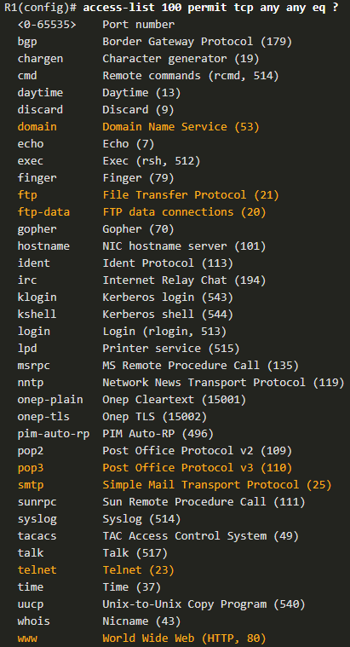


ACL Configurations: Extended ACL
Extended ACLs can filter on different port number and port name options.
This example configures an extended ACL 100 to filter HTTP traffic. The first ACE uses the www port name. The second ACE uses the port number 80. Both ACEs achieve exactly the same result.
Configuring the port number is required when there is not a specific protocol name listed such as SSH (port number 22) or an HTTPS (port number 443), as shown in the next example.

Slide 28
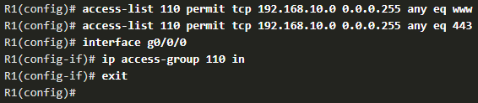
ACL Configurations: Extended ACL
In this example, the ACL permits both HTTP and HTTPS traffic from the 192.168.10.0 network to go to any destination.
Extended ACLs can be applied in various locations. However, they are commonly applied close to the source. Here ACL 110 is applied inbound on the R1 G0/0/0 interface.

Slide 29
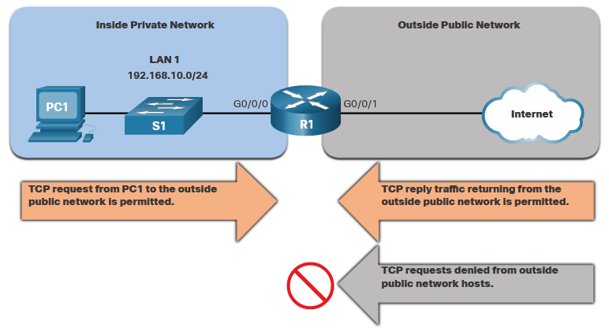
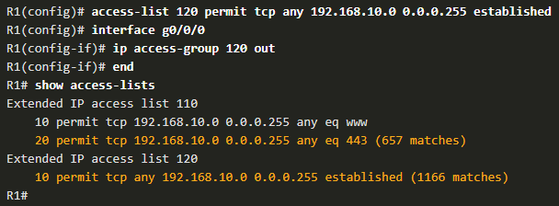
ACL Configurations: Extended ACL
TCP Established Extended ACL
TCP can also perform basic stateful firewall services using the TCP established keyword.
The established keyword enables inside traffic to exit the inside private network and permits the returning reply traffic to enter the inside private network.
TCP traffic generated by an outside host and attempting to communicate with an inside host is denied.
Example: ACL 120 is configured to only permit returning web traffic to the inside hosts. The ACL is then applied outbound on the R1 G0/0/0 interface.
The show access-lists command shows that inside hosts are accessing the secure web resources from the internet.
  Note: A match occurs if the returning TCP segment has the ACK or reset (RST) flag bits set, indicating that the packet belongs to an existing connection.

Slide 30

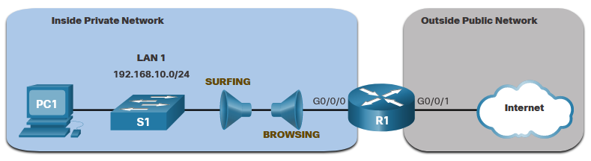
ACL Configurations: Extended ACL
Named Extended IPv4 ACL Syntax
Naming an ACL makes it easier to understand its function. To create a named extended ACL, use the ip access-list extended configuration command.
Example: a named extended ACL called NO-FTP-ACCESS is created and the prompt changed to named extended ACL configuration mode. ACE statements are entered in the named extended ACL sub configuration mode.
Scenario: The topology below is used to demonstrate configuring and applying two named extended IPv4 ACLs to an interface:
SURFING - This will permit inside HTTP and HTTPS traffic to exit to the internet.
BROWSING - This will only permit returning web traffic to the inside hosts while all other traffic exiting the R1 G0/0/0 interface is implicitly denied.

Slide 31
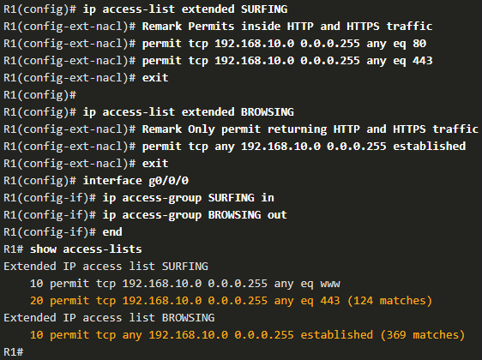
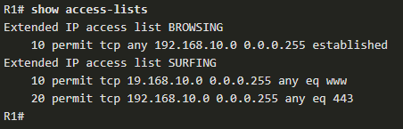
ACL Configurations: Extended ACL
Named Extended IPv4 ACL Syntax
The SURFING ACL permits HTTP and HTTPS traffic from inside users to exit the G0/0/1 interface connected to the internet.
Web traffic returning from the internet is permitted back into the inside private network by the BROWSING ACL.
The SURFING ACL is applied inbound and the BROWSING ACL is applied outbound on the R1 G0/0/0 interface.
The show access-lists command is used to verify the ACL statistics.
Notice that the permit secure HTTPS counters (i.e., eq 443) in the SURFING ACL and the return established counters in the BROWSING ACL have increased.

Slide 32
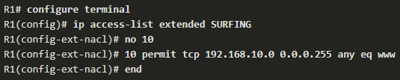
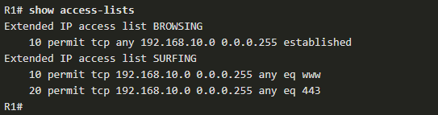
ACL Configurations: Modify Extended ACL
Modify Extended IPv4 ACL
An extended ACL can be edited using a text editor when many changes are required. Or, if the edit applies to one or two ACEs, then sequence numbers can be used.
Example: The ACE sequence number 10 in the SURFING ACL has an incorrect source IP networks address.
To correct this error the original statement is removed with the no sequence_# command and the corrected statement is added replacing the original statement.
The show access-lists command output verifies the configuration change.

Slide 33
Summary
An ACL is a series of IOS commands that are used to filter packets based on information found in the packet header.
A router does not have any ACLs configured by default.
When an ACL is applied to an interface, the router performs the additional task of evaluating all network packets as they pass through the interface to determine if the packet can be forwarded.
An ACL uses a sequential list of permit or deny statements, known as ACEs.
Cisco routers support two types of ACLs: standard ACLs and extended ACLs.
An IPv4 ACE uses a 32-bit wildcard mask to determine which bits of the address to examine for a match.
Standard ACLs should be located as close to the destination as possible. If a standard ACL was placed at the source of the traffic, the "permit" or "deny" will occur based on the given source address no matter where the traffic is destined.
Extended ACLs should be located as close as possible to the source of the traffic to be filtered. This way, undesirable traffic is denied close to the source network without crossing the network infrastructure.
Placement of the ACL may depend on the extent of organizational control, bandwidth of the networks, and ease of configuration.

Slide 34
Summary
To create a numbered standard ACL, use the use the ip access-list standard access-list-name global configuration command.
Use no access-list, show ip interface
To bind a numbered or named standard IPv4 ACL to an interface, use the ip access-group {access-list-number | access-list-name} { in | out } global configuration command.
To remove an ACL from an interface, first enter the no ip access-group interface configuration command.
To remove the ACL from the router, use the no access-list global configuration command.
Extended ACLs can filter on source address, destination address, protocol (i.e., IP, TCP, UDP, ICMP), and port number.
To create a numbered extended ACL, use the Router(config)# access-list access-list-number {deny | permit | remark text} protocol source source-wildcard [operator [port]] destination destination-wildcard [operator [port]] [established] [log] global configuration command.
ALCs can also perform basic stateful firewall services using the TCP established keyword.
To modify an ACL, use a text editor or use sequence numbers.
An ACL ACE can also be deleted or added using the ACL sequence numbers.
Sequence numbers are automatically assigned when an ACE is entered.

Slide 35
Task to Complete
Complete the Lab exercises.
  Lab 1: OSPF Packet tracer Activities (Submit OSPF Skills Challenge)
  Lab 2: Research on Social Engineering
  Lab 3: Configure ACL based on the given scenario
  Practice Packet Tracer Files:
    Configure Numbered Standard IPv4 ACLs
    Configure Named Standard IPv4 ACLs
    Configure and Modify Standard IPv4 ACLs
    Configure Extended IPv4 ACLs - Scenario 1
    Configure Extended IPv4 ACLs - Scenario 2
  Complete and Submit:
    Skill Integration Challenge (IPv4 ACL Implementation Challenge) (Submission Link Created in Moodle 3/3/2023)
    Complete the Chapter Exams in Netacad.

Slide 36
Any Questions?

