Slide 1

Safeguarding children
Week 4

Slide 2
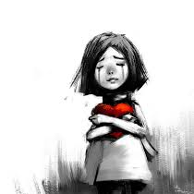
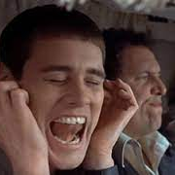

Warnings and Feelings

Slide 3
Child Welfare History
https://www.virtual-college.co.uk/safeguarding-children-timeline/index.html
Show at end

Slide 4
Safeguarding
Safeguarding is the action that is taken to promote the welfare of children and protect them from harm. Safeguarding means: protecting children from abuse and maltreatment. preventing harm to children's health or development.
Wales - Social Services and Well-being (Wales) Act 2014
Every one has responsibility to report concerns
Notes:
https://www.gov.wales/sites/default/files/publications/2019-07/working-together-to-safeguard-people-information-sharing-to-safeguard-children.pdf

Slide 5
Safeguarding Children
There is no single piece of legislation that covers ‘child protection’ or ‘safeguarding’ in the UK but a number of laws that are continually being amended or updated.
The Children’s Act 1989 provides a comprehensive framework for the care and protection of children. It centres on the welfare of children up to their 18th birthday.
It defines parental responsibility and encourages partnership working with parents.
The Children’s Act 2004 supplements the 1989 Act and reinforces the message that all organisations working with children have a duty in helping safeguard and promote the welfare of children.
Notes:
1908 the Children Act 1908 introduced
The Children and Young Person Act 1920
The Children Act 1933 - Important Changes in 1933:
Minimum age of execution was raised from 16 to 18 years.
The age of criminal responsibility was raised from 7 to 8 years.
Introduction of a minimum working age of 14 years.
The minimum age to smoke and to buy tobacco products was set at 16 years.
The minimum age for prostitution and to enter a brothel was set at 16 years.
The minimum age to give alcohol to a child on a private premises was set at 5 years.
Creation of the Royal Society for the Prevention of Cruelty to Animals (RSPCA) in the United Kingdom in 1824

Slide 6

The Children Act 1989
The Act was an important development in safeguarding the welfare of children
Covers any person under the age of 18 (s 105)
Does make reference to the law around specific ages - Discuss
Age at which young people can legally consent to sexual activity
Age to leave school
A person in a position of trust to engage in sexual activity with anyone under the age of 18
Employment

Slide 7

Can Mistakes Happen?
Child Welfare
Children are easy targets
UN Convention on the Rights of the Child – protect the rights of the basic things we need to survive and fulfil children's potential
Bond with abuser, want a better life
Different Children Act's within UK Law
Yet high profile cases of children's deaths still exist
Notes:
children’s Rights basic rights to survive, life, have a name, be safe, live with family, education, play
Most children will live a happy and engaging life but others will have barriers to face to get that life they are entitled too.

Slide 8
Common Sites For Accidental Injury
FOREHEAD
NOSE
BONY SPINE
CHIN
FOREARM
ELBOWS
HIP
KNEES
SHINS
Notes:
Use this diagram to demonstrate some of the common sites for accidental injury.
Not all bruising or marking is cause for concern.
However when explanations do not correlate or the bruising is in an unusual place, this should be recorded and discussed with the designated safeguarding lead.

Slide 9
Common sites for non-accidental physical injury
EYES - bruising, (particularly both eyes)
SKULL - fracture or bleeding under skull (from shaking)
EARS - Pinch or slap marks, bruising
CHEEK/SIDE OF FACE - bruising, finger marks
NECK -bruising, grasp marks
MOUTH - torn frenulum
UPPER & INNER ARM - bruising, grasp marks
SHOULDERS - bruising, grasp marks
CHEST - bruising, grasp marks
GENITALS - bruising
BACK }
BUTTOCKS }
THIGHS }
Linear bruising. Outline of belt/buckles. Scalds/burns
KNEES - grasp marks
Notes:
Use this diagram to illustrate some of the areas that are suggestive of physical abuse.
Reinforce the need to share any concerns with the Designated Senior Person.
Does the explanation for injury / mark add up?
Does parents explanation confirm child’s explanation?
Parents will go to extra-ordinary lengths to cover up – disguised compliance
Explanations may seem plausible at the time. – Importance of chronologies
Reinforce to staff the importance of reporting a concern, even if unsure. The DSL may have a number of previous concerns, which the member of staff is not aware of and their information may be a crucial piece of the jigsaw.

Slide 10
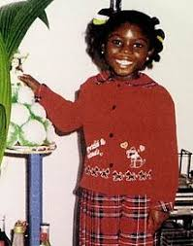
Victoria Climbié 2000
8 yrs. Murdered by her Great-aunty who thought the girl was possessed.
Burnt with cigarettes, tied up, hit with bike chains, hammers and wires.
Up to her death, the police, social services, NHS, NSPCC and a local church all had contact with her and noted the signs of abuse.
Judge in the trial described it as "blinding incompetence“ - all failed to properly investigate the case and little action was taken.
Notes:
Taken away from her home with agreement with parents to have an education in France.
Aunty moved to London with boyfriend and abuse worsened after this. Many organisations involved but did nothing.

Slide 11
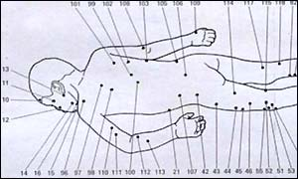
128 separate injuries & scars
Notes:
https://www.slideshare.net/Pr0CEED/the-tragic-case-of-victoria-climbie-revised-2011
For workshops???

Slide 12

Findings
Lord Laming Inquiry
Key recommendations -
Thorough investigations
Proper training for investigators
Inter-agency work
Govt Paper. Evey child Matters = Children Act 2004
Statutory requirement on LA to work with other agencies
However:
Notes:
https://www.gov.uk/government/publications/every-child-matters

Slide 13
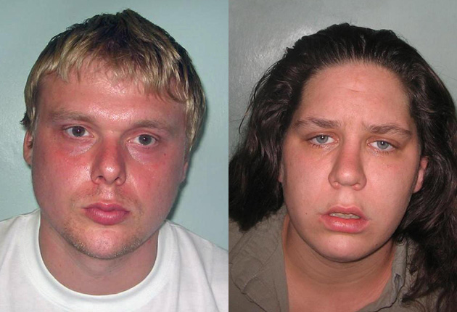
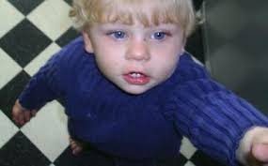
Baby P – Peter Connelly 2007
Sustained over fifty injuries over an eight-month period.
Including a broken back & ribs, gashes to the head, a fractured shinbone, a ripped ear, blackened fingers and toes, missing fingernail, skin torn from the nose and mouth, cuts on the neck and a tooth knocked out.
Tracey Connelly, her boyfriend Steven Barker & Jason Owen were all convicted of causing or allowing the death of a child.
Steven was also charged of raping a two-year-old girl.
Notes:
Peter had lived in the London Borough of Haringey, North London, under the same child welfare authorities that had already failed seven years earlier in the case of Victoria Climbié
Peter was 17 months old

Slide 14
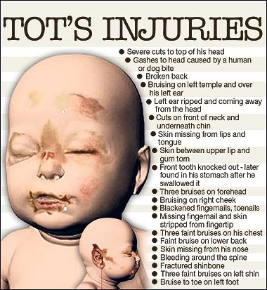
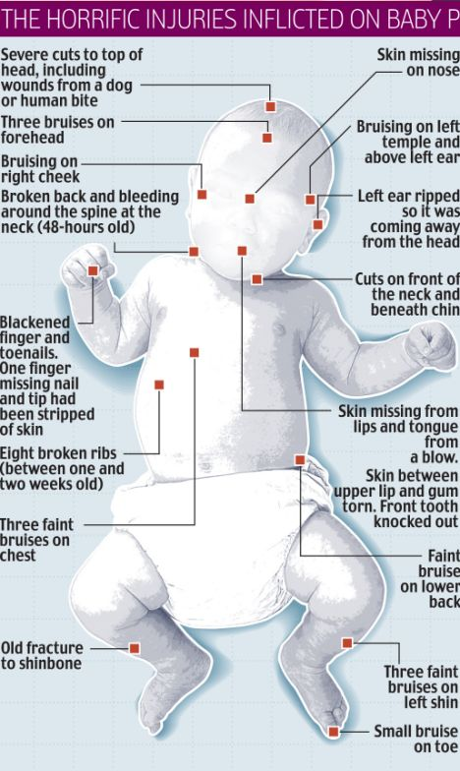

Slide 15
Failures
Showed that although policies in place there were still children being failed
After Baby P children protection procedures not being properly addressed
Lord Laming report 2009 = lack of appropriate action between services
However:
Notes:
https://www.gov.uk/government/publications/the-protection-of-children-in-england-a-progress-report

Slide 16
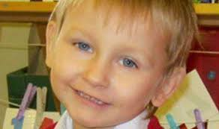
Daniel Pelka 2012 aged 5 years old
Daniel was denied food, regularly “imprisoned” in a locked room, force-fed salt and made to perform punishment exercises.
Teachers described him as a "bag of bones" and he was "wasting away". At the time of his death the schoolboy weighed just over one stone. Was seen scavenging for food in school bins.
Die after six months of starvation and cruelty. Sustained other injuries to body from mum & Step-dad.
Social workers failed opportunities to help.
ID the need to improve how vulnerable children are identified
Communication needed
Notes:
Killed by step-dad but mum was involved too.
Police were called to 26 separate incidents at the family home, many involving domestic violence and alcohol abuse
Excuses made by Daniel's "controlling" mother were accepted by agencies
Daniel stole sandwiches from other children at school and dug through bins for discarded apple cores. His body was so emaciated that one experienced healthworker compared it to that of a concentration camp victim.

Slide 17
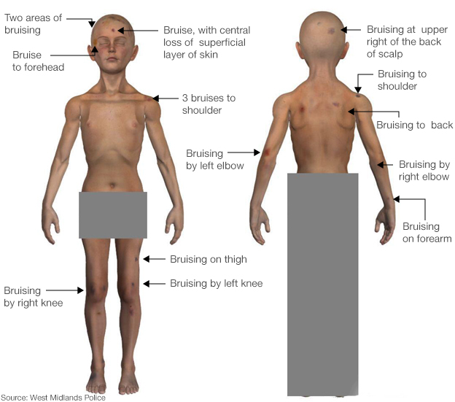

Slide 18
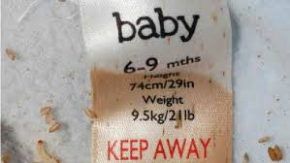
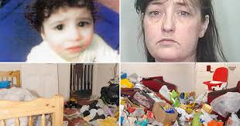
Hamzah Khan 4 Years old
Amanda Hutton mum starved Hamzah.
21 months after his death his mummified remains were found in his cot. Died in December 2009 found 21 September 2011.
Lived in a squalid conditions house where 5 other children lived.
Charged with manslaughter by gross negligence and preventing the burial of a corpse.
Notes:
When found he was in a baby grow aged 6 to 9 months
Hutton had "many opportunities" to accept the professional support which had been offered to her but she had chosen not to, she added.
"She was obstructive, she was difficult and she failed in her ability to parent that child, to look after his basic needs, and sadly he died in the most difficult of circumstances.
https://www.bbc.co.uk/news/uk-england-24388175
https://www.theguardian.com/society/2013/nov/13/hamzah-khan-social-services-warning-signs

Slide 19
Investigating Death’s
The Coroners Act of 1887 consolidated the laws relating to coroners and emphasised the coroner's role in investigating deaths suspected of being violent or unnatural
The Notification of Deaths Regulations 2019
Coroners Act 1988
Coroners and Justice Act 2009
  Investigate certain deaths
  Hold an inquest into deaths
  Postmortems
  Power to remove a body
Notes:
https://www.legislation.gov.uk/ukpga/2009/25/contents
https://assets.publishing.service.gov.uk/media/5e258ec240f0b62c52248094/guide-to-coroner-services-bereaved-people-jan-2020.pdf
https://researchbriefings.files.parliament.uk/documents/SN03981/SN03981.pdf
https://www.legislation.gov.uk/uksi/2019/1112/made

Slide 20
Keanu Williams 2 yrs 2013
killed by mother.
GP’s, social workers, police & nursery staff collectively failed to prevent the death.
Services were more concerned by Mother’s needs
The toddler was found with 37 injuries including a fractured skull and torn abdomen
She expressed some surprise that Keanu had not been removed from her care when born.

Slide 21

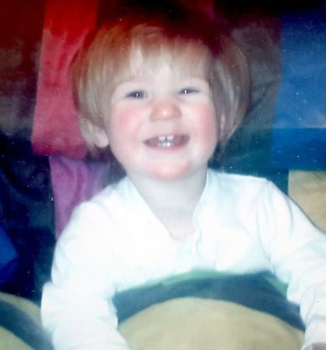
Ayeeshia-Jayne 21 months old
Killed by her mother in 2014
suffered a fatal heart laceration by being stamped on - a type of injury usually only found in crash victims
Social workers missed signs of danger around a toddler and focused too much on the condition of the mother

Slide 22

Child Abuse also include:
Domestic Abuse
Missing children, including truant from school
Children engaged in criminal behaviour, including abusing others
Children abusing animals
Children involved in sexual exploitation or prostitution
Parental drug or alcohol abuse
Further Reading - See link below to College of Policing
Notes:
https://www.college.police.uk/app/major-investigation-and-public-protection/investigating-child-abuse-and-safeguarding-children/police-response-investigating-child-abuse/risk-and-associated-investigations

Slide 23
Child neglect / deaths
Cases include
Lola James – Haverfordwest 2020
Kaylea Titford – Newtown 2020
Logan Mwangi – Bridgend 2021
Star Hobson – West Yorkshire 2020
Dylan Freeman – Birmingham 2020
Arthur Labinjo-Hughes – Birmingham 2020
Alfie Steele – 2021 Coventry
Finley Boden - Derby 2020
Notes:
Lola - 101 surface injuries on her body and suffered a "catastrophic" brain trauma
Kaylea –disability left her restricted to her bed for more than six months in "squalid" and "inhumane" conditions
Logan killed by brother, mother and father body taken to river; weighted 3 stone; treated like a prisoner.
Star – killed by mother’s girlfriend after months of abuse. two brain injuries and various fractures to her skull, ribs and shinbone.
Dylan suffocated by mother
Arthur – un-survivable brain injury 130 bruises, that he had been poisoned with salt and injuries compared to being tortured.
Alfie held underwater in a bath, after months of cruelty that had left him with more than 50 injuries 60 calls made to police.
Finley - 57 breaks to his bones, 71 bruises and two burns on his left hand taken into care but returned dead within 39 days.

Slide 24


Break!

Slide 25
Protecting Children
Under The Children Act 1989:
Children are sometimes exposed to harm by carers/supervisors.
Harm is seen as:
Ill treatment or the impairment of health and development
Suffering from seeing or hearing the ill-treatment of another
Sexual abuse
Forms of ill-treatment that are not physical
4 Types of Abuse
Physical, Emotional, Sexual & Neglect

Slide 26
Children, YP & Sexual Offences
Sexual activity between anyone 16 years old and an adult is unlawful.
Sexual Offences Act 2003
Consider the act or Rape / Sexual assault / inciting a child to engage in sexual activity / Child witness sexual acts / Grooming / Sexual exploitation
Different sections of the Sexual Offences Act 2003 cover these areas

Slide 27
Child Rape
Rape of a child under 13 years old offence under S 5 Sexual Offences Act 2003
Only be committed by a man
Victims can be both male and female
Consented? If they did it's relevant as if the defendant though the victim was over 16 years old
Victims 13-15 lack of consent needs to be proven
Offence triable on indictment only – Maximum is life imprisonment

Slide 28
Sexual Assault of a Child
Under S 6 Sexual Offences Act 2003
Can be committed by Male or Female to a Male or Female
Use any part of the body or items
Sexual Assault (under 13) without penetration covered by S 7 (1) Sexual Offences Act 2003 (touching / sexual)
As rape - Consented? If they did it's relevant as if the defendant though the victim was over 16 years old
Victims 13-15 lack of consent needs to be proven
Penalty – six months imprisonment/fine, up to 14 years imprisonment on indictment

Slide 29
Child abuse V's Terrorism
Any link?
Involvement of children in terrorism acts
S 36 The Counter-Terrorism and Security Act 2015
'Channel Panels' with police and LA to prevent children drawn into terrorism
Panel – to support children/YP

Slide 30
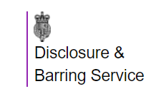
DBS

Slide 31
DBS
The DBS was formed in 2012 by merging the functions of the Criminal Records Bureau (CRB) and the Independent Safeguarding Authority (ISA) under the Protection of Freedoms Act 2012.
It is a legal requirement in the UK for regulated activity employers to refer safeguarding concerns to the DBS.
It is illegal for anyone barred by the DBS to work, or apply to work with the sector from which they are barred.
It is also illegal for an employer to knowingly employ a barred person in the sector from which they are barred.

Slide 32
DBS
Employers can check the criminal record of someone applying for a role.
You can get a detailed check for certain roles
  Child Care / Health / Youth services / education
You can request:
a basic check, which shows unspent convictions and conditional cautions
a standard check, which shows spent and unspent convictions and cautions
an enhanced check, which shows the same as a standard check plus any information held by local police that’s considered relevant to the role
  barred lists
Notes:
https://www.gov.uk/dbs-check-applicant-criminal-record

Slide 33
DBS Pre- 2002
Under the old system, employers sought police checks locally.
Took months, it was standard practice for people to start work subject to a satisfactory clearance coming through later from the police, provided their ‘List 99 Check’ was clear.
Police Forces found the checks burdensome
Official guidance told employers they should normally "consider" having a check done only on people applying for posts entailing:
"a substantial level of access to children which may also be unsupervised, and will be regular or sustained".
Notes:
Access to children = teachers, youth workers, residential staff in boarding schools, para-medical staff, caretakers, independent visitors to childcare organisations, education welfare officers and psychologists, local authority workers in nurseries, playgroups, youth and community groups.
The guidance was that checks "should not normally be sought" on administrative staff, bus drivers, cleaners, dinner assistants, ground staff, parents and other supervised helpers, and - crucially, in view of the current backlog - student teachers and other trainees except in nursery schools.
99 list is a list of people who appear on the sex offenders register and confirms if they are barred from working with children. Contains the names, aliases, dates of birth and national insurance numbers of all those forbidden to work with children in schools, social work and voluntary settings.
Adults convicted of serious sexual offences committed against children under the age of 16 since 1995 can automatically be placed on List 99. Those convicted of possessing indecent photographs of children can only be automatically barred if they were convicted after 1 June 2003. Since June 2003, a judge can also effectively bar an offender from working with children by giving them a "disqualification order" as part of their sentence.

Slide 34
From May 2002
The Criminal Records Bureau had started work as a central point for all checks and the system was tightened up.
All applicants for posts involving working with children were to seek clearance via the bureau - known as "disclosure" - before starting work.
But by end of May the Bureau could not cope with the demand.
Classroom staff could start work pending completion of their police checks, provided they were not on List 99.
Notes:
99 list - not a sex offender and not banded from working with children.
Because the Criminal Records Bureau could not cope with the demand, the Department for Education announced "interim arrangements".
These were that - as under the old system - classroom staff could start work pending completion of their police checks, provided they were not on List 99.
This exemption did not apply to contractors, ancillary staff such as caretakers, or school governors - they still had to be checked first

Slide 35

No or limited police checks could only mean a danger for vulnerable people?
Then this happened:
https://www.youtube.com/watch?v=PGOMkQcKRVs
Notes:
These offences were on file

Slide 36
Soham Murders 4th August 2002
Huntley was found guilty of murdering Jessica and Holly
His link was being the caretaker of the school they attended.
Maxine Carr girlfriend & classroom assistant
Huntley had been suspected of offences including rape, indecent assault and burglary.
Only conviction before the murders was for riding an uninsured and unlicensed motorcycle and burglary. Offences committed in his home area.
Huntley had been hired by the school in November 2001, before the CRB came into force.

Slide 37
Would Huntley have had the job after CRB’s
Huntley had been reported to police in Humberside on 6 occasions over sexual assaults or sexual relationships with underage girls BUT no convictions for sex offences.
Social services investigated 4 relationships between Huntley and schoolgirls.
Police checks on Huntley when he was appointed failed to unearth these details.
At the time Huntley got his job new vetting system was being introduced.
Police state that under the new system Huntley would probably still have slipped through the net as the new Criminal Records Bureau continues to rely on local police forces to provide it with intelligence material.
Notes:
No convictions to put on the 99 list.
Huntley got his job the vetting process was being changed and a new system is now in place.
From Humberside but job else where

Slide 38
Lessons Learnt?
30 August 2002 Education dept. stressed: "We do not advise that people should be allowed to work unchecked if they are supervised.”
4 September: Third U-turn due to the volume of CRB’s waiting. Schools had to turn children away due to not enough staff. Union meetings were held.
The Education Secretary, Estelle Morris - "I have therefore decided to allow teachers, teaching assistants and other to work in schools at the head teachers' discretion after receiving List 99 checks.

Slide 39
Police Protection
Police have statutory duty to safeguard the well-being of children S 11 of the Children Act 2004
Power to take children into police protection, if they are at immediate risk
  Exceptional circumstances no child should be taken into police protection.
This is an 'emergency power' - used when necessary
  Police protection up to 72 Hours (S 46 Children Act 1989)
The Court has the power to make the final decision to remove children/YP from their parents
  LA apply to courts for Emergency Protection Order (EPO)

Slide 40
Parent Responsibility
Under Children Act 1989 (ss 2 and 3)
'all rights, duties, powers, responsibilities and authority which by law a parent of a child has in relation to that child and their property'
'parent' biological parent, step-parent, others such as LA administrative bodies
https://www.gov.wales/sites/default/files/publications/2019-07/working-together-to-safeguard-people-information-sharing-to-safeguard-children.pdf

Slide 41
Task
discuss the following Victim report - ​
Standford Rape case see link below:​
https://www.independent.co.uk/voices/stanford-rape-case-why-a-victim-of-sexual-assault-speaking-out-shouldn-t-be-a-shocking-viral-news-a7072491.html​
Victims parents have impact statement edited see link below:​
https://www.theguardian.com/uk-news/2019/jul/10/parents-victim-statement-edited-to-spare-feelings-of-driver-who-killed-child​
Google the Christchurch, New Zealand 2019 terror attack victim statements.​
Netflix – Athlete A USA Gymnastic team abuse by Dr. Larry Nassar.

Slide 42
Task – Next week
Alfie Steele
  Who is to blame – police / social services/ education
  What should / could have happened to prevent death
Safeguarding report - https://www.safeguardingworcestershire.org.uk/wp-content/uploads/2024/01/CSPR-Worcestershire-Alfie.pdf
Timeline of abuse:
https://www.itv.com/news/central/2024-01-26/timeline-of-abuse-and-mistreatment-suffered-by-schoolboy-before-his-murder

