Slide 1
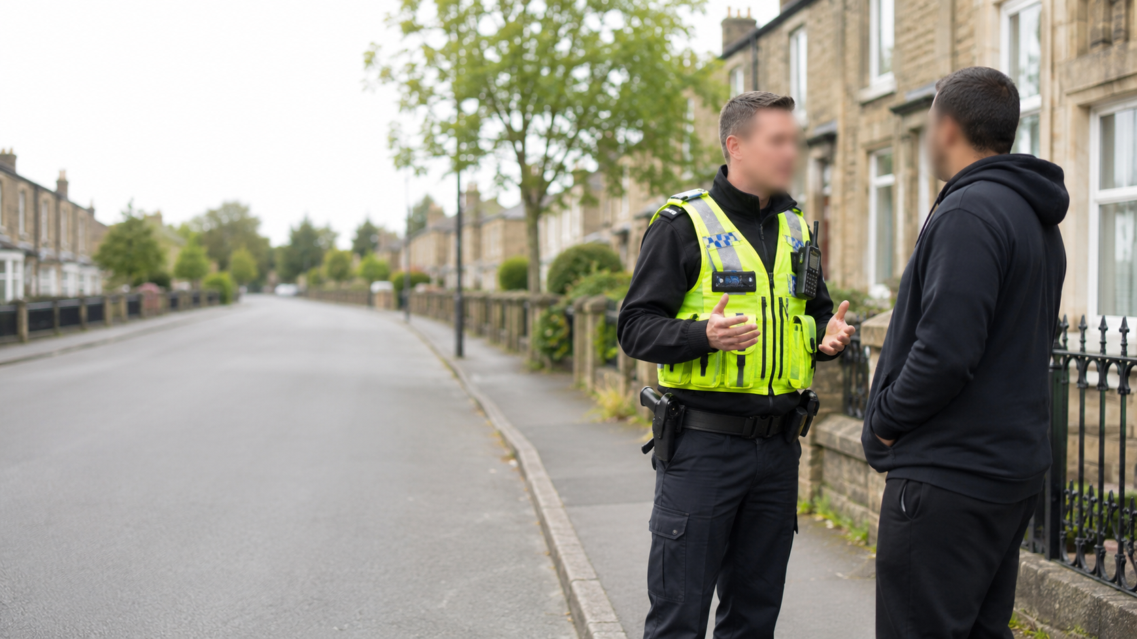
Student-facing session pack
Personal devices, social media and professional risk
BMLP Digital & Operational Policing · Week 4
Focus: Professional judgement, information security and public confidence
Two operational scenarios • academic debate • Assessment 1

Slide 2
BMPL6017A • WEEK 4 • DIGITAL & OPERATIONAL POLICING
Two-hour session plan
Short input • active learning
00–10 Recap and Vevox
10–30 Scenario A: WhatsApp and disclosure
30–50 Personal devices and boundaries
50–70 Youtube: off-duty social media
70–90 Social media and professional conduct
90–110 Law, policy and accountability
110–120 Assessment 1 questions?
PERSONAL DEVICES / SOCIAL MEDIA / PROFESSIONAL RISK 02

Slide 3
BMPL6017A • WEEK 4 • DIGITAL & OPERATIONAL POLICING
Assessment 1: why this matters
AC1 • 2,000-word essay • 50%
Critically assess risks associated with police use of personal digital devices and social media.
LO2: personal AND organisational risk.
A critical essay weighs benefit, harm, mitigation and limitations.
PERSONAL DEVICES / SOCIAL MEDIA / PROFESSIONAL RISK 03

Slide 4
BMPL6017A • WEEK 4 • DIGITAL & OPERATIONAL POLICING
Learning Outcomes
By the end of the discussion students should be able to:
Identify ethical and professional issues arising from digital communications.
Apply the Code of Ethics to operational decision making.
Assess risks relating to data protection and information security.
Evaluate the evidential implications of unofficial communication channels.
Consider the impact on victims, investigations and public confidence.
PERSONAL DEVICES / SOCIAL MEDIA / PROFESSIONAL RISK 03

Slide 5

BMPL6017A • WEEK 4 • DIGITAL & OPERATIONAL POLICING
Vevox: five opening judgements
Agree • disagree
Private WhatsApp chats fall outside police standards.
Deleting a message removes disclosure risk.
Only public profiles can identify an officer.
A lawful social media post can still create professional risk.
Urgency overrides personal-device policy.
PERSONAL DEVICES / SOCIAL MEDIA / PROFESSIONAL RISK 04
Notes:
Answers: disagree, disagree, disagree, agree, disagree.

Slide 6
BMPL6017A • WEEK 4 • DIGITAL & OPERATIONAL POLICING
Personal devices: the trade-off
Operational convenience versus control
Benefits: speed, contact and flexibility.
Risks: device loss, cloud backup, onward sharing and missing audit trails.
Question: who authorises, secures, records and retains the data?
PERSONAL DEVICES / SOCIAL MEDIA / PROFESSIONAL RISK 05
Notes:
College of Policing Social media APP (2026) expects force policy to govern personal devices. Distinguish a potentially useful tool from an authorised workflow. Avoid blanket claims that all personal phone use is criminal.

Slide 7
BMPL6017A • WEEK 4 • DIGITAL & OPERATIONAL POLICING
Follow the information
A chain of possible exposure
Personal phone → messaging app → colleague → screenshot → third party.
Encryption does not resolve retention, disclosure or recipient behaviour.
What controls belong to officers, supervisors and organisations?
PERSONAL DEVICES / SOCIAL MEDIA / PROFESSIONAL RISK 06
Notes:
A message may be encrypted in transit but still vulnerable at endpoints or through onward sharing. The core issue is accountability, necessity, authorised access and proper recording.

Slide 8

Information Sharing & Ethics
PC Thomas domestic abuse case study
PC Thomas attends a domestic abuse incident. A colleague requests the victim address and injury photographs. Thomas uses a personal phone and WhatsApp group. A screenshot is later forwarded.

Slide 9
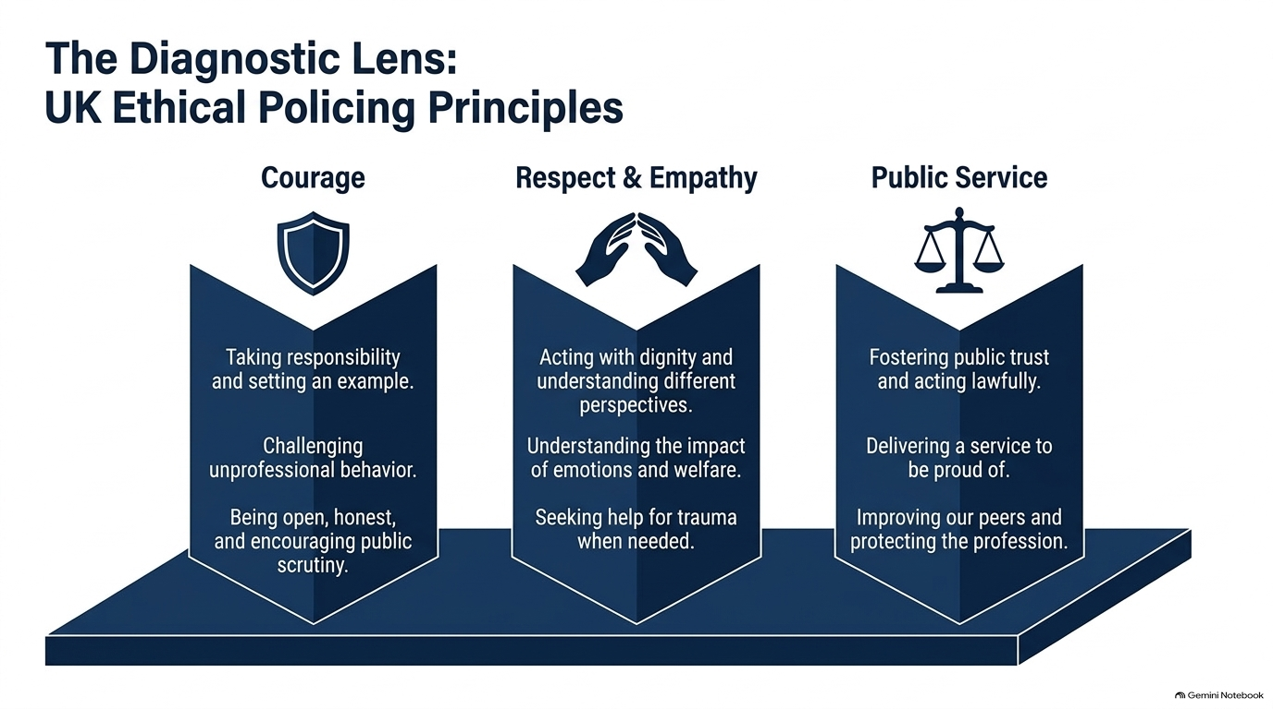
Ethics | College of Policing

Slide 10
BMPL6017A • WEEK 4 • DIGITAL & OPERATIONAL POLICING
Scenario A: Has PC Thomas done anything wrong?
Decide • justify • challenge
Why?, or why not?
What was Thomas trying to achieve?
Was there a legitimate Policing purpose?
Does Operational urgency change the answer?
PERSONAL DEVICES / SOCIAL MEDIA / PROFESSIONAL RISK 10
Notes:
Thomas appears to have had a legitimate policing purpose and may have been acting in good faith. However, ethical decision-making requires officers to consider not only what they are trying to achieve but also how they achieve it. Good intentions do not automatically justify bypassing secure information-sharing processes.

Slide 11
BMPL6017A • WEEK 4 • DIGITAL & OPERATIONAL POLICING
Scenario A: Who could possible be affected by this incident?
Decide • justify • challenge
The victim
The suspect
PC Thomas
The receiving officer
The wider WhatsApp group
The investigating team
The court
The police force
The wider public
Who faces the greatest risk as a result of Thomas's actions?
Consider:
Victim safety
Loss of trust
Disclosure issues
Evidential challenges
PERSONAL DEVICES / SOCIAL MEDIA / PROFESSIONAL RISK 10
Notes:
All information shared is sensitive. However, photographs of injuries may be particularly intrusive because they reveal highly personal information about a victim's circumstances. When combined with an address, the risk to privacy and safeguarding increases substantially

Slide 12
BMPL6017A • WEEK 4 • DIGITAL & OPERATIONAL POLICING
Scenario A: Digital evidence issues
Decide • justify • challenge
What happens when the screenshot is forwarded?
Loss of control
Unauthorised dissemination
Questions around authenticity
Difficulty establishing audit trails
What problems might arise when the case reaches court?
Potential areas:
Disclosure obligations
Continuity of evidence
Defence scrutiny
Requests for personal device examination
PERSONAL DEVICES / SOCIAL MEDIA / PROFESSIONAL RISK 10
Notes:
Once information is shared through unofficial channels, questions arise regarding audit trails, accountability and disclosure. The defence may seek information about who received the material, how it was distributed and whether additional records exist on personal devices

Slide 13
BMPL6017A • WEEK 4 • DIGITAL & OPERATIONAL POLICING
Scenario A: Victim centred perspective
Decide • justify • challenge
Imagine you are the victim and discover that photographs of your injuries have been circulating in a WhatsApp group.
How might this affect confidence in police?
Would the victim continue to engage with the investigation?
Could this impact future reporting of domestic abuse?
PERSONAL DEVICES / SOCIAL MEDIA / PROFESSIONAL RISK 10
Notes:
The damage extends beyond the individual victim. Confidence in police depends on the expectation that highly personal information will be handled responsibly. Poor information management may discourage future reporting and undermine trust in safeguarding processes.

Slide 14
BMPL6017A • WEEK 4 • DIGITAL & OPERATIONAL POLICING
Scenario A: The WhatsApp Group
Decide • justify • challenge
The colleague requested the information. Why might sending it to an entire WhatsApp group create additional concerns?
Did everyone in the group have a genuine need to know?
Who now becomes responsible for protecting that information?
What happens when membership of the group changes?
PERSONAL DEVICES / SOCIAL MEDIA / PROFESSIONAL RISK 10
Notes:
The issue is not only the platform but the audience. Information should typically be shared only with those who have a legitimate operational need. A WhatsApp group may contain officers with varying levels of involvement, making access difficult to justify and monitor.

Slide 15
BMPL6017A • WEEK 4 • DIGITAL & OPERATIONAL POLICING
Scenario A: The Code of Ethics
Decide • justify • challenge
Integrity - Did Thomas demonstrate integrity?
Accountability - Would Thomas be comfortable explaining their decision to a Professional Standards Department investigator?
Confidentiality - What does confidentiality require in this scenario?
Public Trust - How would this look on the front page of a newspaper?
PERSONAL DEVICES / SOCIAL MEDIA / PROFESSIONAL RISK 10
Notes:
Integrity - Students should recognise that integrity concerns doing the right thing in the right way. Thomas may have had good motives, but the decision bypassed established safeguards.
Accountability - Officers should be able to justify decisions transparently. The question is not whether Thomas believed he was helping but whether the decision can withstand scrutiny afterwards
Confidentiality requires officers to share sensitive information only where necessary, proportionate and authorised. The broader the audience becomes, the harder confidentiality becomes to justify.
Even if the action seemed operationally sensible internally, would a reasonable member of the public consider it acceptable?

Slide 16
BMPL6017A • WEEK 4 • DIGITAL & OPERATIONAL POLICING
Scenario A: Alternative scenario
Decide • justify • challenge
What if:
The force system failed completely?
The suspect remained outstanding?
Officers needed immediate access to the address for safeguarding purposes?
Does the ethical answer change?
PERSONAL DEVICES / SOCIAL MEDIA / PROFESSIONAL RISK 10
Notes:
Does urgency change the judgement?
Are there circumstances where policy may need flexibility?
How should risk be balanced?
Model Answer
Urgency is relevant but does not automatically remove responsibility. Ethical decision-making requires balancing competing harms. Students should recognise that exceptional circumstances may influence decisions but do not eliminate the need for accountability and justification.

Slide 17
BMPL6017A • WEEK 4 • DIGITAL & OPERATIONAL POLICING
Scenario A: Final Challenge
Decide • justify • challenge
Which presents the greater ethical risk?
Option A Delay sharing information and potentially compromise safeguarding.
Option B Share information insecurely and potentially compromise confidentiality.
PERSONAL DEVICES / SOCIAL MEDIA / PROFESSIONAL RISK 10
Notes:
There is no perfect answer. The purpose of ethical decision-making is often to identify the least harmful option and justify that choice. Students should demonstrate balancing of competing factors rather than searching for a simple rule.

Slide 18
BMPL6017A • WEEK 4 • DIGITAL & OPERATIONAL POLICING
Scenario A: Conclusion
Decide • justify • challenge
The central issue is not whether Thomas intended to help. Most ethical failures in policing do not begin with bad intentions. The real question is whether operational convenience can justify exposing highly sensitive victim information to unnecessary risk. Ethical policing requires officers to balance effectiveness, legality, professionalism and public trust, even when under pressure
PERSONAL DEVICES / SOCIAL MEDIA / PROFESSIONAL RISK 10

Slide 19

BMPL6017A • WEEK 4 • DIGITAL & OPERATIONAL POLICING
PERSONAL DEVICES / SOCIAL MEDIA / PROFESSIONAL RISK 07
Notes:
Health Warning
USA source – may have some views on the presenter…. Does that change the message?

Slide 20
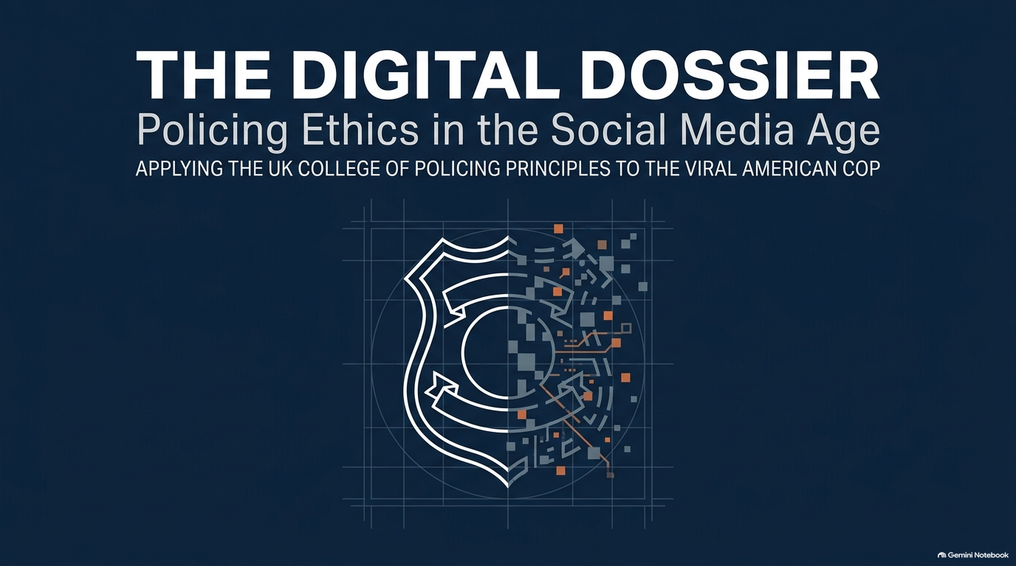
Notes:
May be true? May be not. I have not verified the content – a useful teaching aid nonetheless.

Slide 21
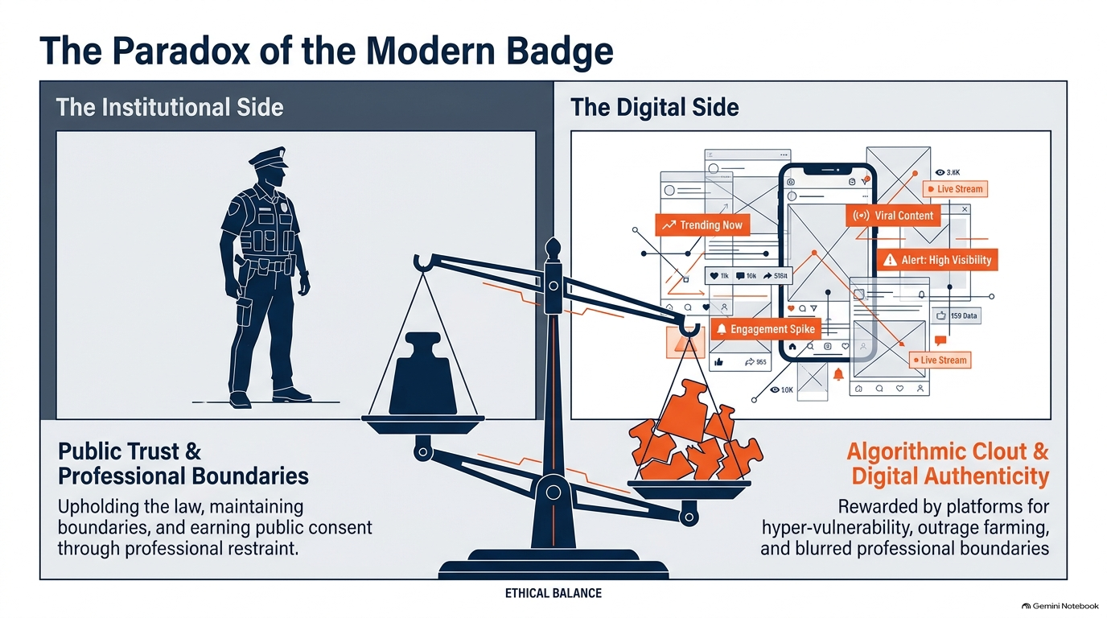
Notes:
Does digital media? Police use of social media run the risk of blurring personal / professional boundaries

Slide 23

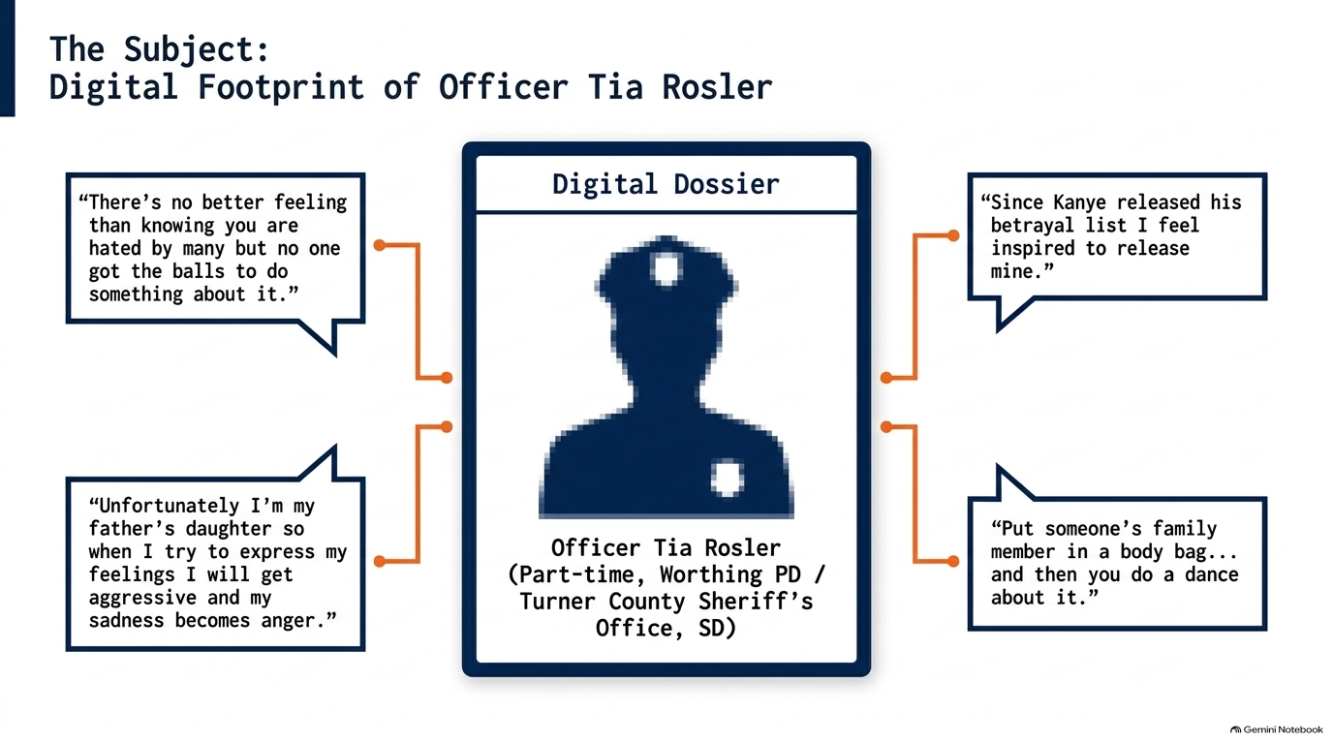
Notes:
Views of the group?
Appropriate? If not – from the perspective of whom?
Press and challenge

Slide 24
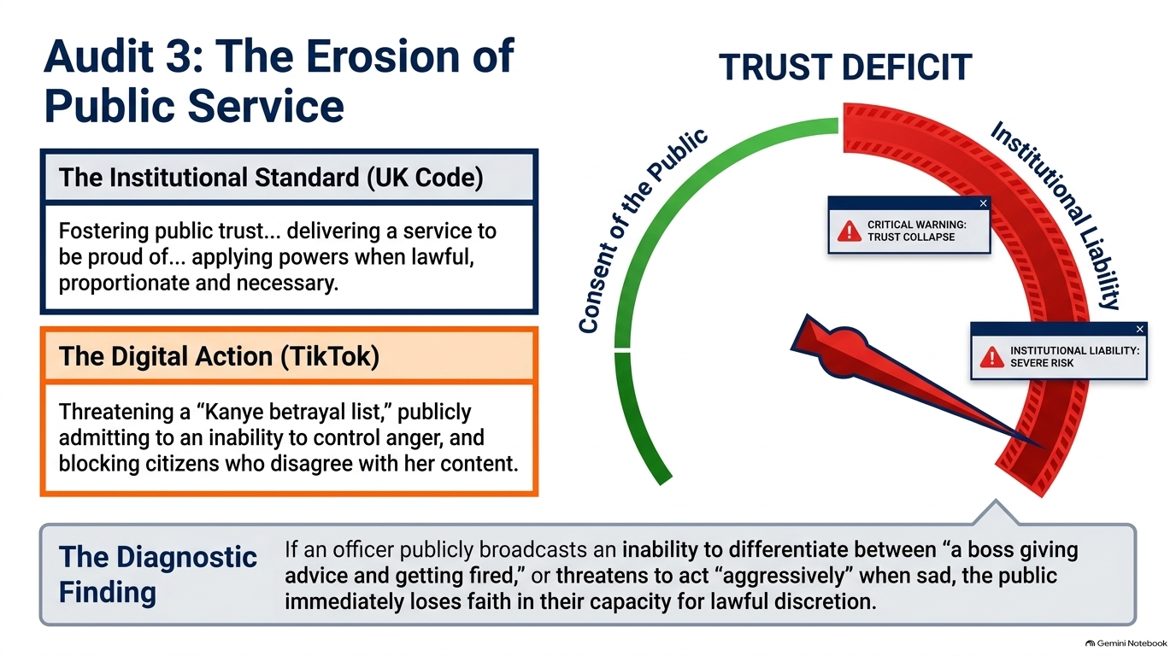
Notes:
The impact on public trust.
The diagnostic finding…. Agree? Why?

Slide 25
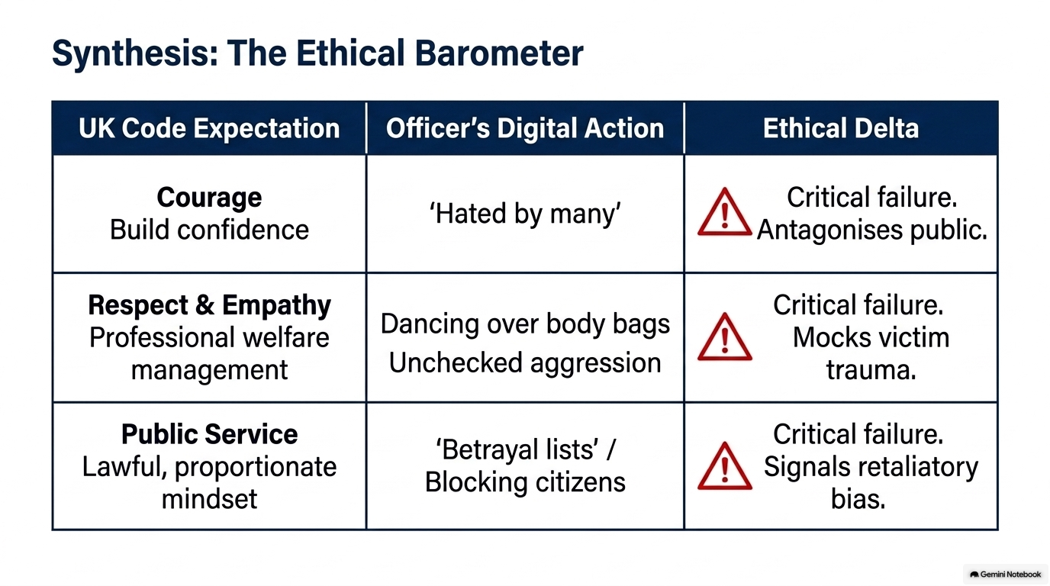

Slide 26
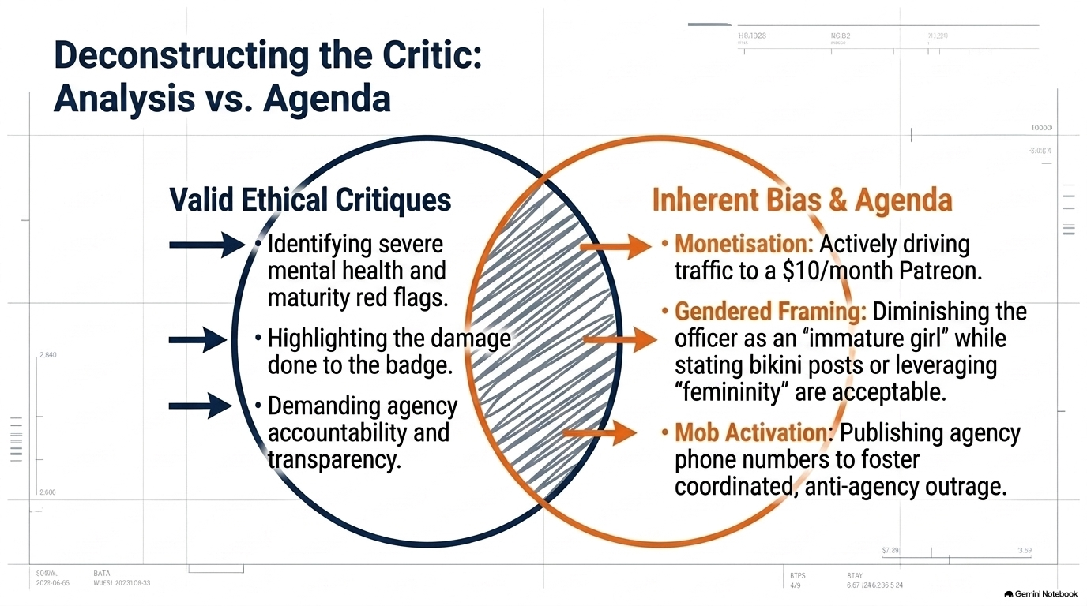
Notes:
The presenter
A unique agenda?
Any biases?

Slide 27
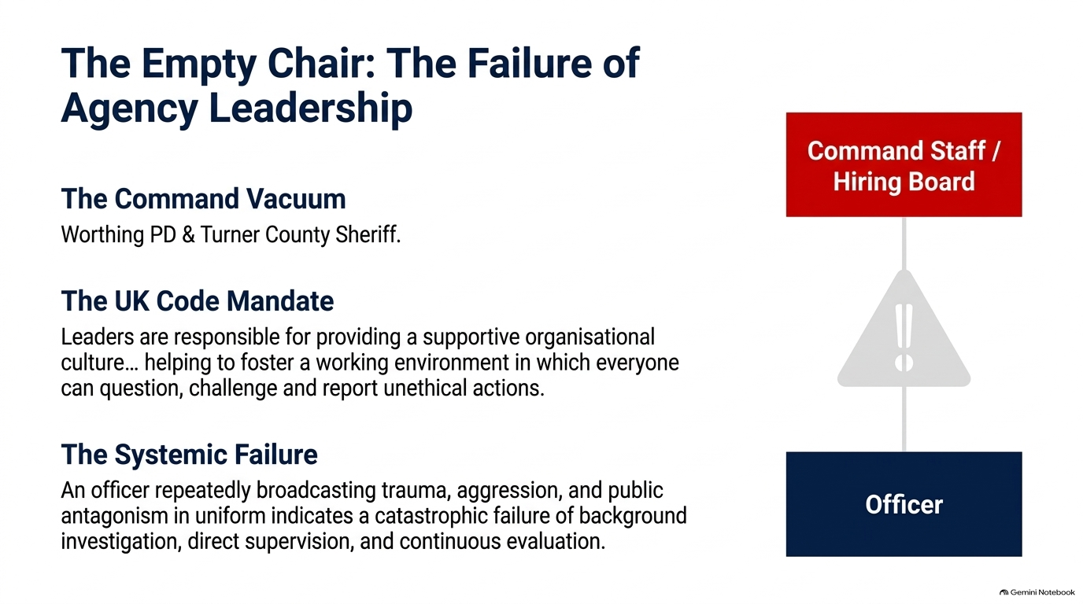
Notes:
Does CoE extend to Organisational responsibilities?

Slide 28
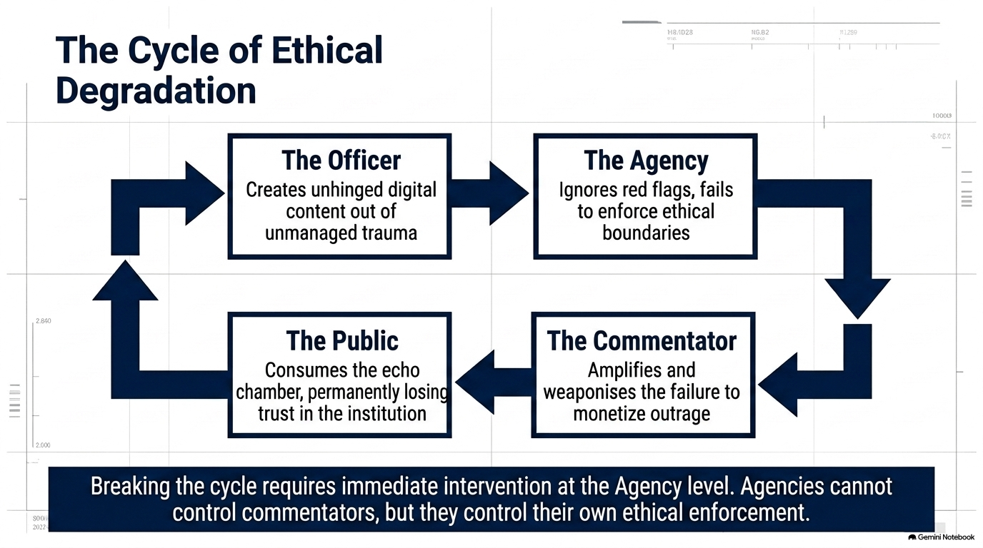

Slide 29
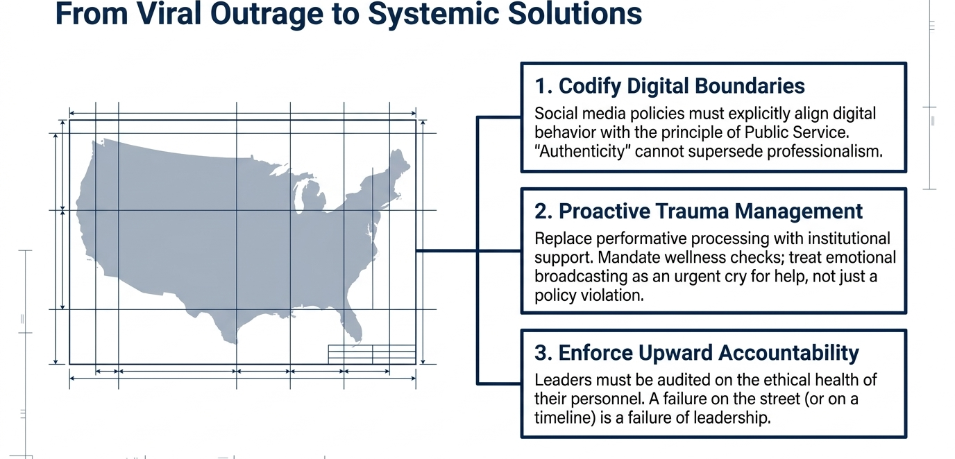
Notes:
Where CoE, force policies and individual behaviour collide.

Slide 30
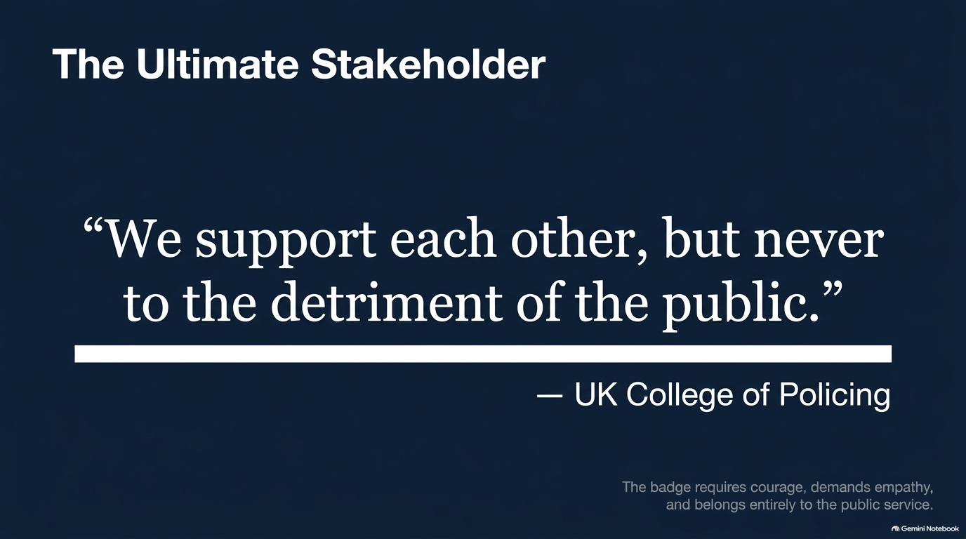

Slide 31
The exit check………..
Full article: Disgracebook policing: social media and the rise of police indiscretion
Digital Evidence — Officer Reference (Device Seizure, Cloud Data, Disclosure) | BlueLineHub
Police Scotland fined £66k and reprimanded following serious data mishandling | ICO
Obtaining data from digital devices – new guidance released | College of Policing

Slide 32
BMPL6017A • WEEK 4 • DIGITAL & OPERATIONAL POLICING
Digital footprints and social media
Private intentions; public consequences
Tags, photographs, contacts and locations may identify an officer.
Closed groups can be copied or recovered.
Lawful expression may still undermine impartiality or confidence.
PERSONAL DEVICES / SOCIAL MEDIA / PROFESSIONAL RISK 07
Notes:
College Code of Ethics guidance (2024) covers private chats and off-duty social media. Goldsmith (2015) examines how online indiscretion can affect police reputation and criminal justice integrity. It is conceptual/case-based, not a prevalence survey.

Slide 33
BMPL6017A • WEEK 4 • DIGITAL & OPERATIONAL POLICING
Three separate questions
Legal • professional • operational
LEGAL: Has any offence or data protection breach occurred?
PROFESSIONAL: Which standards or force policies apply?
OPERATIONAL: What are the safety, evidence and confidence risks?
PERSONAL DEVICES / SOCIAL MEDIA / PROFESSIONAL RISK 08
Notes:
Police (Conduct) Regulations 2020 Schedule 2 sets conduct standards. The College 2024 Code of Ethics is non-statutory guidance, while the 2023 Code of Practice for Ethical Policing is statutory direction to chief officers. Do not conflate them.

Slide 34
BMPL6017A • WEEK 4 • DIGITAL & OPERATIONAL POLICING
Scenario B: off duty, still accountable
Individual exercise • 20 minutes
An officer mocks a vulnerable person on a personal social media account.
A friend tags the officer in a police-related photograph.
The post circulates and complaints follow.
Is the conduct unlawful, unprofessional, both or neither?
PERSONAL DEVICES / SOCIAL MEDIA / PROFESSIONAL RISK 11
Notes:
.

Slide 35
BMPL6017A • WEEK 4 • DIGITAL & OPERATIONAL POLICING
Scenario B: proportionate response
Avoid jumping straight to sanctions
What was posted and who could identify the officer?
Which conduct standards might be engaged?
What would an appropriate supervisor response be?
What additional facts could change your view?
PERSONAL DEVICES / SOCIAL MEDIA / PROFESSIONAL RISK 12
Notes:
Relevant Schedule 2 standards may include discreditable conduct, authority/respect/courtesy and equality/diversity. Encourage a fair and proportionate evidence-based response, not automatic dismissal.

Slide 36
BMPL6017A • WEEK 4 • DIGITAL & OPERATIONAL POLICING
A real IOPC WhatsApp investigation
Published learning report • 2023
An unrelated phone examination uncovered an officer group chat.
More than 6,000 messages were reviewed.
Discriminatory content raised misconduct and criminal concerns.
PERSONAL DEVICES / SOCIAL MEDIA / PROFESSIONAL RISK 13
Notes:
IOPC (2023), Discriminatory and inappropriate comments made by officers within a WhatsApp group chat. Official case learning, not a representative study. Do not treat investigation as a finding of guilt for every participant. Discuss culture, reporting and digital persistence.

Slide 37
BMPL6017A • WEEK 4 • DIGITAL & OPERATIONAL POLICING
Professional source hierarchy
Use the correct authority
Police (Conduct) Regulations 2020 Sch 2: conduct standards.
College Code of Ethics (2024): ethical guidance.
College Social media APP (2026): governance and security.
DPA 2018 Part 3 and ICO: law-enforcement data.
PERSONAL DEVICES / SOCIAL MEDIA / PROFESSIONAL RISK 14
Notes:
2024 Code of Ethics is non-statutory; 2023 Code of Practice for Ethical Policing is statutory and addresses chief officers. Local force policy is essential. Police (Conduct) Schedule 2 was amended in 2026; use current text.

Slide 38
BMPL6017A • WEEK 4 • DIGITAL & OPERATIONAL POLICING
The organisational risk
Assessment 1: critical evaluation
Are secure alternatives accessible under pressure?
Do supervisors reinforce policy consistently?
Does workplace culture reward speed over accountability?
How should training and reporting be improved?
PERSONAL DEVICES / SOCIAL MEDIA / PROFESSIONAL RISK 15
Notes:
The 2023 statutory Code of Practice emphasises organisational ethical culture. Do not excuse individual breaches; analyse how individual choices and system design interact.

Slide 39
BMPL6017A • WEEK 4 • DIGITAL & OPERATIONAL POLICING
Goldsmith (2015): research briefing
Disgracebook policing
Conceptual argument with illustrative cases.
Explores reputation, operational integrity and justice risks.
Limitation: does not measure misconduct prevalence.
PERSONAL DEVICES / SOCIAL MEDIA / PROFESSIONAL RISK 16
Notes:
Goldsmith, A. (2015) Disgracebook policing: social media and the rise of police indiscretion, Policing and Society 25(3), 249–267, DOI 10.1080/10439463.2013.864653. Study summary: theoretical/case-based analysis of off-duty social media disclosure. Useful for mechanisms, but cannot support population prevalence or causal claims about interventions.

Slide 40
BMPL6017A • WEEK 4 • DIGITAL & OPERATIONAL POLICING
Fallik et al. (2020): research briefing
Policing through social media
Qualitative ethnography and officer interviews.
Officers in three agencies in one southern US state.
Limitation: context-specific, not statistically representative.
PERSONAL DEVICES / SOCIAL MEDIA / PROFESSIONAL RISK 17
Notes:
Fallik, S.W., Deuchar, R., Crichlow, V.J. and Hodges, H. (2020) Policing through social media: a qualitative exploration. DOI 10.1177/1461355720911948. Study summary: observations and semi-structured interviews explore officers’ actual practices. Strength: situated insight. Limitations: US context, small geographical scope and no statistical generalisation to UK policing.

Slide 41
BMPL6017A • WEEK 4 • DIGITAL & OPERATIONAL POLICING
Henry (2024): research briefing
Digital ritual and police legitimacy
Theoretical account of police–public digital interaction.
Potential benefit: engagement and solidarity.
Risk: popularity or performance over professional probity.
PERSONAL DEVICES / SOCIAL MEDIA / PROFESSIONAL RISK 18
Notes:
Henry, A. (2024) Digital Ritual: Police–Public Social Media Encounters and Authentic Interaction, British Journal of Criminology 64(2), 452–467, DOI 10.1093/bjc/azad036. Conceptual analysis, not a randomised evaluation; useful as counterweight to an exclusively risk-based account.

Slide 42
BMPL6017A • WEEK 4 • DIGITAL & OPERATIONAL POLICING
Assessment 1: a critical paragraph
10-minute writing and peer review
Write 120–150 words about one risk in the PC Thomas essay.
Include a claim, professional source, academic evidence, counterargument and justified recommendation.
Identify one limitation of your safeguard.
PERSONAL DEVICES / SOCIAL MEDIA / PROFESSIONAL RISK 19
Notes:
Five minutes. Do not merely describe the risk; you should weigh operational benefit against information security, privacy and public confidence.
Confirm full assessment brief and deadline on Moodle.

Slide 43
BMPL6017A • WEEK 4 • DIGITAL & OPERATIONAL POLICING
References and further reading
Verified sources and lecturer links
College of Policing (2024) Code of Ethics and guidance.
College of Policing (2026) Social media APP.
Police (Conduct) Regulations 2020, Schedule 2.
ICO Guide to Law Enforcement Processing.
IOPC (2023) WhatsApp learning report.
Goldsmith (2015); Fallik et al. (2020); Henry (2024).
PERSONAL DEVICES / SOCIAL MEDIA / PROFESSIONAL RISK 20
Notes:
https://www.college.police.uk/ethics/code-of-ethics
https://www.college.police.uk/ethics/code-of-ethics/guidance
https://www.college.police.uk/app/media-and-communications/social-media
https://www.legislation.gov.uk/uksi/2020/4/schedule/2
https://ico.org.uk/for-organisations/law-enforcement/guide-to-le-processing/
https://www.policeconduct.gov.uk/our-work/learning/discriminatory-and-inappropriate-comments-made-officers-within-whatsapp-group
https://doi.org/10.1080/10439463.2013.864653
https://doi.org/10.1177/1461355720911948
https://doi.org/10.1093/bjc/azad036

