Slide 1
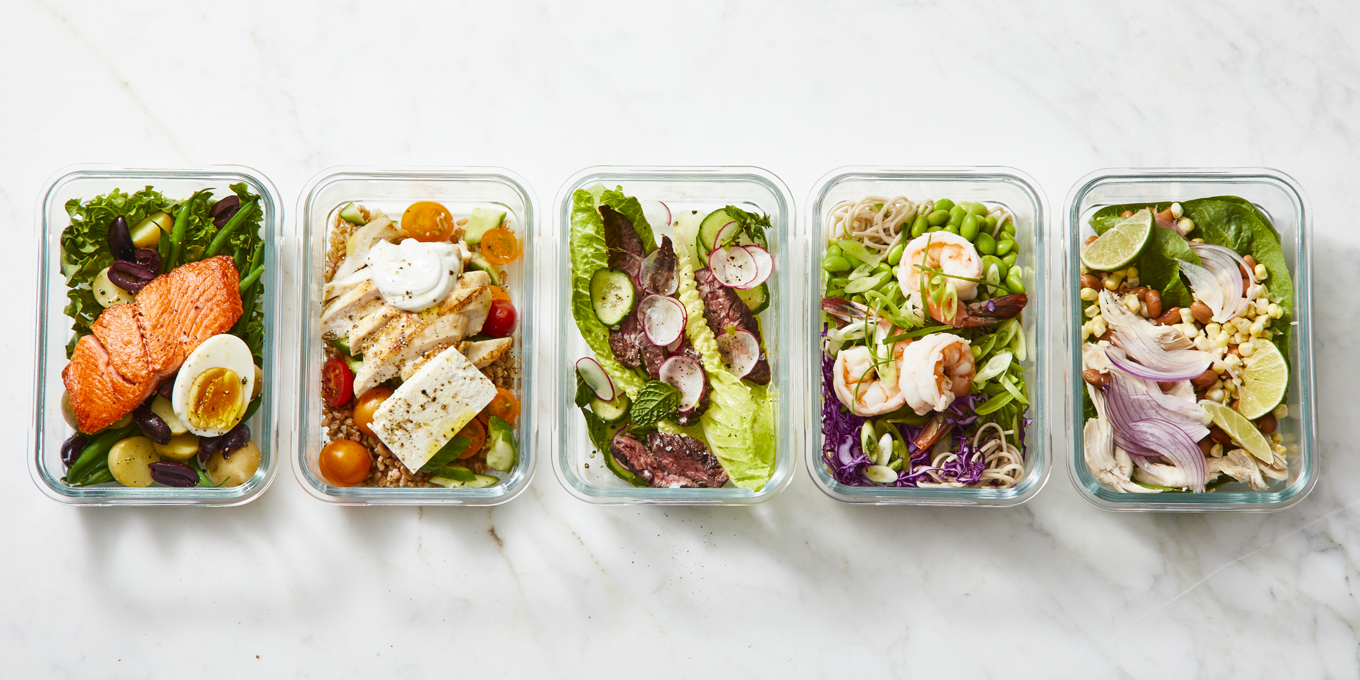



GreeCo
Managing Enterprise in 21st Century
(BMSW4006_LON)
Sebastian Soliman(2124214)
Georgiana Spuma(2123450)
Reiz Daniel Avila(2125130)
Lecturer: Mushfiqur Rahman

Slide 2
Table of Contents
Introduction
Business History
Aim and Objectives
Mission and vision
Structure
Product description
Marketing Analysis and Trends
SWOT Analysis
PESTLE Analysis
Operations
Technology Plan
Management and organization
Social Responsibility and Sustainability
Development, Milestone and Exit Plan
Financial Data
Profit and Loss Account
Cash Flow Statement
Balance Sheet
Conclusion
References

Slide 3
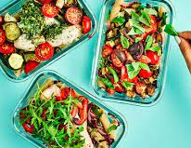
Introduction
GreeCo we are a healthy kitchen that prepares food and delivers to customer door step. The aim of our business is preparing nutrition plans for people and make pre-meals for the whole week.
Our product is suitable for everyone, what we offer:
Healthy food
Vegan food
Allergy free food
Halal food

Slide 4
Business History
The story starts with us, three colleagues that has the same business vision. We decided to open GreeCo kitchen for people to eat healthy food and deliver them the pre-meals for whole week.
We started the business two years ago during the pandemic, that was a difficult time for everyone; and we thought by opening a delivery business it will prevent more people from Covid19.

Slide 5
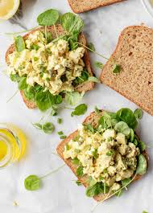
Aim and Objectives
The aim of the business is to make sure that people are indoors as much as possible
To preventing them from gaining weight
To offer a quick and efficient delivery
Advanced technology for ordering food
Freshly prepared meals

Slide 6
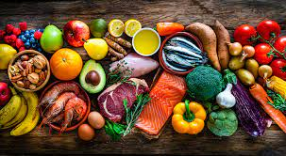
Mission and vision
The mission of GreeCo is to double our investment and open more kitchens all around London
Determinizing people to eat more healthy is a part of the vision
Showing people that there is another way to still eat healthy during pandemic times
Efficient and quick delivery
Developing our GreeCo app in more areas

Slide 7
Business Structure
Georgiana Spuma
-associate-
Sebastian Soliman
-general director-
Reiz Daniel Avila
-associate-

Slide 8
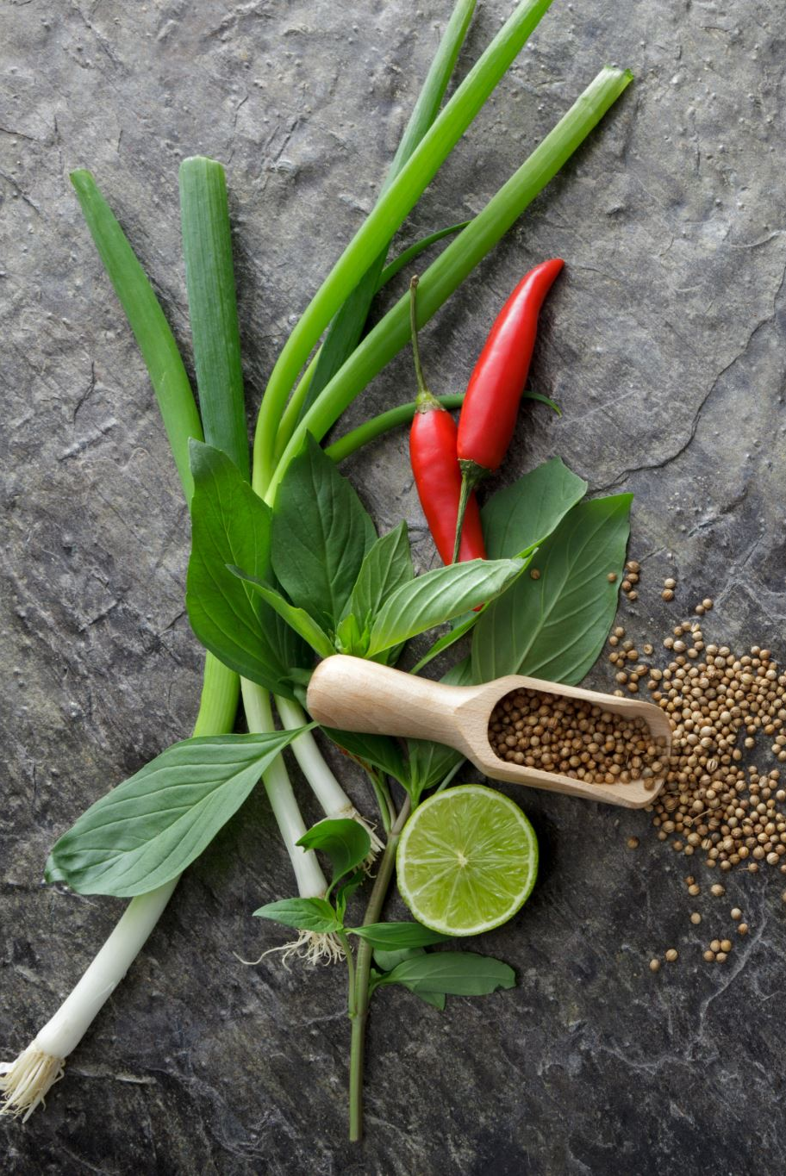
Product description
Natural products used make our menu:
Goat curry(Halal)
Chicken biryani(Halal)
Kebab(Halal)
Samosa(Halal)
Veggie Burger(Vegan)
Vegan Pizza(Vegan)
Spinach Lasagne(Vegan)
Fruit Salads

Slide 9
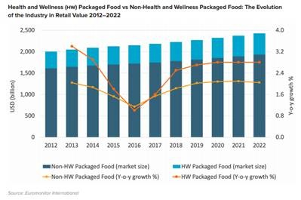
Marketing Analysis and Trends
Marketing analysis is determinizing the direction of the business looking after:
Market needs
Target market
Marketing strategy
Competitors

Slide 10
SWOT Analysis
Strengths | Weaknesses
Efficiency New product on the Market Accessibility Good prices(13 pounds) | The weather conditions Stuff issues The Timing Late supplies
Opportunities | Threats
Social media Internet/App Promotion Partnership | Competition Market place Feedback Social media

Slide 11
PESTLE Analysis
Political | Economical | Social | Technological | Legal | Environmental
Country and national wide multiple stringent food regulations and laws | Disposable income | Different cultures | Internet speed | Health and Safety act | Pollution
Growing awareness of halal as driver | Inflation rate | Population age | New platforms/Social media | Food business registration | Attitudes on the environment

Slide 12
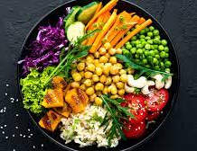
Operations
Customer service
Marketing strategy
Financial aspects
Management
Business strategy

Slide 13

Technology Plan
The GreeCo has two supportive technology elements:
Our App( used to take the orders, view the menu and effective information)
Social media(used for promotions and information about our product)

Slide 14

Management and organization
Make
Make your menu simpler.
Produce
Production guidelines for your staff.
Create
Generate a productive stock system
Avoid
Avoid financial ties by ordering your goods in accordance with your supply.
Establish
Establish designated work areas in the kitchen. preparation of food.
Develop
Develop your workforce.

Slide 15

Social Responsibility and Sustainability
Sustainability is usually spread in three elements: economic, environmental and social.
GreeCo has the goal to be economic, environmental and social friendly using as much as possible products that are not harmful to the society.

Slide 16
Development, Milestone and Exit plan
Development- the goal of GreeCo over two years is to open another two kitchens in opposite parts of London
Milestone- the next big achievement for GreeCo is desired to be opening of 100 kitchens over United Kingdom in the next 10 years
Exit plan- GreeCo exit plan will be a friendly selling to more investors

Slide 17
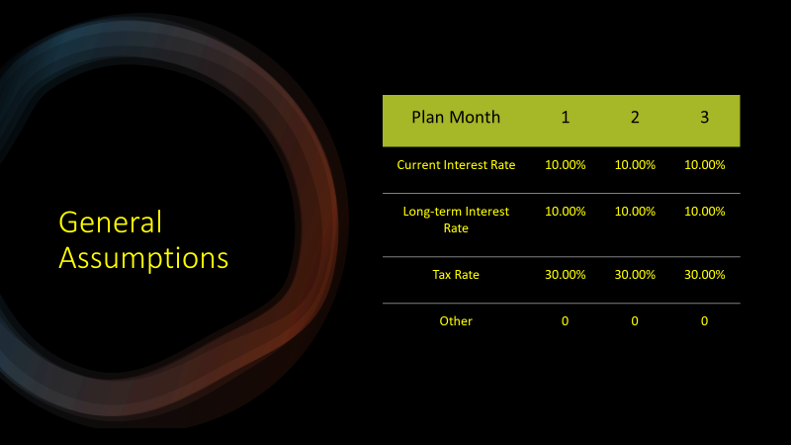
Financial Data
Important financial assumptions are explained in the section that follows:

Slide 18
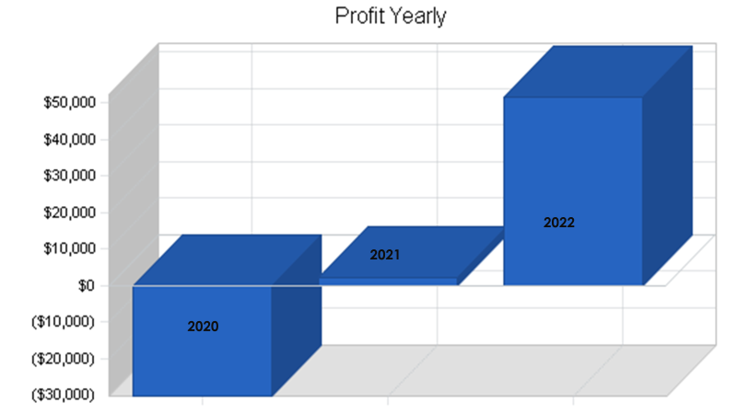
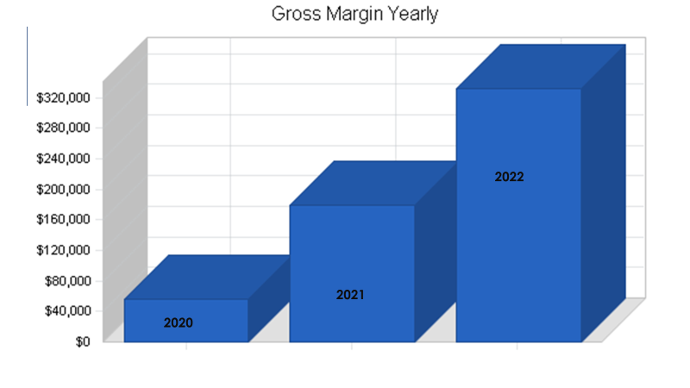
Profit and loss
The projected profit and loss are shown in the following table:

Slide 19
Profit and Loss /Expenses
Sales | $80,597 | $255,156 | $475,163
Direct Cost of Sales | $24,179 | $76,547 | $142,549
Other Costs of Sales | $0 | $0 | $0
Total Cost of Sales | $24,179 | $76,547 | $142,549
Gross Margin | $56,418 | $178,609 | $332,614
Gross Margin % | 70.00% | 70.00% | 70.00%
Payroll | $46,550 | $99,200 | $147,800
Sales and Marketing and Other Expenses | $3,600 | $7,200 | $10,000
Depreciation | $12,996 | $20,000 | $24,000
Rent | $9,000 | $18,000 | $27,000
Utilities | $2,400 | $4,800 | $7,200
Insurance | $2,400 | $4,800 | $7,200
Payroll Taxes | $6,983 | $14,880 | $22,170
Other | $900 | $1,800 | $2,700
Total Operating Expenses | $84,829 | $170,680 | $248,070

Slide 20
Expenses
Profit Before Interest and Taxes | ($28,411) | $7,929 | $84,544
Interest Expense | $1,867 | $4,836 | $11,036
Taxes Incurred | $0 | $928 | $22,052
Net Profit | ($30,278) | $2,165 | $51,456
Net Profit/Sales | -37.57% | 0.85% | 10.83%

Slide 21
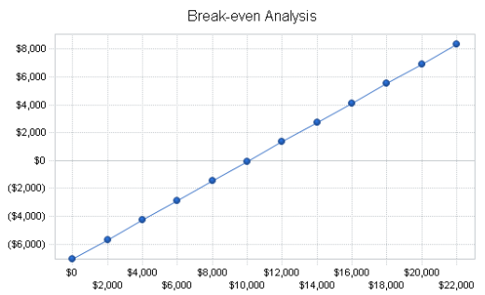
Break even analysis
According to the break-even analysis, $10,099 in monthly revenue is required to break even.
Break-even Analysis
Monthly Revenue Break-even | $10,099
Assumptions:
Average Percent Variable Cost | 30%
Estimated Monthly Fixed Cost | $7.069

Slide 22
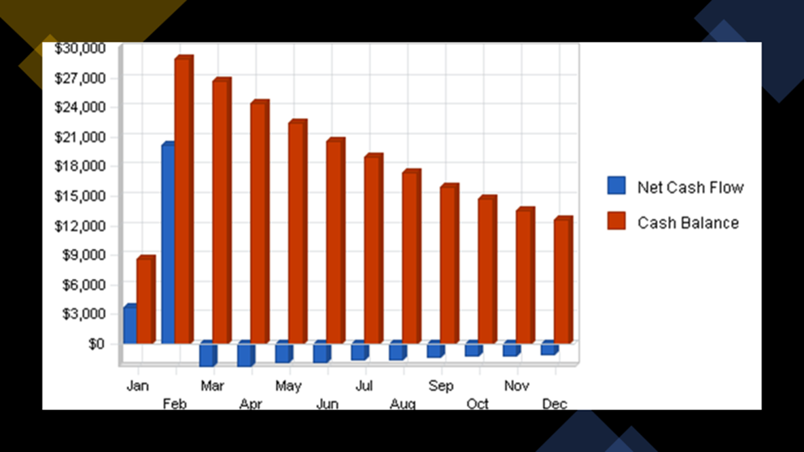
Cash Flow Statement
Projected Cash Flow is shown in the table and chart below.

Slide 23
Cash Flow
Cash Received
Cash from Operations
Cash Sales | $80,597 | $255,156 | $475,163
Subtotal Cash from Operations
Additional Cash Received
Sales Tax, VAT, HST/GST Received | $0 | $0 | $0
New Current Borrowing | $20,000 | $0 | $0
New Other Liabilities (interest-free) | $0 | $0 | $0
New Long-term Liabilities | $0 | $75,000 | $75,000
Sales of Other Current Assets | $0 | $0 | $0
Sales of Long-term Assets | $0 | $0 | $0
New Investment Received | $10,000 | $0 | $0
Subtotal Cash Received | $110,597 | $330,156 | $550,163
Expenditures | 2020 | 2021 | 2022

Slide 24
Expenditures from Operations
Cash Spending | $46,550 | $99,200 | $147,800
Bill Payments | $50,960 | $127,404 | $242,199
Subtotal Spent on Operations | $97,510 | $226,604 | $389,999
Additional Cash Spent
Sales Tax, VAT, HST/GST Paid Out | $0 | $0 | $0
Principal Repayment of Current Borrowing | $5,500 | $5,500 | $5,500
Other Liabilities Principal Repayment | $0 | $0 | $0
Long-term Liabilities Principal Repayment | $0 | $7,500 | $7,500
Purchase Other Current Assets | $0 | $0 | $0
Purchase Long-term Assets | $0 | $75,000 | $75,000
Dividends | $0 | $0 | $0
Subtotal Cash Spent | $103,010 | $314,604 | $477,999
Net Cash Flow | $7,586 | $15,552 | $72,164
Cash Balance | $12,575 | $28,127 | $100,291

Slide 25

Balance sheet
Current Assets
Cash | $12,575 | $28,127 | $100,291
Other Current Assets | $0 | $0 | $0
Total Current Assets | $12,575 | $28,127 | $100,291
Long-term Assets
Long-term Assets | $22,141 | $97,141 | $172,141
Accumulated Depreciation | $21,985 | $41,985 | $65,985
Total Long-term Assets | $156 | $55,156 | $106,156
Total Assets | $12,731 | $83,283 | $206,447
Liabilities and Capital | 2020 | 2021 | 2022

Slide 26
Current Obligations
Accounts Payable | $4,610 | $10,996 | $20,705
Current Borrowing | $14,500 | $9,000 | $3,500
Other Current Liabilities | $0 | $0 | $0
Subtotal Current Liabilities | $19,110 | $19,996 | $24,205
Long-term Liabilities | $2,858 | $70,358 | $137,858
Total Liabilities | $21,968 | $90,354 | $162,063
Paid-in Capital | $10,000 | $10,000 | $10,000
Retained Earnings | $11,041 | ($19,237) | ($17,071)
Earnings | ($30,278) | $2,165 | $51,456
Total Capital | ($9,237) | ($7,071) | $44,384
Total Liabilities and Capital | $12,731 | $83,283 | $206,447
Net Worth | ($9,237) | ($7,071) | $44,384

Slide 27
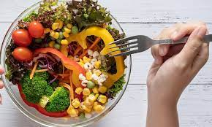
Conclusion
GreeCo is aiming to produce quality food to ensure the customers with nutrition pre-meals during the whole week.
During the lookdowns, GreeCo was the favorite company and now that we are safe than before, we still continue to be on the top list of the market.

Slide 28
References
Myclimate (2022) ‘What is sustainability?” available at:https://www.myclimate.org/information/faq/faq-detail/what-is-sustainability/?etcc_med=SEA&etcc_par=Google&etcc_cmp=FAQs_EN_UK&etcc_grp=120069100 last accessed: 12/08/2022
Wikipedia(2022) ‘Milestone’ available at: https://en.wikipedia.org/wiki/Milestone last accessed 12/08/2022
Wikipedia(2022) ‘Exit planning’ available at: https://en.wikipedia.org/wiki/Exit_planning last accessed 12/08/2022
Limetry (2019)‘Kitchen Management: Manage Your Restaurant Kitchen Effectively’available at:https://limetray.com/blog/restaurant-kitchen-management/ last accessed 12/08/2022
Researchgate(2008-2022) ‘PESTLE Analysis’ available at: https://www.researchgate.net/figure/PESTEL-Analysis-of-Halal-Market-Halal-Goes-Global-International-Trade-Centre-2015_fig2_332676262 last accessed: 12/08/2022

