Slide 1
Module Name : Advanced Digital Signal Processing
Module Code : ACDA6018
Lecture : 3
Topic : Fourier Series & Fourier Transform
Lecture By,
Mrs. Jenifer Prince Devaraj,
Lecturer - Embedded Electronics,
Faculty of Applied Computing,
UWTSD
Email:j.prince-devaraj@uwtsd.ac.uk

Slide 2
Fourier Series & Fourier Transform
LEARNING OUTCOMES
Upon the successful completion of this lecture, the student should be able to know
Basics of Fourier Series
Basics of Fourier Transform
ACDA6018- Advanced Digital Signal Processing

Slide 3
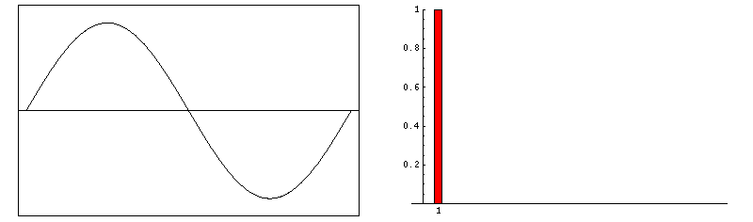
Fourier Series & Fourier Transform
Fourier Series
A Fourier series is a mathematical tool used to represent a periodic function as a sum of sine and cosine functions (harmonics).
Any periodic function of time f(t) can be represented by an infinite series
A function of time f(t) is said to be periodic of period T if f(t) = f(t + T) for all t.
ACDA6018- Advanced Digital Signal Processing

Slide 4
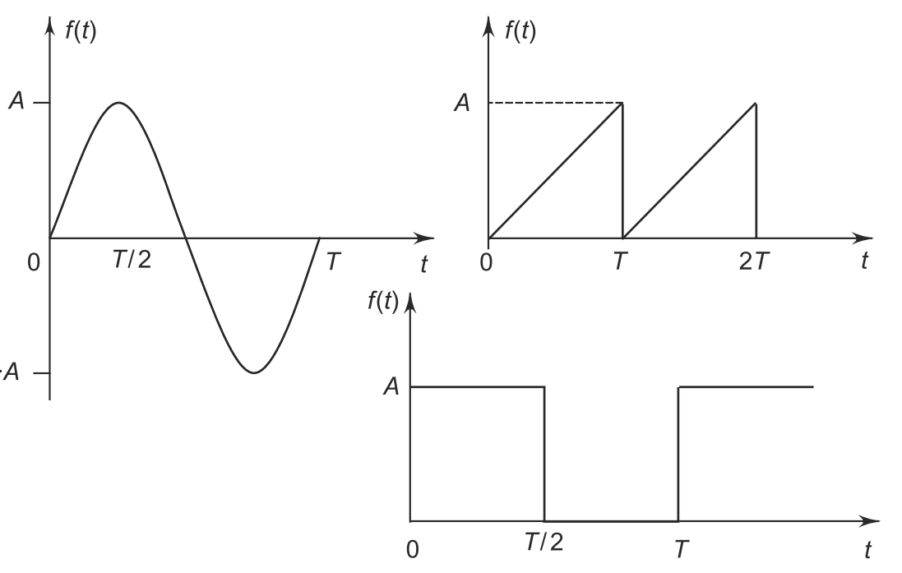
Fourier Series & Fourier Transform
Fourier Series
Periodic waveforms may be expressed in the form of Fourier series.
Non- periodic waveforms may be expressed by Fourier transforms
  Examples of periodic processes : vibration of a tuning fork, oscillations of a pendulum, conduction of heat, alternating current passing through a circuit, propagation of sound in a medium, etc.
ACDA6018- Advanced Digital Signal Processing

Slide 5
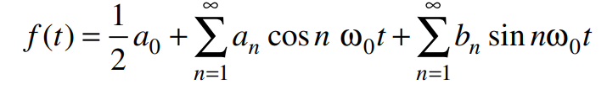
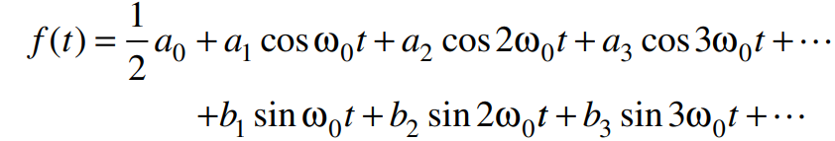
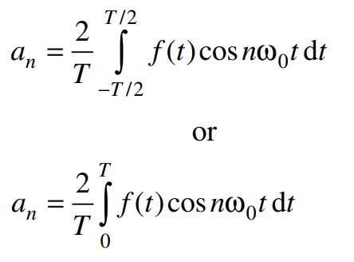
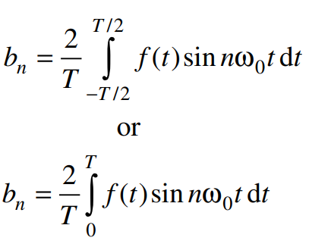
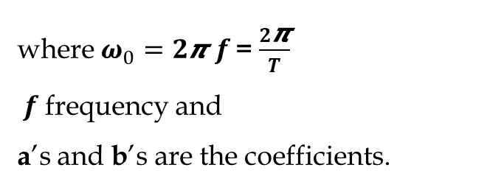
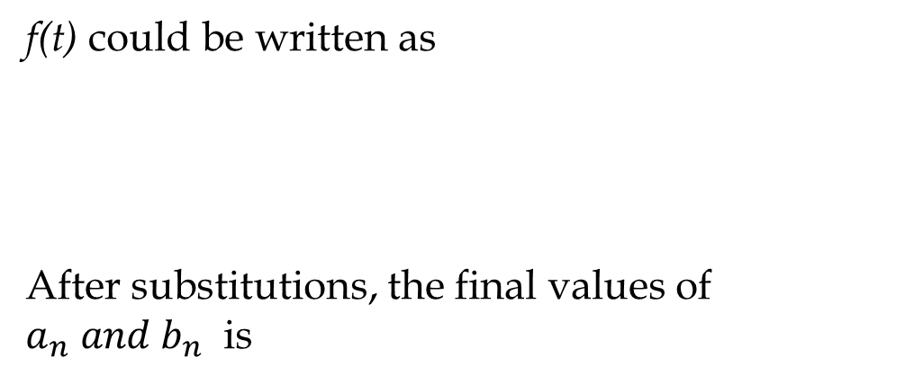
Fourier Series & Fourier Transform
Fourier Series
A periodic function f(t) can be expressed in the form of trigonometric series as
f(t) could be written as
After substitutions, the final values of $a_{n} and b_{n}$ is
where $ω_{0}=2$𝞹$f$ = $\frac{2\text{π}}{T}$
$f$frequency and
a’s and b’s are the coefficients.
ACDA6018- Advanced Digital Signal Processing

Slide 6
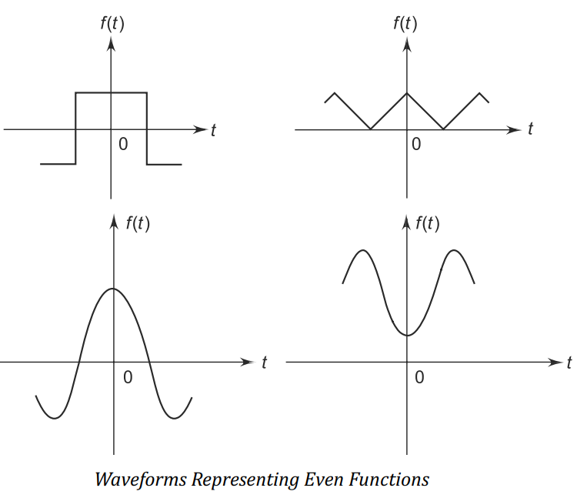

Fourier Series & Fourier Transform
Fourier Series – Symmetry Conditions
A function 𝑓(𝑡) is said to be even if 𝑓(𝑡)=𝑓(−𝑡). This means the function is symmetrical with respect to the y-axis.
Even functions only contribute to the cosine part of the Fourier Series due to their symmetry.
ACDA6018- Advanced Digital Signal Processing

Slide 7
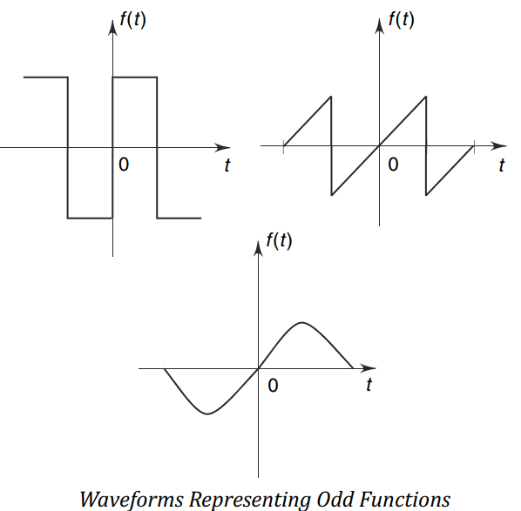

Fourier Series & Fourier Transform
Fourier Series – Symmetry Conditions
A function 𝑓(𝑡) is said to be odd if 𝑓(𝑡)= -𝑓(𝑡). This means the function is symmetrical about the origin, with a rotational symmetry of 180 degrees.
When the function is odd, only sine terms appear in the Fourier series.
ACDA6018- Advanced Digital Signal Processing

Slide 8
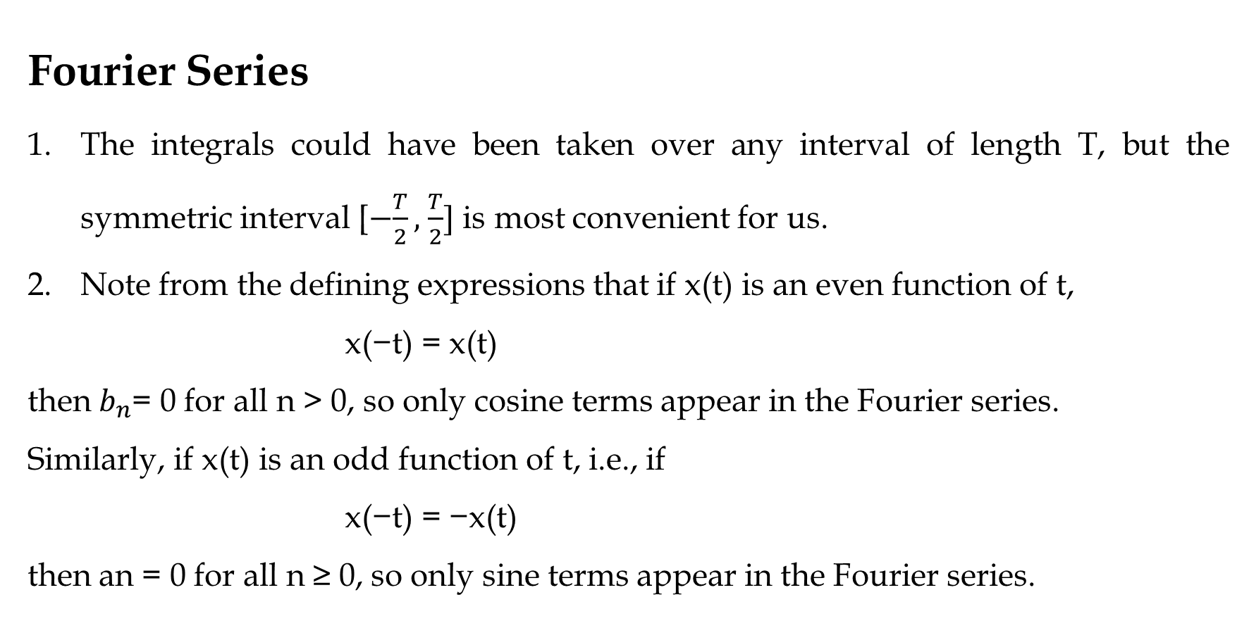
Fourier Series & Fourier Transform
Fourier Series
The integrals could have been taken over any interval of length T, but the symmetric interval [$−\frac{T}{2},$ $\frac{T}{2}]$ is most convenient for us.
Note from the defining expressions that if x(t) is an even function of t, x(−t) = x(t)
then $b_{n}$= 0 for all n > 0, so only cosine terms appear in the Fourier series.
Similarly, if x(t) is an odd function of t, i.e., if
x(−t) = −x(t)
then an = 0 for all n ≥ 0, so only sine terms appear in the Fourier series.
ACDA6018- Advanced Digital Signal Processing

Slide 9
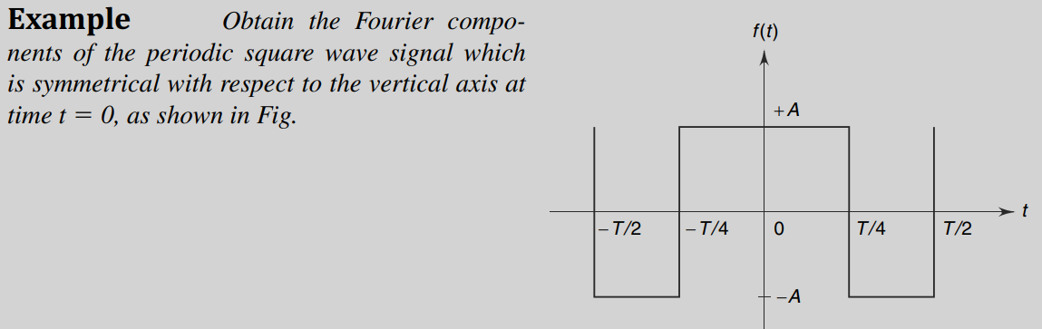
Fourier Series & Fourier Transform
Fourier Series
Example 1: Obtain the Fourier components of the periodic square wave signal which is symmetrical with respect to the vertical axis at time 𝑡=0, as shown in Fig.
ACDA6018- Advanced Digital Signal Processing

Slide 10
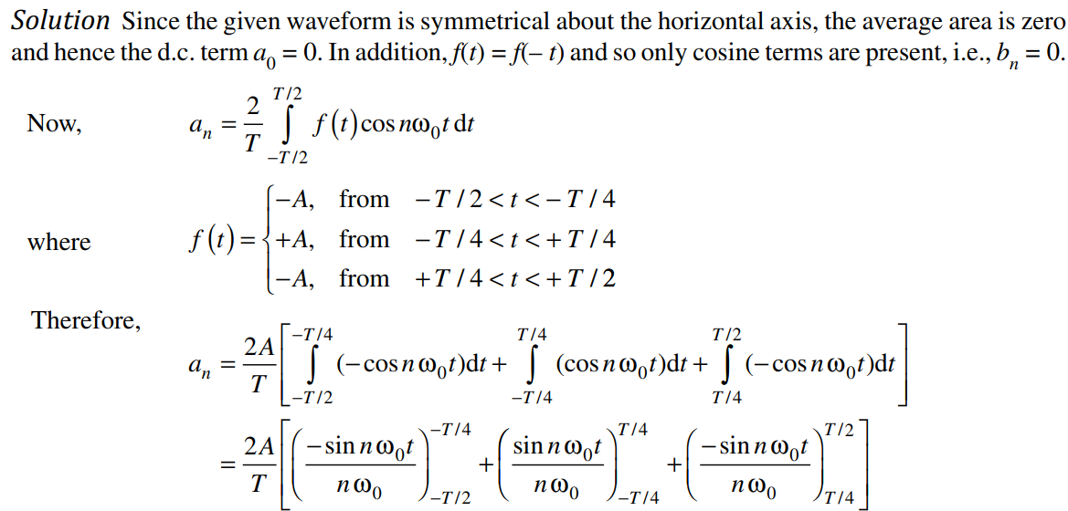
Fourier Series & Fourier Transform
Fourier Series : Example 1
ACDA6018- Advanced Digital Signal Processing

Slide 11
Fourier Series & Fourier Transform
ACDA6018- Advanced Digital Signal Processing

Slide 12
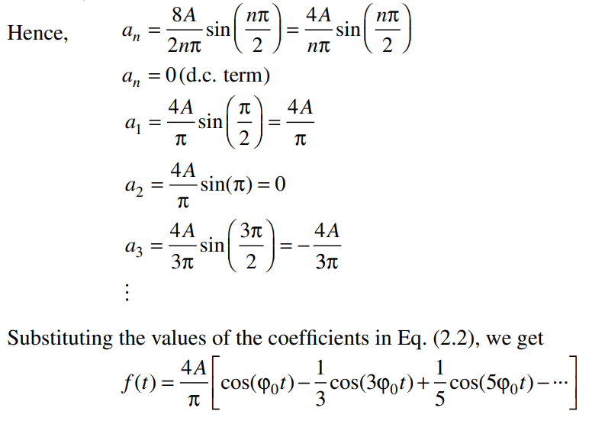
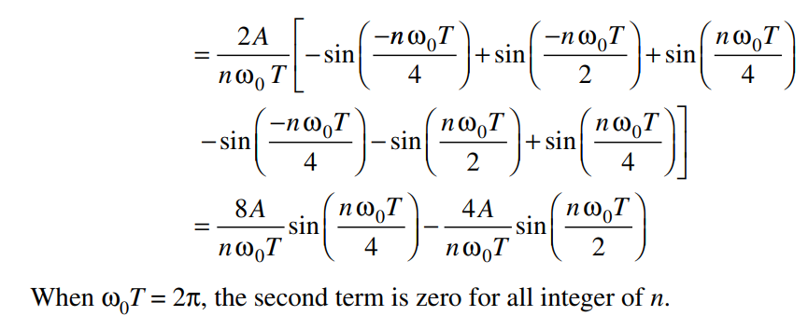
Fourier Series & Fourier Transform
Fourier Series : Example 1
ACDA6018- Advanced Digital Signal Processing

Slide 13
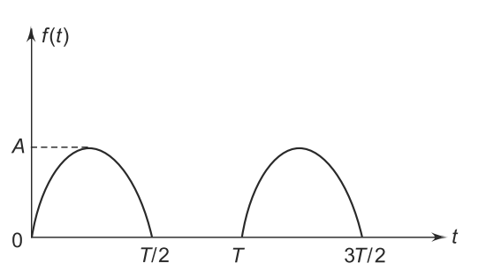
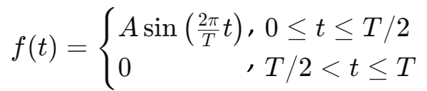
Fourier Series & Fourier Transform
Fourier Series
Example 2: Obtain the trigonometric Fourier series for the half-wave rectified sine wave shown in Fig.
The half wave rectifier could be written as
ACDA6018- Advanced Digital Signal Processing

Slide 14
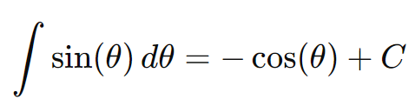
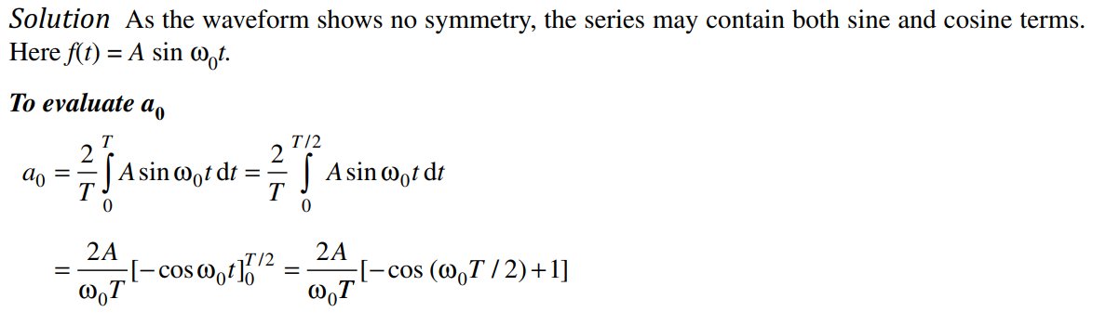
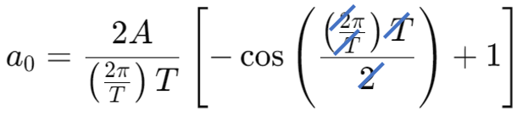
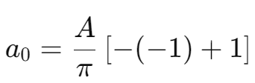
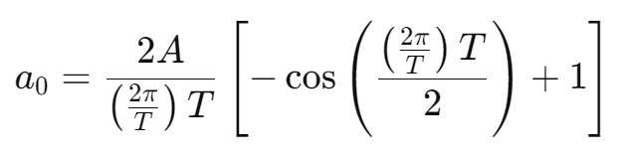
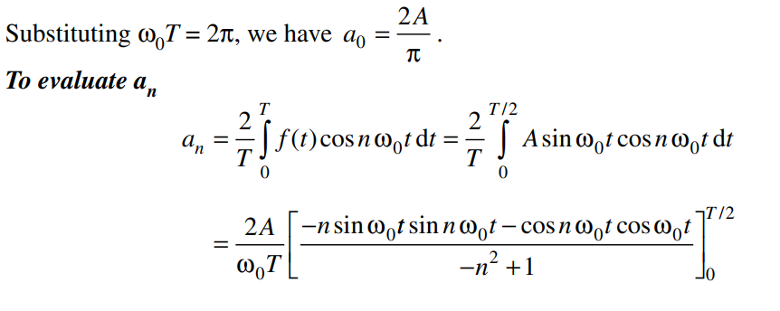
Fourier Series & Fourier Transform
Fourier Series
Example 2:
cos(π)=−1
ACDA6018- Advanced Digital Signal Processing

Slide 15
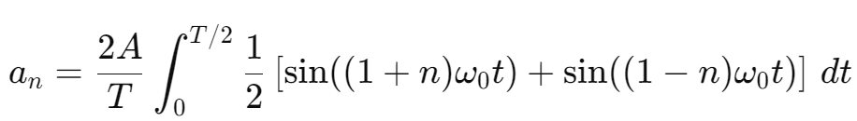
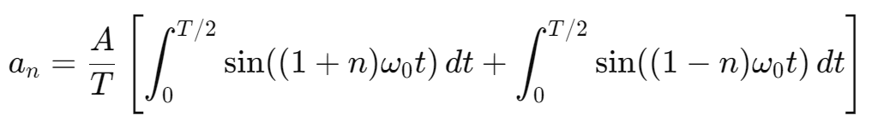
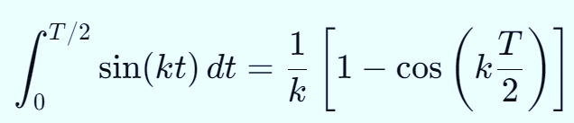
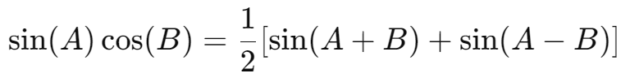
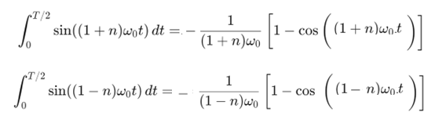

Fourier Series & Fourier Transform
Fourier Series
Example 2:
cos(π)=−1
We know that
This is of the form
ACDA6018- Advanced Digital Signal Processing

Slide 16
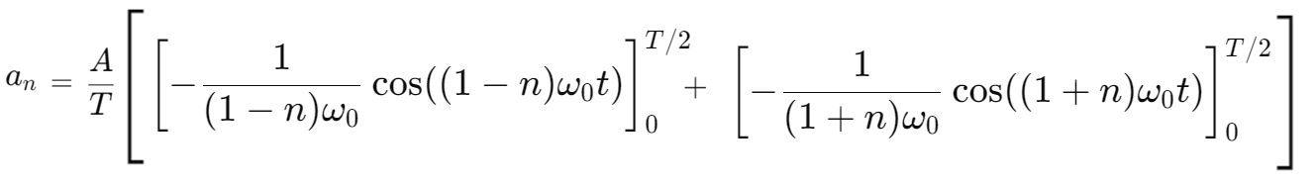
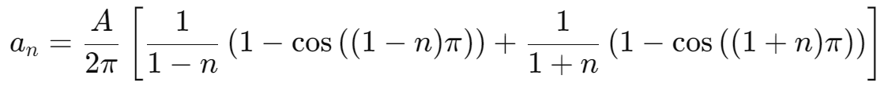

Fourier Series & Fourier Transform
Substitute the values of $ω_{0}=\frac{2 π}{T}$

Slide 17
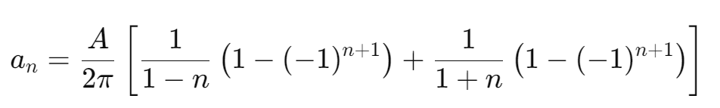
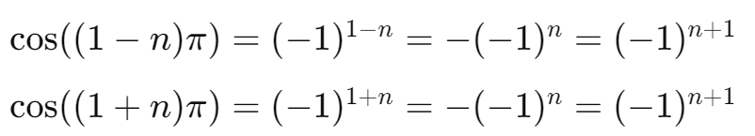


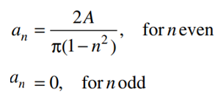
Fourier Series & Fourier Transform

Slide 18
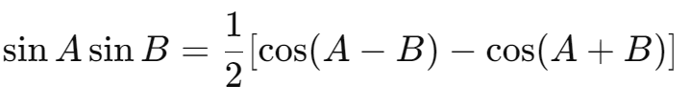
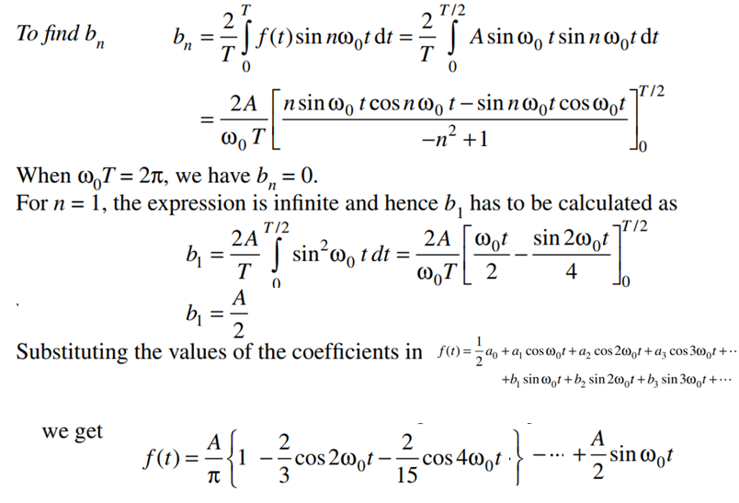
Fourier Series & Fourier Transform
Fourier Series
Example 2:
ACDA6018- Advanced Digital Signal Processing

Slide 19
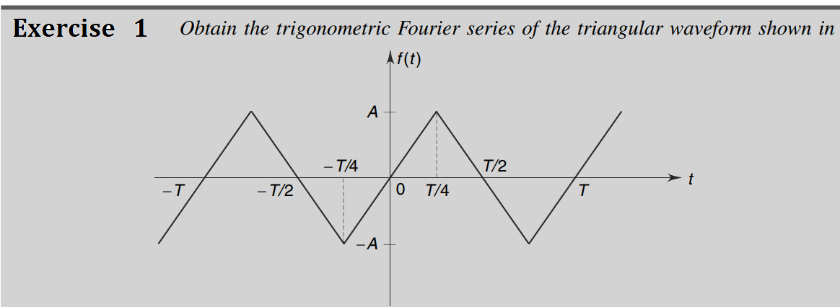
Fourier Series & Fourier Transform
Fourier Series
ACDA6018- Advanced Digital Signal Processing

Slide 20
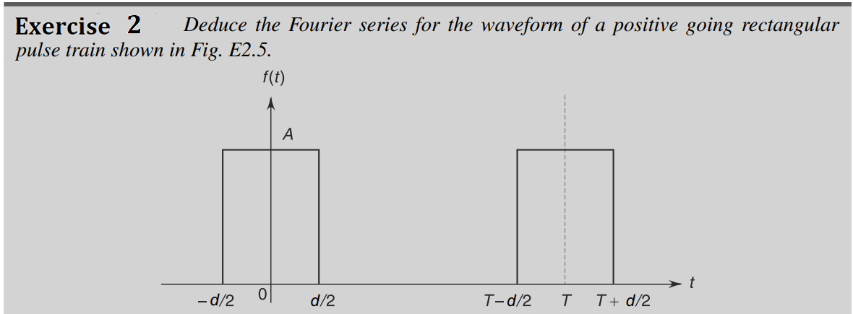
Fourier Series & Fourier Transform
Fourier Series
ACDA6018- Advanced Digital Signal Processing

Slide 21
Fourier Series & Fourier Transform
References
[1] Salivahanan Digital Signal Processing , Thirded., New Delhi, 2015.
[2] S. Haykin and B. V. Veen, Signals and System, SECOND ed., USA, 2002.
ACDA6018- Advanced Digital Signal Processing

Slide 22
Thank You

