Slide 1
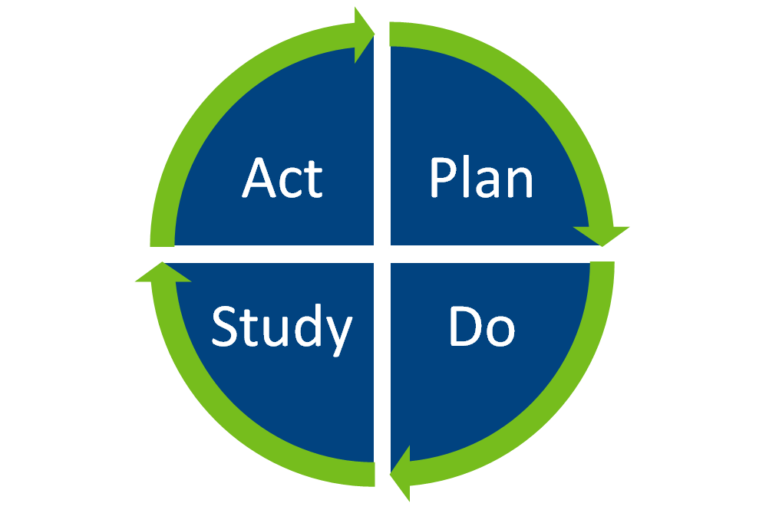
PDSA : Accurate WAASP scoring for better Dietitian referrals
Aim: To improve the accuracy of WAASP scoring by nursing staff on the CF ward and ensure appropriate dietitian referrals for patients at nutritional risk.
Beata Potocka

Slide 2
Introduction
What is WAASP?
WAASP stands for: Weight, Appetite, Ability to Eat, Stress factors, and Pressure sores/wounds
WAASP ensures consistency in identifying low, moderate, and high-risk patients
According to the Welsh Government (2019), the WAASP tool standardizes nutritional risk assessment across some Welsh adult acute hospitals
WAASP ensures patients get the right nutritional support and quick dietitian referrals

Slide 3
The All Wales Adult Nutritional Risk Screening Tool (WAASP)
(NHS Wales, 2025)

Slide 4
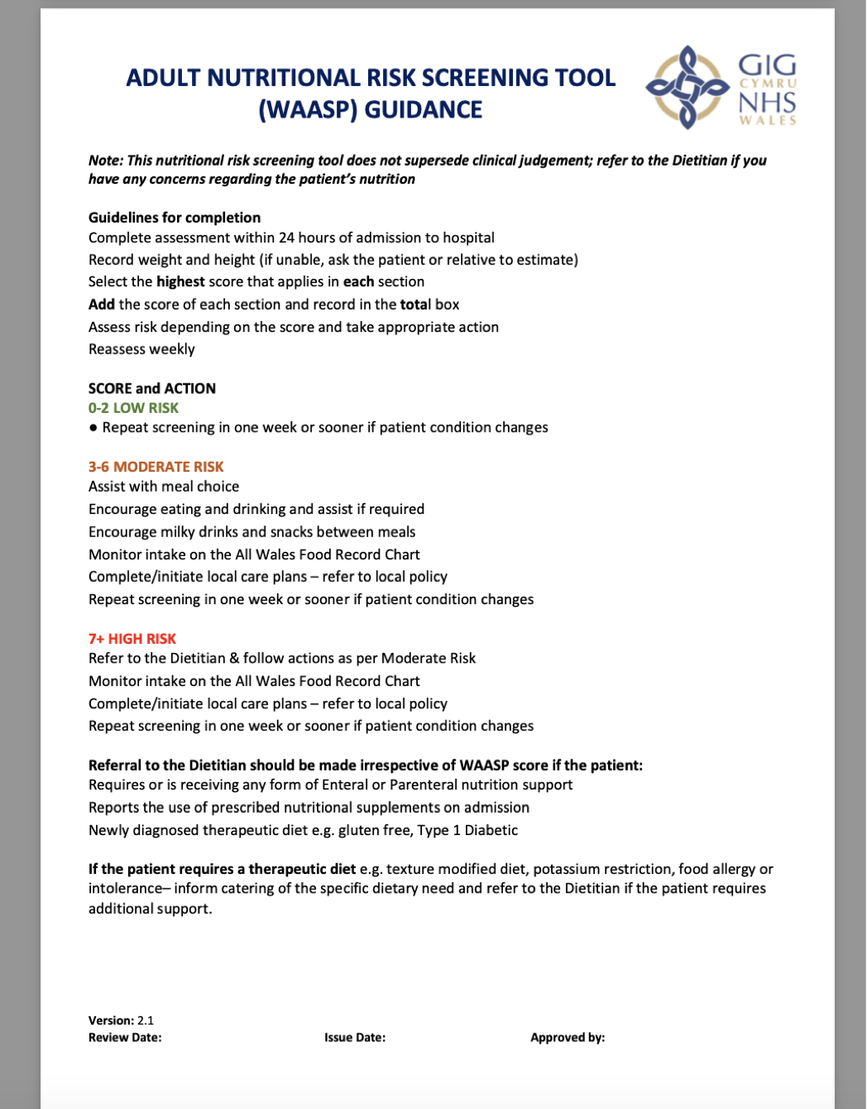
WAASP guidance

Slide 5
Reasons for initiating the PDSA project
Untrained staff
Unreliable Scoring
Under-referral of Patients
Over-referral of Patients
Patient health risks
Continuous improvement

Slide 6
PLAN
What are we trying to achieve and why?
Our main goals :
to improve WAASP scoring accuracy by nursing staff
Ensure patients at risk of malnutrition are referred quickly and correctly
Who was involved?
Nursing staff, dietitians, dietetic assistant practitioner , ward managers, and healthcare assistants.
Why It’s Important?
Incorrect WAASP scoring can cause missed or delayed referrals
Accurate WAASP scoring helps identify high-risk patients early

Slide 7
PLAN
How will we improve WAASP scoring?
Weekly WAASP audits
Referral checklist
WAASP training for nurses
Staff Feedback
Support staff

Slide 8
DO
What actions are taken?
Started a weekly audit of WAASP forms to check accuracy
Identify any gaps in referrals by comparing WAASP scores with actual dietitian referrals
Questionnaire feedback on challenges in scoring and making referrals
Identified common mistakes and tracked improvements over time

Slide 9
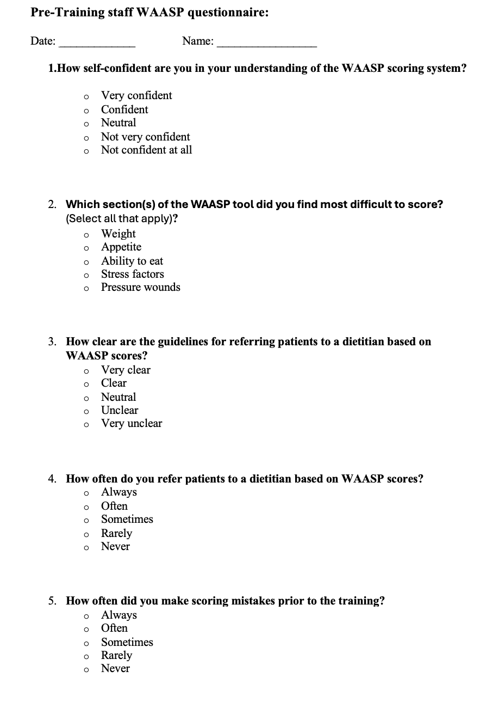
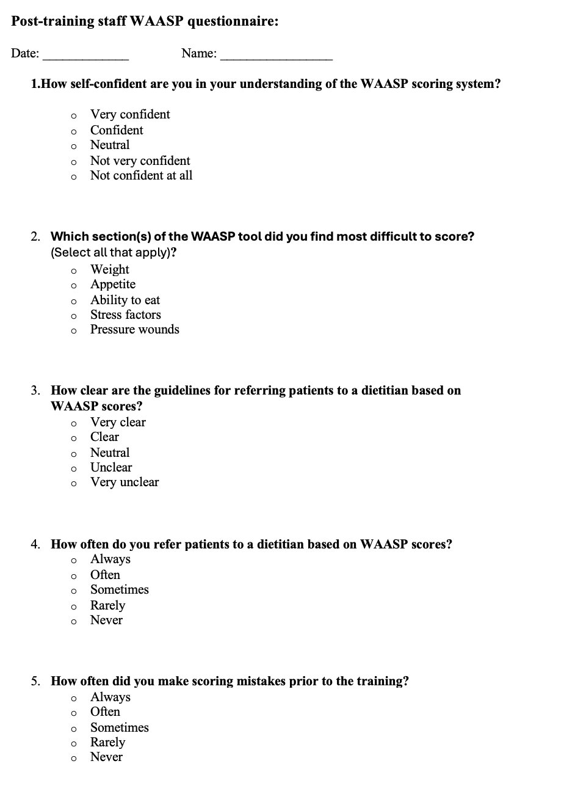
Staff Questionnaire

Slide 10
DO
What actions are taken?
A dietetic assistant practitioner led the training session, as the Code of Conduct for Healthcare Support Workers in Wales highlights the need for ongoing professional development(NHS Wales , 2019)
Who attend ?
10 ward staff attended ( 2 ward managers ,4 qualified nurses and 4 auxiliary nurses )
How was delivered ?
WAASP training sessions was a presentation
hands-on practice
Q&A sessions
What We Achieved?
Less errors in WAASP forms were detected
Nursing staff gained better understanding of WAASP

Slide 11
STUDY
What does the data say?

Slide 12
STUDY
What does the data say?

Slide 13
Study – Key findings
Self-confidence in WAASP scoring improved
Scoring difficulties reduced
Referral guidelines became clearer
More accurate referrals
Fewer scoring mistakes

Slide 14
ACT
What’s our next steps?
Ongoing audits (monthly)
Continued use of the referral checklist
Monthly WAASP refresher training to reinforce scoring accuracy
Encouraging peer feedback and mentorship
Regular Meetings

Slide 15
Future PDSA cycle
My current PDSA cycle has helped set the foundation for long-term improvements in WAASP scoring
We could adapt this training for other wards e.g. mental health, general medical, respiratory, geriatric wards
If the checklist proves useful, we could explore digital referral tools
To introduce 1:1 WAASP coaching sessions those who need extra help

Slide 16


Slide 17
Reference list
1.Welsh Government (2019) Nationally Standardised Adult Inpatient Assessment and Core Risk Assessments. Available at: https://www.gov.wales/sites/default/files/publications/2019-08/nationally-standardised-adult-inpatient-assessment-and-core-risk-assessments_0.pdf
2. NHS Wales (2025) Adult Nutritional Risk Screening Tool (WAASP). Available at: https://nwis.nhs.wales/information-services/information-standards/data-standards/data-standards-files/nursing-documentation-docs/rsk-allwales-waaspnutrition-paperform-v2-1-pdf-docx-pdf/
3. HEIW (2019) Code of Conduct for Healthcare Support Workers in Wales. Available at: https://heiw.nhs.wales/files/educational-development/code-of-conduct-for-health-support-workers-in-wales-pdf/

