Slide 1
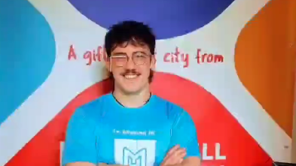
Matthew's House Placement
Wiliam Bryce (2416710)
(Mattscafesa1, 2026)
Notes:
Hello, my name is Willliam Bryce. This is presentation is a reflection of the 80 hours that I completed at Matthew's House.

Slide 2
Overview:
Main Question:
‘’Having completed your academic placement, consider how that experience will benefit your future study and career aspirations and goals’’
Overview of my placement at Matthew's House
Why I chose Matthew's House and how it relates to my future career.
Skill developed throughout the placement
Reflection using Gibbs' reflective Cycle.
What has Matthew's House taught me about my future career and what knowledge have I gained toward it.

Slide 3
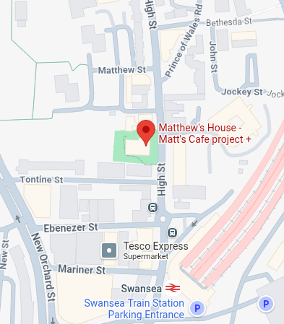
Matthews House Overview:
Setting:
Matthew's house is a community-based organisation in Swansea supporting vulnerable members of the community.

Slide 4
Continued:
Main duties:
Food preparation
Serving food and drinks
Cleaning
Sorting donations and stock checks
Collections and deliveries
Training completed:
Safeguarding and values training
Naloxone training

Slide 5
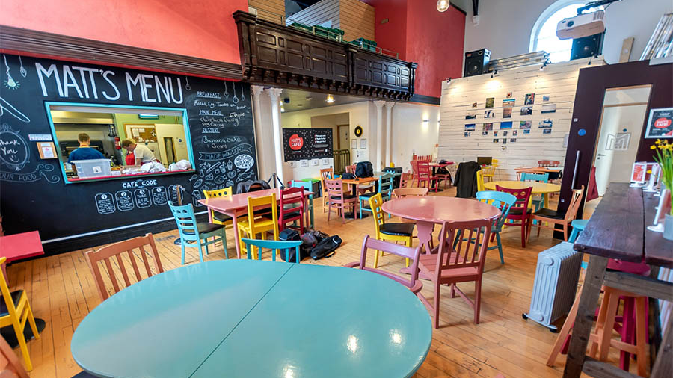
Why I chose Matthew's House
(Matthews House,2026)

Slide 6
I chose Matthew's House because it puts me in direct contact with real community issues that are relevant in policing.
Vulnerability:
Working at Matthew House helped me understand the needs and how to provide support for people that are dealing with homelessness, addiction, poverty, trauma, and social exclusion.
Community:
It showed me how charities and volunteering contributes to public safety and welfare beyond the formal criminal justice system.
Career:
I hope to join the Metropolitan police and become a detective. For this I need experience working with the public, as well as confidence, empathy, and calm decision-making skill.

Slide 7

Skills gained and developed

Slide 8
Confidence:
Initially nervous at the start to then being more comfortable with volunteers, customers, and tasks.

Slide 9
Communication:
Taking orders from customers, asking for help from fellow volunteers, and adapting to customer's needs. I was constantly having to talk to people which helped develop my communication skills.

Slide 10
Teamwork:
Developed through working with volunteers under pressure to ensure service runs efficiently and effectively.

Slide 11
Resilience:
Staying focused during difficult tasks, especially drinks service and serving meals on the pass.

Slide 12
Professionalism:
Always being reliable, punctual, respectful, patient, adaptable, and always willing to complete any task.

Slide 13
Gibbs' Reflective Cycle
Description: Duties require lots of focus, high pressure roles during service.
Evaluation: Positive growth through support, feedback, and practice.
Analysis: Pressure helped me develop transferable skills for policing.
Conclusion: I became more confident, adaptable, and professional.
Action plan: Continue volunteering, build confidence in communication and seek further training.
Feelings: Nervous at first, especially with unfamiliar tasks and social interacts.
Gibbs, 1988

Slide 14

Reflective Example:

Slide 15
Situation
On Sunday 18th January, I was responsible for making drink during service. It was extremely busy, orders came in quick, many customers kept forgetting what they had ordered due to substance use or they move tables.

Slide 16
What I did
I stayed focused, used what I had learnt already from serving meals on the pass, and kept going rather than letting the pressure affect me.

Slide 17
What I learnt
I learnt that I work well under pressure when I stay calm, ask for guidance when needed, and apply my previous experiences to new tasks

Slide 18
Knowledge gained for studies and career
Safeguarding and values training:
Completing my safeguarding and values training allows me to recognise vulnerability and distress and how to respond appropriately.
This is useful for my future career as the (Children Act 2004) places duties on the police so safeguard and promote the welfare of children.
The (Care Act 2014) also relates as it focuses on protecting adult at risk of abuse or neglect, which detectives often investigate with domestic abuse, exploitation, and modern slavery cases.

Slide 19
Continued:
Substance misuse and naloxone training:
This training helped me understand the seriousness of drug related harm and why interventions matters.
Naloxone reverses the effects of an opioid overdose, giving first responders more time. This training helped me recognise the signs of an overdose and to stay calm under pressure and when calling for emergency services.
(Home Office, 2025)

Slide 20
Continued:
Practical empathy:
Helped me recognise that a lot of the behaviours that I saw, may be shaped by trauma, addiction, and instability.

Slide 21
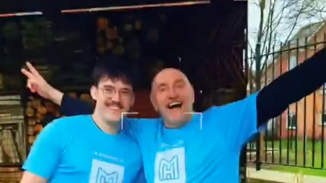
What Working at Matthew's House taught me about my future career.
(Mattscafesa1, 2026)

Slide 22
Insight 1
Communications is central. Many situations require patience, clear communication and the ability to adapt with new information.

Slide 23
Insight 2
Vulnerability must be understood. People may present as being difficult, but they may be intoxicated, distressed, or have deeper personal issues.

Slide 24
Insight 3
Being level-headed is a professional skill. Busy service periods taught me to stay focus and not panic when under pressure.

Slide 25
Insight 4
Effective support is a multi-agency response. It relies on charities, public services, volunteers, and public infrastructure working together to be successful.

Slide 26
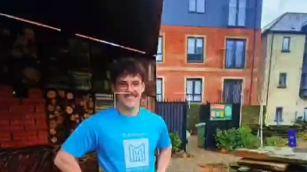
Action plan for future studies and employment
(Mattscafesa1, 2026)

Slide 27
I have chosen to remain at Matthew's House after finishing my mandatory 80 hours. This is to build confidence and experience working with vulnerable people.
Continue volunteering:

Slide 28
Develop communication
Work on one-to-one conversations in unfamiliar situations, this is an area that still needs more growth.

Slide 29
Build specialist knowledge
Seek and enrol on more training courses that will be beneficial to future employment and apply these skills and experiences to real world applications.

Slide 30
Conclusion
Volunteering at Matthew's House has helped me develop transferable skills such as confidence, resilience, teamwork, and professionalism. More importantly, it has shown me how community support, empathy, vulnerability, and safeguarding connect to my future studies and policing career.
This placement has confirmed my interest in working with vulnerable people through the police. My action plan has given me practical steps to take.

Slide 31
Reference List
Care Act 2014, c. 23. Available at: https://www.legislation.gov.uk/ukpga/2014/23/contents (Accessed: 30 April 2026)
Children Act 2004, c. 31. Available at: https://www.legislation.gov.uk/ukpga/2004/31/contents (Accessed: 30 April 2026).
Gibbs, G. (1988) Learning by doing : a guide to teaching and learning methods. London: FEU.
Matthews House (2026) The Hill Church Swansea. Available at: https://the-hill.co/matthews-house/ (Accessed: 30 April 2026).
Mattscafesa1 (2026) [Instagram]. Available at: https://www.instagram.com/mattscafesa1/ (Accessed: 29 April 2026).

Slide 32
AI Acknowledgement
I acknowledge the use of PowerPoint's design AI tool on 30/04/26 to make my PowerPoint look nice.
I used the prompt(s): I just clicked on the designs that I liked.
I confirm that I have not presented any AI generated text as my own work. I confirm I have copies of my drafts, notes, and other resources I used before, and after the use of AI tools which I may be asked to provide in evidence.

