Slide 1
Module Name:
Data Centre Virtualization(ACUA6001)
Title: Task A - Presentation 1
Celdwan Bandeira
ID:1812407
Lecturer: Koushik Modak

Slide 2
What is Virtualization?
Virtualization is the process of converting a physical IT resource into a virtual IT resource [1].

Slide 3
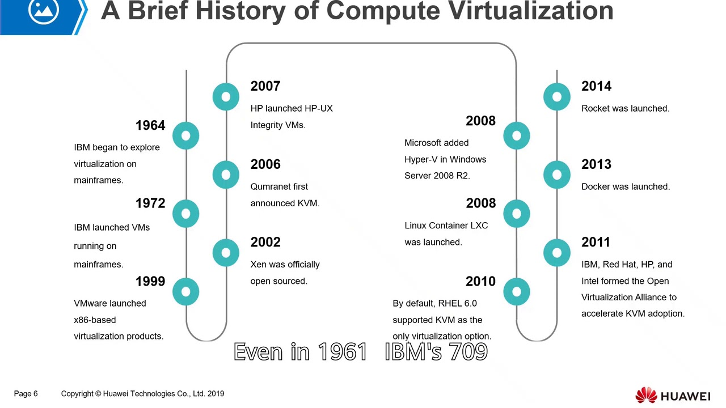


Virtual Machines (VMs)
Brief History
Early 1960’s by IBM (ideia of Mainframes, today called Virtual Desktops) [2]
- As each user, logs on, new “VM” is created.
CMS, a single-user, interative OS was commonly run as the OS The introduction of Virtual Machine Manager from VMWare, and similar products from companies like Microsoft and Citrix has allowed this area to grow very rapidly.
[3]
Figure 1 [4]

Slide 4
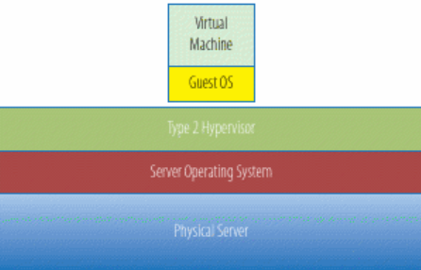
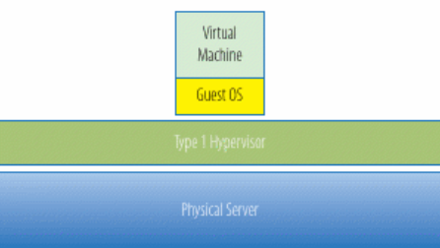
Others VMs
Vmware
Windows VMs
Azure
Citrix
VirtualBox
Parallels Desktop
etc…
Figure 2. Source[2]
Figure 3 Source[2]

Slide 5
Types of Virtualization
Server Virtualization
Desktop Virtualization
Network Virtualization
Application Virtualization
Data Virtualization
Storage Virtualization
Power Virtualization
[1], [2], [5]

Slide 6
Some Common Feature of Virtual Machines
Portability – VMs run on large number of Operating Systems
Supported Guest Operating Systems
Virtual Machines Processor support – Each processing core may only be referenced to one CPU – bound VM at a time
Virtual Machine Memories allocation – The total amount of available RAM on the server cannot be exceeded by the instances of running Virtual machine
Compatible Virtual Machines
[9]

Slide 7
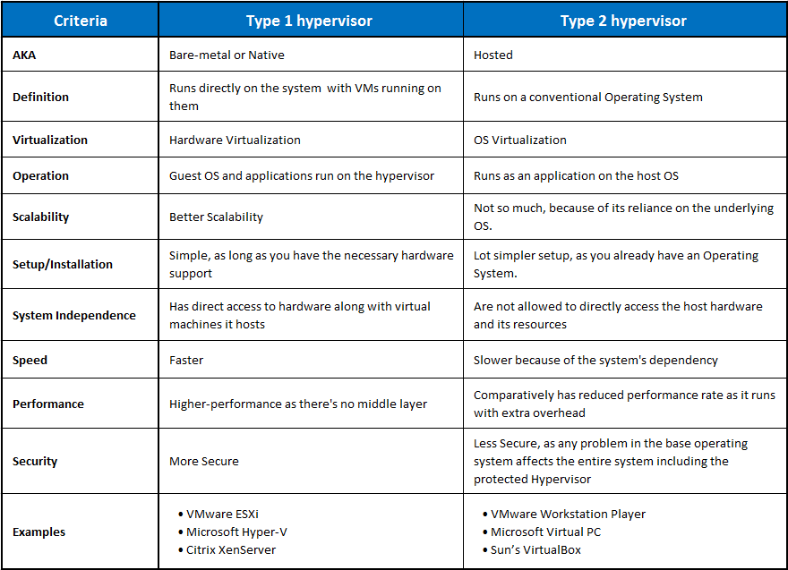
Hypervisor Type 1 and Type 2
Figure 4 [6]

Slide 8
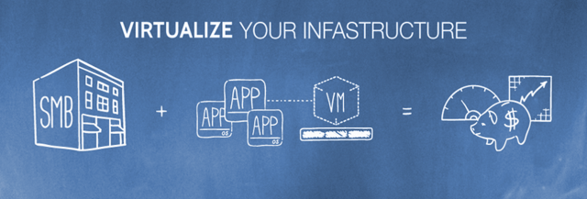
Benefits of Virtualization
Running multiple operating systems simultaneously
Reduce Overall Footprint of Data Center(Infrastructure Consolidation)
Easier Software Installation
Testing and Disaster Recovery
[2], [7], [8]
n.b., Clouds Computing focused in reducing the CO₂ emissions
of their host datacenters are known as Green Clouds.[13]
Figure 5

Slide 9
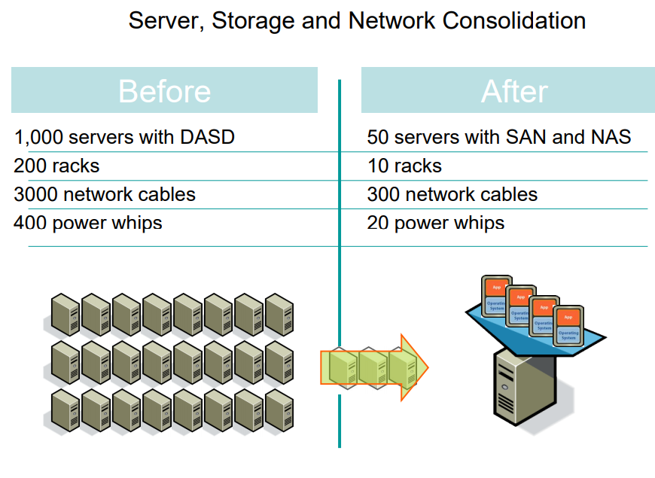
Consolidation
Facility
Hardware
Application
Data
[11]
Figure 6 [10]

Slide 10
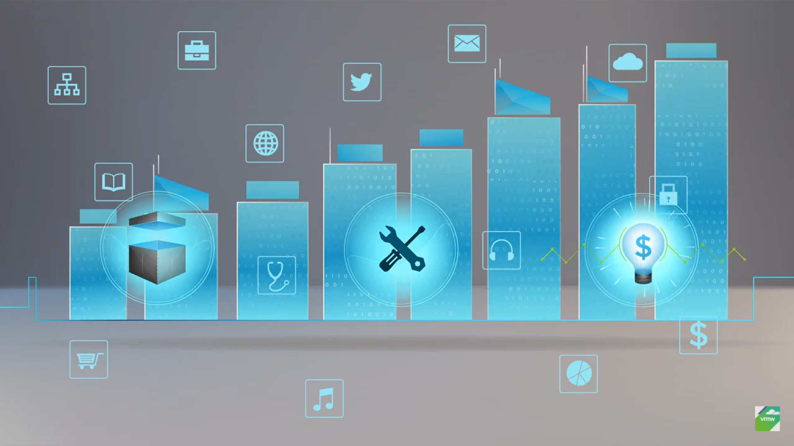
Features and Benefits for an Organization to Adopt Cloud Computing
Reduce investment and Proportional costs
Increase ScalabilityIncrease Availability and Reliability
Quick, self-service access to infrastructure
Simplified management and built-in-security
High performance
[1], [7], [11]
Figure 7 [12]

Slide 11
vSphere 7.0 vs Hyper-V
VMware vSphere 7.0 (2020)
Released in 2020 by VMware
Components(EXSi, vCenter Server, vCenter Host Client)
Powerful for Hybrid Cloud

Slide 12
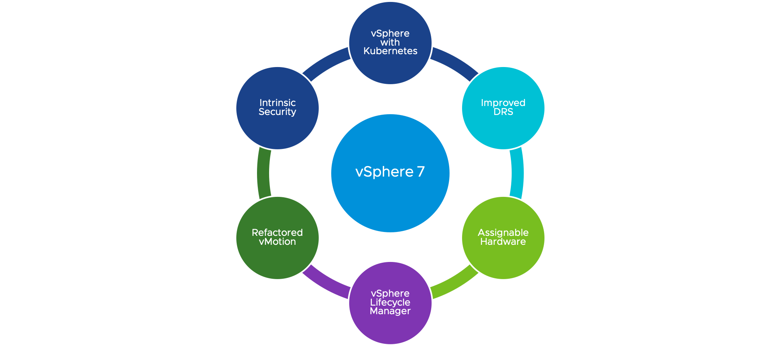
Cont.
Lifecycle
vCenter Profiles
APIs+Developers
Contents Library
Storage
Phycal HW
Virtual HW
Security
DRS + vMotion
[12]
Figure 8

Slide 13
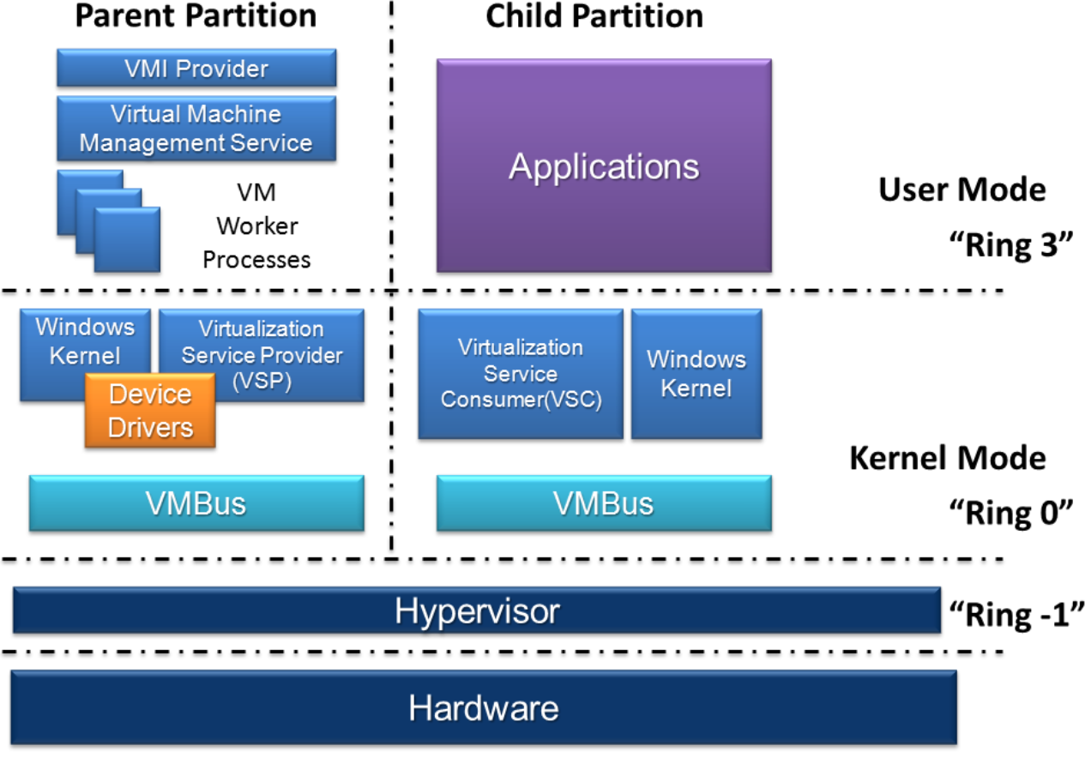
Microsoft Hyper-V(2012)
Experiment with other operating systems. Hyper-V makes it very easy to create and remove different operating systems.
Test software on multiple operating systems using multiple virtual machines. With Hyper-V, you can run them all on a single desktop or laptop computer. These virtual machines can be exported and then imported into any other Hyper-V system, including Azure.
Run software that requires an older versions of Windows or non-Windows operating systems.
Figure 9 []

Slide 14
Cont.
Can use local Storage
Free
live music mixing applications or high precision times could have issues running in a virtual machine
Overload of device resources: can affect all virtual machines.
Limitation(Programs that depend on specific hardware(GPU) will not work well in a virtual machine).
[12]

Slide 15
References
[1] T. Erl, Z. Mahmood, and R. Puttini, Cloud Computing : Concepts, Technology & Architecture. Prentice Hall, 2013. pp.42- 44.
[2] M. Portnoy, Virtualization essentials, Second edition. Indianapolis, Indiana, Sybex, 2016, pp.2-33
[3] techtipsfromwill, “Lesson One: Introduction to Hyper-V” YouTube, 2015. [Online] Available: https://www.youtube.com/watch?v=aueGGZSNRcI [Accessed Mar. 11, 2021].
[4] Loginto Courses“What is Virtual Machine ?, History of Computer Virtualization”, YouTube, 2018, [Online] Available at: https://youtu.be/JdLeXaJpCz4?t=247
[5] S. Vetter, M. Cordero, L. Correia, H. Lin, V. Thatikonda, & R. Xavier, IBM PowerVM Virtualization Introduction and Configuration. IBM Redbooks, 2017, pp.74-98, Available at: https://www.google.co.uk/books/edition/IBM_PowerVM_Virtualization_Introduction/v7HEAgAAQBAJ?hl=en&gbpv=1, [Accessed Mar. 11, 2021].
[6] K. Taylor, “Hypervisor Type 1 vs. Type 2: Difference Between the Two” HiTechNectar, , 2021. [Online] Available at:https://www.hitechnectar.com/blogs/hypervisor-type-1-vs-type-2/, [Accessed Mar. 14, 2021].
[7] Microsoft, “Reasons to use virtualization”, Microsoft 2021, Available at: https://docs.microsoft.com/en-us/virtualization/hyper-v-on-windows/about/, [Accessed Mar. 11, 2021].
[7] S.C. Misra, and A. Mondal, “Identification of a company’s suitability for the adoption of cloud computing and modelling its corresponding Return on Investment”, Mathematical and Computer Modelling, 53(3-4), pp.504-521, 2011. Available: https://reader.elsevier.com/reader/sd/pii/S089571771000155X?token=91F5ACE9D0127FB2BCDE70B78078118D7C4A26717F9D30863818ADBA2B211FC576A3D016D07A1ED5AE803485DF8707CE [Accessed Mar. 10, 2021].
[8] Oracle VM VirtualBox, User Manual, Version 6.1.18, Oracle Corporation, 2004-2021, pp.2, Available at: https://download.virtualbox.org/virtualbox/6.1.18/UserManual.pdf, Accessed Mar. 07, 2021].
*[8] W. Vogels. “Beyond Server Consolidation: Server consolidation helps companies improve resource utilization, but virtualization can help in other ways, too”, pp.20-26, Queue, 6(1), 2008. Available at: https://dl.acm.org/doi/pdf/10.1145/1348583.1348590, [Accessed Mar. 10, 2021].
[9] VMware, “Virtual Machine Features and Specifications”, VMware 2021, Available at: https://docs.vmware.com/en/VMware-Workstation-Player-for-Windows/16.0/com.vmware.player.win.using.doc/GUID-5A20BB16-6400-4D4B-9ED2-66C5BE124285.html [Accessed Mar. 10, 2021].
[10] M. Eisen, “Introduction to virtualization”. The Long Island Chapter of the IEEE Circuits and Systems (CAS) Society. 2011. [Online] Available at: http://mmc2.geofisica.unam.mx/cursos/femp/Herramientas/MaquinasVirtuales/CursoMaquinasVirtuales/Bibliograf%C3%ADaMaquinasVirtuales/introduction_to_virtualization.pdf
[11] N. K. Tan, S. R. Smoot, Private Cloud Computing: Consolidation, Virtualization, and Service-Oriented Infrastructure, Germany: Elsevier Science, 2011.

Slide 16
*[11] P. Krüger, T. Urban, A. Siegling, R. Zimmermann, and H.K. Arndt, “Conceptual Methods to Design Sustainable IT Infrastructures-Standardization, Consolidation, and Virtualization”, pp. 607-616, EnviroInfo 2012 [Online]. Available at: http://enviroinfo.eu/sites/default/files/pdfs/vol7793/0607.pdf, [Accessed Mar. 07, 2021].
[12] VMware vSphere, “Overview: VMware vSphere”, YouTube, 2018, [Online] Available at: https://youtu.be/3OvrKZYnzjM?list=PLgwy_0pHD8S2SK4KJ5KNTMAoTqZVDi2gq, [Accessed Mar. 09, 2021].
[12] VMware vSphere, “Overview of vSphere 7”, YouTube, 2020, [Online] Available: https://www.youtube.com/watch?v=XkP6QCutw9k, [Accessed Mar. 18, 2021].
[13] F. Fernandes, D. Beserra, E.D. Moreno, B Schulze and R.C.G. Pinto, “A virtual machine scheduler based on CPU and I/O-bound features for energy-aware in high performance computing clouds”, Computers & Electrical Engineering, 56, pp.854-870, 2016.

