Slide 1
Topic 3 - Normalization

Slide 2
Learning Objectives
Define what is normalization and its purpose in database design.
Differentiate between the types of normal forms 1NF, 2NF and 3NF.
Transform from lower normal forms to higher normal forms
Use normalization modeling to produce a good database design to 3NF.

Slide 3
Acknowledgments
Some of these slides have been adapted from Thomas Connolly and Carolyn Begg

Slide 4
Normalization
Main objective in developing a logical data model for relational database systems is to create an accurate representation of the data, its relationships, and constraints.
To achieve this objective, must identify a suitable set of relations.

Slide 5
Purpose of Normalization
Characteristics of a suitable set of relations include:
  the minimal number of attributes necessary to support the data requirements of the enterprise;
  attributes with a close logical relationship are found in the same relation;
  minimal redundancy with each attribute represented only once with the important exception of attributes that form all or part of foreign keys.

Slide 6
Purpose of Normalization
The benefits of using a database that has a suitable set of relations is that the database will be:
  Easier for the user to access and maintain the data;
  Take up minimal storage space on the computer.

Slide 7
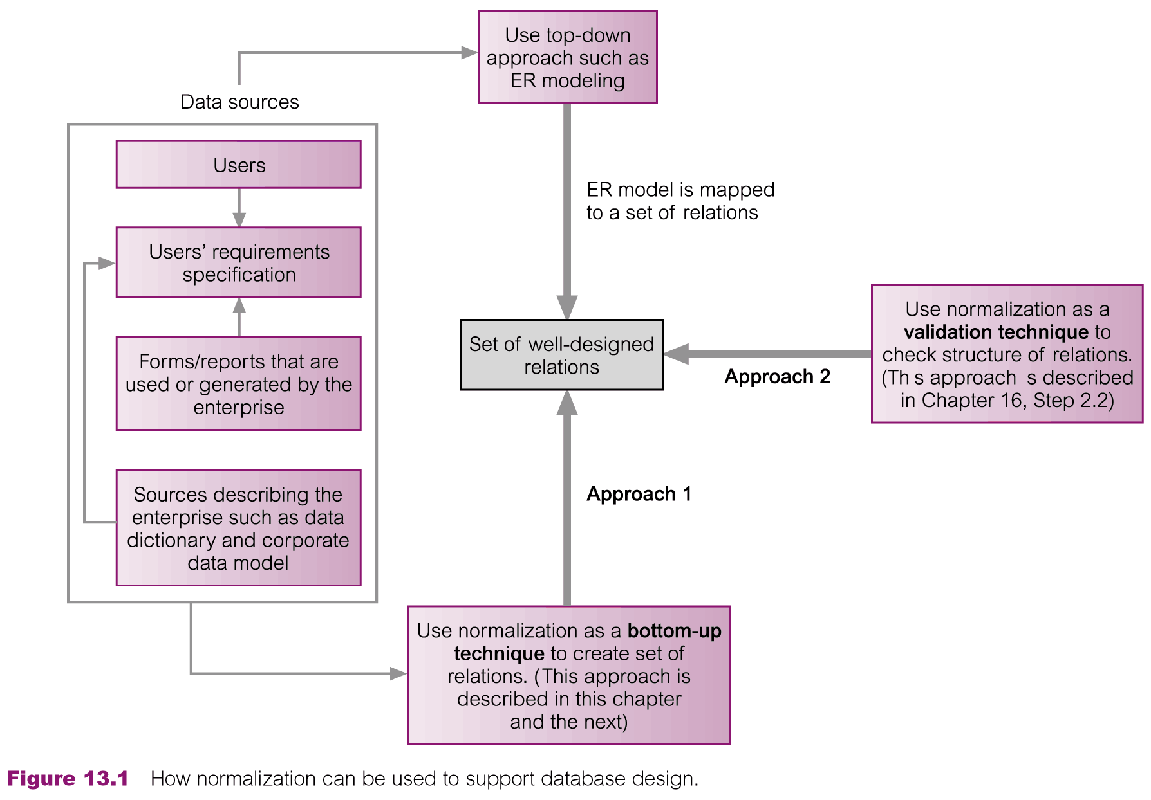
Normalization Supporting Database Design

Slide 8
Normalization
The three most commonly used normal forms are:
  First Normal Form (1NF);
  Second Normal Form (2NF);
  Third Normal Form (3NF).
Based on functional dependencies among the attributes of a relation.
A relation can be normalized to a specific form to prevent possible occurrence of update anomalies.

Slide 9
Normalization
Normalization is the process for assigning attributes to entities
  Reduces data redundancies
  Helps eliminate data anomalies
  Produces controlled redundancies to link tables
Normalization stages
  1NF - First normal form
  2NF - Second normal form
  3NF - Third normal form
  4NF - Fourth normal form

Slide 10
Normalization
Database normalization is process used to organize a database into tables and columns.
The idea is that a table should be about a specific topic and that only those columns which support that topic are included.

Slide 11
Normalization
For example, a spreadsheet containing information about sales people and customers servers several purposes:
  Identify sales people in your organization;
  List all customers your company calls upon to sell product;
  Identify which sales people call on specific customers.

Slide 12
Normalization
By limiting a table to one purpose you reduce the number of duplicate data that is contained within your database, which helps eliminate some issues stemming from database modifications.
To assist in achieving these objectives, some rules for database table organization have been developed.

Slide 13
Data Redundancy
Major aim of relational database design is to group attributes into relations to minimize data redundancy and reduce file storage space required by base relations.
Problems associated with data redundancy are illustrated by comparing the following Staff and Branch relations with the StaffBranch relation.

Slide 14
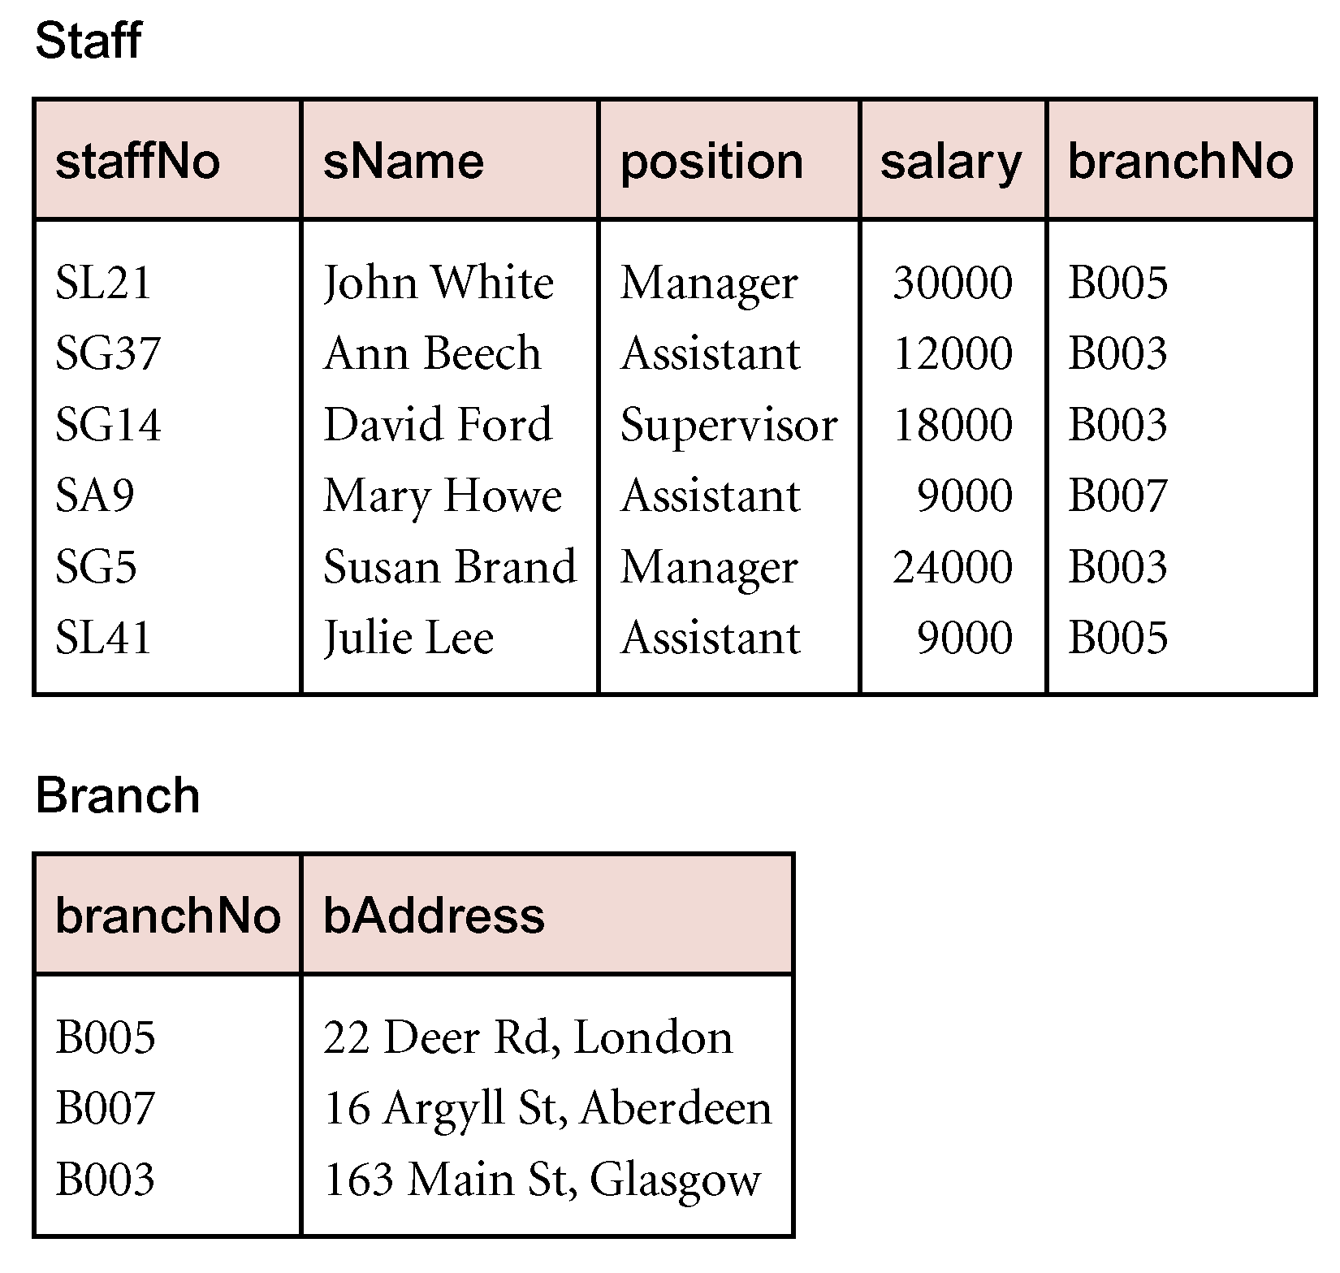
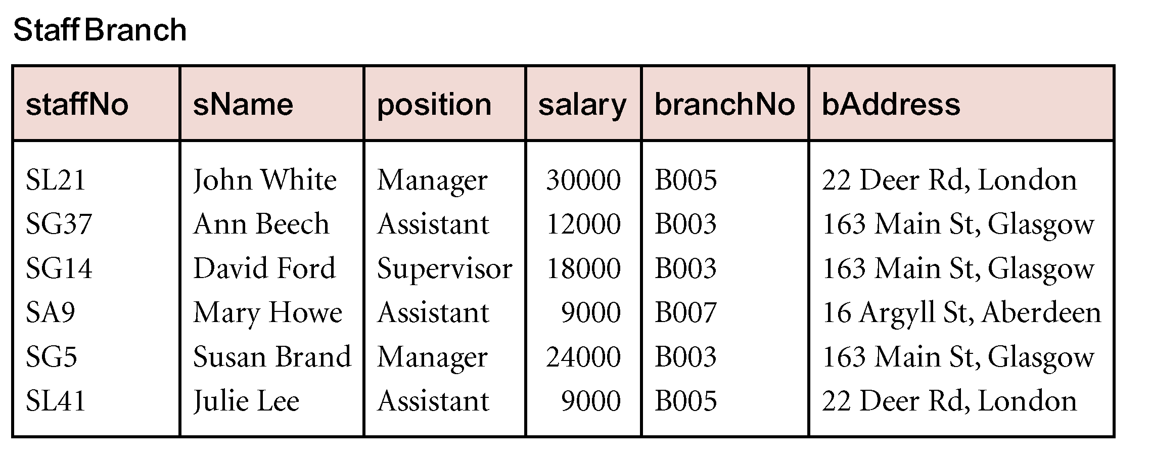
Data Redundancy

Slide 15
Data Redundancy
StaffBranch relation has redundant data:
  Details of a branch are repeated for every member of staff.
In contrast, branch information appears only once for each branch in Branch relation and only branchNo is repeated in Staff relation, to represent where each member of staff works.

Slide 16
Lossless-join and Dependency Preservation Properties
Two important properties of decomposition.
  Lossless-join property enables us to find any instance of the original relation from corresponding instances in the smaller relations.
  Dependency preservation property enables us to enforce a constraint on the original relation by enforcing some constraint on each of the smaller relations.

Slide 17
Update Anomalies
Relations that contain redundant information may potentially suffer from update anomalies.
Types of update anomalies include:
  Insertion;
  Deletion;
  Modification.

Slide 18
Insertion Anomalies
To insert the details of new members of staff into the StaffBranch relation:
  We must enter the correct details of the branch at which the staff are to be located to keep the data consistent.

Slide 19
Deletion Anomalies
If we delete a tuple from the StaffBranch relation that represents, the last member of staff located at a branch:
  The details about that branch are lost from the database;
  If we delete the tuple for SA9 (Mary Howe) we lose the details relating to branch B007.

Slide 20
Modification Anomalies
If we want to change the value of one of the attributes of a particular branch in the StaffBranch relation:
  For example the address of branch number B003:
    We must update the tuples of all staff located at that branch.

Slide 21
Functional Dependency
The main concept associated with normalization is functional dependency.
Functional Dependency
  Describes relationship between attributes in a relation.
  If A and B are attributes of relation R:
    B is functionally dependent on A (denoted A → B), if each value of A in R is associated with exactly one value of B in R.

Slide 22
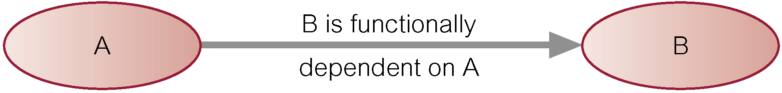
Functional Dependency
Property of the meaning (or semantics) of the attributes in a relation.
Diagrammatic representation:
Determinant of a functional dependency refers to attribute or group of attributes on left-hand side of the arrow.

Slide 23
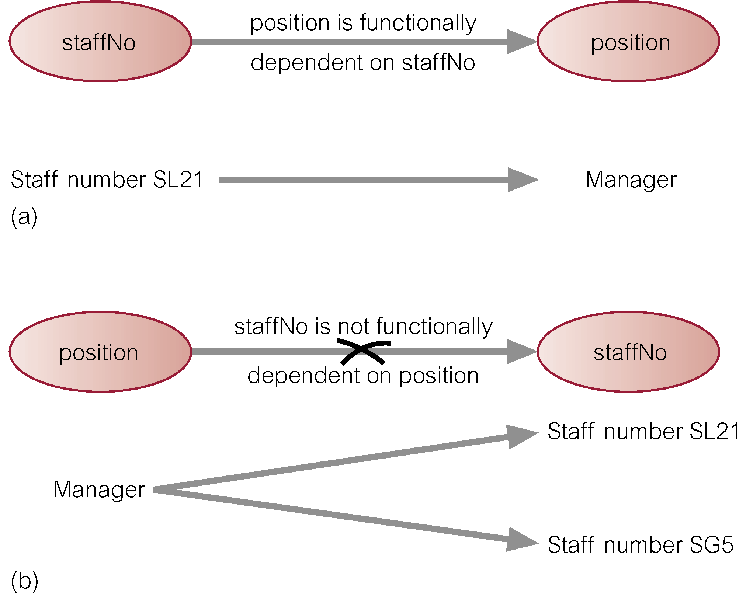
Example - Functional Dependency

Slide 24
Functional Dependency
Main characteristics of functional dependencies used in normalization:
  Have a 1:1 relationship between attribute(s) on left and right-hand side of a dependency;
  Hold for all time;
  Are nontrivial.

Slide 25
Functional Dependency
Complete set of functional dependencies for a given relation can be very large.
Important to find an approach that can reduce set to a manageable size.
Need to identify set of functional dependencies (X) for a relation that is smaller than complete set of functional dependencies (Y) for that relation and has property that every functional dependency in Y is implied by functional dependencies in X.

Slide 26
Example Functional Dependency that holds for all Time
Consider the values shown in staffNo and sName attributes of the Staff relation
  (see Slide 14).
Based on sample data, the following functional dependencies appear to hold.
  staffNo → sName
  sName → staffNo

Slide 27
Example Functional Dependency that holds for all Time
However, the only functional dependency that remains true for all possible values for the staffNo and sName attributes of the Staff relation is:
  staffNo → sName

Slide 28
Characteristics of Functional Dependencies
Determinants should have the minimal number of attributes necessary to maintain the functional dependency with the attribute(s) on the right hand-side.
This requirement is called full functional dependency.

Slide 29
Characteristics of Functional Dependencies
Full functional dependency indicates that if:
  A and B are attributes of a relation:
  B is fully functionally dependent on A,
  If B is functionally dependent on A, but not on any proper subset of A.

Slide 30
Example Full Functional Dependency
Exists in the Staff relation
  (see Slide 14).
staffNo, sName → branchNo
  True - each value of (staffNo, sName) is associated with a single value of branchNo.
  However, branchNo is also functionally dependent on a subset of (staffNo, sName), namely staffNo. Example above is a partial dependency.

Slide 31
Characteristics of Functional Dependencies
Main characteristics of functional dependencies used in normalization:
  There is a one-to-one relationship between the attribute(s) on the left-hand side (determinant) and those on the right-hand side of a functional dependency.
  Holds for all time.
  The determinant has the minimal number of attributes necessary to maintain the dependency with the attribute(s) on the right hand-side.

Slide 32
Transitive Dependencies
Important to recognize a transitive dependency because its existence in a relation can potentially cause update anomalies.
Transitive dependency describes a condition where A, B, and C are attributes of a relation such that if A → B and B → C, then C is transitively dependent on A via B (provided that A is not functionally dependent on B or C).

Slide 33
Example Transitive Dependency
Consider functional dependencies in the StaffBranch relation (see Slide 14).
staffNo → sName, position, salary, branchNo, bAddress
branchNo → bAddress
Transitive dependency, branchNo → bAddress exists on staffNo via branchNo.

Slide 34
The Process of Normalization
Formal technique for analyzing a relation based on its primary key and the functional dependencies between the attributes of that relation.
Often executed as a series of steps. Each step corresponds to a specific normal form, which has known properties.

Slide 35
Identifying Functional Dependencies
Identifying all functional dependencies between a set of attributes is relatively simple if the meaning of each attribute and the relationships between the attributes are well understood.
This information should be provided by the enterprise in the form of discussions with users and/or documentation such as the users’ requirements specification.

Slide 36
Identifying Functional Dependencies
However, if the users are unavailable for consultation and/or the documentation is incomplete then depending on the database application it may be necessary for the database designer to use their common sense and/or experience to provide the missing information.

Slide 37
Example - Identifying a set of functional dependencies for the StaffBranch relation
Examine semantics of attributes in StaffBranch relation (see Slide 14). Assume that position held and branch determine a member of staff’s salary.

Slide 38
Example - Identifying a set of functional dependencies for the StaffBranch relation
With sufficient information available, identify the functional dependencies for the StaffBranch relation as:
staffNo → sName, position, salary, branchNo, bAddress
branchNo → bAddress
bAddress → branchNo
branchNo, position → salary
bAddress, position → salary

Slide 39
Example - Using sample data to identify functional dependencies.
Consider the data for attributes denoted A, B, C, D, and E in the Sample relation (Slide 40).
Important to establish that sample data values shown in relation are representative of all possible values that can be held by attributes A, B, C, D, and E.
Assume true despite the relatively small amount of data shown in this relation.

Slide 40
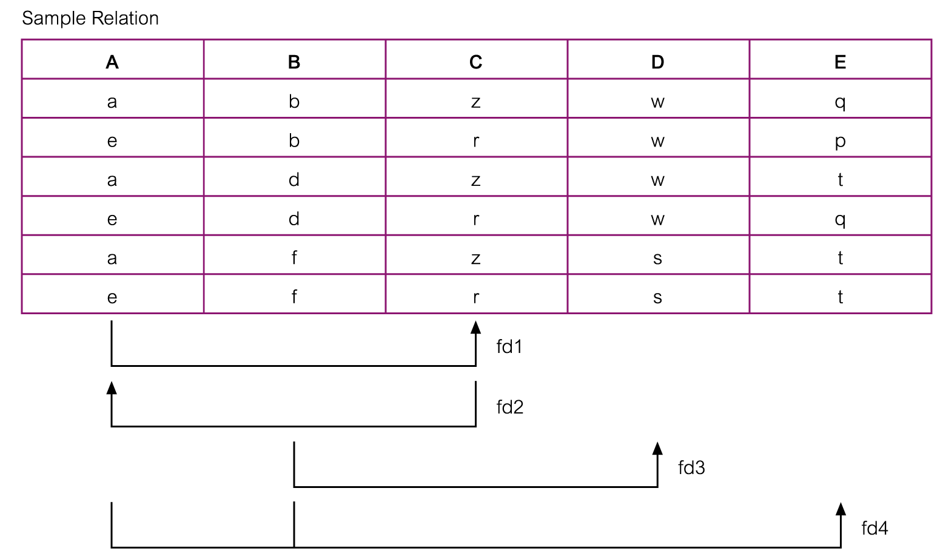
Example - Using sample data to identify functional dependencies.

Slide 41
Example - Using sample data to identify functional dependencies.
Function dependencies between attributes A to E in the Sample relation.
A → C (fd1)
C → A (fd2)
B → D (fd3)
A, B → E (fd4)

Slide 42
Identifying the Primary Key for a Relation using Functional Dependencies
Main purpose of identifying a set of functional dependencies for a relation is to specify the set of integrity constraints that must hold on a relation.
An important integrity constraint to consider first is the identification of candidate keys, one of which is selected to be the primary key for the relation.

Slide 43
Example - Identify Primary Key for StaffBranch Relation
StaffBranch relation has five functional dependencies (see Slide 38).
The determinants are:
  staffNo;
  branchNo;
  bAddress;
  (branchNo, position);
  (bAddress, position).
To identify all candidate key(s), identify the attribute (or group of attributes) that uniquely identifies each tuple in this relation.

Slide 44
Example - Identifying Primary Key for StaffBranch Relation
All attributes that are not part of a candidate key should be functionally dependent on the key.
The only candidate key and therefore primary key for StaffBranch relation, is staffNo, as all other attributes of the relation are functionally dependent on staffNo.

Slide 45
Example - Identifying Primary Key for Sample Relation
Sample relation has four functional dependencies (see Slide 46).
The determinants in the Sample relation are A, B, C, and (A, B). However, the only determinant that functionally determines all the other attributes of the relation is (A, B).
(A, B) is identified as the primary key for this relation.

Slide 46
Example - Using sample data to identify functional dependencies.

Slide 47
The Process of Normalization
Formal technique for analyzing a relation based on its primary key and functional dependencies between its attributes.
Often executed as a series of steps. Each step corresponds to a specific normal form, which has known properties.
As normalization proceeds, relations become progressively more restricted (stronger) in format and also less vulnerable to update anomalies.

Slide 48
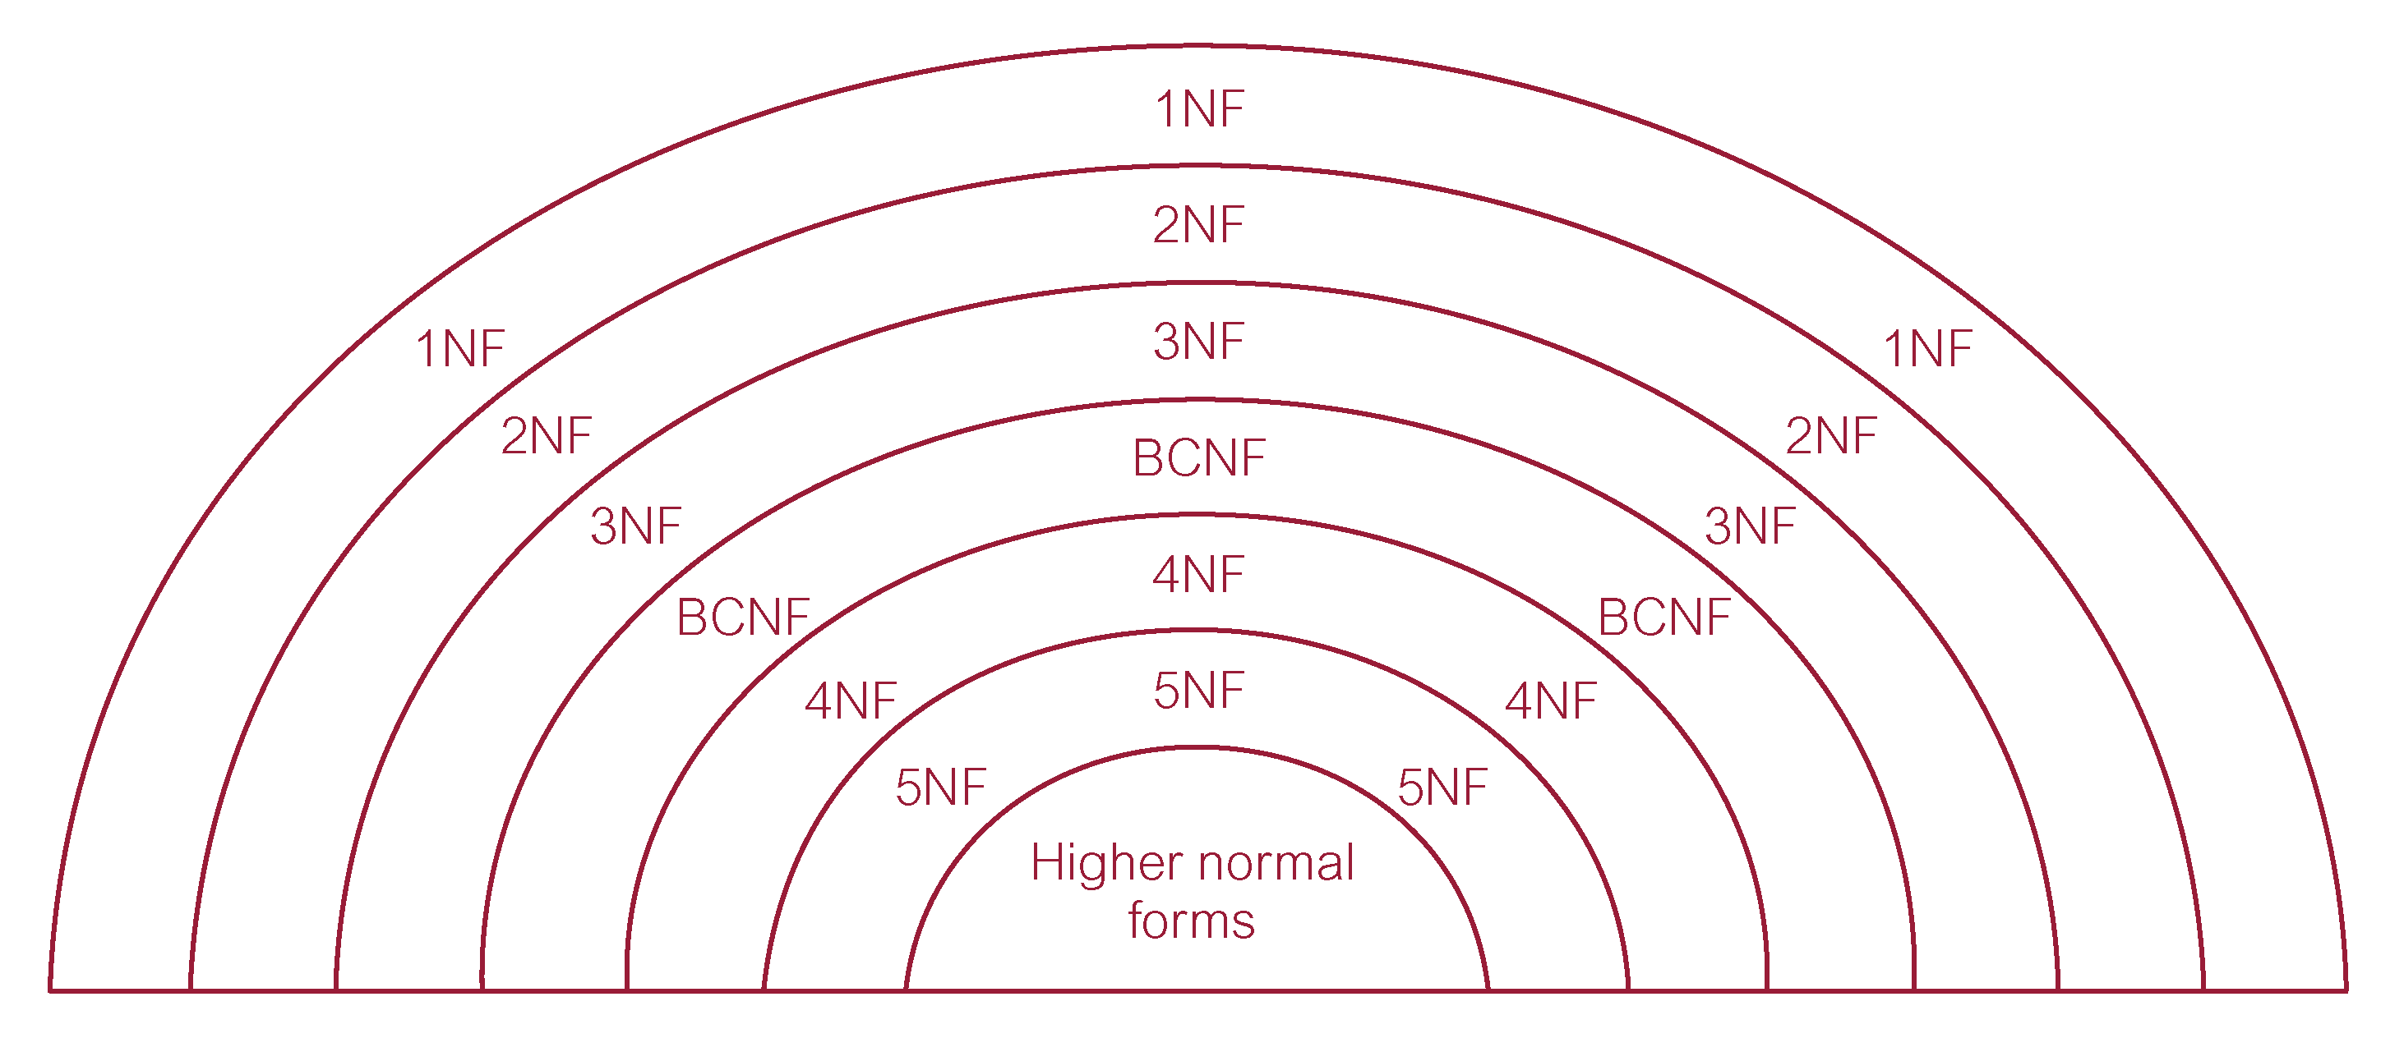
Relationship Between Normal Forms

Slide 49
The Process of Normalization
As normalization proceeds, the relations become progressively more restricted (stronger) in format and also less vulnerable to update anomalies.

Slide 50
Unnormalized Form (UNF)
A table that contains one or more repeating groups.
To create an unnormalized table:
  transform data from information source (e.g. form) into table format with columns and rows.

Slide 51
First Normal Form (1NF)
A relation in which intersection of each row and column contains one and only one value.
The information is stored in a relational table and each column contains:
  Atomic values;
  No repeating groups of columns.

Slide 52
UNF to 1NF
Nominate an attribute or group of attributes to act as the key for the unnormalized table.
Identify repeating group(s) in unnormalized table which repeats for the key attribute(s).

Slide 53
UNF to 1NF
All key attributes defined.
No repeating groups in table.
All attributes dependent on primary key.

Slide 54
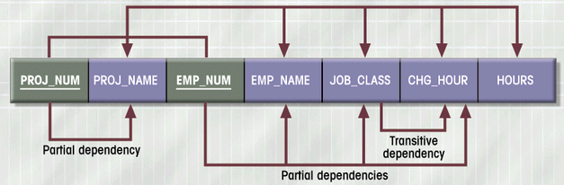
Dependency Diagram (1NF)

Slide 55
Second Normal Form (2NF)
Based on concept of full functional dependency:
  A and B are attributes of a relation,
  B is fully dependent on A if B is functionally dependent on A but not on any proper subset of A.
2NF - A relation that is in 1NF and every non-primary-key attribute is fully functionally dependent on the primary key (no partial dependency)

Slide 56
1NF to 2NF
Identify primary key for the 1NF relation.
Identify functional dependencies in the relation.
If partial dependencies exist on the primary key remove them by placing them in a new relation along with copy of their determinant.
Relations that are in 1NF and have a single attribute as a key:
  Cannot have partial dependency on the primary key;
  Therefore, are in 1NF and 2NF.

Slide 57
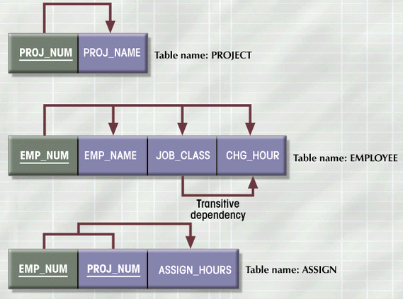
2NF Conversion Results

Slide 58
Third Normal Form (3NF)
Based on concept of transitive dependency:
  A, B and C are attributes of a relation such that if A → B and B → C,
  then C is transitively dependent on A through B. (Provided that A is not functionally dependent on B or C).
3NF - A relation that is in 1NF and 2NF and in which no non-primary-key attribute is transitively dependent on the primary key.

Slide 59
2NF to 3NF
Identify the primary key in the 2NF relation.
Identify functional dependencies in the relation.
If transitive dependencies exist on the primary key remove them by placing them in a new relation along with copy of their determinant.

Slide 60
3NF Conversion Results
Prevent referential integrity violation by adding a JOB_CODE
PROJECT (PROJ_NUM, PROJ_NAME)
ASSIGN (PROJ_NUM, EMP_NUM, HOURS)
EMPLOYEE (EMP_NUM, EMP_NAME, JOB_CLASS)
JOB (JOB_CODE, JOB_DESCRIPTION, CHG_HOUR)

Slide 61
General Definitions of 2NF and 3NF
Second normal form (2NF)
  A relation that is in 1NF and every non-primary-key attribute is fully functionally dependent on any candidate key.
Third normal form (3NF)
  A relation that is in 1NF and 2NF and in which no non-primary-key attribute is transitively dependent on any candidate key.

Slide 62
Summary
We will use normalization in database design to create a set of relations in 3NF normal form:
  Each entity has a unique primary key, and each attribute depends upon the primary key
  No partial dependency
  No transitive dependency

