Slide 1

MBA Managing Marketing change
BMMB7026
The Marketing Mix (7Ps)
Gwyneth jones
June 2024

Slide 2

introduction
In previous weeks we have looked at the macro (external) and micro (internal) environments within which an organisation operates, as well as ways of identifying and analysing buying behaviour in order to develop the Segmentation, Targeting, Positioning (STP) approach.
We have also looked at customer value. Developing value for customers can be a key part of ensuring long-term success for an organisation, and this also links back to the STP process.
Once the target market is identified, the details of the marketing mix can be planned.

Slide 3
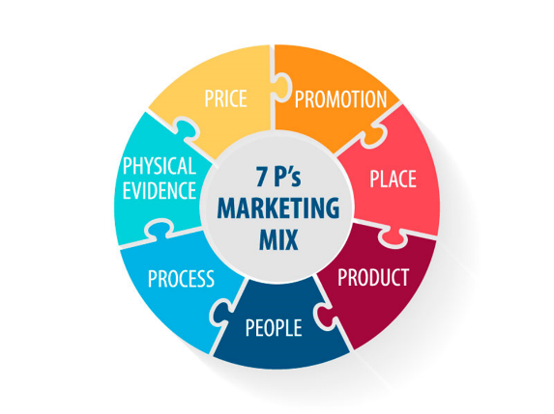
Marketing mix – 4p and 7p introduction
A Marketing Mix is a set of tactical marketing tools that an organisation uses to get the response it is seeking for its products. These elements are adjusted and aligned to meet the needs of a target market and achieve marketing objectives.
Traditionally referred to as the Four Ps of Marketing: Price, Product, Place, Promotion (The ‘4 Ps’ of product marketing (McCarthy, 1960))
To account for the rise in the service economy: Seven Ps of Marketing now also include People, Process, Physical (The ‘7 Ps’ of services marketing (Booms & Bitner, 1981))
Marketing Strategy must be based on these factors

Slide 4
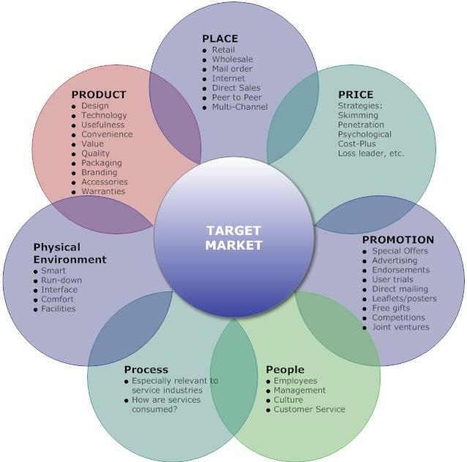
7p marketing mix

Slide 5
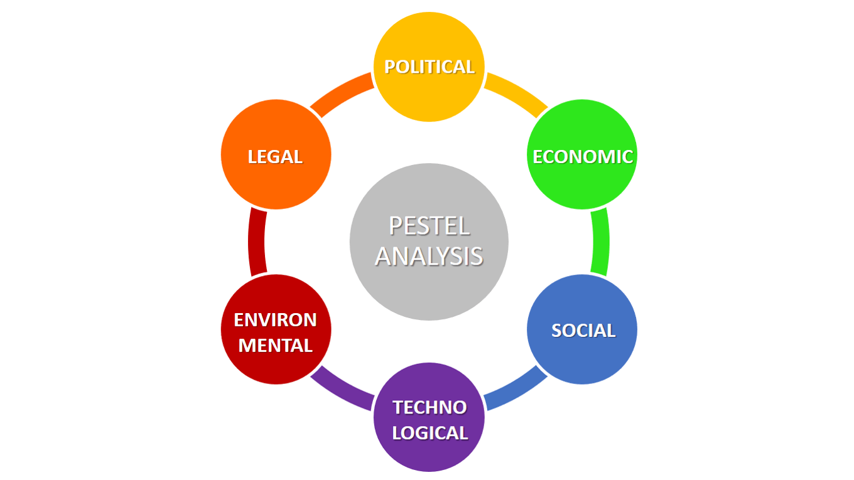
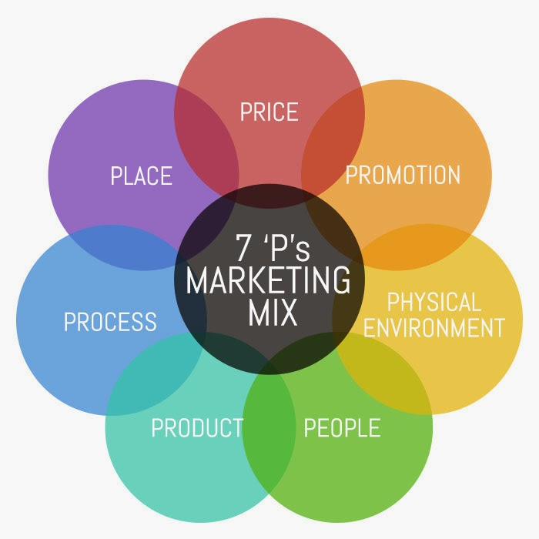
The Extended Marketing Mix within the External Environment

Slide 6
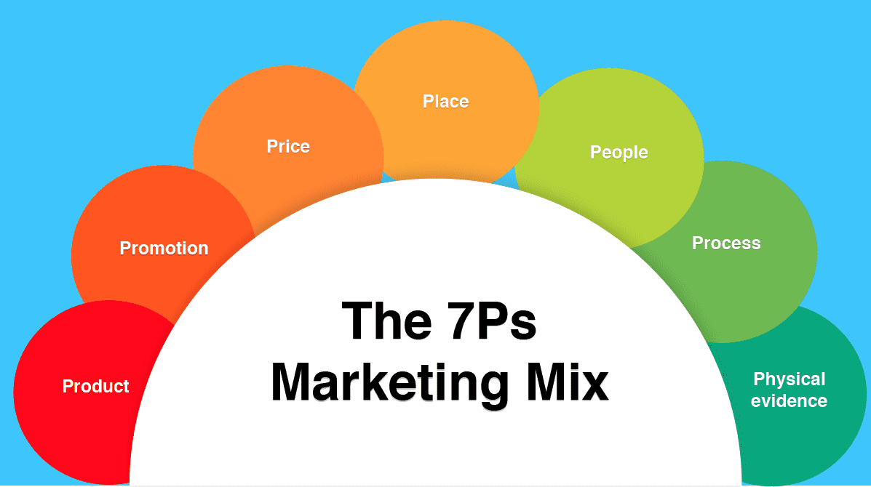
The marketing mix is a set of tactical tools which must be coordinated together to develop market offerings
Support brand building
Satisfy needs and aspirations of targeted groups of customers
Differentiate from competition

Slide 7


Product vs. service
Broadly:
Products are tangible
Services/experiences are intangible (have no physical form)
Most offerings are a mixture of product and service E.g. a meal in a restaurant or a car service

Slide 8
service characteristics
Four characteristics distinguish services:
Service refers to an activity, benefit, or satisfaction offered for sale that is essentially intangible
Does not result in ownership of anything
Service Intangibility | Service Inseparability | Service Variability | Service Perishability
Service cannot be seen, tasted, touched or heard. | Service is produced and consumed at the same time Cannot be separated from providers. | Service may vary greatly depending upon who specifically provides it and how they provide it. | Service cannot be stored for later sale or use.

Slide 9
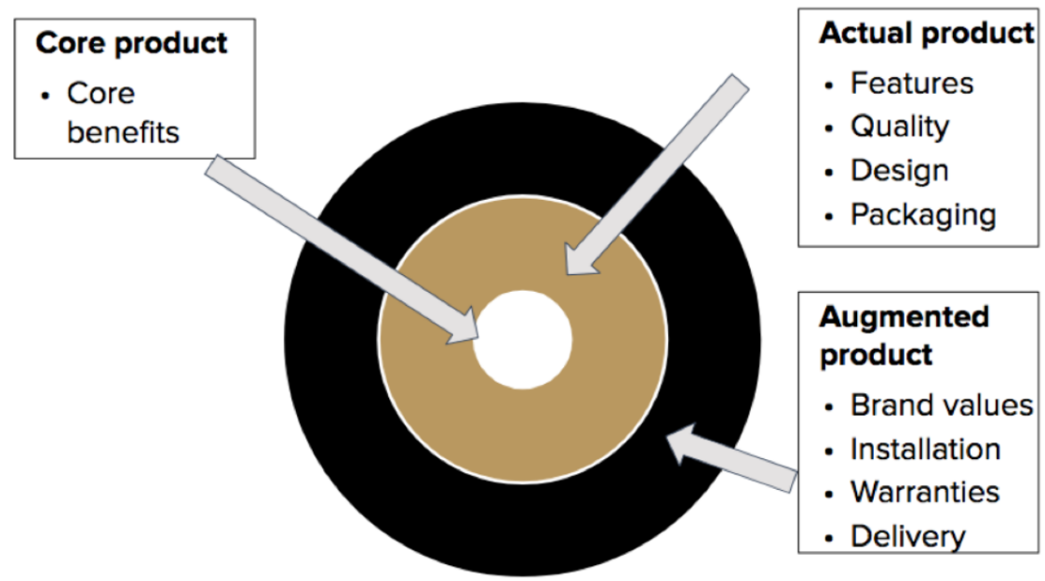
Three product levels
Nature of a product requires three levels of understanding: core, actual and augmented
Level 1: Core Product
is the benefit of the product that makes it valuable to you
Level 2: Actual Product
is the physical item
Level 3: Augmented Product
is the additional value beyond the physical product

Slide 10
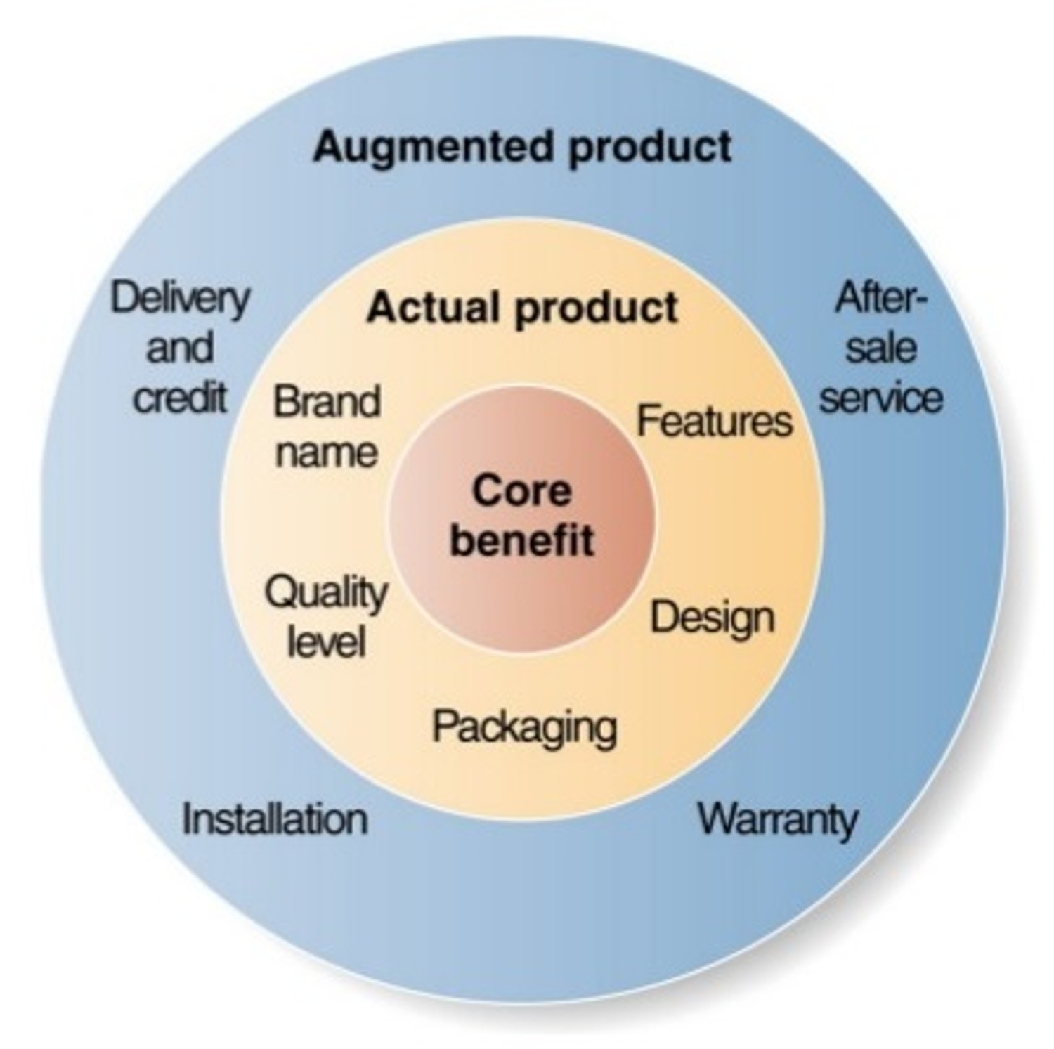
Product Levels

Slide 11
Product differentiation
Very few companies differentiate their offering solely on one level.
They tend to ensure that they differentiate their offerings to various extents on all three levels.

Slide 12
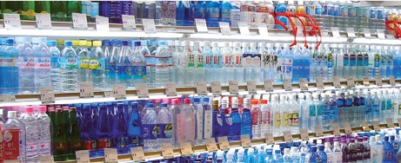
Class Task
What are the different product levels of the brands in the bottled water industry?
At what product level do the brands differentiate themselves?

Slide 13
Product differentiation
Core Differentiation | Actual Differentiation | Augmented Differentiation
Occurs as a result of new disruptive innovation & technology Example: the TV-entertainment industry faces a challenge from new competitors (Netflix) who have moved away from the model of providing a certain show at a certain time, by releasing every episode of a new season at once for customers to view when and where they want. | When a business competes by having superior quality, functionality, or design Mobile phones tend to compete on this basis as customers have relatively low brand loyalty (with some exceptions!) – hence the move towards better speakers, higher resolution screens, curved aluminium backs, etc. | Most differentiation happens at this level By building an admired and respected brand, Apple can charge premium prices on their product ranges.

Slide 14
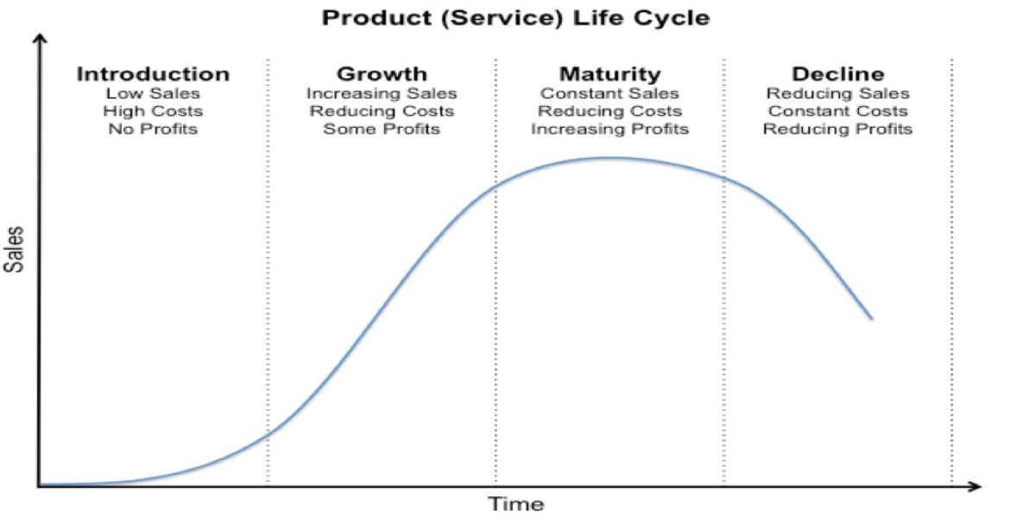
Product / service life cycle
The Product Life Cycle (PLC) is the course of a product’s sales and profits over its lifetime.
The PLC has four phases after the initial development: introduction, growth, maturity and decline
Every product has a life cycle
Some short, some long

Slide 15
Product life cycle (PLC) Facts
  PLCs vary from product to product
  Not all products will follow the PLC, some products may not get out of the first phase
  Price and promotion are determined at the introduction/product development phase
  The time-space of each phase is different from product to product: a product may experience a short growth stage but a long maturity stage
  A product may be in different phases of its lifecycle in different market segments: e.g. it may be in the maturity phase in a domestic market, whilst in a growth phase in an overseas market

Slide 16
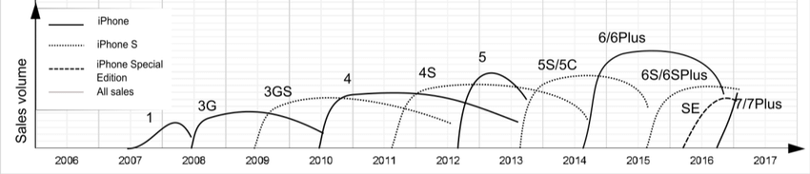
Apple Iphone life cycle 2007 - 2017

Slide 17
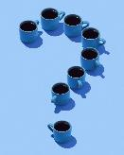
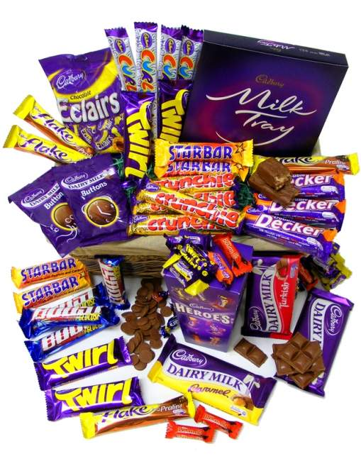
Product range
A business will constantly change and update its product range.
Q: What would happen if a business has too few products?
Q: What if there are too many products?

Slide 18
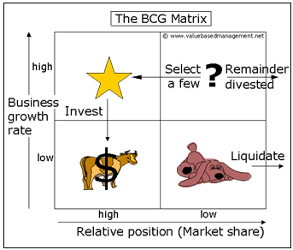
Portfolio Analysis

Slide 19
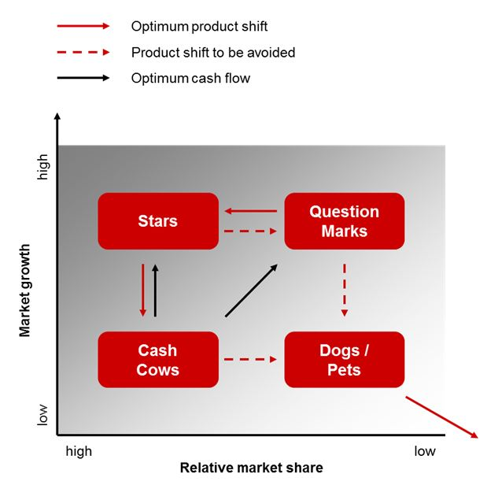
Using the Boston Matrix to Maximise Resource Capabilities

Slide 20
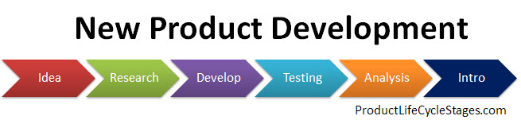
NPD is essential for survival and growth in dynamic competitive environments

Slide 21


Slide 22
Product Decisions
Product decisions involve defining the product’s features, benefits, and specifications.
It also includes branding, packaging, and positioning in the market.
Metrics for the product component may include sales volume, market share, customer satisfaction, and product quality ratings.
A well-defined product strategy can lead to increased customer satisfaction, loyalty, and market differentiation.
Neglecting product development or failing to meet customer expectations can result in reduced market competitiveness.

Slide 23
P – promotion

Slide 24
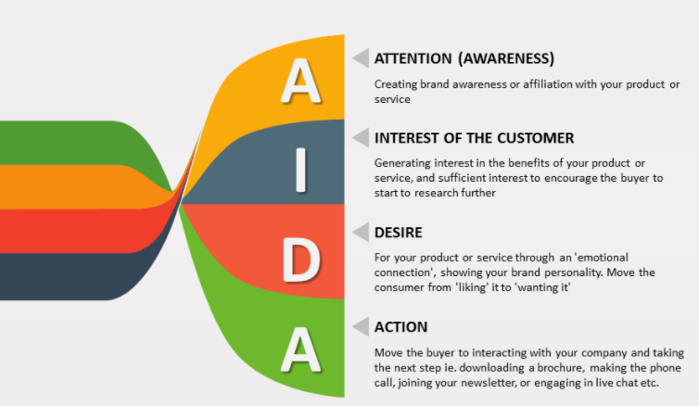
promotion
Various methods of communicating with your target audience
Aims to raise awareness of an organisation’s product or service to generate sales
A common model for doing this is the AIDA model

Slide 25
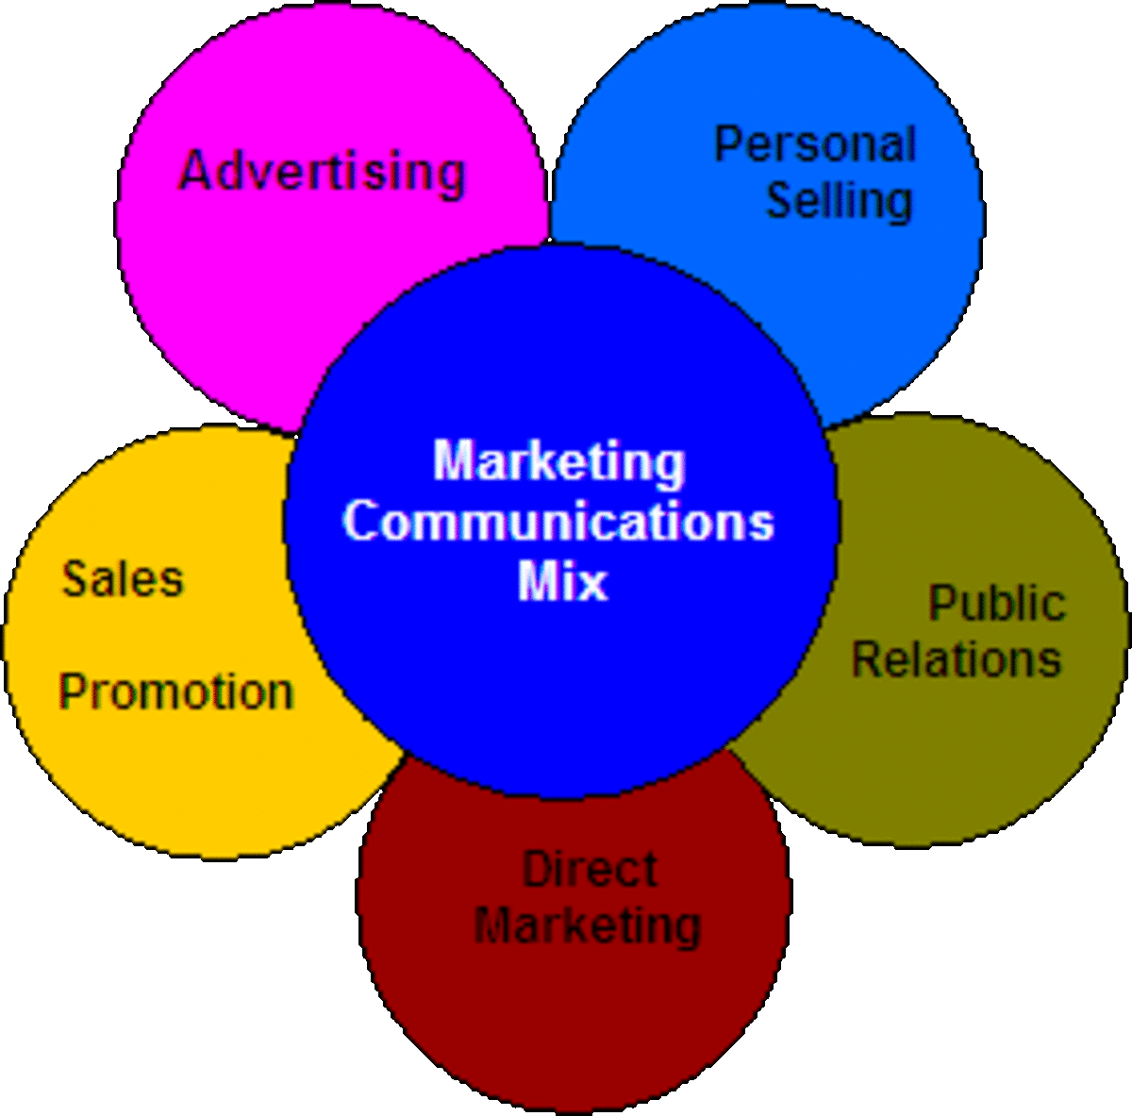
Promotions mix
Refers to the specific blend of tools the company can use to communicate customer value and build customer relationships persuasively
The core of any promotions mix includes six key elements:
  Advertising
  Sales promotion
  Personal selling
  Public relations (PR)
  Direct marketing
  Digital marketing
The Promotions Mix is often what people think ‘Marketing’ is, as it is most visible

Slide 26
Promotions mix – key elements
Advertising: any paid form of non-personal presentation and promotion of ideas, goods or services by an organization.
Sales Promotions: short-term incentives to encourage purchase of product or service, incl. limited-time sales events at retail stores (“The first 100 customers get 50% off a computer”).
Personal Selling: personal customer interactions by sales force to engage customers, make sales, and build customer relationships. (e.g. in-store selling by employees or door-to-door salesperson).
Public Relations (PR): building good relations with the company’s public stakeholders by obtaining publicity, building up a good corporate image, and handling unfavourable (e.g. negative) stories, events, and publicity.
Direct and Digital Marketing: engaging with carefully targeted individual customers / communities to obtain immediate response and build long-term relationships.
Crucial: coordinating the various elements to work together seamlessly
(e.g. through careful crafting of an integrated marketing communications plan)

Slide 27
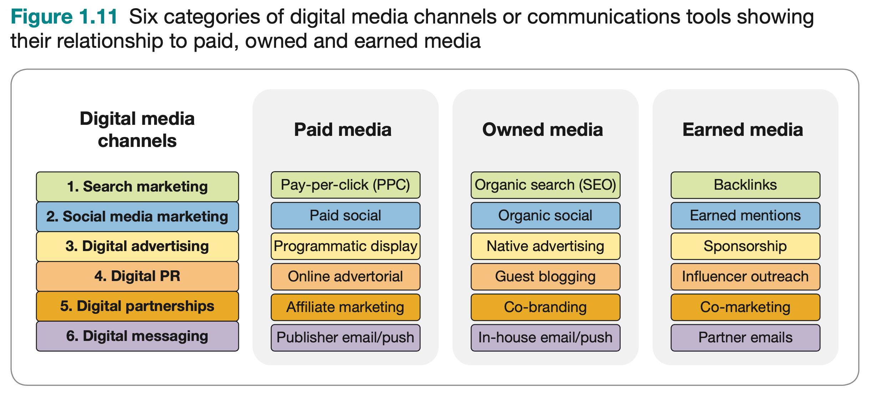
DIGITAL MARKETING TECHNIQUES (Smart Insights)

Slide 28
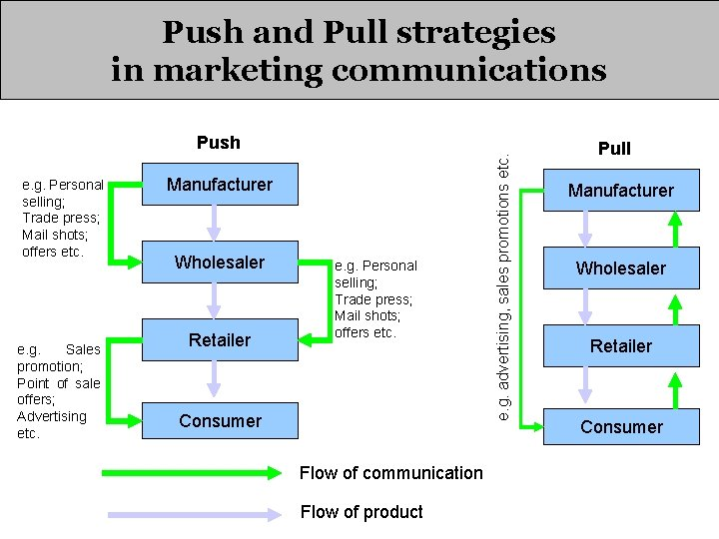

Slide 29

Public relations (PR)
DEFINITION - Public relations is the planned and sustained effort to establish and maintain mutual understanding and good will between an organisation and its publics (Chartered Institute of Public Relations)
Commonly confused with advertising, but PR is very different!
Aims to address the needs of a company’s various stakeholders, e.g.:
  Employees
  local community
  Shareholders
  Media
  pressure groups
  government

Slide 30
Difference between advertising and public relations (PR)
Common with Advertising
Difference to Advertising
Builds brands, prestige and reputation
Communicates with target audiences
Creates awareness and interest
Overcomes misconceptions surrounding the organisation and/or its offerings
Advertising space is paid for
PR results are earned (e.g. by providing the media with information such as press releases)
PR revolves around seminars, publications, lobbying, charitable donations, interviews, etc.

Slide 31

Public relations’ three main characteristics
There are three main characteristics of PR, which are important to consider.
Characteristic | Description
High credibility | Nature of PR: the message being put across appears to have been independently written/produced (i.e. by a journalist and/or individual employee) Gives it higher credibility, in the consumer's eyes, than an advertisement.
No direct cost | Allows organisation to push a message without paying the media organisation Indirect costs: writing a press release, liaising with journalists and events organisers etc.
No control | Advertising offers the organisation full control of its message PR leaves the final presentation of your organisation’s message in the hands of an independent reporter Final message may not be whole or indeed at all positive.

Slide 32


Promotions mix – example of mcDonald’s
Two Teachers
https://youtu.be/XI2qK1UASxI

Slide 33


Creative advertising – example of tesla
ThoughtCatalyst
https://youtu.be/tF9r9LrOb70

Slide 34
Promotion Decisions
The promotion element of the Marketing Mix encompasses all communication and marketing activities used to promote and sell a product or service.
Promotion involve selection and coordination of elements of the promotions mix.
Metrics include brand awareness, click-through rates, conversion rates, return on investment (ROI), and customer acquisition cost (CAC).
Effective promotion drives brand recognition, customer engagement, and sales. It helps build and maintain brand reputation and loyalty.
Ineffective or misleading promotion can damage brand credibility and result in customer backlash.

Slide 35
P – price

Slide 36
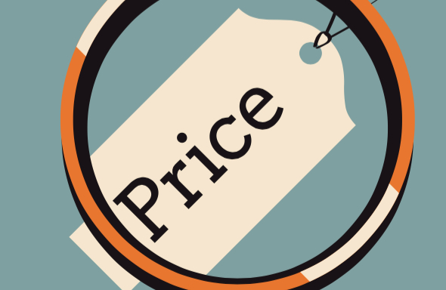
price
Price is one element of the Marketing Mix that produces Revenue – the others produce Costs.
An organisation must set a price for a product.
Prices can be changed quickly.

Slide 37

Six stages of Pricing strategy
In deciding a product’s price, marketers can follow six stages:
Select the price objective
Determine the demand
Estimate costs
Analyse competitors
Select pricing strategy
Select final price

Slide 38
Pricing strategy
Premium
High price – High quality
Penetration
Initial low price – Price increase
Economy
Deliberate setting of low price
Skim
High initial price – Price lowers
Psychological
Customers emotive response – High quality with high price
Captive
Product consumables, e.g. razors at low cost – Replacement blades priced high
Product Line
Different prices for perceived different quality levels within the same Product Range
Competitive
Set prices to based on competitor pricing and market positioning

Slide 39
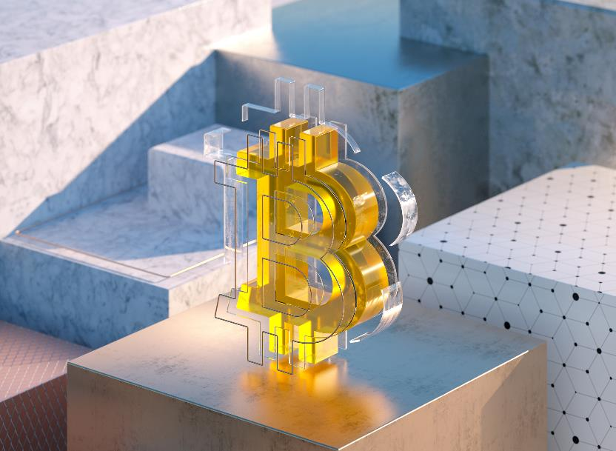
Impact of economy on pricing strategies
Economy can have a considerable impact on how to best approach pricing
In boom times (i.e. economy is growing quickly, people have higher disposable incomes):
  Demand for higher quality, more expensive goods and services tend to increase
When recession or inflation is high:
  Consumers tend to be more frugal

Slide 40



Impact of economy on pricing strategies – example
Example: UK’s biggest supermarket Tesco
As people tightened their purse strings, low-cost supermarket chains Aldi and Lidl gained traction
Aldi and Lidl:
  Smaller product line (about 2000)
  Reliance on cheaper brands
  Could provide customers with cheaper food without a loss of quality
Tesco:
  Big product line (about 40,000)
  Can’t press prices down as low as a chain that orders huge quantities of a smaller product range
  Result, Tesco needed to reposition itself in the market

Slide 41
Price Decisions
The price element of the Marketing Mix pertains to how a company sets the monetary value for its products or services.
Pricing decisions directly affect revenue generation and profit margins
Metrics include pricing elasticity, gross profit margin, break-even point, and average transaction value.
Effective pricing can optimize revenue, attract target customers, and enhance brand perception.
Poor pricing strategies can lead to lost sales, decreased profitability, or perceptions of overpricing or underdelivering.

Slide 42
P – place

Slide 43
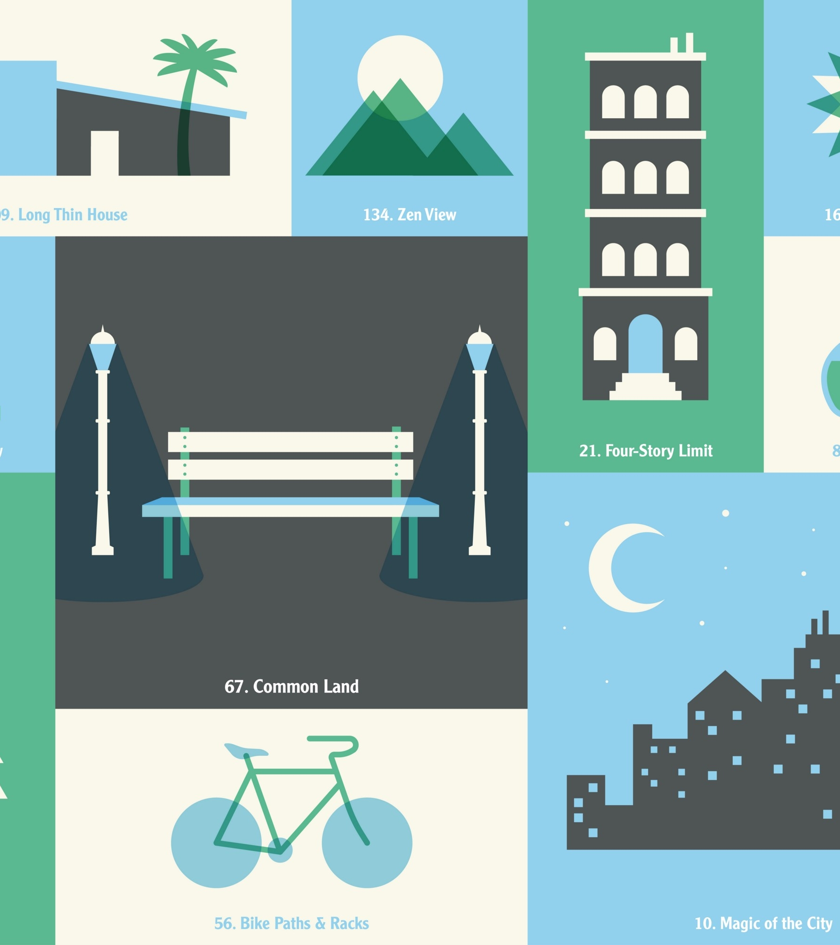
place
Refers to where the product is purchased from and how it is distributed

Slide 44
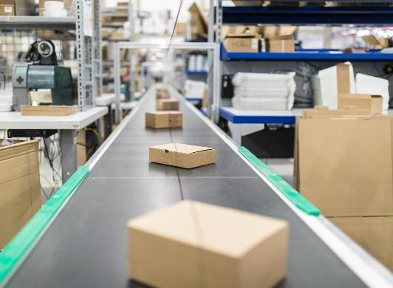
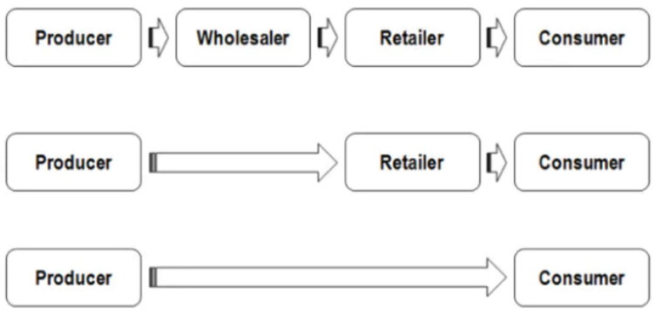
distribution
Distribution is the process of moving products from its manufacturing source to its customers.
Two forms of Distribution:
  Indirect
  Direct

Slide 45
Place Decisions
The place component of the Marketing Mix involves decisions related to the distribution and availability of a product or service. It focuses on making products accessible to the target market.
Place decisions encompass channel selection (e.g., direct, retail, e-commerce), logistics, inventory management, warehousing, and supply chain optimisation.
Metrics for place include distribution efficiency, lead times, inventory turnover, and channel performance.
Effective distribution ensures products reach the right customers at the right time and location, improving market reach and accessibility.
Poor distribution strategies can lead to stockouts, overstocking, delivery delays, or missed market opportunities.

Slide 46
P – people

Slide 47

people
Service providers like airlines frequently use images of their staff (People) in their advertising.

Slide 48
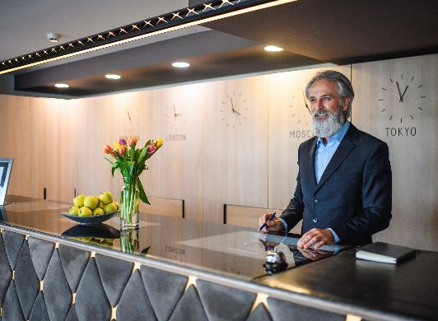
people
P – for People – is specifically service-related
The term Service Encounter is used to describe an interaction between a service provider and a customer
For service employees to be in the frame of mind to treat customers well, they need to feel that their company is treating them well
This has given rise to the idea of the service profit chain whereby having a happy workforce leads to having happy customers and, ultimately, superior profitability
Internal marketing – includes selecting, training, and motivating staff members to provide customer satisfaction

Slide 49
P – process

Slide 50
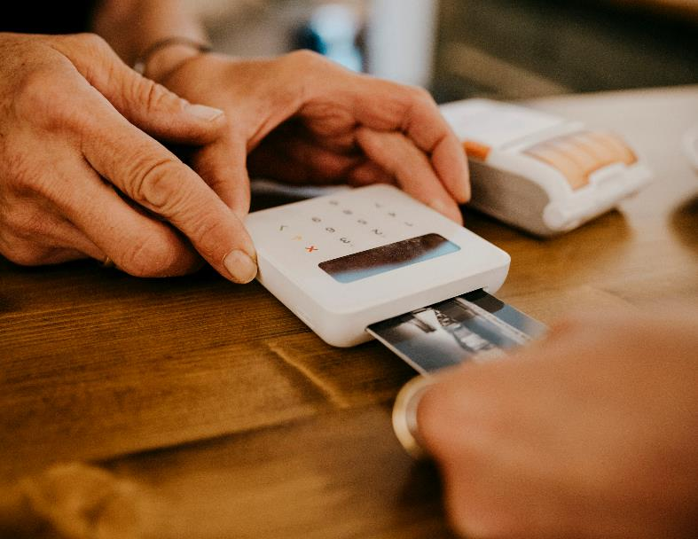
process
Process refers to the flow of activities or mechanism that take place when there is an interaction between the customers and the businesses
All companies want to create a smooth, efficient and customer-friendly journey – and this can’t be achieved without the right processes behind the scenes to make that happen.
Understanding the steps of the customer journey helps consider what processes need to be in place to ensure the customer has a positive experience.

Slide 51


Process example
Example:
A customer decides to take membership with service providers like Netflix or Amazon Prime
Processes involved are:
  Customer who decides on a particular service depending on the features
  Customer will download the application
  Customer will register their account

Slide 52
P – physical evidence

Slide 53

Physical evidence
Customers look for clues to examine the likely quality of a service by inspecting the physical / tangible evidence
Includes the décor, furnishings and lighting
The ambience of a retail store is highly dependent on décor
Colour can play an important role in establishing mood
Changes in the physical evidence are often part of a marketer’s effort to reposition a brand

Slide 54
Measuring the effectiveness of marketing mix decisions
Metrics within the Marketing Mix are quantifiable measurements used to evaluate the performance and effectiveness of each element, and specific tools within each element.
Metrics provide insights into whether marketing strategies are achieving desired objectives and help in making data-driven decisions.
Selecting appropriate metrics depends on specific marketing goals. Examples include return on ad spend (ROAS), customer lifetime value (CLV), customer acquisition cost (CAC), net promoter score (NPS), and market share.
Metrics enable marketers to assess the impact of marketing efforts, allocate resources effectively, and refine strategies for better results.
Overreliance on single metrics without considering the overall marketing mix can lead to suboptimal decisions.

