Slide 1

Silvio Lisciandrelli
Student Number: 2133468
Effective Management BMGM4000_GRP
Jayne Griffith Parry

Slide 2

INTRODUCTION
Open check-list 10 AM
Head chef and general manager on the premises
Checking booking sistem
Mise en place and table plan
Briefing staff
Starting service 12 AM
Make sure the service going well
Closing chek-list
During service
Assigning roles and tasks to the team FOH and BOH

Slide 3

KITCHEN BRIGATE
1 Head Chef
1 Sous Chef
2 Commis Chef
1 Kitchen Porter

Slide 4


FOH BRIGATE
Floor brigate:
1 General manager
1 Head waiter
4 waiter/waitress
1 Host
Bar brigate:
1 Bar manager
1 Bartender
1 Bar back

Slide 5

MISE EN PLACE AND BRIEFING STAFF
Assign task to the staff
Roles and suddivison of the floor
Speaking about special offers
Target of the day

Slide 6

DURING THE SERVICE
Supervising and cordinating the staff
Controlling and checking the food quality
Make sure customers having a good experience
Check back every table and ask feedback
Prevent and sort out any possible issue and complaint

Slide 7
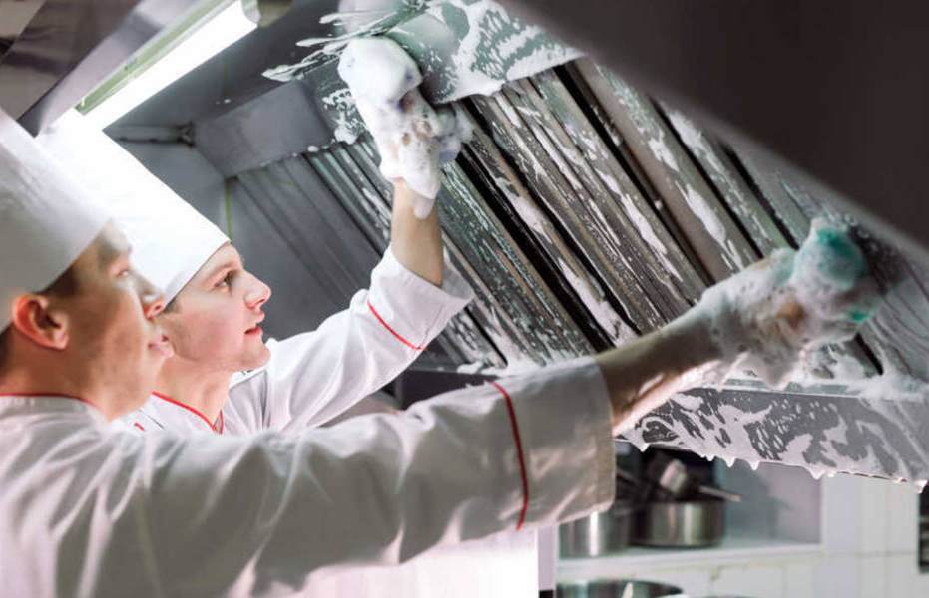

POST SERVICE
Closing check-list:
Clining and set up for the next day
Refil stock
Bring out the rubbish
Polish cutlerys and plates
Clean the own area
Cashout
Switch off all the lights
Close all the doors
Activate the alarm and close the restaurant

Slide 8
References list:
Service.gov.uk. (2020). Waiter | Explore careers. [online] Available at: https://nationalcareers.service.gov.uk/job-profiles/waiter [Accessed 1 Mar. 2023]
Recruiting Resources: How to Recruit and Hire Better. (2017). Head Chef job description template | Workable. [online] Available at: https://resources.workable.com/head-chef-job-description [Accessed 2 Mar. 2023].
Burns, C. (n.d.). Commis Chef Job Description Template. [online] Comeet. Available at: https://www.comeet.com/resources/job-descriptions/cmis-chef [Accessed 2 Mar. 2023].
BlueArrow. (n.d.). Kitchen Porter Job Description. [online] Available at: https://www.bluearrow.co.uk/featured-employers/working-with-sodexo/kitchen-porter-job-description [Accessed 2 Mar. 2023].
Mise en Place - The Philosophy of Preparation and Utility. [online] Available at: https://www.linkedin.com/pulse/mise-en-place-philosophy-preparation-utility-craig-loss [Accessed 3 Mar. 2023].

