Slide 1
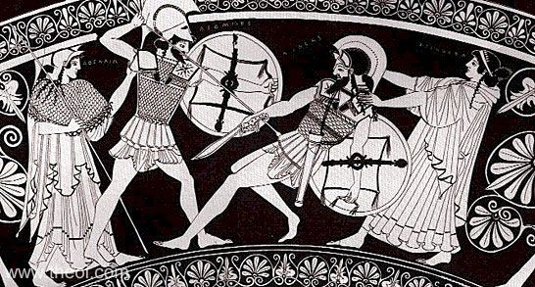
Classical Mythology and Art
The Trojan war in art
Classical Mythology and Art
Week 3
Dr Catherine Rozier

Slide 2
The Trojan War in art
Just as in literature, the Trojan War is a popular topic for art throughout antiquity.
However, the scenes which were popular with artists do not usually match up with the stories told in the literature.
Artists may have been adapting the stories told in poems and plays, or they may have been inventing their own stories.
What does become clear is that it is usually not possible for us to say that an art depiction is ‘an illustration’ of the same myth in literature.

Slide 3
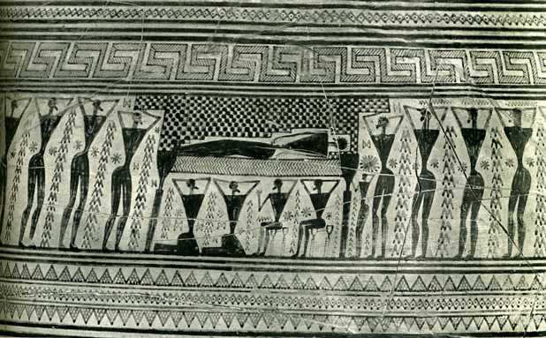
Geometric art
The earliest types of Greek art do not show character or narrative, so it is not possible to say they are telling a particular story.
Geometric amphora by the Dipylon Painter. 760-750 BCE (National Archaeological Museum of Athens)

Slide 4
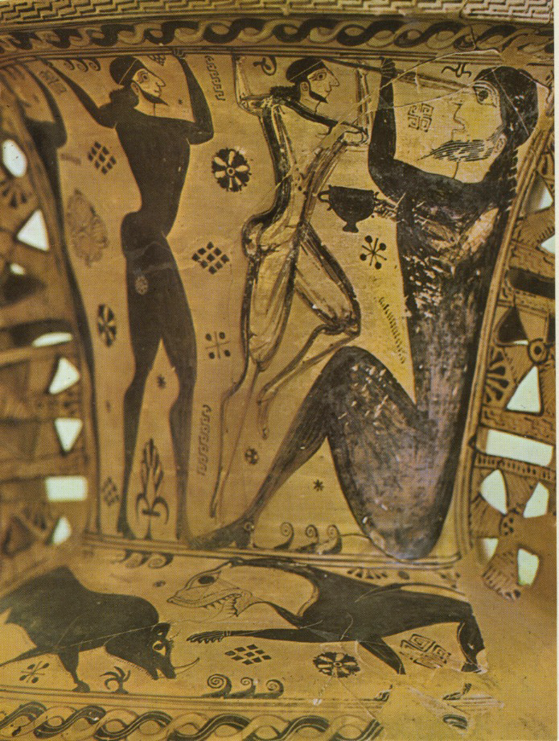
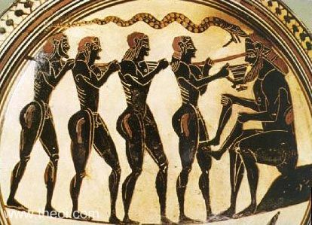
The earliest scene to appear on vases from the Trojan War mythology is the blinding of Polyphemus, which is told in the Odyssey.
Attic black-figure amphora, c.670 BC Laconian black-figure cup, c. 560 BC

Slide 5
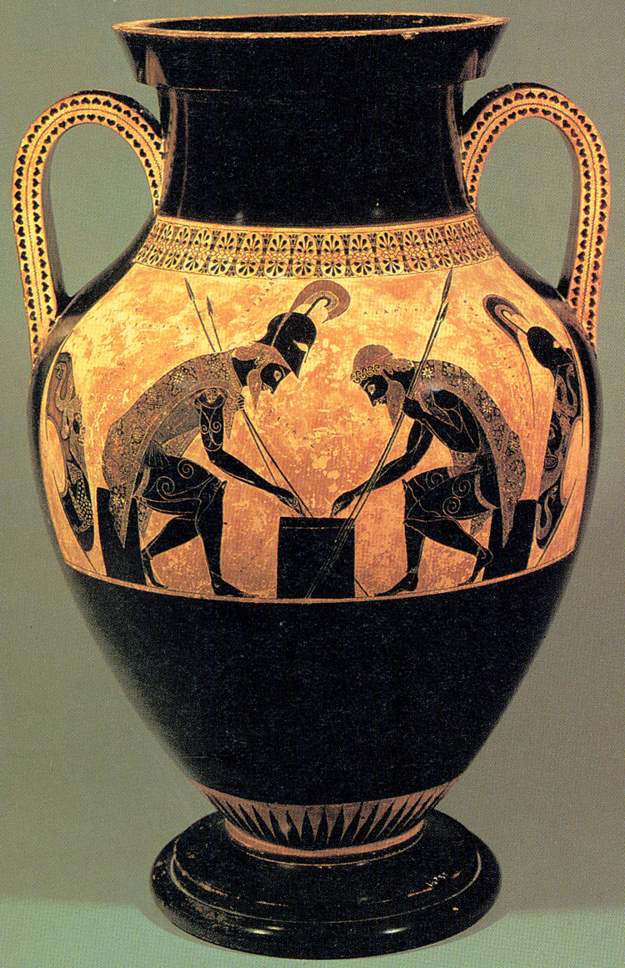
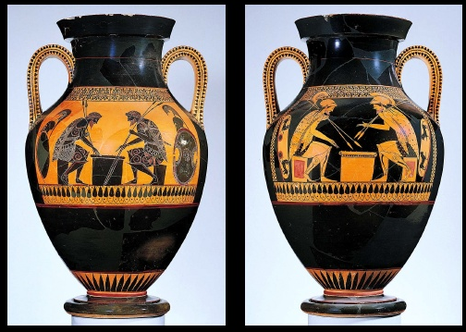
A popular scene in the archaic period was a board-game between Ajax and Achilles, which does not appear in any written sources.
Amphora by Exekias c. 550BC Amphora by the Andokides Painter, c. 525BC

Slide 6
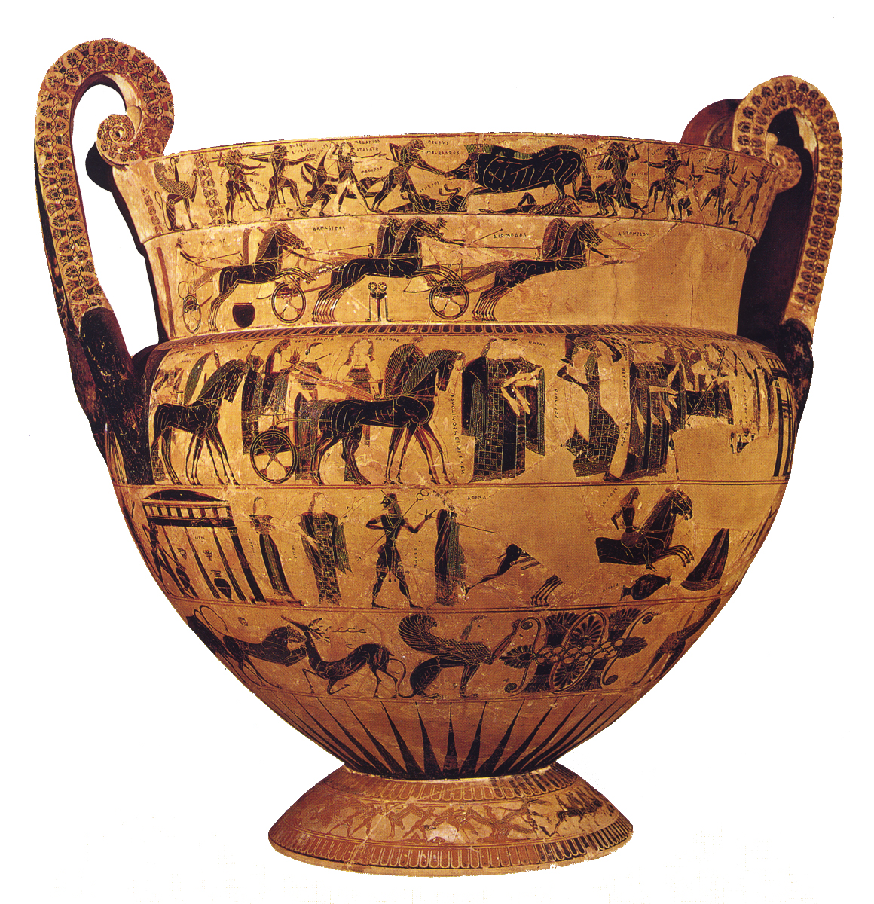
The Francois Vase
This is an example of how several different stories can be depicted on a single object.
Trojan War mythology links four of the seven decorated areas.
Black-figure volute krater by Kleitias, 570-560BC

Slide 7
The Francois Vase
Funeral games for Patroclus
Wedding of Peleus and Thetis (Achilles’ parents)
Achilles pursuing Troilos

Slide 8
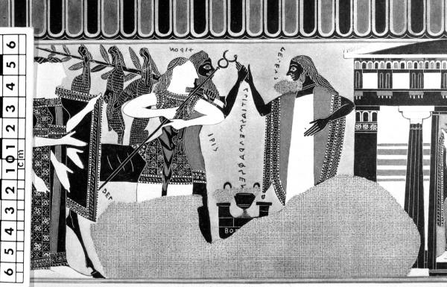
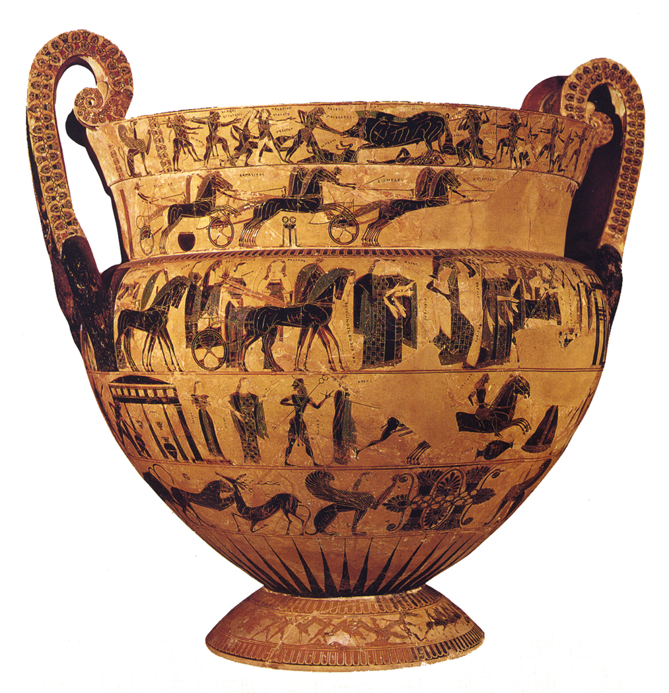
Francois Vase: Wedding of Peleus and Thetis
Procession of the gods arriving at the wedding; Hera and Zeus on a chariot
Peleus stands at the end of the procession and Thetis is just visible sitting inside the building (far right)

Slide 9
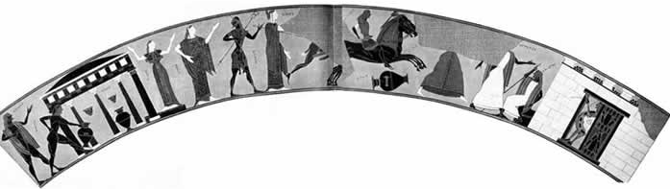
Francois vase: Achilles and Troilos
According to this myth, not told in any remaining written sources, there was a prophecy that Troy would not be defeated if the young prince Troilos lived to the age of 20.
This scene shows Achilles pursuing Troilos before he kills him, after ambushing him at a water fountain.
Apollo / Water-fountain / Girl /Thetis,Hermes,Athena / Achilles leaping / Troilos / Polyxena/ Antenor,Priam / Trojan soldiers

Slide 10
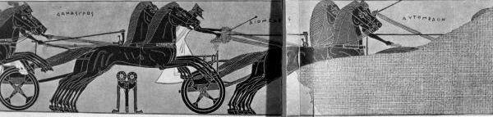
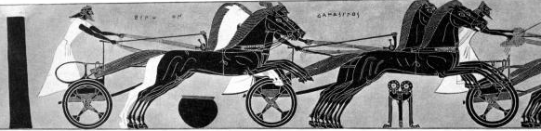
Francois vase: Funeral games for Patroclus
This scene appears in the Iliad: Achilles stages extravagant athletic competitions to honour his dead friend.
However, the names of the competitors, and the apparent winner, do not match up with the version in the Iliad.

Slide 11
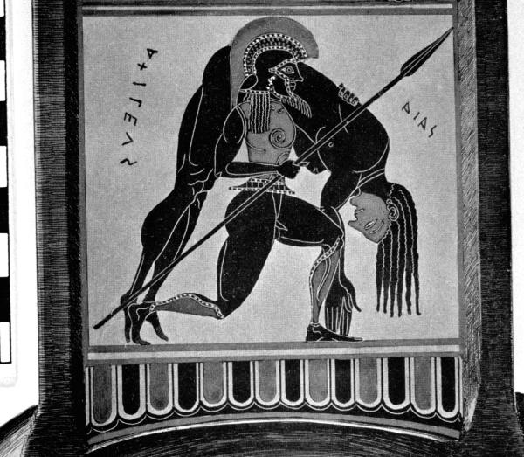
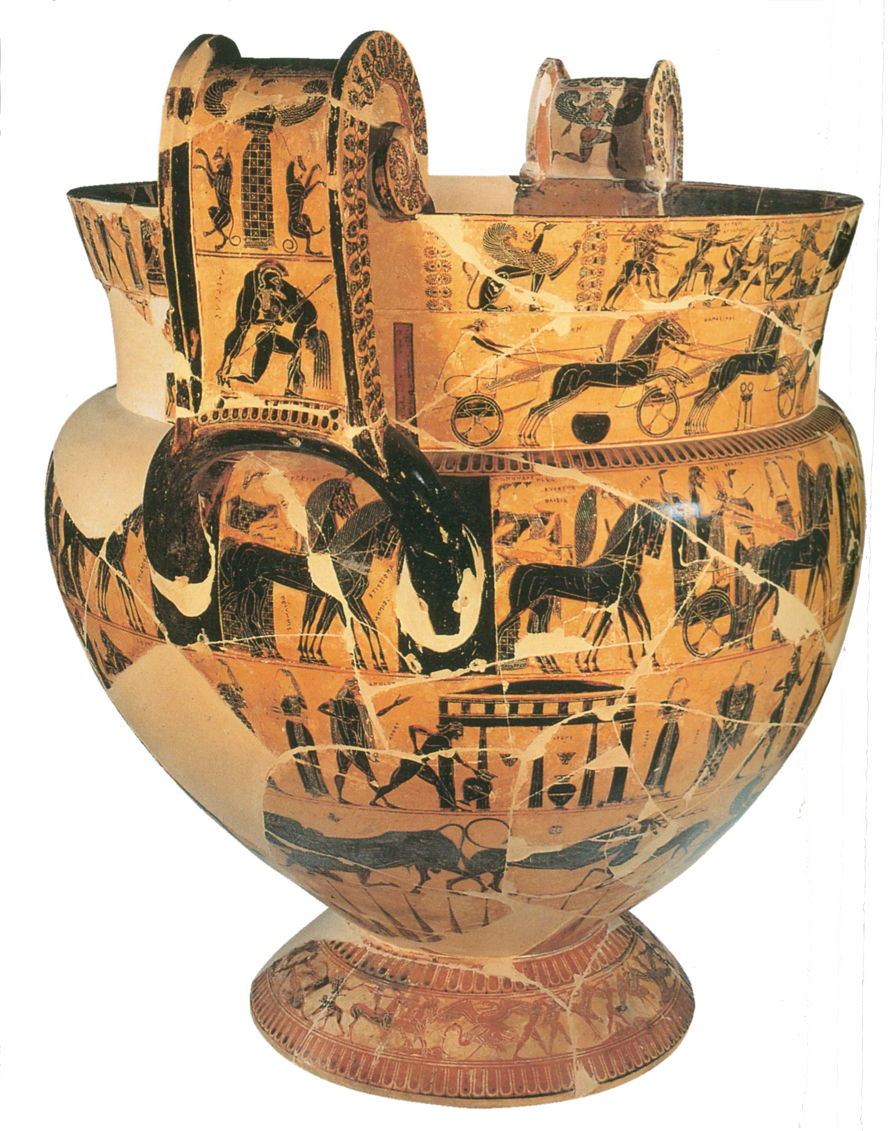
Francois Vase: Ajax and body of Achilles

Slide 12
The Francois Vase
This vase gives some important clues about how ancient audiences were used to encountering Trojan War mythology.
Rather than telling one continuous story, the artist depicts separate myths which can be linked, but only if we know the myths well enough.
He also combines Trojan War stories with other myths, such as the Caledonian boar hunt (top frieze) and the return of Hephaestus to Olympus (reverse of second frieze).
This suggests that the more an audience/viewer knew about mythology, the more complex associations they could make between stories.
Black-figure volute krater by Kleitias, 570-560BC

Slide 13
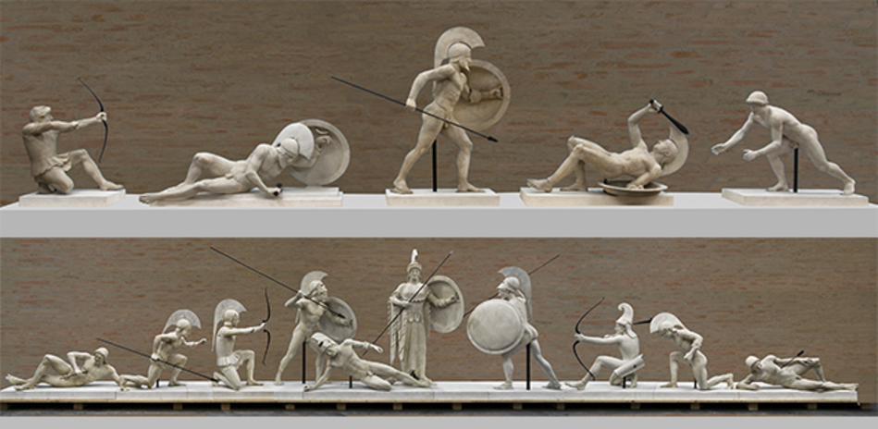
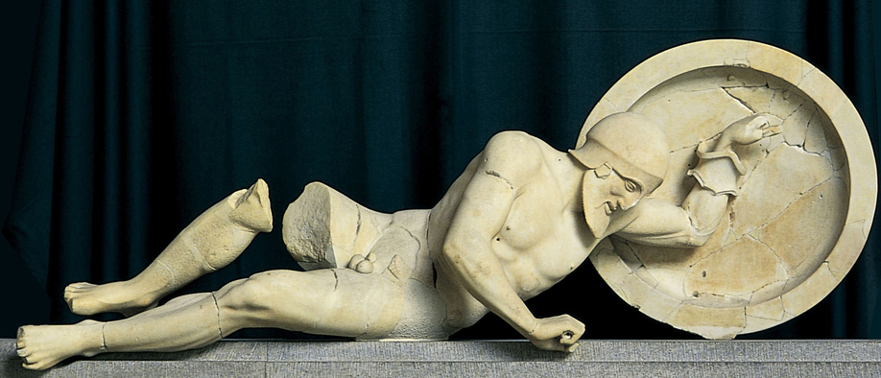
The ‘other’ Trojan War
Pediments of the temple of Aphaia at Aegina c.500BC

Slide 14
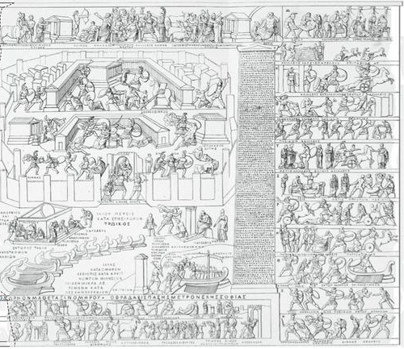
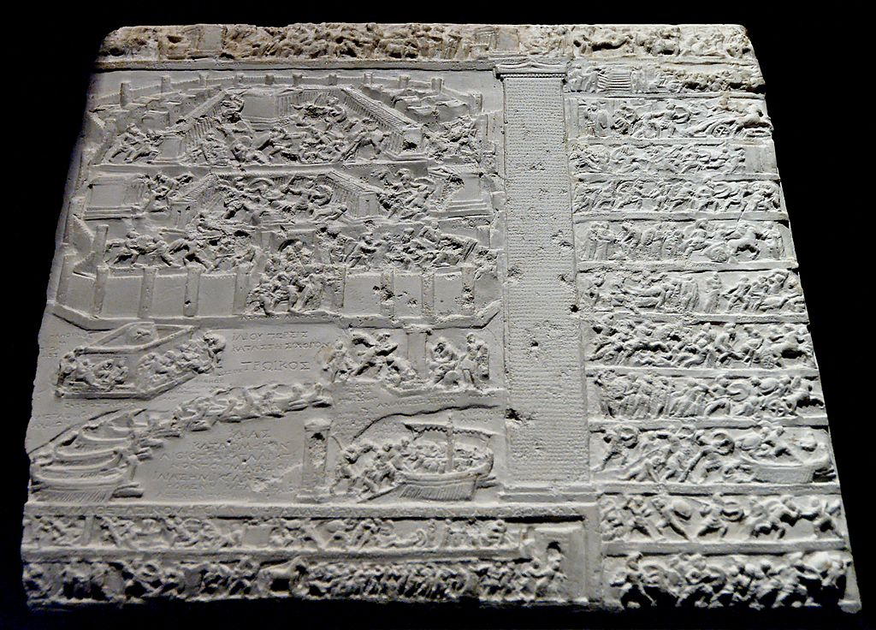
Trojan War in Roman art
Tabula Iliaca Capitolina, late 1st century BC
One of probably 21 marble reliefs depicting specific scenes from the Iliad or the Epic Cycle, with labelling inscriptions.
Clearly meant as literary illustrations.

Slide 15
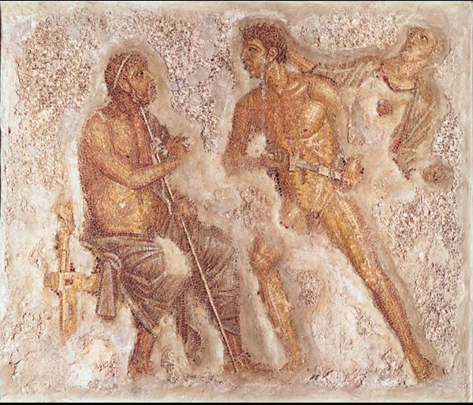
Trojan War in Roman art
Mosaic from Pompeii, 1st century AD
Shows a very specific scene from Iliad book 1: Achilles is about to draw his sword on the seated Agamemnon, but Athena, behind him, pulls him back by his hair.

Slide 16
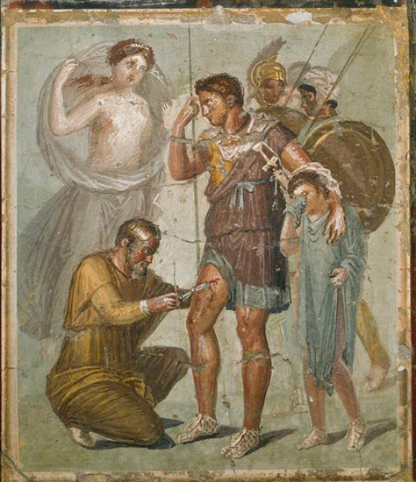
Trojan War in Roman art
Fresco from Pompeii, 1st century AD
Shows Aeneas being treated for a wound, with his son Ascanius at his side and his mother Venus looking on.
All these characters are familiar from the Aeneid, but this specific scene is not told in any written sources.

Slide 17
Summary: the Trojan War in art
The earliest Greek depictions of Trojan War mythology are usually not possible to identify with specific scenes from a particular poem, probably because the poems were still being told orally throughout the archaic period, and so stories would change.
This changes in Roman art, when specific literary scenes or characters are depicted.
As in literature, the wide variety of myths available to an artist means he can choose specific stories or characters to suit his aims.

