Slide 1
Lecture 8:
Communication & Health
Psychology Health & Medicine
Dr Ceri Phelps

Slide 2

How do we communicate?

Slide 3
Recap: how do we communicate?
Verbal communication:
  What we say and how we say it
  Includes characteristics of speech (speed, sighs, pauses)
Strategies for enhanced verbal communication include:
  Open questions
  Closed questions
  Funnel approach (closed to open)
  Avoidance of leading/ambiguous questions

Slide 4
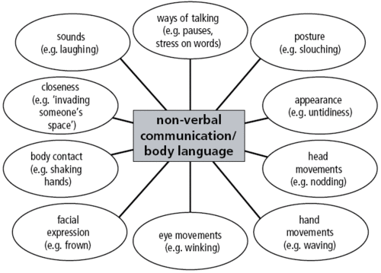
Recap: how do we communicate?
Non-verbal communication
  Facial expressions
  Eye movement
  Spatial behaviour
  Gestures
  Touch
  Bodily contact

Slide 5
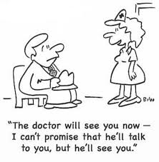
Why is communication important in the field of health and medicine?

Slide 6
Doctor – Patient Communication
Good communication in healthcare is important for many reasons:-
  More accurate diagnosis
  Better patient understanding of illness
  Better adherence to treatment
  Patient satisfaction
  Improved physical health outcomes
  Improved emotional outcomes
Important element of medical training

Slide 7
Doctor-patient relationship
Development of good doctor-patient relationship is key to effective medical communication
Perceptions of a good doctor-patient “partnership” in terms of treatment and decision-making associated with higher levels of satisfaction
Person centred approach often considered important for successful communication

Slide 8
Doctor-patient relationship
Person centred approach, based on principles of psychotherapy (e.g., Rogers, 1951) considered important for successful communication:
Non-judgemental
Empathic/Sensitive
Respectful
Use of non-verbal communication and silence
Use of reflecting back and paraphrasing
Enabling patient to raise all issues of concern - physical and emotional

Slide 9

How would you feel if a doctor asked to carry out a clinical/physical examination?
What would be your expectations of this process in terms of verbal and non-verbal communication?

Slide 10
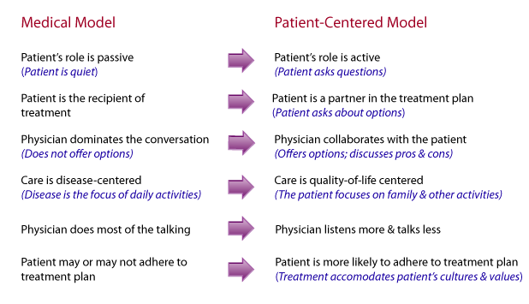

Slide 11
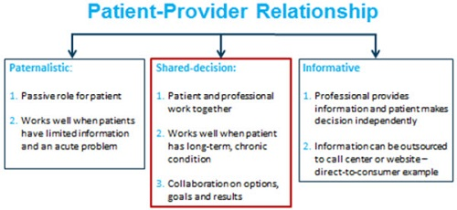

Slide 12
How would you feel if a doctor suggested a long-term course of medication for you?
What information would you expect the doctor to give you?
What questions would you want to ask?

Slide 13
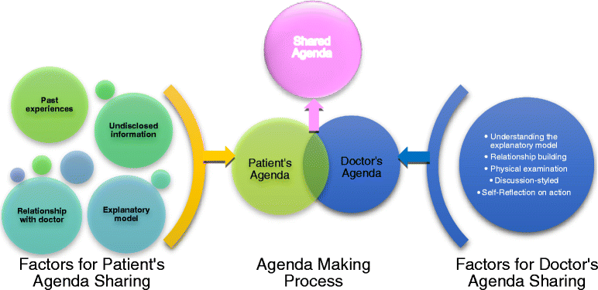

Slide 14
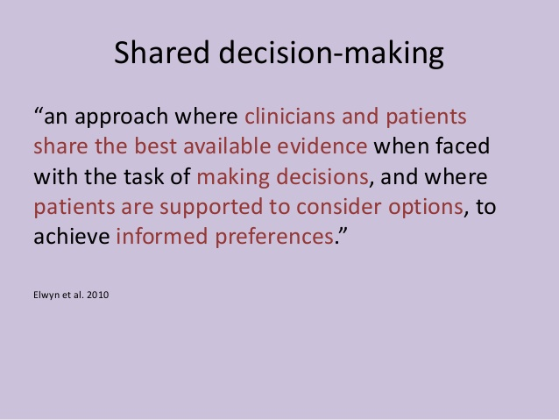
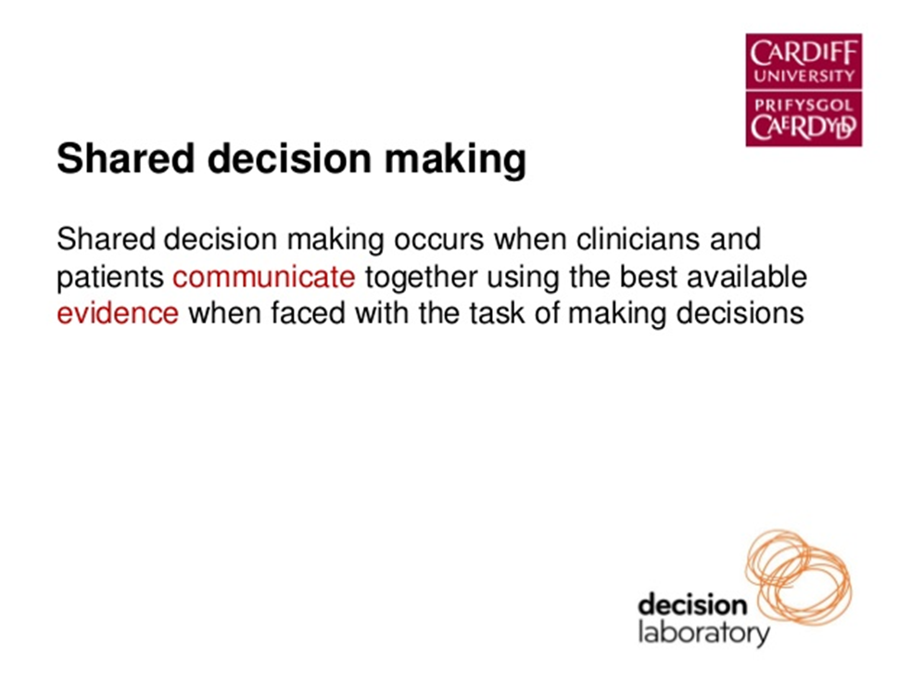

Slide 15
Characteristics of shared decision-making
Involves at least the doctor and patient – may also include relatives or other advocates
Both parties must share information
Both parties must make an effort to be involved
A decision must be made and both parties must agree to it
Does NOT necessarily mean 50/50 share!

Slide 16
Challenges of shared decision-making
Individual differences/personality of patient
Not always the optimal model
Many patients prefer/want the clinician to make the “best” decision for them
Behaviour of doctors can prevent shared decision-making from taking place
  Beliefs
  Behaviours
  Consultation pressure

Slide 17
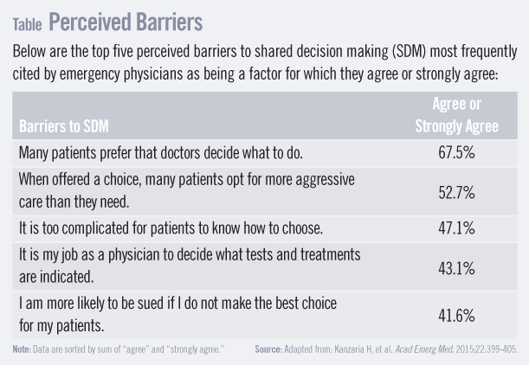

Slide 18
‘Decision Support Interventions’
(Following slides kindly supplied by Dr Kate Brain, Division of Population Medicine, Cardiff University)
Notes:
Decision support interventions synonymous with Decision aids, decision support tools…

Slide 19
A Definition of ‘Decision Support Interventions’
“Interventions that provide support for patients who are facing tough decisions.”
(Elwyn et al. 2010)
“Decision aids differ from usual health education materials because they make explicit the decision being considered and the detailed, specific, and personalized focus on options and outcomes for the purpose of preparing people for decision making.”
(Stacey et al. 2011)
Notes:
Decision support interventions synonymous with Decision aids, decision support tools…

Slide 20

Why use Decision Support Interventions?
In 86 trials evaluating decision support tools that cover 35 different screening or treatment decisions, use has led to:
Greater knowledge
More accurate risk perceptions
Greater comfort with decisions
Greater participation in decision-making
Fewer people remaining undecided
Fewer patients choosing major surgery
Stacey et al.
Cochrane Database of Systematic Reviews, 2011

Slide 21
            Types of Decision Aids
Self-administered decision aids (extensive)
In-clinic decision aids (brief)
Most decision aids to date have been self-administered, but they have faced substantial implementation issues (Elwyn et al. 2008; Frosch et al., 2011):
  Professionals are reluctant to recommend them
  Professionals do not know about them
  Patients do not use them
  There is no policy guiding implementation
The bottom line: there are many good decision aids that no one uses!

Slide 22
            Option Grids - Introduction
Option Grids are brief easy-to-read tools to help patients and providers talk about difficult decisions.
They answer frequently asked questions in a grid format, enabling direct comparison of options
They are available online: http://www.optiongrid.org/
http://vimeo.com/55088088

Slide 23
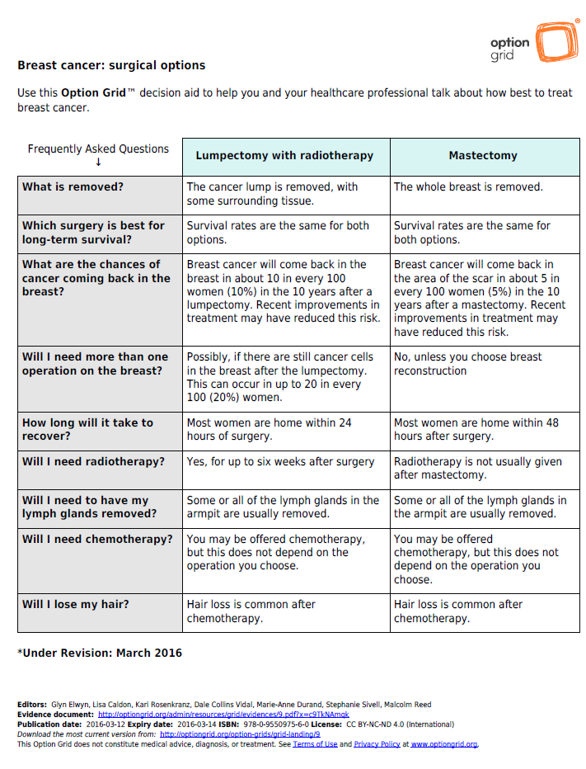
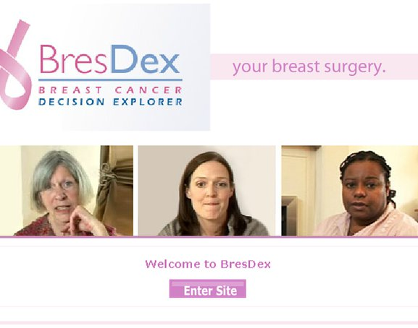

SDM Tools

Slide 24

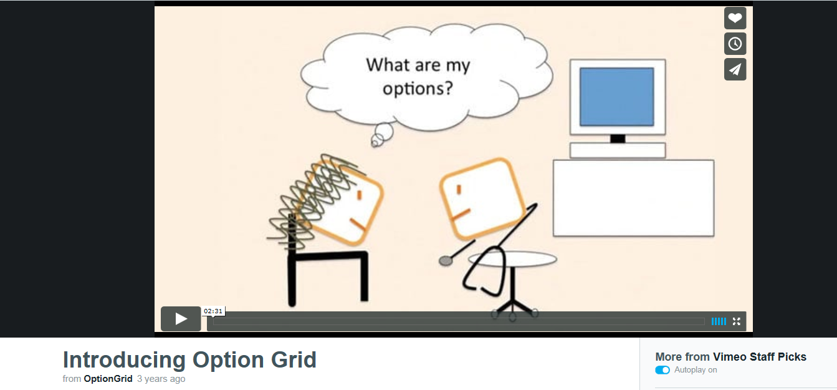
https://vimeo.com/55088088

Slide 25
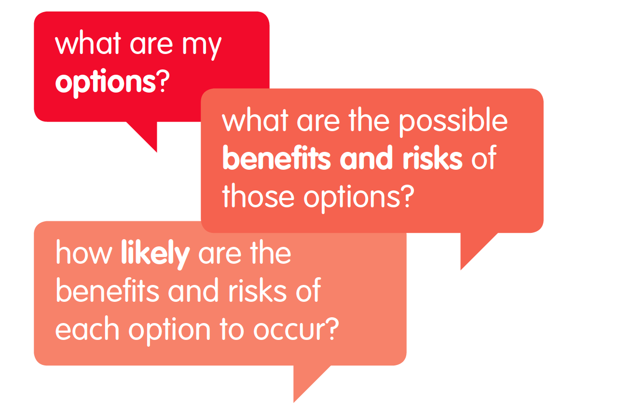
“Ask 3 Questions” Campaign
    Patient engagement campaign.
    Patient Activation – bottom-up approach
    3 questions to help patients become more involved in healthcare decisions
Campaign adapted from:
Shepherd H, Barratt A, Trevena L, et al. Three simple questions to increase information about treatment options and patient involvement in healthcare consultations. Patient Education and Counseling. 2011;84:379–85.2011

Slide 26
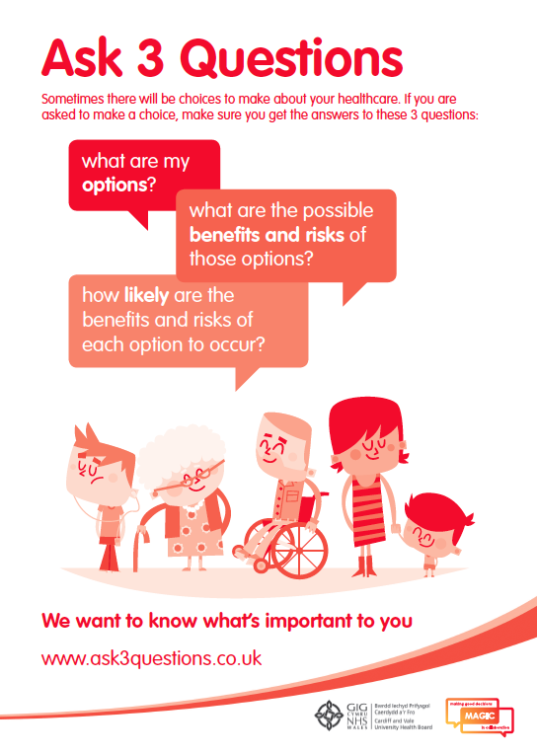
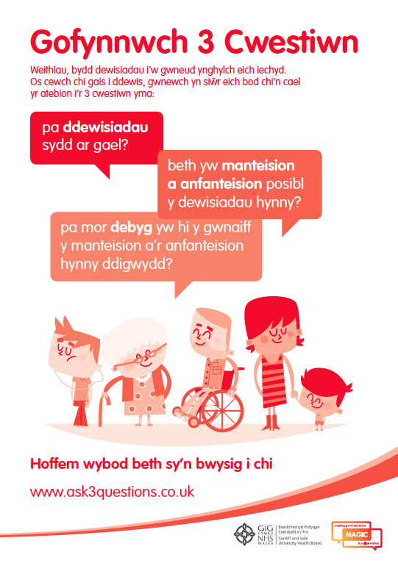

Slide 27
Understanding the SDM encounter and the use of SDM aids
SDM in practice is highly complex incorporating consideration of a patient’s clinical history, lifestyle, social circumstances and preferences.
Clinician skills are imperative in achieving SDM.
SDM tools are not necessary for SDM and are often presented at the end of the consultation.
One of the key learning points from the MAGIC programme is that:
‘skills trump tools, and attitudes trump skills’

Slide 28
Motivational Interviewing
A form of directive counselling that attempts to help patients understand their reasons for their behavioural choices and their reluctance to trying to change a behaviour
Aim is to help the person become motivated to change, rather than persuading them
https://www.youtube.com/watch?v=s3MCJZ7OGRk

Slide 29
Motivational Interviewing demonstration
https://www.youtube.com/watch?v=bTRRNWrwRCo

Slide 30
Motivational Interviewing V Shared Decision Making
“Motivational interviewing and shared decision making provide practical and well-described methods to accomplish patient-centered care in the context of situations where medical evidence supports specific behaviour changes and the most appropriate action is dependent on the patient’s preferences”
Elwyn et al., 2014
(seminar discussion article)

Slide 31
Motivational Interviewing V Shared Decision Making
Different clinical situations require different approaches and
Clinicians need to be skilled enough to adapt and, where needed, integrate methods.
If faced with difficult treatment decisions, shared decision making alone can be effective and appropriate.
Where clinicians perceive a need to change behaviour to improve health outcomes, motivational interviewing may be a useful approach
(Elwyn et al., 2014)

Slide 32
Summary
Our understanding of communication styles can inform our understanding of effective patient-doctor relationships
The patient’s “agenda” is important in effective medical communication and MI techniques can tap into this
Clinicians needs to be skilled in recognising different emotional responses and responding appropriately
Shared decision-making approaches considered best approach but not without its challenges

Slide 33
Essential readings from core text for exam preparation
Chapter 17 – Section 17.3
Chapter 18 – all of it!

Slide 34
Next week
Revision/review lecture
Mock exam practice –bring your core text book and notes with you!

