Slide 1

Managing People (lcbb5004)-Assessment 1
Name: bianca Petronela Paunescu
Student ID: 2024896
Name of Lecturer: dr. Nadeem Mirza
A case in favour of flexible working within the headquarters of NEXT PLC.

Slide 2
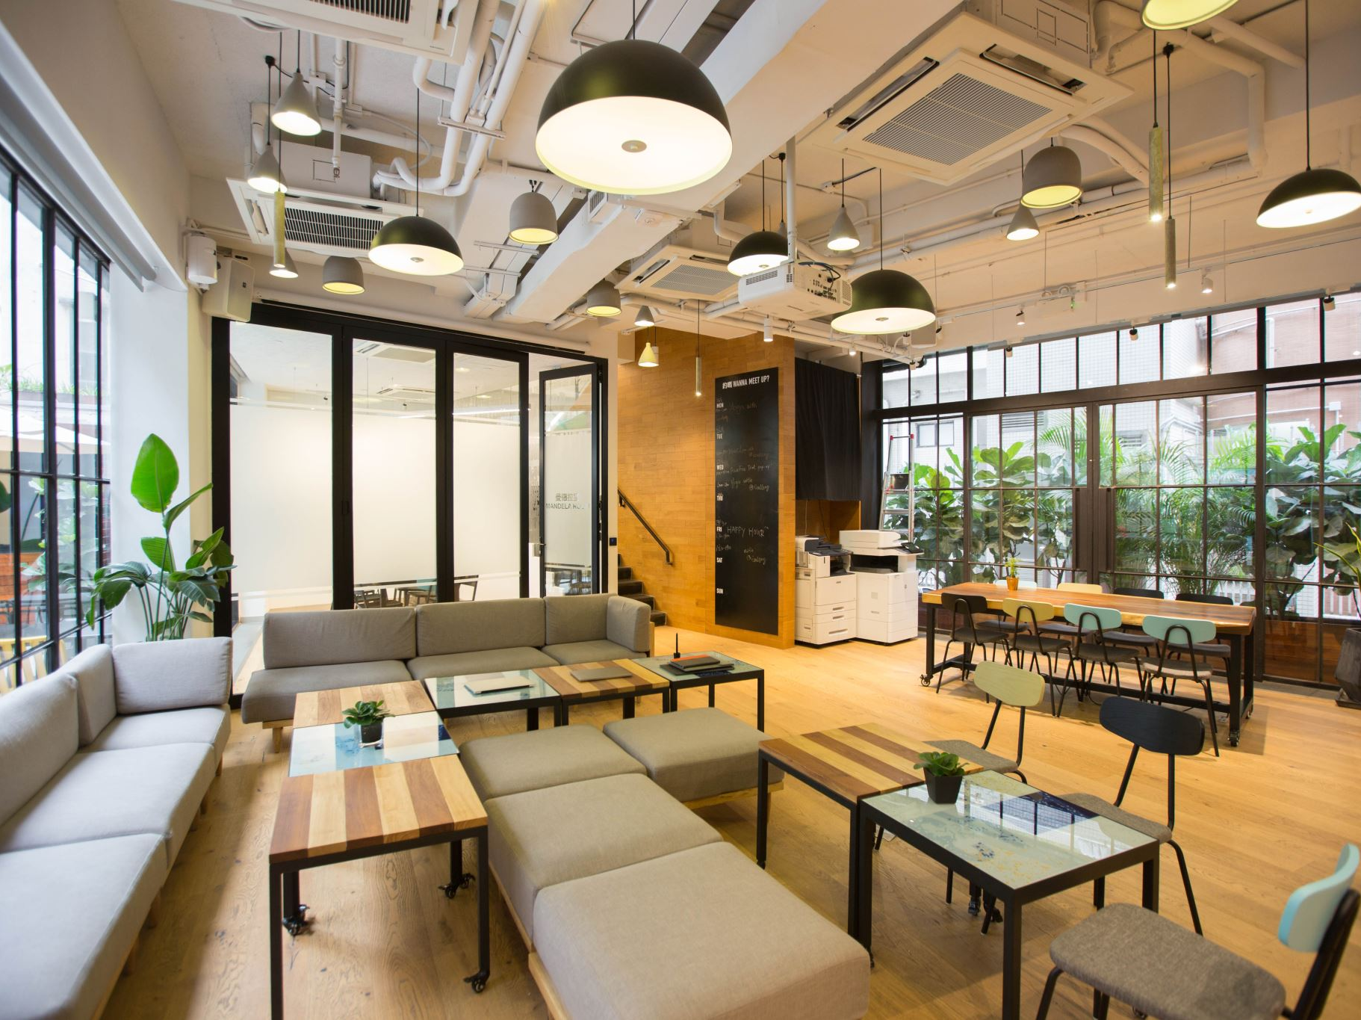
Flexible working

Slide 3
CONTENT
What is Flexible Working?
Advantages of Flexible Working
What is Diversity and Inclusion at the workplace?
Human Resources’ Role in implementing Diversity and Inclusion at the workplace
Conclusions
References

Slide 4
WHAT IS FLEXIBLE WORKING?
Workplace Flexibility can be defined as an employee’s ability to control his or her working hours and location (remotely from the office).
Flexible working can be perceived in different ways:
Working from home
Part-time
Flexi time
Compressed hours

Slide 5
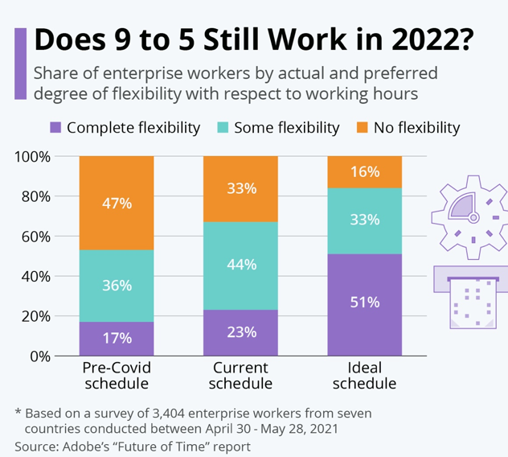
(Fleck, A., 2022)

Slide 6
ADVANTAGES OF FLEXIBLE WORKING
For employees
FOR EMPLOYERS
Facilitates work-life balance, increasing general life satisfaction (Shagvaliyeva, S. and Yazdanifard, R. ,2014).
Helps avoid rush hours or commute costs
Reduces stress and health issues
Gender Equality
Greater employees productivity and higher organisation profitability
Increase in employees’ loyalty and engagement towards the company
Reduced absenteeism
Company is viewed as a family friendly organisation

Slide 7

WHAT IS DIVERSITY AND INCLUSION IN THE WORKPLACE?
Understanding difference is the essence of Diversity. It is about recognising the value of having a variety of viewing points when it comes to decisions-making and not only.
Inclusion is when differences between people are embraced. Any employee, regardless of origin, identity, or situation, should feel like they belong in an inclusive workplace. They must believe they are making a difference and can achieve their full potential (CIPD, 2021).
“Cultural Diversity is when differences in race, ethnicity, language, nationality, religion and sexual orientation are represented within a community” (Martin, G., 2014).
People are legally protected against discrimination in the workplace and in larger society under the Equality Act of 2010. Discriminating against anybody on the basis of their age, gender identity, marriage, pregnancy, handicap, race (colour, nationality, ethnic origin), religion, sex, or sexual orientation is illegal (GOV – Discrimination: Your rights).

Slide 8
HUMAN RESOURCES- IMPLEMENTING DIVERSITY AND INCLUSION IN THE WORKPLACE
HRM has a great role in ensuring the organisation promotes diversity and inclusion in the workplace. It is the duty of HR to create an environment where all employees feel appreciated and involved (Martin, G. , 2014). As they fulfil various roles within the organisation, they oversee the following and not only:
RECRUITMENT AND SELECTION
The recruitment and selection process must be unbiased when it come to criteria such as gender, nationality, ethnicity, etc.
TRAINING AND DEVELOPMENT
Anyone showing interest and the right qualities for a higher position should be considered and offered the possibility to advance on the corporate ladder. Promotions should be given based on merit.

Slide 9
DIVERSITY AND INCLUSION AWARENESS
Awareness needs to be raised when it comes to Diversity and Inclusion, for everyone to understand the importance of having an inclusive workplace.
FAIR RULES AND PRACTISES
They must be implemented in an inclusive workplace, allowing a wide variety of people to collaborate successfully.
COMPLAINS PROCEDURES
The complains process must be the same for everyone and to follow the same guidelines no matter the persons involved. It is important to show equality at the workplace.

Slide 10
CONCLUSIONS
Flexible working has advantages for both employees and employers. Employees feel empowered by the possibility of choosing their working hours and location, while employers benefit from a more involved and dedicated personnel.
Having a diverse and inclusive workplace makes employees feel understood and respected for who they are and appreciated for their performance.
Human Resources Manager must ensure a healthy and diverse environment for employees, where they can all learn from one another, evolve together and fulfil the organisational goals.

Slide 11
REFERENCES
Chung, H. and van der Lippe, T. (2018). Flexible Working, Work–Life Balance, and Gender Equality: Introduction. Social Indicators Research, [online] 151(2), pp.365–381. doi:10.1007/s11205-018-2025-x.
CIPD (2021). Diversity and Inclusion in the Workplace | Factsheets | CIPD. [online] CIPD. Available at: https://www.cipd.co.uk/knowledge/fundamentals/relations/diversity/factsheet [Accessed 18 Jul. 2022].
Fleck, A. (2022). Infographic: Is 9 to 5 working in 2022? [online] Statista Infographics. Available at: https://www.statista.com/chart/27260/is-9-to-5-working-in-2022/ [Accessed 17 Jul. 2022].
GOV – Discrimination: Your rights. Available at: https://www.gov.uk/discrimination-your-rights [Accessed 18 Jul. 2022].
Grissom, A.R. (2018). The Alert Collector: Workplace Diversity and Inclusion. Reference & User Services Quarterly, 57(4), p.243. doi:10.5860/rusq.57.4.6700.
Martin, G. (2014). The Effects of Cultural Diversity in the Workplace. Journal of Diversity Management (JDM), 9(2), pp.89–92. doi:10.19030/jdm.v9i2.8974.
Shagvaliyeva, S. and Yazdanifard, R. (2014). (PDF) Impact of Flexible Working Hours on Work-Life Balance. ResearchGate. [online] Available at: https://www.researchgate.net/publication/260219489_Impact_of_Flexible_Working_Hours_on_Work-Life_Balance [Accessed 17 Jul. 2022].

