Slide 1
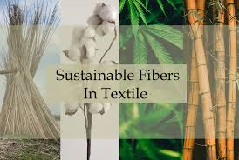
SUSTAINABLE ENTERPRISE
PRESENTATION

Slide 2
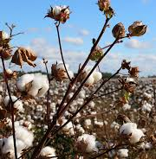


Introduction
Produces ethically sourced apparel and accessories.
Private limited entity with fair labor practices and environmental stewardship.
Aims to develop closed-loop production model.
Reduces textile waste.
Delivers high-quality, ethically appealing products.

Slide 3


Business Model and Sustainability Approach
Sources organic and recycled materials to minimize chemical usage.
Manufactures garments in energy-efficient facilities.
Encourages material circularity by encouraging return for repair or recycling.
Offers equitable pricing reflecting sustainable input costs.
Commits to ethical transparency for stakeholders.

Slide 4


Marketing Strategy
Partners with certified suppliers for efficient operations.
Distribution center located near major shipping hubs.
Utilizes digital channels for marketing.
Shares content on fair labor, responsible sourcing, product durability.
Fosters brand credibility through influencer collaborations, community events, and online storytelling.

Slide 5

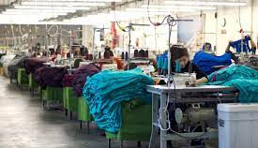
Justification for Success
Aligns with shifting consumer preferences for responsible lifestyle products.
Emphasizes design, quality, and brand authenticity.
Differentiates from competitors with superficial sustainability measures.
Embedding social and environmental impact throughout supply chain.
Provides resilient foundation for scalable, long-term success in fashion industry.

Slide 6
References
Meek, W. R., Pacheco, D. F., & York, J. G. (2010). The impact of social norms on entrepreneurial action-Evidence from environmental entrepreneurship. Journal of Business Venturing, 25(5), 493–509.
Moore, M.-L., Westley, F. R., & Brodhead, T. (2012). Social finance intermediaries and social innovation. Journal of Social Entrepreneurship, 3(2), 184–205.
Nazarkina, L. (2012). How sustainable are the growth strategies of sustainability entrepreneurs? In G. Mennillo, T. Schlenzig & E. Friedrich (Eds.), Balanced Growth: Finding Strategies for Sustainable Development. Berlin: Springer.
Nicholls, A., & Pharoah, C. (2008). The landscape of social investment: A holistic topology of opportunities and challenges. Working paper. Oxford: Skoll Centre for Social Entrepreneurship.
Nill, J., & Kemp, R. (2009). Evolutionary approaches for sustainable innovation policies: From niche to paradigm? Research Policy, 38(4), 668–680.
OECD (2009). Sustainable manufacturing and eco-innovation: Framework, Practices and Measurement Synthesis Report, Eco-innovation. Paris: OECD.

