Slide 1

Leadership and Management
Student Name and ID:
Constantin Patrascu (2022567)
Lecturer: Dr.Mushfiqur Rahman
Module name: Leadership and Management Theory and Practice (LCBB 6003)
University of Wales Trinity Saint David

Slide 2

Table of Contents
Transactional leadership .…………………………………………………….Constantin Patrascu
Leadership transformation …………………………………………………… Constantin Patrascu
Elements of transformational leadership ………………………….…..Constantin Patrascu
Other Leadership and Management Theories …………………………. Stefan GheorgheConclusion ……….…………….…………………………………………………Stefan Gheorghe
References

Slide 3

Introduction
This presentation will discuss, in turn, the leadership perspectives and the attributes and various factors of leadership, the benefits of leadership and its principles. We will also briefly review some well-known Leadership Theories and one Management Theory.
We will provide a summary of Welch’s leadership and management style, outlining its attributes and characteristics, and the challenges associated with Welch’s approach.
Finally, we will evaluate Welch’s Leadership style and end with a brief conclusion.
Who is Jack Welch?
most influential leader in the history of business
innovative leadership style
charismatic, effective communication skills, ability to motivate and inspire
challenges of his leadership style
Notes:
Jack Welch is an American business leader and former Chief Executive Officer (CEO) of General Electric Corporation (GE). He is widely regarded as one of the most influential leaders in the history of business, renowned for his innovative leadership style and profound influence on GE's growth and success. Welch's approach to leadership was characterized by a relentless pursuit of cost reduction, a short-term focus on results, and an unwavering commitment to competitiveness. Jack Welch was renowned for his charisma, effective communication, and ability to motivate and inspire others. Welch's commitment to efficiency and performance was matched only by his commitment to accountability and results. His leadership style has been highly beneficial to General Electric, as it has enabled the company to experience significant growth and increased market position. Additionally, Welch's leadership has fostered an urgency and high-performance culture, encouraging employees to surpass expectations and foster innovation. At the same time, Welch’s leadership style had its limits. One of those limits was a culture of competition within GE. Welch’s “rank and yank” system drove performance but also reduced collaboration, destroyed trust, and created a fear-based culture. Welch also tended to prioritize short-term financial results over long-term sustainability. This led to underinvestment in R&D and a possible lack of innovation. His leadership style was also criticized for its lack of emphasis on fostering creativity and for limiting employee autonomy.

Slide 4
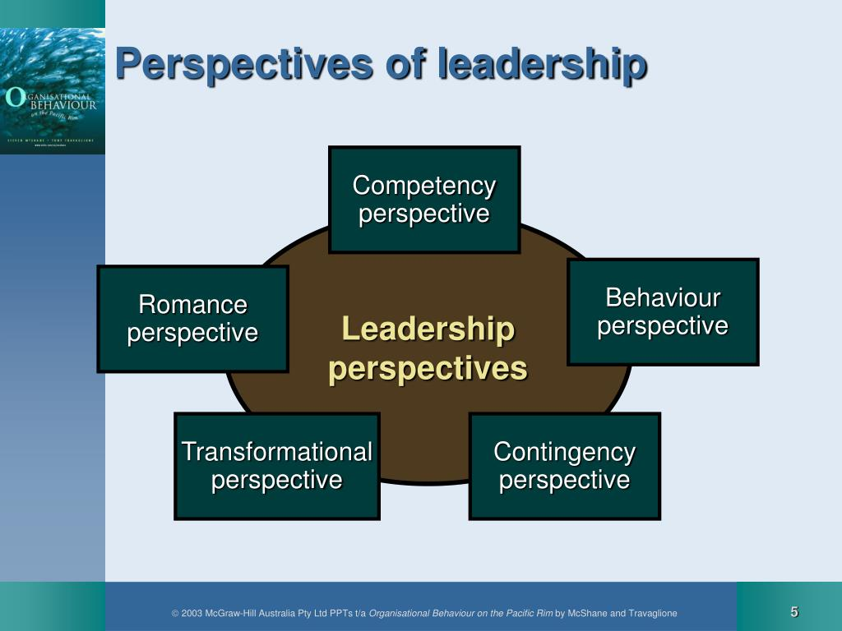
Leadership Perspectives
A leader must have the ability to recognize talent and to educate, delegate and motivate his team members (Jakobsen et al., 2023).
To complete a mission efficient team-making is important and he should know the art of making a team of trusted advisors.
He should have dedication, and passion towards his mission and to achieve the target he must create an example and step out of his comfort zone.
Apart from these qualities being caring and compassionate is also very important (Forbes, 2023).
Source: (Forbes, 2023)
Notes:
Leadership perspective
For the execution of the plan efficient leadership is required and there are some key qualities that a leader should have to lead the team. A leader must have the ability to recognise talent and to educate, delegate and motivate his team members (Jakobsen et al., 2023). He must have a clear vision, enthusiasm and charisma. To complete a mission efficient team-making is important and he should know the art of making a team of trusted advisors. He should have dedication, and passion towards his mission and to achieve the target he must create an example and step out of his comfort zone. Apart from these qualities being caring and compassionate is also very important (Forbes, 2023).

Slide 5
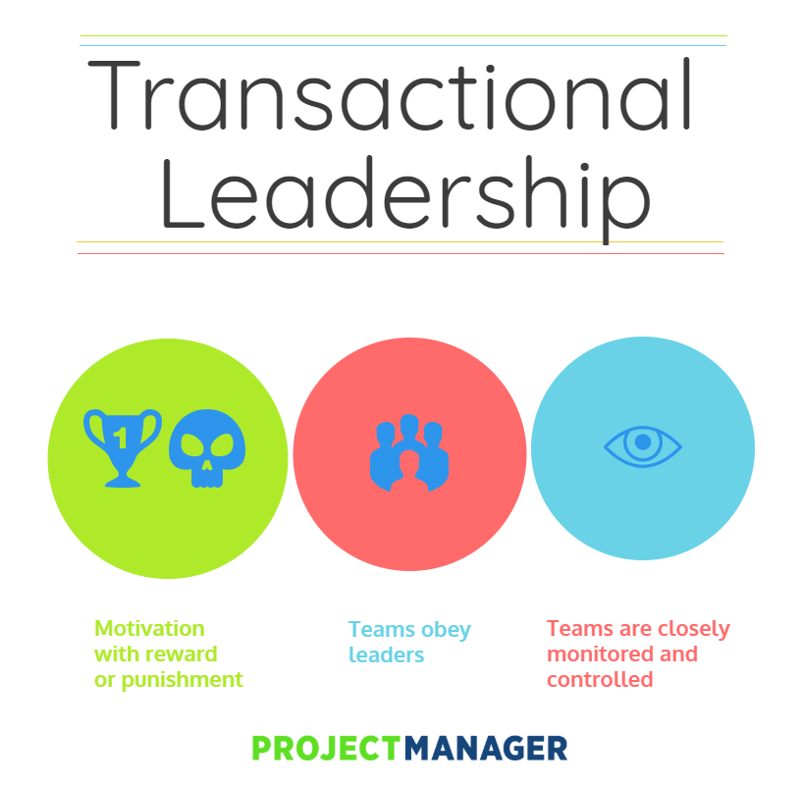
Transactional leadership is a style of leadership that depends on the exchange of transactions (Nurlina, 2022).
This model believes that individuals cannot be motivated until they have a well-defined structure of instruction and supervision.
This theory involves three approaches contingency which involves reinforcement theory and motivation based on incentives, rewards, and punishment.
Active management involves active monitoring by leadership by anticipating an issue and taking corrective action to solve the problem.
In passive management, leadership stays away from the team and only intervenes when team members fail to perform.
Source: (Nurlina, 2022)
Notes:
Transactional leadership
Transactional leadership is a style of leadership that depends on the exchange of transactions. It relies on reward and punishment to fulfil the optimal job target from the workers (Nurlina, 2022). This model believes that individuals cannot be motivated until they have a well-defined structure of instruction and supervision. This theory involves three approaches contingency which involves reinforcement theory and motivation based on incentives, rewards and punishment. Active management involves active monitoring by leadership by anticipating an issue and taking correct action to solve the problem. In passive management, leadership stay away from the team and only intervene when team members fail to perform. In this system the instructions are direct, work structure is rigid which gives stability, and improves efficiency but it lacks creativity which often demotivates the workers.

Slide 6
Conclusion
The various leadership and management styles have been highlighted in this presentation.
A few benefits of leadership styles along with their principles have been incorporated into this presentation.
Several perspectives on leadership and the transformational as well as transactional leadership styles have also been highlighted in this presentation.
Various attributes of leadership such as self-confidence and innovativeness have also been demonstrated here.
The leadership and management qualities of Jack Welch along with the challenges and an evaluation of his leadership style have been elaborated in the end part of this presentation.
Notes:
Jack Welch's leadership style at General Electric left an undeniable mark on the company and the business world. His aggressive approach, characterized by cost-cutting measures, a focus on short-term results, and a relentless pursuit of competitiveness, brought numerous benefits to General Electric. Under Welch's leadership, GE experienced significant growth, improved financial performance, and a culture of accountability and high performance.
However, Welch's leadership style also had its limitations and challenges. The cutthroat culture, the potential neglect of long-term sustainability, and the limited emphasis on nurturing innovation and creativity presented obstacles for GE. These challenges underscore the importance of striking a balance between short-term performance and long-term sustainability, fostering a collaborative and innovative work environment, and ensuring effective talent development and succession planning.
While Jack Welch's leadership style may have faced limitations and challenges, his tenure at General Electric undoubtedly had a profound impact on the company's success and established him as one of the most influential corporate leaders of his time. The lessons learned from Welch's leadership style continue to inform discussions on effective leadership and the complexities of driving organizational growth and sustainability.

Slide 7

References
businessleadershiptoday, (2023). 7 Important Leadership Qualities. [Online] Available at: https://businessleadershiptoday.com/what-are-7-important-leadership-qualities/#:~:text=Seven%20important%20leadership%20qualities%20that,that%20result%20in%20exceptional%20performance. [Accessed 16 June 2023].
forbes, (2023). 10 Unique Perspectives On How To Be An Effective Leader (Part 3). [Online] Available at: https://www.forbes.com/sites/brentgleeson/2016/11/27/10-unique-perspectives-on-how-to-be-an-effective-leader-part-3/?sh=1c5817cce660 [Accessed 01 June 2023].
Harahap, V.A., (2023). Healthy Principal Leadership Concepts. MUDABBIR (JOURNAL RESEARCH AND EDUCATION STUDIES), 3(1), pp.60-65.
imd, (2023). The 6 most common leadership styles & how to find yours. [Online] Available at: https://www.imd.org/reflections/leadership-styles/ [Accessed 19 June 2023].
Jakobsen, M.L., Kjeldsen, A.M. and Pallesen, T., (2023). Distributed leadership and performance‐related employee outcomes in public sector organizations. Public administration, 101(2), pp.500-521.
Ladkin, D. and Patrick, C.B., (2022). Whiteness in leadership theorizing: A critical analysis of race in Bass’ transformational leadership theory. Leadership, 18(2), pp.205-223.
mckinsey, 2022. What is leadership?. [Online] Available at: https://www.mckinsey.com/featured-insights/mckinsey-explainers/what-is-leadership [Accessed 21 June 2023].
Nurlina, N., (2022). Examining Linkage Between Transactional Leadership, Organizational Culture, Commitment and Compensation on Work Satisfaction and Performance. Golden Ratio of Human Resource Management, 2(2), pp.108-122.
performyard, 2023. Does the Jack Welch Management Style Work in 2023?. [Online] Available at: https://www.performyard.com/articles/jack-welch-management-style [Accessed 21 June 2023].
Walsh, M.M. and Arnold, K.A., (2020). The bright and dark sides of employee mindfulness: Leadership style and employee well‐being. Stress and Health, 36(3), pp.287-298.
"Leadership styles at GE and Canon: Jack Welch and Fujio Mitarai's differing approaches", 2006, Strategic Direction, vol. 22, no. 11, pp. 15.
Amanchukwu, R.N., Stanley, G.J. and Ololube, N.P., 2015. A review of leadership theories, principles and styles and their relevance to educational management. Management, 5(1), pp.6-14.
O’Boyle,T.(1998) “At Any Cost: Jack Welch, General Electric, and the Pursuit of Profit” , Alfred A. Knopf

Slide 8

Questions

