Slide 1

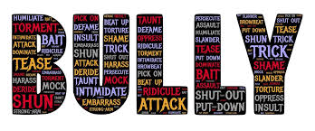
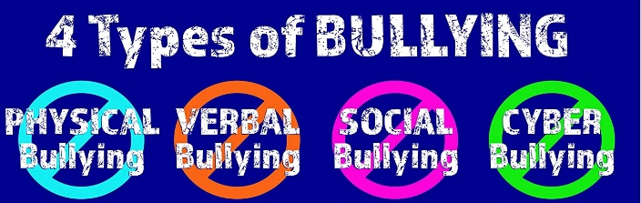
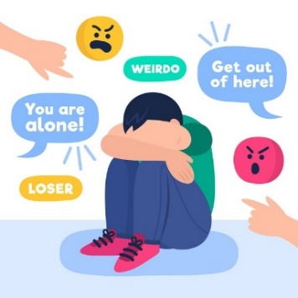

(Bullyingprevention.com,
2020).
Don’t be a
Done on purpose
Hurtful
(Mentalhealth.com,2020).
Bullying is…
Done
again and again
Wrong
Bullying effects us all, including those who are
bullied, those
who bully others and those who witness bullying.
Say NO! to bullying! Tell someone.
Steps to prevent
bullying.
Bullying is NOT ok!
Don’t ignore it.
Tell someone
Have confidence.
When you see something, do something.
(Freepik.com,2020).
(pintrest,2021).

Slide 2
Reference list:
Aggleton, P, Hurry, J, Warwick, I. (2004), Yong People and Mental Health, London: Wiley Publishers.
Atkinson, M and Hornby, G, (2002). Mental Health Handbook for Schools. London: Routledge Falmer.
Barlow, J and Scott, J. (2010), Research in Practice: Safeguarding in the 21st Century: Where to Now? Sheffield: Dartington Press: University Of Sheffield.
Beckett, C. (2010), Childhood Safe Guarding & Bullying: An Introduction, 2nd Ed, London: Sage.
Bullying prevention, Midwest schools, (2019), Available at: https://www.michiganschoolshows.com/bullying_prevention_postes, accessed on : 11/1/2021).
Bronfenbrenner, U. (1979). The Ecology of Human Development, Cambridge MA: Harvard University Press.
Bronfenbrenner, U (1974) Is Early Identification Effective? Washington DC, US Department of Health and Welfare.
Clipart (2020).
Donaldson, G, (2015), Successful futures looking at the curriculum and assessments arrangements in Wales, Available at: https://gov.wales/sites/default/files/publications/2018-03/succesful-futures-a-summary-of-professor-graham-donaldsons-report.pdf Accessed on: 5/1/2021.
Freepik, (2020), Available at: https://www.freepik.com Accessed on: 12/1/2021.
Lindon, J. (2010), Understanding Child Development: Linking Theory and Practice. Second Edition. London: Hooder Education.
Macleod – Brudenell, I, Kay, J, (2008), Advanced Early Years for Foundation Degrees, Levels 4/5, 2nd ed. Essex, Pearson Education Limited.
Menatlhealth. Gov (2020) available at https://www.mentalhealth.gov accessed on 4/1/2021.
Mental health foundation (2020) available at https://www.mentalhealth.org.ukaccessed on: 6/1/2021.
Palaiologou, I, (2013), The Early Years Foundation Stage Theory and Practice, 2nd Ed, London, SAGE publications Ltd.
UNCRC Rights of the child, Available at: - https://www.savethechildren.org.ukaccessed on: 7/1/2021.
Varma, V. (1992), The Secret Life of Vunerable Children, London:Routledge.
Young Minds (2021) available at: - https://youngminds.org.uk accessed on: 6/1/2021.

