Slide 1
Elliot Barnett
Computer networks
Marketing

Slide 2
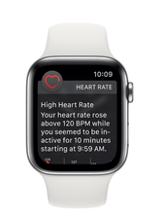
Competitors
Apple Watch
Heart rate monitor
Identification
Fall detection system
Pros
Quick and easy to use
Advise users to get help (Heart rate to high)
Call emergency services if the fall is bad.
Cons
Expensive
Short battery life
[1]

Slide 3
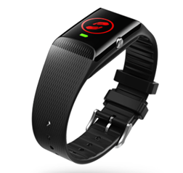
Competitors
Vodaphone SOS band
SOS button
Fall detection system
1 month battery life
Pros
Long battery life
GPS location
Quick and easy to use
Cons
Moderately expensive (£78) with added contract
Does not store any critical medical information of the user
[2]

Slide 4
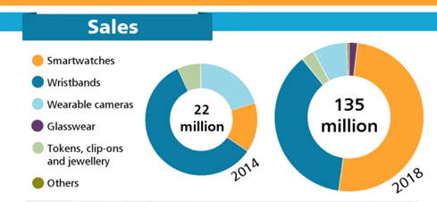
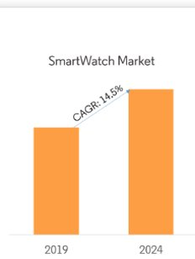
Statistics
Very little statistics on digital medical wristbands at the moment.
With the increase in smart wear, there I huge potential for a making the medical wristband digital.
[3]
[4]

Slide 5
Target Market
Anybody who needs it
Specifically for people with dementia and disabilities

Slide 6
Conclusion
References
[1] Apple "Apple watch", 1 12 2019 [online] Available:
https://www.apple.com/uk/healthcare/apple-watch/
[2]Vodaphone "SOS Wristband", 27 11 2019[online] Available:
https://eshop.v.vodafone.com/uk/v-sos-band?cid=ppc-google-non-6459912926-prch-08-21-2019--IoTUK_AlwaysOn&kpid=go_cmp-6459912926_adg-80141799591_ad-378980723484_aud-794144595355:pla-810133502108_dev-c_ext-_prd-vsos2&gclid=Cj0KCQiA2vjuBRCqARIsAJL5a-JqD777gNJj6RUTOHXvtOw2z51Iz5LE9dTEUiO5grBvaTQgKH9B8R4aAligEALw_wcB
[3]CCsinsight "Smart watches and Smart bands", 20 11 2019 [online] Available:
https://www.ccsinsight.com/press/company-news/1944-smartwatches-and-smart-bands-dominate-fast-growing-wearables-market/
[4] Mordor Intelligence "Smart watch market", 20 11 2019[online] Available:
https://www.mordorintelligence.com/industry-reports/global-smart-watches-market-industry
One or two current competitors
The growth for smart wear is increasing at a fast rate

