Slide 1
Creating Presentations with PowerPoint
CertHE Skills for the Workplace

Slide 2
Aims of presenting
ABC of presenting
Before and during presentations
Creating a PowerPoint

Slide 3
The aim of your presentation
To send a clear, persuasive message confidently
To engage your audience
To present info accurately and memorably

Slide 4
The ABC of Presenting
Accuracy
  Spelling, content etc
Brevity
  Points should be what the audience must know
Clarity
  Neat, simple, uncluttered
Notes:
Dates, names refs etc should be accurate.
Each slide should deal with one concept or one idea, only the essential details as points should be included; cardinal sin of too much on one slide to be avoided
Visibly obvious and clear – try to avoid clutter or unnecessary info – this is a bit personal/subjective but try and keep the background simple – for example this or this?

Slide 5
Creating your PowerPoint
Follow the ABC rule
Remember visibility
Make it interesting
Plan the sequence
  Title slide
  Intro slide
  Slides of topics
  Concluding slide (+ refs if necessary)
Notes:
Familiarise yourself with the equipment and the programme so that you are confident about using it on the day.
Visibility; font size; highlight the salient info if you want
Remember about visual impairments – colour blind for instance; remember contrasting
Background not too cluttered but consistency is good, use images to highlight the main idea or to bring some humour into the proceedings.
Can reveal the info slowly if you want. People tend to read the slides before they listen to you. As you put it up to see give them some time to absorb the slide and then go over the points. The points should be in brief – you can add to them.
Title slide, intro slide, slide of topics (one for each page), concluding slide and refs if necessary.

Slide 6
Before the presentation
Preparation
  Know the equipment
  Know the room
  Know the information
Notes:
Know the equipment in the room – try it prior so that you don’t get any shocks; know how dark the room needs to be for max visibility.
Practice doing the presentation to your friends – time it; make a note of where it doesn’t quite work, where there might be a conceptual leap or where some info is missing – alter your presentation – don’t assume people will understand. Prepare handouts etc if you are going to use them.
Know your info – practice saying it out loud; remember the sequence of information. Have your notes to hand just in case you need a reminder of what you want to say.
Know when to change your slides and what follows on.
Don’t be drunk or late

Slide 7
During the presentation
Breathe
Take your time
Don’t ONLY read the slides
Don’t ONLY read your notes
Notes:
Don’t give out handouts and then expect people to not read them. Make sure your timing is right; don’t pass around distracting info
Don’t move off the slide too quickly, give people time
Don’t ONLY read the slide.
If you lose your place don’t worry, we are all human. Never introduce yourself as ‘rubbish’ – don’t put your work down.

Slide 8
Presenting yourself
Open body language
Eye contact
Use gestures
Don’t fiddle
Speak out into the room
Notes:
Aim is to appear confident – even if you’re not feeling so. We all get scared. Breathe. Focus on the information and you will loose some of your self-consciousness. Open body language – not hunched, allow all your inner organs enough space to breath and digest; head up, face out; eye contact – scan back of the room. Use gestures to emphasis; point out and indicate for the audience. Make them listen and look at the things you want them to.
Don’t fidget, twiddle, stroke your neck, bite your nails etc.
Project your voice back – too quiet and no-one can hear you – you will bore them.

Slide 9

Creating a PowerPoint Presentation
Notes:
Aim is to appear confident – even if you’re not feeling so. We all get scared. Breathe. Focus on the information and you will loose some of your self-consciousness. Open body language – not hunched, allow all your inner organs enough space to breath and digest; head up, face out; eye contact – scan back of the room. Use gestures to emphasis; point out and indicate for the audience. Make them listen and look at the things you want them to.
Don’t fidget, twiddle, stroke your neck, bite your nails etc.
Project your voice back – too quiet and no-one can hear you – you will bore them.

Slide 10
The Tool Bar
Home – similar functions to Word
Insert – pictures, film, hyperlink, tables, charts
Design – themes of the slides, background
Animations – moving objects in the slide
Slide Show – see the show
Review - Spelling, Thesaurus
View - seeing the slides

Slide 11
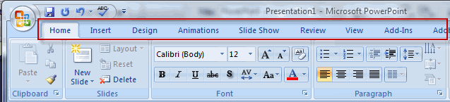
The Tool Bar

Slide 12
Charts:
Copying data from Excel into PP

Slide 13
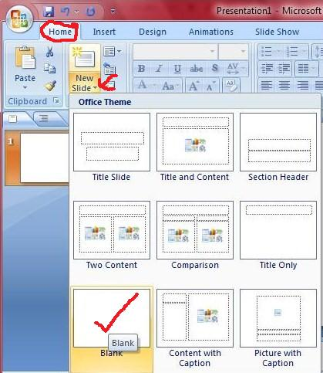
New Slide and Slide types

Slide 14
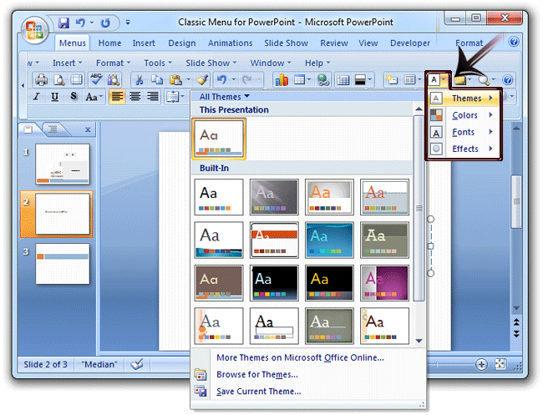
Choosing a theme

Slide 15
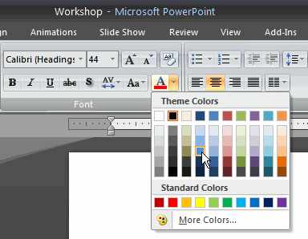
Colours and Fonts
Choose contrasting colours
Choose a clear bold font

Slide 16
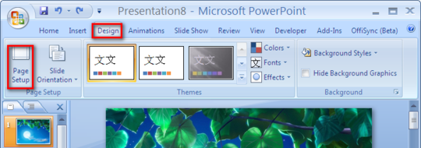
Backgrounds
Go to Design, Background Styles
Choose style or insert a picture
Widen picture in page set up, if necessary

Slide 17
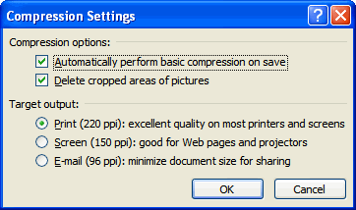
Inserting Pictures
Pictures from
  Your files
  From clip art
  From online sources

Slide 18

Adjusting Pictures

Slide 19
Inserting more info
Header and footer
  Page number
  Date
  Time
  Title or author
Text box – available on ‘Home’ tab, in ‘Drawing’ section
Hyperlink – available on ‘Insert’ tab, in ‘Links’ section
Available on ‘Insert’ tab,
in ‘Text’ section

Slide 20
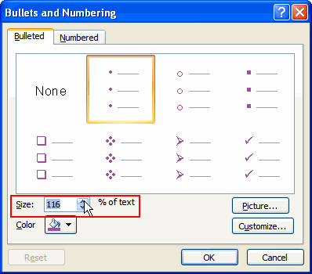

Lists
Bullet points
  Customise bullet points
Number lists
  Customise number list

Slide 21
Animations
4 types
  Entrance – how something arrives on the slide
  Emphasis – draws attention to something
  Exit – how something leaves the slide
  Motion – determines a path of movement in the slide
Animations can be customised

Slide 22
To Animate
Highlight the part of the slide that you want to animate
Choose ‘Animation’ tab
Choose ‘Custom Animation’ in tool bar
‘Add Effect’ appears
  Choose which of the 4 types of animation you want.
  Then select your effect from the submenu
Select ‘Auto Preview’ to see the animation

Slide 23
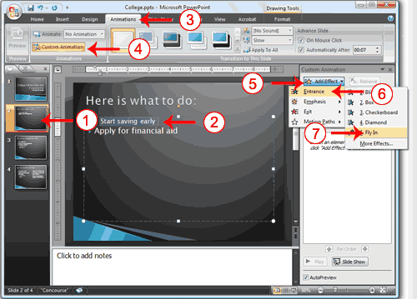
To Animate

Slide 24
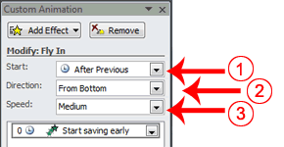
To adapt your Effect

Slide 25

Transitions
Alters how the slides appears in the show
Choose ‘Animations’
Select the type of transition you want
Then set timings on the toolbar
  Select ‘on click’ or ‘mouse over’
  Timing in seconds
  Then ‘apply to all’ or just that slide

Slide 26
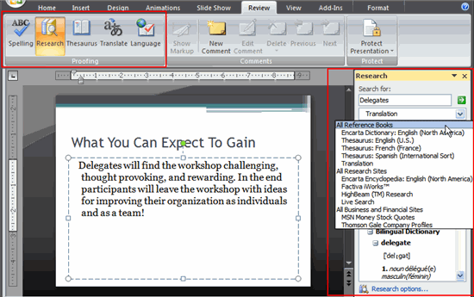
Review Tab
Spelling, Thesaurus etc.

Slide 27
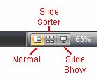
Viewing your Slides
Normal – with or without side bar
Sorter – view of all at the same time
Slide Show – as a show

Slide 28
Save as…
Save as a PowerPoint file (.ppt or .pptx)
Save as ‘PowerPoint Show’ .ppts
Save as pdf file (.pdf) when you want to upload the file to Moodle, the web etc. and don’t need to make any further changes.

Slide 29
In Summary
Presenting material is a necessary skill these days both in academia and employment
To present using PowerPoint follow the ABC of presentations
Using PowerPoint effectively means being accurate, brief and clear*
*Modified from an original presentation by Luci Attala TSD 2011.

