Slide 1



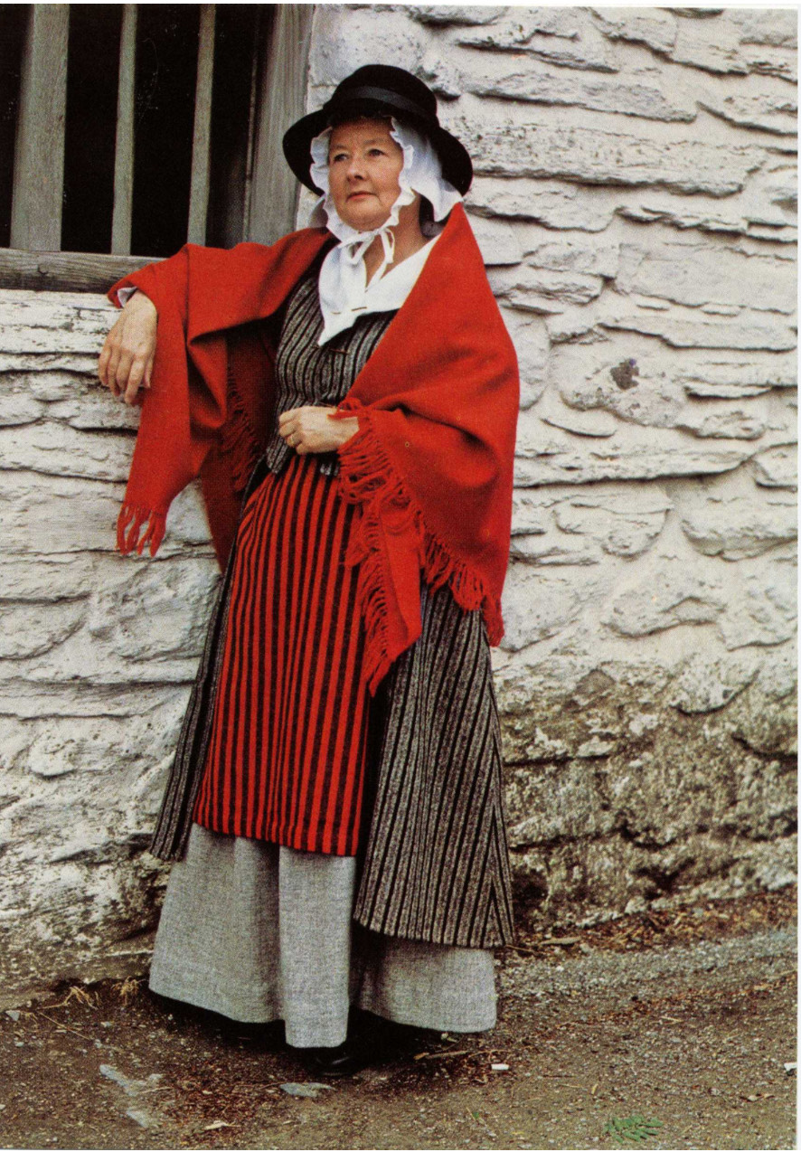
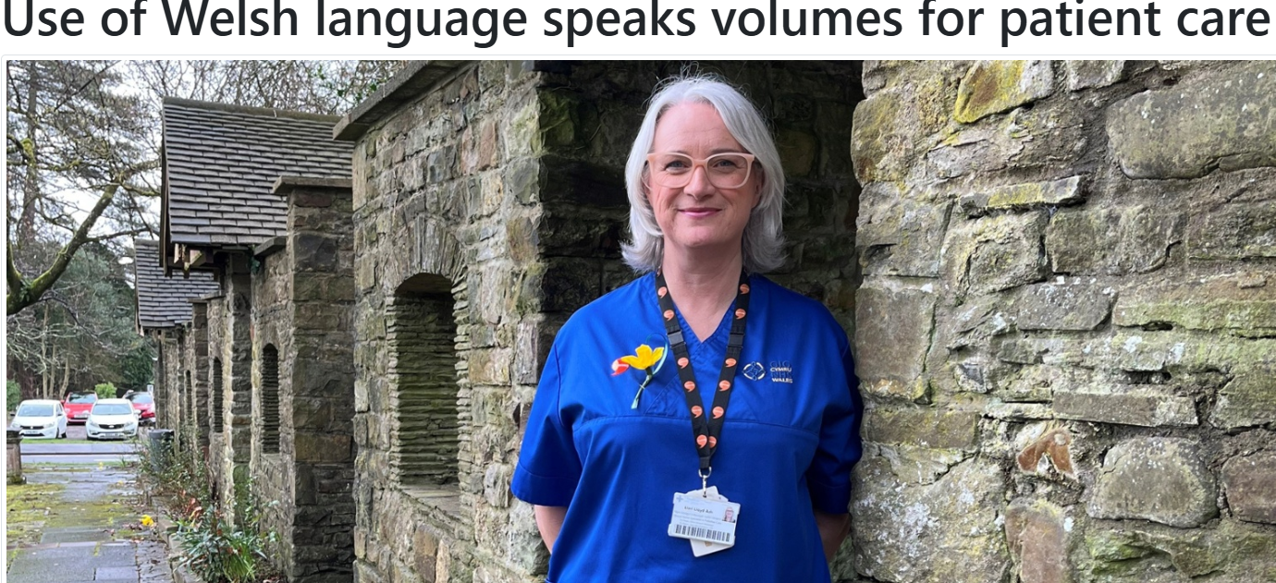
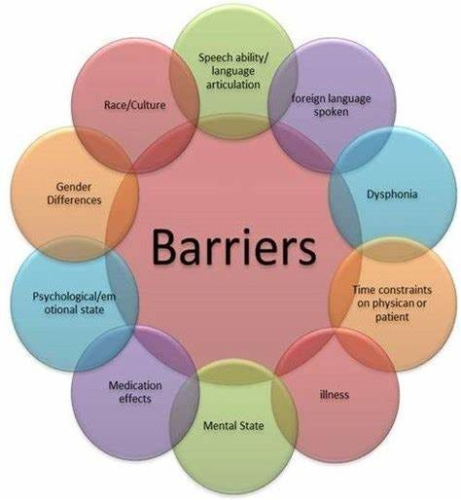

The Value of Welsh Language and Culture in Health and Social Care
Introduction
Wales achieved official devolution status in 1999 through which UK Parliament transferred specific authority to the Welsh Government and Senedd. A significant shift of authority enabled Wales to manage health and educational domains thus creating policies through an approach based on local needs. The healthcare sector has experienced a major impact through service development which prioritizes Welsh values. The implementation of devolution has solidified both the Welsh language and cultural presence in public services and thus enhances health and social care national identity. (Senedd. Wales, 2020)
Welsh Language and Culture
The Welsh language serves as a fundamental factor that promotes intentionality together with belonging among Welsh speakers who seek healthcare services. Integrating Welsh language access in healthcare services allows patients to communicate in their native language thus enhancing their sense of comfort and trust. According to the "More than Just Words" framework of the Welsh Government patients must not need to ask because healthcare providers should offer Welsh language services as a standard practice while maintaining dignity and respect. Through effective communication in Welsh healthcare professionals become better able to understand what patients need and prefer for improved health outcomes. Active Offer enables the creation of bilingual settings which strengthens cultural identity and embraces inclusivity among both patients and professionals.​(WeCare Wales, 2022)
Policy and Legislation
The Welsh Government implemented official status to the Welsh language in 2011 thereby setting significant changes for healthcare services throughout Wales. The requirement now demands healthcare providers to develop specific services tailored for Welsh speakers. Healthcare professionals receive encouragement to determine language preferences so Welsh-speaking patients can get care in the language they prefer which leads to improved communication and patient satisfaction. Through this policy healthcare institutions must align their services to protect the Welsh language and support its cultural identification. Bilingual healthcare care supports both patient satisfaction and promotes the continued use of Welsh language in the community (Jones, 2024)
Link to UN SDGs
SDG 3 (Good Health and Wellbeing)
SDG 19 (Reduced Inequalities) (UNDP, 2015)
Proposed Solution
Organizations need to provide multilingual services following the guidelines of Welsh language policies.
Healthcare staff must receive training which enables them to meet both language and cultural needs of patients.
The healthcare organization should create an environment that embraces cultural competence and celebrates diversity in all its form (Luquis et al. 2021).
Local involvement and leadership at the top level should ensure effective implementation of bilingual healthcare services.
Healthcare organizations should utilize technology platforms to assist and improve their bilingual care delivery system. (Language, Work and Bilingual Services Report of the Working Group on the Welsh Language and Local Government, 2016)
Challenges
The lack of Welsh language fluency among healthcare professionals at numerous medical facilities prevents them from delivering care through their native language.​
The availability of Welsh language services in healthcare presents inconsistent levels since various regions provide minimal options for patients who wish to receive services in Welsh (Prys et al. 2021).​
Diverse patients encounter obstacles when accessing healthcare services in Welsh because it reduces their comfort with the system and affects their trust in it.​
Healthcare staff face challenges in serving Welsh-speaking patients because they normally need more training in cultural practices.​ (News, 2015).
Conclusion
Wales requires the Welsh language and culture to maintain inclusive patient-centered health and social care services across the nation. Under devolution authorities designed policies with specific focus on local needs which includes language rights and cultural respect. The implementation of effective communication leads to trust development while it improves patient results together with social inclusion techniques. To enhance healthcare delivery staff training must occur alongside community engagement while service provision becomes bilingual to overcome barriers in healthcare delivery. Health and social care services must embed the Welsh language because it serves as both a legal need and a dedication to preserving dignity together with equality and cultural heritage for everyone in Wales.
Link to UN SDGs
SDG 3 which focuses on good health and well-being functions parallel to healthcare access reduction initiatives through efforts to achieve universal health care and equalize health conditions(Un.org, 2015). The objectives of SDG 3 for good health and well-being can be achieved through initiatives to extend healthcare services to underdeveloped zones and lower health system costs which enhance global healthcare accessibility and disease prevention (UNICEF DATA, 2023).
Notes:
This brings you "The Value of Welsh Language and Culture in Health and Social Care" today with high enthusiasm.
This article starts by setting the scene historically.
The Welsh Government obtained the power to create policies suited for Welsh-specific national needs through devolution since 1999. Health and social care organizations reprioritized service delivery around the core values of Welsh language together with its culture and identity beyond political reforms since 1999. Through devolution we gained both political and cultural authority which enabled us to establish dignity as well as inclusiveness and belonging as fundamental values for our communities.
Why does language matter?
The essence of language extends beyond verbal communication because trust in addition to comfort preferences and connection requirements become an important aspect.
Studies demonstrate that patients who communicate in their preferred language including Welsh, especially in Welsh environments experience increased feelings of security together with greater reverence and enhanced comprehension.
Patient care receives a quantitative improvement using Welsh language.
The Welsh Language Measure 2011 along with the “More Than Just Words" framework establish both legal and moral responsibilities for healthcare providers to provide bilingual care services.
The delivery of bilingual care services advances both patient rights protection while decreasing social differences while elevating universal healthcare quality.
Of course, challenges exist. Inadequate numbers of Welsh speakers together with communication difficulties and cultural cross-sections produce adverse results in patient care and diminish trust. Organizations should prioritize training staff while promoting bilingualism and creating environments that celebrate diversity since these measures are essential for delivering care.
Our poster shows how this movement supports the UN Sustainable Development Goals, especially through objectives 3: Good Health and Wellbeing and 10: Reducing Inequalities. Following the growth of Welsh language, use in healthcare will establish a more equitable and healthier environment for the people of tomorrow.
In conclusion —
The Welsh language stands as more than a traditional practice.
The living connection improves healthcare services through crystallized trust between patients and healthcare providers which creates robust communities.

Slide 2
References
Senedd.wales. (2020). History of devolution. [online] Available at: https://senedd.wales/how-we-work/history-of-devolution/ [Accessed 28 Apr. 2025].
‌Jones, C. (2024). Grant of £5,000 for Welsh speakers and families for Wales return. [online] Bbc.com. Available at: https://www.bbc.com/news/articles/cn4z84k4v21o [Accessed 28 Apr. 2025].
News, I. (2015). Welsh language ‘faces challenges’, survey reveals. [online] ITV News. Available at: https://www.itv.com/news/wales/2015-11-26/welsh-language-faces-challenges-survey-reveals [Accessed 28 Apr. 2025].
UNICEF DATA. (2023). SDG Goal 3: Good Health and Well-being - UNICEF DATA. [online] Available at: https://data.unicef.org/sdgs/goal-3-good-health-wellbeing/ [Accessed 28 Apr. 2025].
WeCare Wales. (2022). The importance of the Welsh Language at work | WeCare Wales. [online] Available at: https://wecare.wales/news/the-importance-of-the-welsh-language-at-work [Accessed 28 Apr. 2025].
Language, Work and Bilingual Services Report of the Working Group on the Welsh Language and Local Government. (2016). Available at: https://www.gov.wales/sites/default/files/publications/2019-02/language,-work-and-bilingual-services-report-working-group-on-the-welsh-language-and-local-government.pdf [Accessed 28 Apr. 2025].
Prys, C., Hodges, R. and Roberts, G.W., 2021. Rhetoric and reality: a critical review of language policy and legislation governing official minority language use in health and social care in Wales. Minorités linguistiques et société, (15), pp.87-110.
Luquis, R.R. and Pérez, M.A. eds., 2021. Cultural competence in health education and health promotion. John Wiley & Sons.
UNDP. (2015). Sustainable Development Goals. [online] Available at: https://www.undp.org/sustainable-development-goals [Accessed 28 Apr. 2025].
Un.org. (2015). THE 17 GOALS | Sustainable Development. [online] Available at: https://sdgs.un.org/goals [Accessed 28 Apr. 2025].

