Slide 1
Academic Skills (ACS)
Introduction to the module

Slide 2

WELCOME!!!

Slide 3

Activity 1
Speak to the person next to you and
find out the following:
  their age, profession, background
  why they are on this programme
  their goals for work and study
  two interesting things about them
Take it in turns to introduce your
classmate to the whole class

Slide 4

Activity 2
In groups of 3-4 students, discuss the following:
  what would a perfect learning environment look like
  how would you want your classmates to behave to ensure everyone is getting the most out of the university learning
Share your observations with the rest of the class

Slide 5
Rules and General Housekeeping

Slide 6
Punctuality and attendance
  Coming to the session from the start = full attendance
  Coming within 1-10 minutes = marked as PRESENT
  Coming 11-40 minutes late = marked as LATE
  Coming more than 40 minutes late = allowed to participate but marked as ABSENT
  The same rules apply at the end of the class
  No authorised absences; if you cannot attend for longer than a week, please get in touch with Student Services who will advise you on your options

Slide 7
Student Engagement Requirements
Engage with all scheduled and asynchronous learning in the programme/module;
Attend punctually and completely all scheduled and timetabled learning and teaching activities;
Inform Student Services team (LondonStudentServices@uwtsd.ac.uk) of any issues that affect or are expected to affect your engagement with your course.
Notes:
Fill in the correct person/role for the cohort.
You can add information here as appropriate to your cohort.

Slide 8
Student Engagement Policy
Engagement is measured through class attendance, Moodle engagement, and Teams activity.
If you fall behind, you will be contact by the University to help you to re-engage.
Failure to re-engage could result in being withdrawn from your programme.
It is important that you attend and complete all scheduled and timetabled learning and teaching activities.
The full Student Engagement Policy can be found in the Academic Quality Handbook.

Slide 9
Rules and General Housekeeping
Respect the classroom environment
  Only one person speaking at a time (lecturer or student, unless it’s pair/group work)
  Do not eat in the classroom
  Do not leave any rubbish behind
  Mobile phone set to silent / switched-off
Come prepared
  Remember to have a pen and some paper to take notes;
  If you miss a class, make sure you find out what was covered and try to catch up (lectures will be recorded)

Slide 10
Assignments
Individual Written Report – 25%
Group Written Report – 75%

Slide 11
Activity 3
Discuss your past learning experiences in pairs/threes:
Successful learning experience
Interesting subject?
A good teacher?
Supportive atmosphere?
?
?
?
Unsuccessful learning experience
Boring subject.
A teacher who talked too fast
A noisy class
?
?
?
Notes:
In pairs or groups, as students to reflect on the above. What were the experiences, but also WHAT THINGS HELPED OR PREVENTED LEARNING.
Feedback experiences / students could write their results on the board or read them out and the teacher notes down the best / most interesting / most common ideas and experiences.

Slide 12
What are academic skills?
What is a skill?
The ability to do something well (Oxford Dictionary)
What are academic skills?
​’Academic skills are the skills people need in order to succeed in an educational setting.’
(Drew, 2022)

Slide 13

Activity 4
Discuss with a partner before telling the class.
What are the skills you need for university?
What skills are particularly important for being successful on this programme?
What skills do you already have and which do you need to improve?

Slide 14
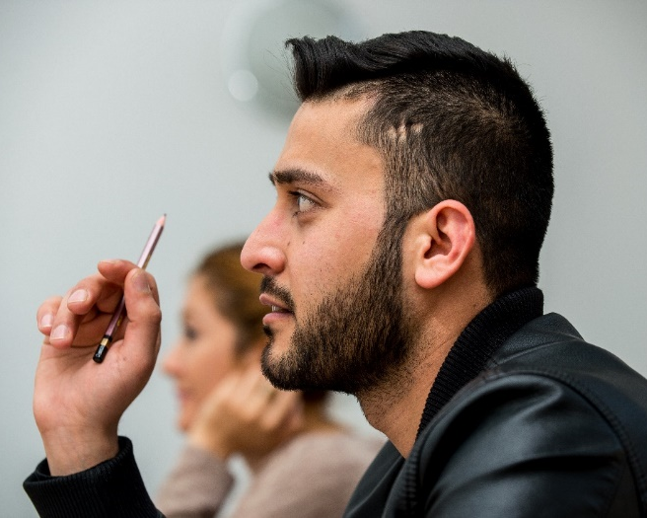
Key academic skills
Communication skills: academic writing, delivering a presentation, etc.
Research skills
Study skills: note-taking, summarising, ability to focus
Critical thinking skills: ability to analyse and evaluate information.
Digital literacy
Problem-solving skills
Time management skills
Stress management skills
Public speaking skills
Referencing skills… and many more

Slide 15

Hopefully this is you in a year’s time!

Slide 16
References
Drew, C. (2022). 106 Academic Skills Examples. Helpful Professor. https://helpfulprofessor.com/academic-skills-examples/ (Accessed 09.10.2022)
Moore, S., Colin, N., Murphy, M., and Connolly, C (2010) The Ultimate Study Skills Handbook, Maidenhead: Open University Press.

