Slide 1

Psychology in Health and Social Care
LCHS401
Assignment 1: Individual Presentation
Programme: Certificate of Higher Education in Health and Social Care
Student name: Erika Cabrera Lopez
Student ID: 2424586
Lecturer: Bianca Sanfilipo

Slide 2
PSYCHOLOGY & DEVELOPMENTAL PSYCHOLOGY
The scientific evaluation of mindset and human behaviour
Developmental Psychology: Is the scientific study of why and how people grow in all aspects and change over the course of their lives, from birth to death. Bornstein, M.H. et al. (2018)

Slide 3
EARLY CHILDHOOD 3-5 AMIRA
Talking, reading and singing with Amira daily, will build up her confidence
Constant love and reassurance, set up routines, gentle social play in safe and familiar places.
SROUFE, L.A. et al. (1999)

Slide 4
Developmental changes in early childhood (Amira)
Physical Development | Intellectual/Language
Climbing up and down the stairs, using her hands to play with Play-Doh Drawing circles, building bocks Throw and kicking a ball | Support with talking, reading stories aloud, singing Encourage expressions Showing understanding to Amira’s learns words and meanings
Emotional | Social
Improving their skills to control their emotions to cope with stressful scenarios Worry that the care giver will never return When the bond is safe, Amira will feel confident to explore around her | Confident to play and interact with others Let ger play near other children first without forcing her to share Parents should encourage Amira turn taking, sharing and greetings when playing with other children

Slide 5
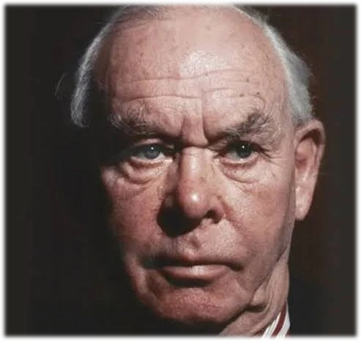
Jhon Bowlby
Born on 26.02.1907 London
Died on 02.09.1990 Scotland
https://edmorata.es/autores/bowlby-john/

Slide 6
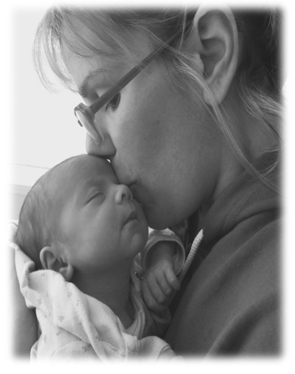
BOWLBY’S THEORY OF ATTACHMENT
Infants are Born with an instinct to stay close to their caregivers, they feel safety, comfort and protected.
Early bonding shapes a child cognitive, emotional and social development.
Main, M. (1996)

Slide 7
APPLY THE THEORY TO AMIRA’S SITUATION
Amira, age 3,
Is distress and anxious when separated from her caregivers
Has very limited speech
Avoids interacting and playing with other children

Slide 8
PROPOSE PRACTICAL STRATEGIES OR INTERVENTIONS FOR AMIRA
Consistent caregiving
progressively separation
Routine and family time
Collaboration with a speech therapist or educator will support her confidence and general development
Regular caregivers
The emotional security also helps Amira in other areas of development such as social and language which difficult for her.
Veríssimo, M.(2006)
Klatte, I. et al. (2025)

Slide 9
‘NATURE AND NURTURE’
Nature:
Her sensitive temperament makes her more anxious, shy and introverted
Genetic reasons could also influence her rate of speech and language development.
Nurture:
According to Bolby’s Theory suggest that inconsistent or insecure caregiving can led to low confidence, separation anxiety ,low social relationships,
Diamond, D. and Keefe, J.R. (2024)

Slide 10
CRITICAL EVALUATION OF BOWLBY’S ATTACHMENT THEORY
Strengths | Limitations
It's important to highlight the essential of early emotional on a child’s growth Bowlby’s concept of secure base provide useful framework to support Amira’s development through constant loving caregiving to strengthen her confidence and independency | Bowlby focused strongly on mother as primary attachment Bowlby’s theory was developed in Western society, where independence is valued Chaudhary, N.(2017) )

Slide 11
CONCLUSION:
Amira has demonstrated insecure attachment, according to Jhon Bowlby’s attachment theory, which affects her emotional, social and language development, Providing support, consistent responsive, and nurturing care, along with opportunities for social and language stimulation, can help Amira improving her confidence, communication and develop relationships skills

Slide 12
REFERENCE LIST
Drazheva, E. (2025) ‘A Case Study Analysis of Separation Anxiety in the Effect of the Maternal and Paternal Role on Separation Anxiety in Early Childhood’, Global Psychotherapist, 5(2), pp. 106–113. Available at: https://doi.org/10.52982/lkj279.
Main, M. (1996) ‘Introduction to the Special Section on Attachment and Psychopathology: 2. Overview of the Field of Attachment’, Journal of consulting and clinical psychology, 64(2), pp. 237–243. Available at: https://doi.org/10.1037/0022-006X.64.2.237.
SROUFE, L.A. et al. (1999) ‘Implications of attachment theory for developmental psychopathology’, Development and psychopathology, 11(1), pp. 1–13. Available at: https://doi.org/10.1017/S0954579499001923.
Veríssimo, M. and Salvaterra, F. (2006) ‘Maternal secure-base scripts and children’s attachment security in an adopted sample’, Attachment & human development, 8(3), pp. 261–273. Available at: https://doi.org/10.1080/14616730600856149.

Slide 13
Klatte, I. et al. (2025) ‘Collaborative working with Parents of Children with DLD in Speech and Language Therapy: Identifying Dutch Speech and Language Therapists’ barriers to enhancing practice’, Research in developmental disabilities, 156(NA). Available at: https://doi.org/10.1016/j.ridd.2024.104882.
Diamond, D. and Keefe, J.R. (2024) ‘Separation Anxiety: The Core of Attachment and Separation-Individuation’, The Psychoanalytic study of the child, 77(1), pp. 251–274. Available at: https://doi.org/10.1080/00797308.2023.2284588.
McKnight, A.S. (2024) ‘BOWLBY’S ATTACHMENT THEORY AND BOWEN’S FAMILY SYSTEM THEORY: THEIR DIFFERENCES AND THE IMPLICATIONS FOR CLINICAL PRACTICE’, Family systems, 18(2), pp. 81–96.
Chaudhary, N. and Keller, H. (2017) ‘Is the Mother Essential for Attachment?’, in The Cultural Nature of Attachment. The MIT Press. Available at: https://doi.org/10.7551/mitpress/9780262036900.003.0005.

