Slide 1
Geographical Information Systems
B Holland

Slide 2
Indicative Content
Why Does GIS Matter.
Brief historical overview of GIS software.
An overview of applications of GIS
Fundamental theories of spatial databases and spatial analysis.
How do we represent geography in computing terms
Building attributes of spatial data sets.
The map as a visual information system.
The principles of thematic mapping
Using GIS software for data analysis.
Building end-user software solutions using GIS.
Exploring MapInfo software packages.

Slide 3
Introduction
Everything that happens, has to happen somewhere.
As humans we tend to be confined to activities that occur on or near the Earth.
Knowledge of a location can prove to be of critical importance.
We could say that most decisions have geographical consequences.
Geographical Information Systems are a special class of information systems that keep track not only of events, activities, and things, but also of where these events and things happen or exist.

Slide 4
Overview and background
GIS has been available in various forms for many decades, but they have only come into their own in recent years
It would be fair to say that this technology is becoming a buzz word in business systems solutions and location analysis.
Again it would be true to say , some of the influencing factors in its sudden surge in popularity is the fast declining costs of HW/SW that will support and run such systems.

Slide 5
…cont
GIS has been technology led. Based on CAD/CAM systems, they required expensive, memory rich kit.
The GIS market remains an immature one, potential customer are confused over the benefits.
Two emerging themes have increased the popularity of GIS :-
    Data is collected containing a geographical / spatial reference
    Rapid improvements in technology

Slide 6
How GIS Emerged
Geographical information has been with us since man travelled and made map references.
GIS has been developed out of a desire to replace manual cartography with a digital solution.
The OS ( ordnance survey) organisation of UK was under pressure to convert their maps into digital format and the aim was to have many paper maps digitised by 1995. They finally completed this task about 10 years later but this is an evolving process with many new map sets appearing every year.

Slide 7
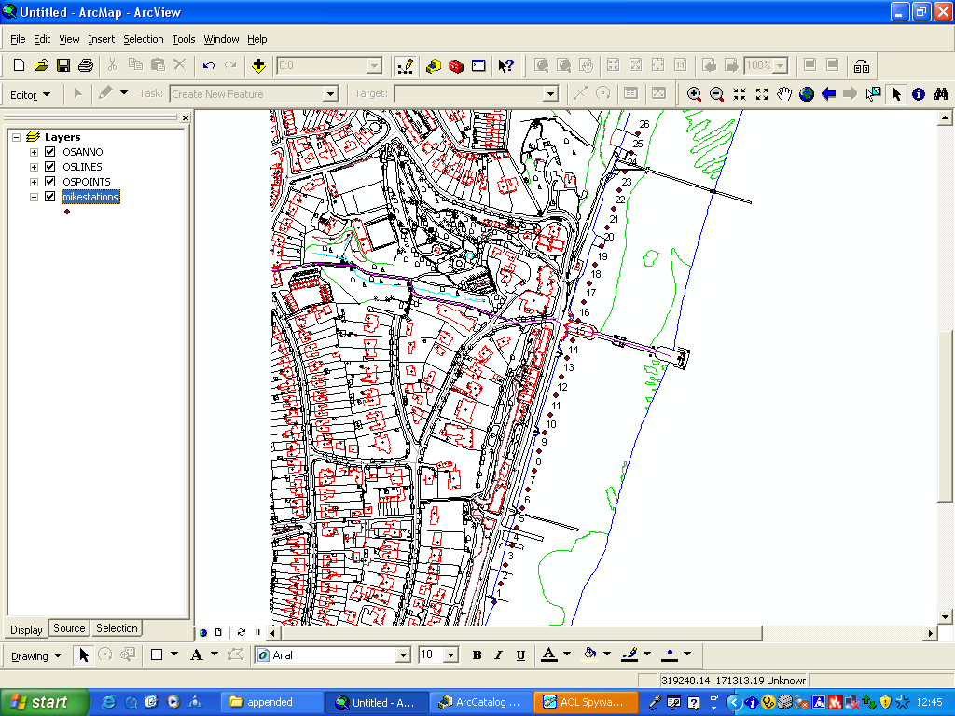
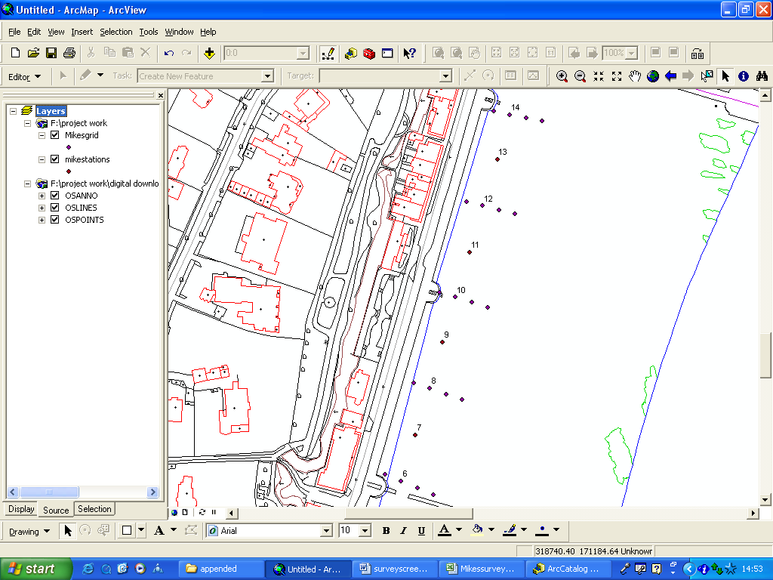
Original OS Landline Maps of Penarth coastline

Slide 8
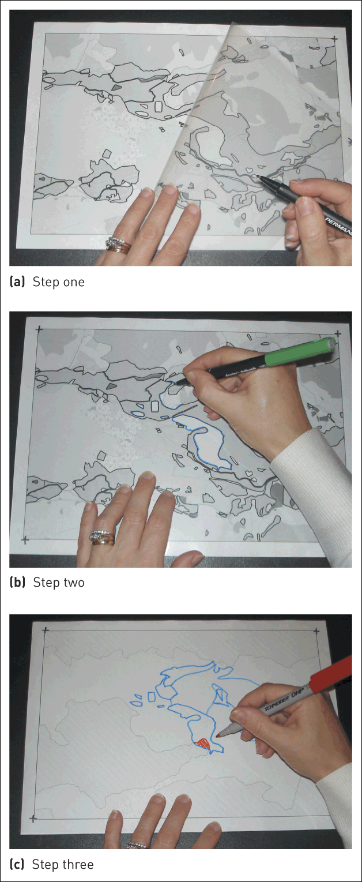
Tracing paper overlay to digitize older paper maps !!

Slide 9
GIS Defined
The literature offers some differing definition but here are some suggestions :-
  A business tool developed for the effective handling of spatial references
  A set of tools for collecting storing referencing at will, transforming and displaying spatial data from the real world for a set of purposes.
  A GIS is an information technology tool that can manage, analyse and report on data. The data can encompass applications from many disciplines, business, legal, social, environmental plus many more. The common theme is that all the data is spatially referenced.

Slide 10
So what is a GIS
A computer system that can handle and use databases of information that describes things i.e.. object or places on the earth's surface.
Elements that occupy space and have a spacial reference.
GIS offers the user a model of geographical reality
To explain:
    an aspatial query :
        How many students are attend courses at the school of Applied computing.
    a spatial query :
        How many students travel to the HND course daily, form a distance greater than 20 miles.

Slide 11
What question can be expect a GIS to answer
Where are particular features found ?
What geographical patterns exist?
Where have changes occurred over a given period ?
Where do certain conditions apply?
What will the spatial implication be if an organisation takes certain actions?
https://www.ordnancesurvey.co.uk/support/understanding-gis/
Notes:
These are typical geographical question so whats new

Slide 12
Visualisation
The term visualisation was first made popular around 1987. There was a growing interest in the study of techniques for display behaviour.
Def: A mental Image - to imagine or remember as if actually seen
we can see that it is an activity which a human being engages in, and that it is a cognitive activity
In terms of computer graphics there is a much more specific and overcomplicated definition:
  “The technical display of visualisation concerns itself with the display behaviour – making complex states of behaviour comprehensible to the human eye.”
“ A solution searching for a problem”
Visualisation encompasses the generation, manipulation and comprehension of the products of vision.

Slide 13
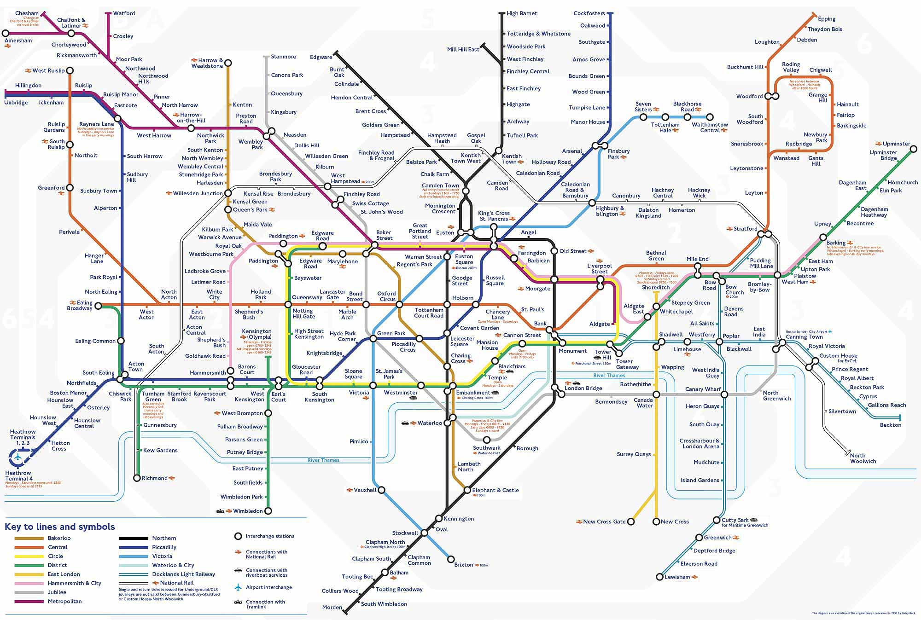
Information Visualisation
There are many situations in which data is available, in very large quantities, and where some human insight into the data is required.
Here is
an example

Slide 14
…cont
Sight of the map usually results in the viewer forming some understanding - though not a completely memorised image - of the underground railway routes and their regular and interchange stations.
Typically, attention will be focus on the planned journey.
The route may be memorised by the colour and direction of the line(s) involved.
Thus, a relevant portion of the underground system has been visualised and the resulting internal model - whatever its form - can be accessed during the journey to ensure arrival at the correct destination.
This internal model is sometimes called a cognitive map.

Slide 15
Scientific visualisation
This is a related and somewhat overlapping field.
It primarily relates to, and represents visually a physical ‘thing’ such as a mountain range over which clouds are flowing or a girder in which stress is of interest.
A study of football statistics does not require an image of a football, however demonstrating flow in a pipe is usually best displayed in the context of the pipe itself.

Slide 16
What is Geovisualisation?
Clearly the ability to visually analyse data is fundamental to geographic display.
The graphical display of spatial data helps towards recognition of patterns.
It is computer graphics that allows for the rapid display of vast volumes of data, and the processes provided by GIS help us analyse data sets that we could not achieve manually.
This places GIS in the field of ViSC visual science.
Today we can think of Geovisualisation as the application of geographic activity that makes use of data resources to facilitate scientific and social applications and can be considered as an area of research that looks at the development of new tools to utilise geographic data and provide better methods for visual interpretation.[1] (Longley, Goodchild et al., 2005).

Slide 17
Within a Geovisualisation environment, a map is used to help the user to stimulate their “visual thinking”. A map as a visual analysis tool should give insight to spatial patterns and trends. Within a visual environment such as a computer based map data can be manipulated beyond the traditional norms.

Slide 18
Spatial statistics
A GIS is usually designed to help us understand and model real world features and to help us we need to have relevant data usually a spatial database.
When we analyse something we hope to gain an insight into the problem or form a hypothesis that can be questioned.
Analysis should help us identify quantify and describe.

Slide 19
Can MapInfo Help
Yes
We can import spatial data
We can georeference data
We can produce results from the data
We can interpret and analyse the results.

Slide 20
Remote Sensing
The science and art of obtaining information about an object area or phenomenon through the analysis of data acquired by a device that is not in contact with the area under observation (Lillesand et al, 2004 ).
This data has been captured by some mechanism that is physically apart from the GIS system that may be eventually used to analyse such data.
Usually the data is in electronic format as it is easier to transport such large volume of data in this way.
We could think of an aerial photograph as one of the earliest methods of remotely colleting data – a ‘snapshot’ in time.

Slide 21
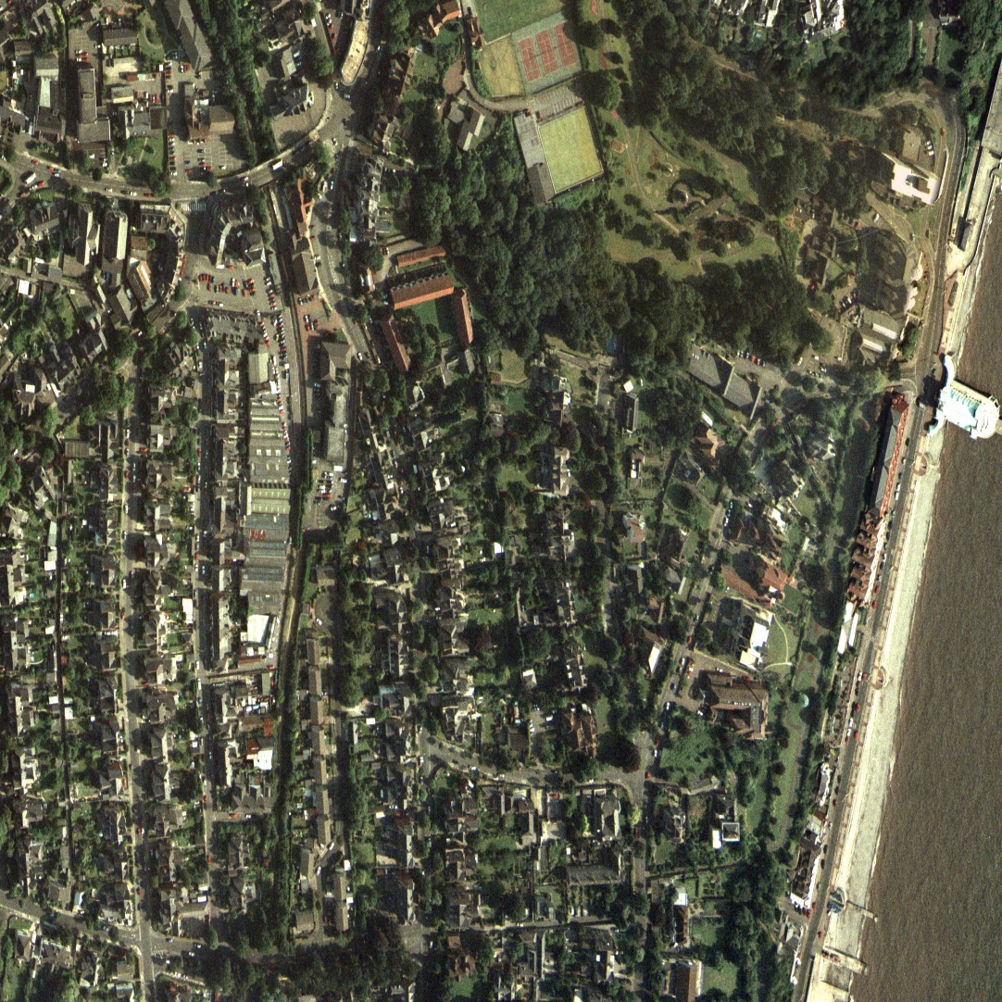
Aerial Photography
This method of data capture can produce more detailed imagery and data content. It is said to be one of the most widely used methods of remote sensing that allows for the development of maps

Slide 22
LiDAR Light Detection and Ranging
Light Detection and Ranging (LiDAR) can be thought of as an airborne mapping technique.
It is becoming an important mapping tool that is finding a growing audience in GIS.
The laser scanning or collection system consists of the laser scanner or sensor, which transmits and receives point information, a position and orientation system (POS) usually achieved via GPS and an inertial, measuring or navigation unit (IMU) or (INS).

Slide 23
Airborne laser scanning
Airborne laser scanning is thought of as a relatively new technology for an automated method of generating digital terrain modelling (DTM).
However, it should be noted that its development began in the 1970’s and it makes use of laser technology which has been available for many years.
In simplistic terms a laser emits a light from a source at a specific frequency in LiDAR terms this is beamed towards the Earth and reflected back i.e. a pulse return. The light has obviously travelled some distance (D) by knowing the speed of light or velocity (v) and using a highly accurate timing device is used to capture (t) we can calculate the distance using a simple formula D =vt /2.

Slide 24
Airborne laser scanning
Every time a laser beam is shot at a spot on the earth surface a vector X,Y,Z coordinate is captured. All laser systems measure by some means of distance between the sensor and the illuminated spot on the ground.
This spot must be in the lasers field of view. Consideration must be given to the aircrafts movement i.e. the flight path, which will allow for the collection of data over a surveyed area. In addition to the laser beam, the LiDAR system which is usually mounted on a small airplane uses mirrors to reflect the light waves across an area to form a line or swathe of light pulses.
The width of these swathes depends on the mirror angle and the amount of point data collected will depend on the speed at which the aircraft travels.

Slide 25
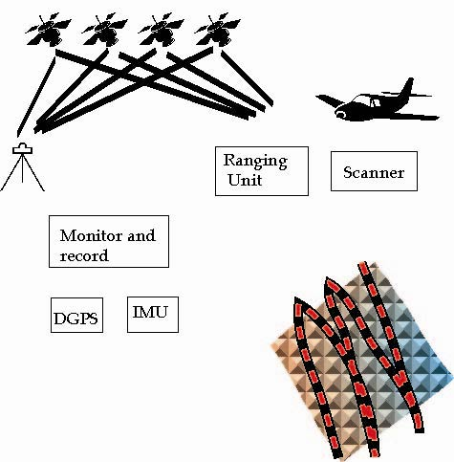
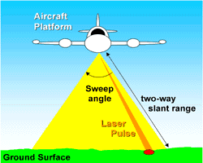
Airborne laser scanning
© environmental agency

Slide 26
High Definition Surveying
High definition ground based laser scanning (HDS) or terrestrial 3D laser scanning is beginning to filter into organisations as yet another way to capture survey data suitable for entry and analysis into a GIS.
They are similar to total stations which are modern day theodolite levelling devices.
This type of scanning device has been gaining popularity in the built environment as a mechanism to capture point data that will allow for the display of 3D models of building and engineering structure such as bridges or pipelines.

Slide 27
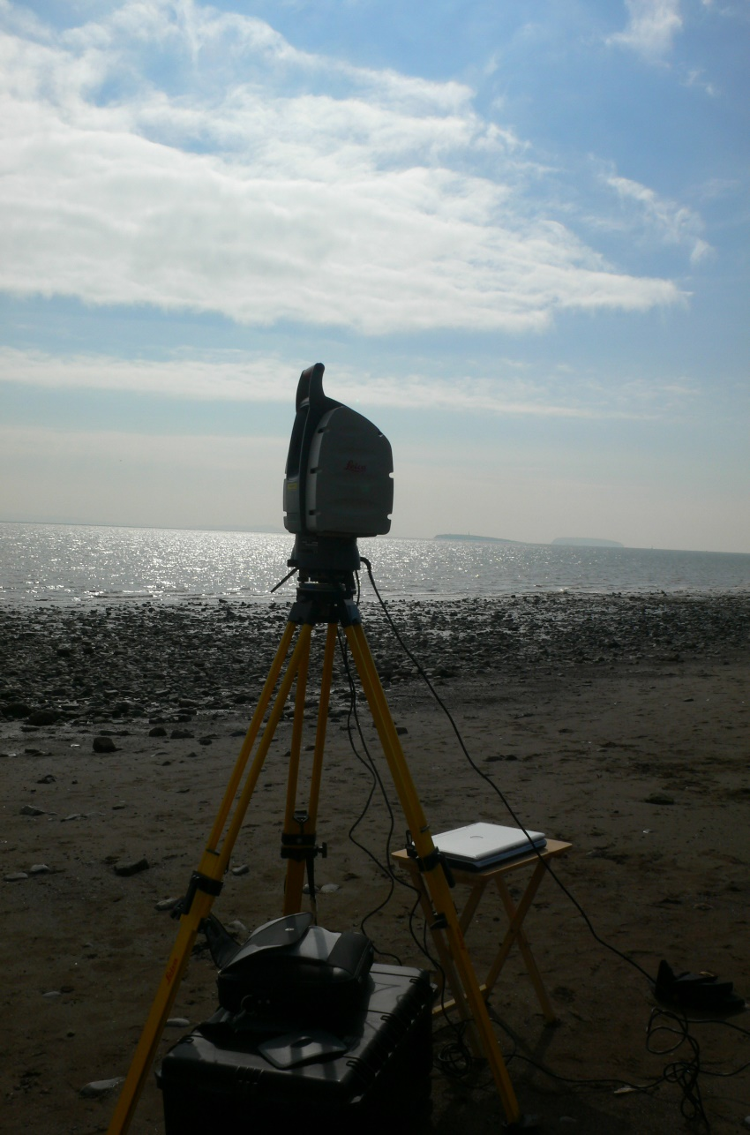
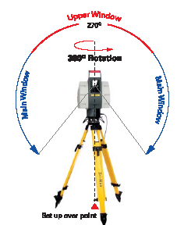
HDS

Slide 28
READING LIST:
Longley, P, Goodchild, M, Maguire, D, Rhind, D Geographical Information Systems and Science, Wiley (e-book online UWTSD LIbrary
Daniel, L., Loree, P. & Whitener, A. Inside MapInfo Professional, Onward press,
Heywood, I., Cornelius, S. & Carver, S. (2011 4th edition) An Introduction to Geographical Information Systems, Prentice Hall

