Slide 1
Transnational Childhoods
Plentyndod: Ffurfiau Trawsgenedlaethol
Heike ~Griffiths, 2022
ECGE4006P

Slide 2
Background:
Young people on the move…..
Cefndir:
Pobl ifanc symudol…..
Cynyddodd amcangyfrif y bobl 19 oed neu’n iau sy’n byw mewn gwlad wahanol i’r un lle cawsant eu geni 28.7 miliwn yn 1990 i 37.9 miliwn yn 2019.
Yn 2019, ymfudwyr o blant (19 oed neu’n iau) oedd 14 y cant o gyfanswm poblogaeth ymfudwyr a 5.9 y cant o’r boblogaeth gyfan (o bob oed).
Cododd amcangyfrif nifer yr ymfudwyr ifanc (rhwng 15 a 24 oed) hefyd o 22.4 miliwn i yn 1990 i 30.9 miliwn yn 2019.
The estimated number of people aged 19 or under living in a country other than the one where they were born rose from 28.7 million in 1990 to 37.9 million in 2019.
In 2019, child migrants (aged 19 years and under) accounted for 14 per cent of the total migrant population and 5.9 per cent of the total population (of all ages).
The estimated number of young migrants (aged 15 to 24) also rose from 22.4 million in 1990 to 30.9 million in 2019.
Porth Data Ymfudo Adran Materion Economaidd a Chymdeithasol y Cenhedloedd Unedig (UN DESA)
United Nations Department of Economic and Social Affairs (UN DESA)

Slide 3

Migration in the UK
Ymfudo yn y DU
https://www.un.org/en/development/desa/population/migration/data/estimates2/countryprofiles.asp
Country profile UK
What is the difference between refugees and migrants? DISCUSS.
https://www.un.org/en/development/desa/population/migration/data/estimates2/countryprofiles.asp
Proffil Gwladol y DU
Beth yw’r gwahaniaeth rhwng ffoaduriaid ac ymfudwyr? TRAFODWCH
Proffil Gwladol y DU

Slide 4
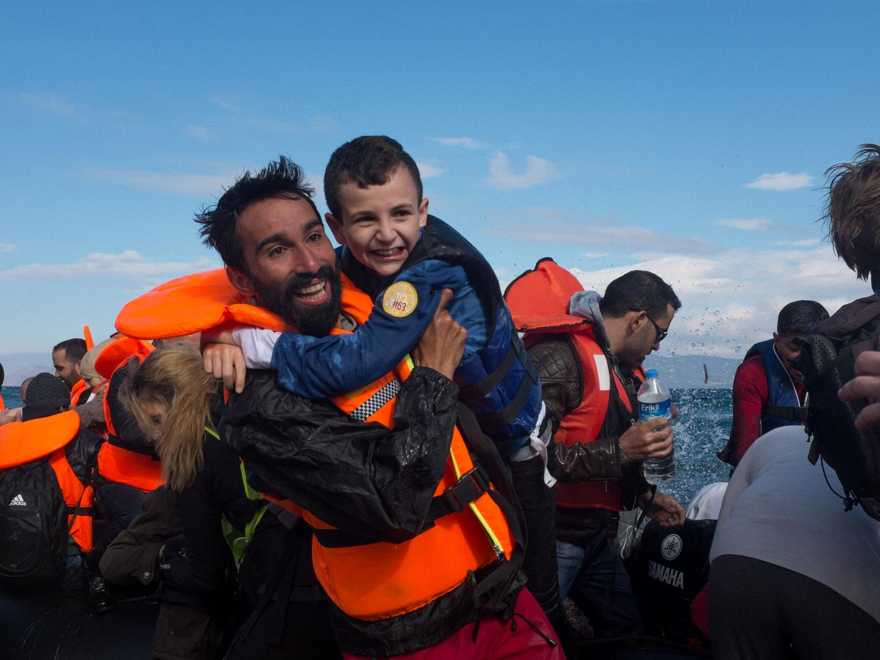

word POWER
Notes:
This powerpoint presentation accompanies activity 2 ‘Word Power’ in Unicef UK’s ‘In search of safety: children and the refugee crisis in Europe’ (p. 34 in our teaching pack: http://unicef.uk/refugee-resource-pack)
Title slide to the ‘Word Power’ activity.
The picture: migrant and refugee crisis in Europe. See http://www.unicef.org/emergencies/index_85510.html
(copy and paste the links in your browser)

Slide 5
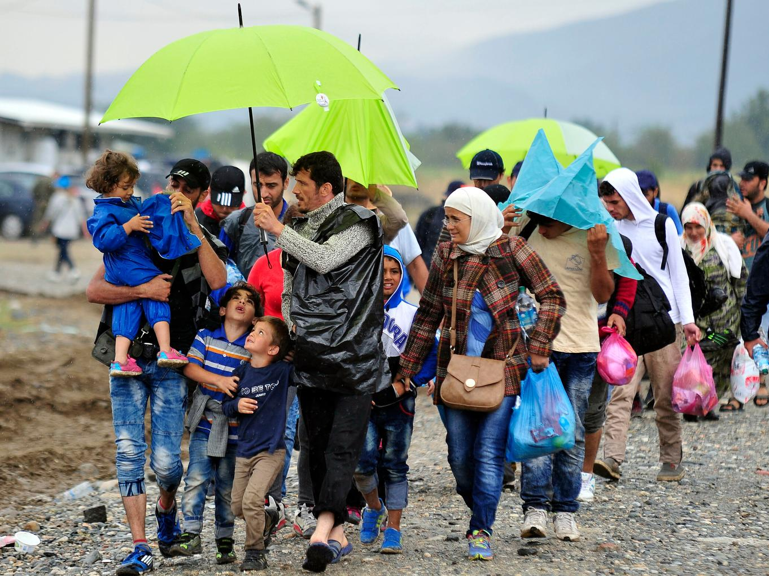
There are about 15 million refugees in the world.
More than half are children.
Notes:
This final slide makes the key point that many of the world’s refugees are children and their rights as outlined in the United Nations Convention on the Rights of the Child (CRC or UNCRC) are being denied in so many ways.
Using the picture in the slide, discuss with the class which rights from the Convention (UNCRC) they think are particularly relevant for the children in this picture and/or children seeking refuge in general. Are there any rights they are not enjoying? Are there rights in the Convention that particularly apply to them? Here are some of the rights (or Articles) that may come up:
- non-discrimination (Article 2)
- best interests of the child Article 3)
- life, survival & development (Article 6)
- birth, registration, nationality, care (Article 7)
- separation from parents (Article 9)
- respect for the views of the child (Article 12)
- the right to privacy (Article 16)
- protection from violence, abuse & neglect (Article 19)
- refugee status (Article 22)
- health and access to health services (Article 24)
- the right to an adequate standard of living (Article 27)
- the right to an education (Article 28) & the goals of education (Article 29)
- the right to leisure play and to take part in cultural & artistic activities (Article 31)
- the right to recovery from trauma and reintegration (Article 39)

Slide 6
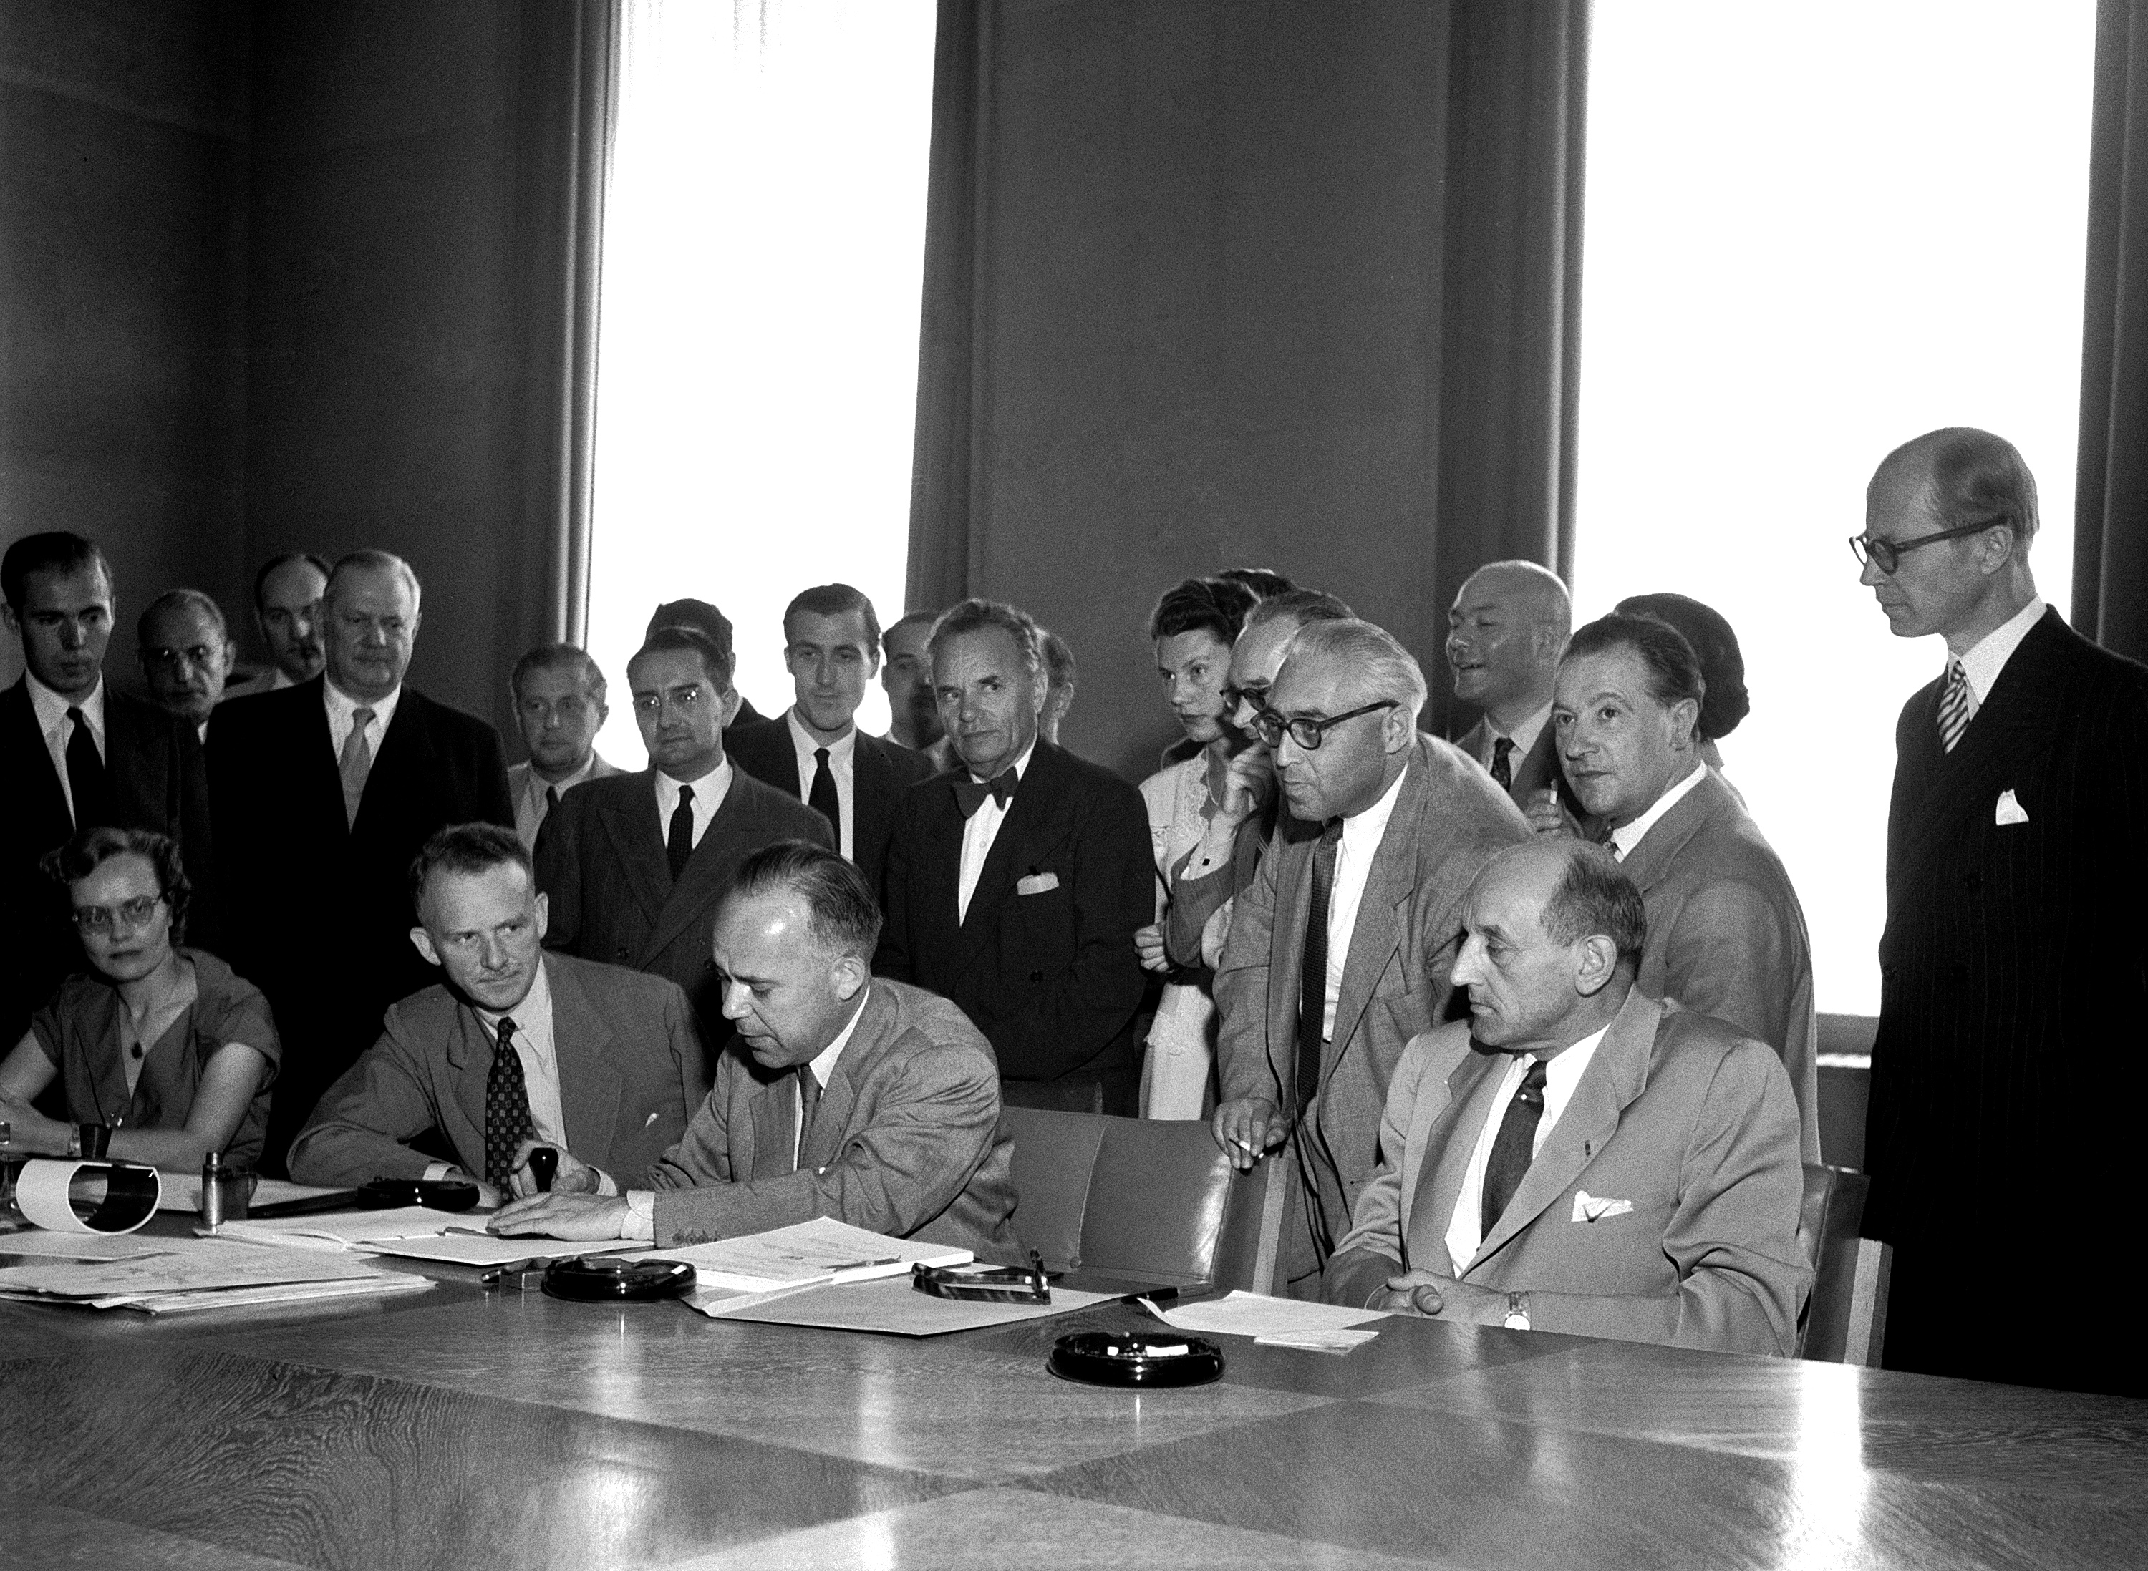
The 1951 refugee Convention
In 1951, the Refugee Convention was adopted by the United Nations.
Denmark was the first country to ratify the Convention in 1952. Since then a total of 145 countries, including the UK, have made a legal promise to protect refugees.
Notes:
Explain to students that in the aftermath of the Second World War, the United Nations adopted The 1951 Convention relating to the Status of Refugees (the 1951 Refugee Convention). Check that they understand that the word ‘Convention’ means in this context an ‘agreement between states’.
It is important to stress that by ratifying the Convention a country has entered into an internationally legally binding agreement to protect refugees.
It follows that defining what is meant by ‘refugee’ is key to understanding the Convention.
Further information about the Convention can be found in our glossary of terms in ‘In search of safety: children and the refugee crisis in Europe’ available at http://unicef.uk/refugee-resource-pack on pp. 57-59 as well as at http://www.unhcr.org/pages/49da0e466.html and http://www.unhcr.org/4ec262df9.html

Slide 7
Definition
The 1951 Refugee Convention defines a refugee as a person who owing to a:
well-founded fear of being persecuted
for reasons of race, religion, nationality, membership of a particular social group, or political opinion,
is outside the country of his nationality,
and is unable to or, owing to such fear, is unwilling to avail himself of the protection of that country
Notes:
Once students have come up with their own definitions of ‘refugee’ and discussed their definitions, show the 1951 Refugee Convention definition of a refugee; the definition has been broken down into specific bullet points to emphasise the different reasons why someone might seek refugee and it is important to go through each of these points carefully, checking both students’ understanding of the words being used and providing opportunities for any discussion.
Then go to next slide to show a short film about how important the Refugee Convention is.

Slide 8
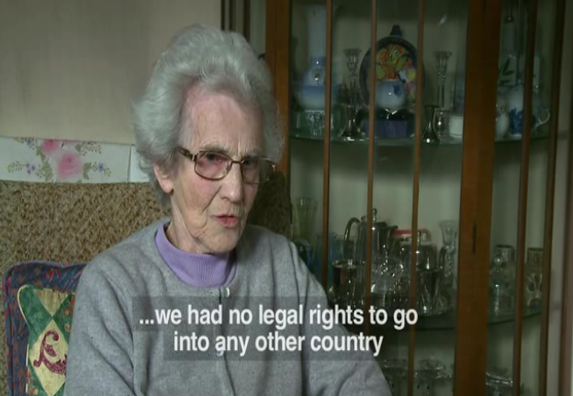
Why is it important?
Notes:
Video: why is the 1951 Refugee Convention so important?
Here is an optional video that you can show pupils (click on the image and it will open the website with the video or just click on this link: https://www.youtube.com/watch?v=LtPXV8a_niI) This video links the personal stories of two refugees over the span of several decades and helps to re-emphasise that the Convention is there to protect people- past, present and future.
(you can also copy and paste the link into your browser)

Slide 9
Migrants, asylum seekers and refugees
https://www.unicef.org.uk/rights-respecting-schools/wp-content/uploads/sites/4/2016/04/in-search-of-safety-complete-teaching-pack.pdf

Slide 10
What adjustments need to happen when children move country?
Pa addasiadau sydd eu hangen pan fydd plant yn symud gwlad?
Mae pob plentyn a’i amgylchiadau yn unigryw
Addasiadau diwylliannol: Iaith, cyfathrebu, crefydd
Addasiadau teuluol: Colledion ac enillion
Economaidd
Cymunedol
Gwleidyddol
Amgylcheddol
(Faist et al, 2013)
Bronfenbrenner?
Each child and their circumstances are unique
Cultural adjustments: Language, communication, religion
Family adjustments: Losses and gains
Economic
Community
Political
Environmental
(Faist et al, 2013)
Bronfenbrenner?

Slide 11
Identity
Hunaniaeth
Mae addasiadau personol yn ganlyniad i’r holl addasiadau eraill
Beth yw hunaniaeth?
Nid un diffiniad ond yn hytrach gwahanol bersbectifau damcaniaethol.
Yn ôl Goffman (1968, dyfynnwyd yn Lawler, 2014, p. 8)
Hunaniaeth bersonol
Hunaniaeth gymdeithasol
Hunaniaeth yr ego
Personal adjustments are a consequence of all the other adjustments
What is identity?
Not one definition but rather different theoretical perspectives.
According to Goffman (1968, cited in Lawler, 2014, p. 8)
Personal identity
Social identity
Ego identity

Slide 12
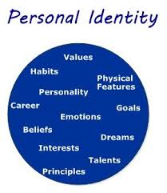
Hunaniaeth Bersonol
Personal Identity
Personol:
nodweddion unigryw’r person hwnnw, ynddyn nhw eu hunain yn ogystal ag o ran eu perthynas ag eraill
(Ibid) Hunaniaeth Bersonol
Personal:
the unique characteristics of that person, both in themselves and in terms of their relation with others
(Ibid)

Slide 13
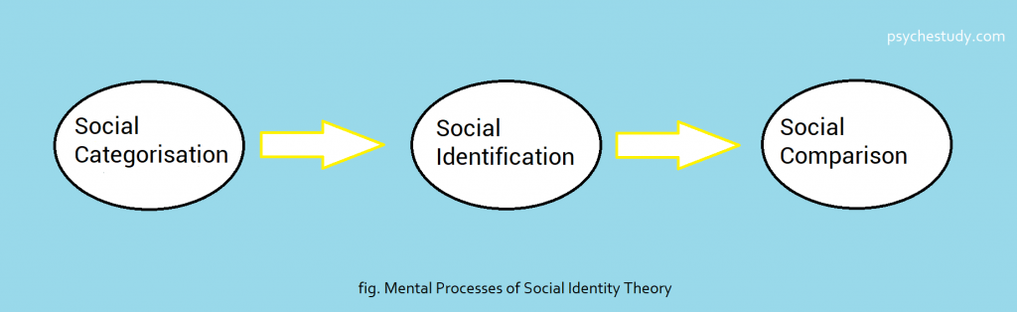
Social Identity
A ‘categorical identity’ – an identity that persons have by virtue of their membership of social categories.
Examples of social categories?
Multiple identities
Identity shifting
‘Hunaniaeth gategorïaidd’ – hunaniaeth sydd gan bersonau yn sgil eu haelodaeth o gategorïau cymdeithasol.
Enghreifftiau o gategorïau cymdeithasol?
Hunaniaethau lluosog
Newid hunaniaeth

Slide 14
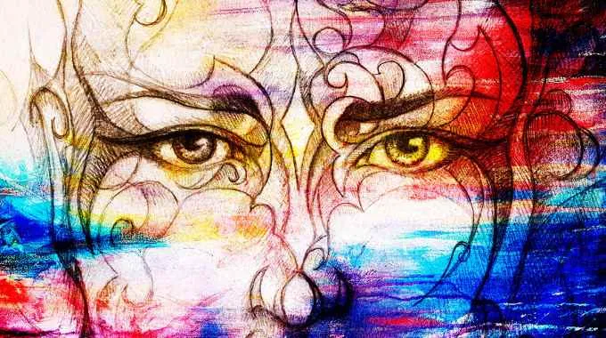
Ego Identity
Hunaniaeth yr ego
Mae hunaniaeth bersonol a chymdeithasol yn deillio o ddiddordebau a diffiniadau eraill
Rhaid i’r unigolyn y mae ei hunaniaeth dan sylw deimlo hunaniaeth yr ego.
Syniad goddrychol o ‘bwy ydym’ neu bwy rydyn ni’n credu ein bod ni.
(Ibid)
Social and personal identity are made up by other peoples concerns and definitions
Ego identity must be felt by the individual whose identity is at question.
A subjective sense of ‘who we are’ or who we believe ourselves to be.
(Ibid)

Slide 15
Links to other theorists….
Cysylltiadau â damcaniaethwyr eraill….
Erikson
Hunaniaeth o’i chymharu â dryswch rôl: pumed cam datblygiad, lle mae person yn ceisio ateb y cwestiwn “Pwy ydw i?” ond mae’n ddryslyd o ran pa roliau o blith llawer o rai posibl i’w mabwysiadu.
Cyflawniad hunaniaeth – term Erikson ar gyfer sicrhau hunaniaeth, y pwynt lle mae person yn deall pwy yw e neu hi yn unigolyn unigryw, yn unol â phrofiadau’r gorffennol a chynlluniau’r dyfodol.
(Magnusson, 1996)
Erikson
Identity versus role confusion: the fifth stage of development, in which the person tries to figure out “Who am I?” but is confused as to which of many possible roles to adopt.
Identity achievement –Erikson’s term for the attainment of identity, the point at which a person understands who he or she is as a unique individual, in accord with past experiences and future plans.
(Magnusson, 1996)

Slide 16
Unconscious bias - Implicit stereotypes?
Rhagfarn anymwybodol – Ystrydebau ymhlyg?
(Greenwald, Banaji, 1995)

Slide 17
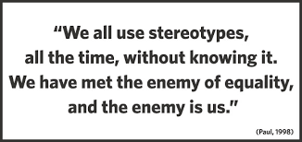
Stereotypes and Identity Formation
Ystrydebau a Ffurfio Hunaniaeth

Slide 18
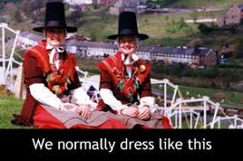
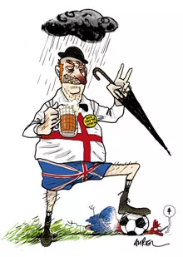
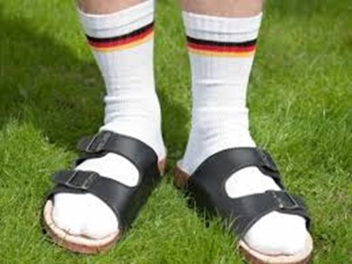
What about us?
Beth amdanom ni?

Slide 19
Stereotypes and Inclusion
Ystrydebau a chynhwysiant
https://www.youtube.com/watch?v=6YfIM6HTJas
We will learn the origin of the word and some theories/concepts around it.
Byddwn yn dysgu am darddiad y gair a rhai o’r damcaniaethau/cysyniadau yn ei gylch.

Slide 20
Concepts and theories from the video
Cysyniadau a damcaniaethau o’r fideo
Intergroup bias
Prejudice
Unconscious bias – implicit association
Dimensions of stereotypes
Tueddfryd rhwng grwpiau
Rhagfarn
Tueddfryd anymwybodol – cydgysylltiad ymhlyg
Dimensiynau ystrydebau

Slide 21
Why is this important?
Pam mae hyn yn bwysig?
https://www.youtube.com/watch?v=FTYMSulvnyw&t=3s
Stereo type threat
Bygythiad ystrydebau

Slide 22
Some very old quote…(3rd Century)
Rhyw ddyfyniad hen iawn…(3^{edd} Ganrif)
‘We do not see things as they are. We see things as we are.
We do not hear things as they are; we hear them as we are.’
(Rabbi Shemuel ben Nachmani, as quoted in the Talmudic tractate Berakhot (55b.) cited in Plaister-Ten, 2016, p. 2)
Dydyn ni ddim yn gweld pethau fel y maen nhw. Rydyn ni’n gweld pethau fel yr ydym ni.
Dydyn ni ddim yn clywed pethau fel y maen nhw; rydyn ni’n eu clywed nhw fel yr ydyn ni.’
(Rabbi Shemuel ben Nachmani, fel y’i dyfynnir yn y traethawd Talmwdaidd Berakhot (55b.) dyfynnwyd yn Plaister-Ten, 2016, t. 2)

Slide 23
Equality Act, 2010
Race Discrimination
When someone is treated unequally because of their race, their perceived race or the race of someone they are associated with.
Under this Act, race is one of the ‘protected characteristics’ and as such, discriminating against someone because of race is illegal.
Definition Of Race According To The Equality Act 2010
Race means being part of a group of people who are identified by their nationality, citizenship, colour, national or ethnic origins.
It also counts as discrimination if you are not part of any one of these groups but someone discriminates against you because they think you are. This is known as perceived race discrimination.
(EOC, 2022)

Slide 24
Equality Act, 2010
Race discrimination that occurs within any of the subsequent settings is unlawful:
In the workplace.
In any educational institution.
Housing.
When providing services or goods such as in the banking, entertainment or transportation industries.
Any activity performed by any of our public authorities like the police, prisons, the NHS, local authorities and government departments.
Also, irrespective of whether the race discrimination was deliberate or unintentional, it would still count as discrimination and be deemed unlawful.
(EOC, 2022)

Slide 25
Equality Act, 2010
Race Discrimination In An Educational Institution
It is unlawful for any learning institution to discriminate against someone because of their race. This applies to private as well as state schools and colleges.
Educational institutions must take care not to discriminate in any of their policies or practices; including admissions, exclusions, treatment of students and decisions regarding a student’s special education needs.
All educational institutions should have a clear policy to eradicate racism within their premises and encourage race equality.
Types of Race Discrimination
According to the Act, racism can be either indirect or direct. It could also be in the form of victimisation or harassment.
(EOC, 2022)

Slide 26
Cultural Relativism vs Ethnocentricity
Perthynolaeth Ddiwylliannol o’i chymharu ag Ethnosentrigrwydd
Yn gysyniad ar gyfer arfer gorau ar lawr dosbarth :
Cymerwch bersbectif gwlad letyol (Gsir, 2014)
Byddwch yn ymwybodol o dueddfryd ymhlyg
Rhwystrau amgylcheddol
Gweithio gyda rhieni
Iaith a Chyfathrebu
Ystyriaethau rhyngddiwylliannol (Liu et al. 2015).
As a concept for best classroom practice:
Take a host country perspective (Gsir, 2014)
Be aware of implicit bias
Environmental barriers
Working with parents
Language and Communication
Intercultural considerations (Liu et al. 2015).

Slide 27
Linguist research evidence:
Low expectations – low results giving directions role play (Kang, and Rubin,2009)
NNES less believable than NES (Lev-Ari and Keysar 2012)
Stereotypes of Cantonese English, apparent native/non-native status, and their effect on non-native English speakers’ perception (Hu, Lindemann 2009).
Non language factors affecting undergraduates’ judgments of non-native English-speaking teaching assistants. (Rubin, 1992).

Slide 28
Tystiolaeth ymchwil ieithyddion:
Disgwyliadau isel – canlyniadau isel mewn chwarae rôl rhoi cyfarwyddiadau (Kang, and Rubin,2009)
NNES yn llai credadwy na NES (Lev-Ari and Keysar 2012)
Ystrydebau ynghylch Saeson Cantonaidd, statws brodorol/anfrodorol ymddangosiadol, a’u heffaith ar ganfyddiad siaradwyr Saesneg anfrodorol (Hu, Lindemann 2009).
Ffactorau anieithyddol sy’n effeithio ar farn israddedigion am gynorthwywyr addysgu Saesneg eu hiaith anfrodorol. (Rubin, 1992).

Slide 29
References
Cyfeiriadau
EOC (2022). Race Discrimination. https://www.eoc.org.uk/race-discrimination/
Gsir, S. (2014) Social Interactions between Immigrants and Host Country Populations: A country of Origin Perspective, INTERACT Research report, 2014/02
Faist, T., Fauser, M. and Reisenauer, E. (2013) Transnational migration. Cambridge: John Wiley & Sons.
Krings F., Johnston C., Binggeli S., Maggiori C. (2014). Selective incivility: Immigrant groups experience subtle workplace discrimination at different rates. Cultural Diversity & Ethnic Minority Psychology, 20, 491-498.
Lev-Ari, S. and Keysar, B. (2012). Less-detailed representation of non-native language: Why non-native speakers’ stories seem more vague. Discourse Processes, 49(7), pp. 523–538.
Lindemann, S. (2010). Who’s “Unintelligible”? The Perceiver’s Role. Issues in Applied Linguistics, 18(2).
Liu, S., Volcic, Z. and Gallois, C. (2015). Introducing Intercultural communication: Global cultures and contexts. London, United Kingdom: SAGE Publications.
Magnusson, D (Editor) (1996): The Lifespan Development of Individuals. Cambridge: Cambridge University Press
Moyer, A. (2013). Foreign accent: The phenomenon of non-native speech. New York, NY: Cambridge University Press.
Rubin, D. L. (1992). Nonlanguage factors affecting undergraduates’ judgments of non-native English-speaking teaching assistants. Research in Higher Education 33(4): 511-531.
Sigona, N.; Hughes, V. (2012). NO WAY OUT, NO WAY IN - Irregular migrant children and families in the UK, Research Report Nando, Universities of Oxford
UNICEF (no date) CASE STUDIES, BEST PRACTICE FROM RIGHTS RESPECTING SCHOOLS
United Nations (no date). Department of Economic and Social Affairs, International Migration Stock, 2019. COPYRIGHT © UNITED NATIONS https://www.un.org/en/development/desa/population/migration/data/estimates2/estimates19.asp
United Nations (no date). Department of Economic and Social Affairs, Country Profile: UK 2019. COPYRIGHT © UNITED NATIONS. https://migrationdataportal.org/data?cm49=826&focus=profile+&i=stock_abs_&t=2019

