Slide 1
Online Tutorial & Revision
Weds 9th December 2020

Slide 2


Today’s agenda….
BMWP & ASPT Tutorial Excel Spreadsheet
Excel worksheet of a similar dataset from the river Pelenna.
Explanation & and guided self-analysis of the BMWP & ASTP scores for that dataset. This will aid you in applying the same method to your own coursework datasets.
January Exam Revision
Discussion of the exam’s extended essay topic and content you should consider researching in your exam prep.

Slide 3
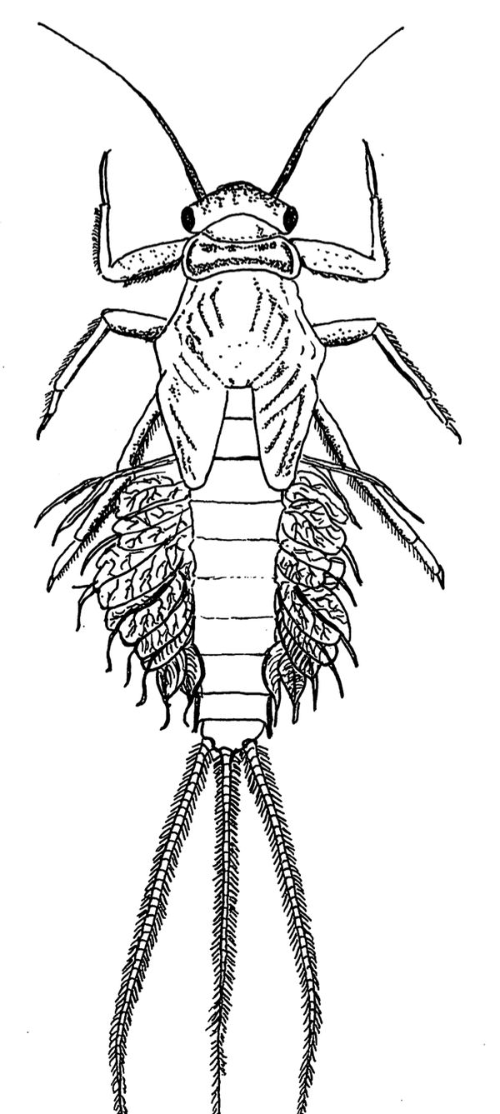
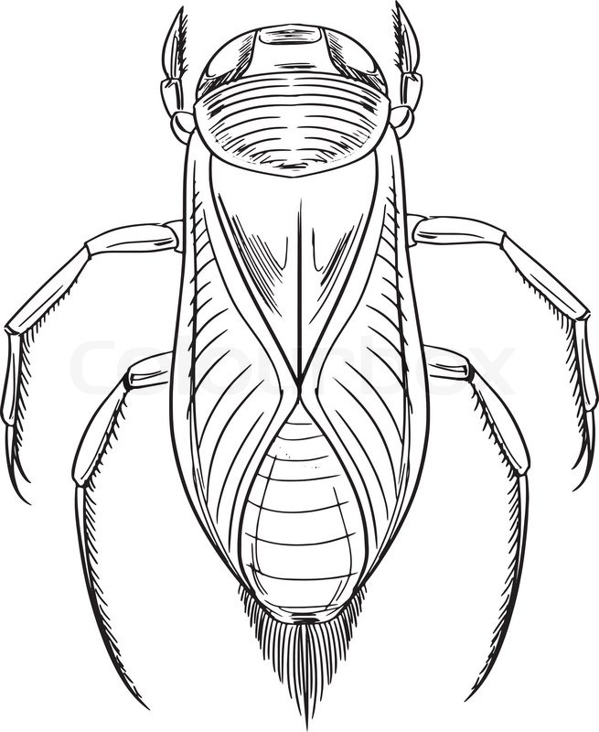
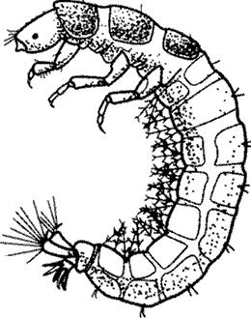
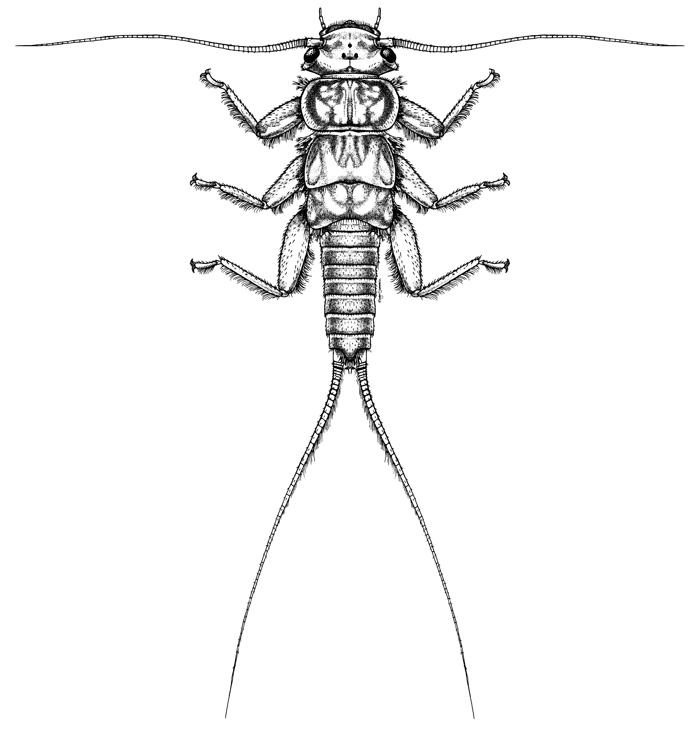
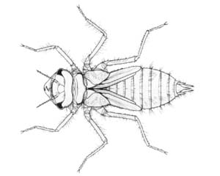
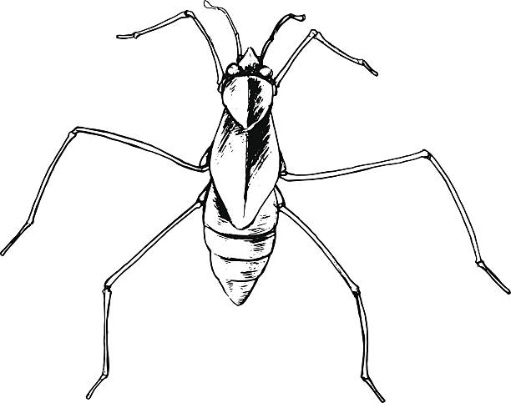
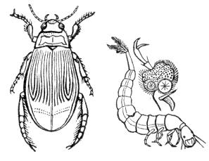
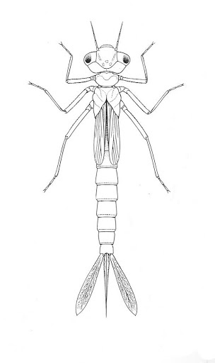
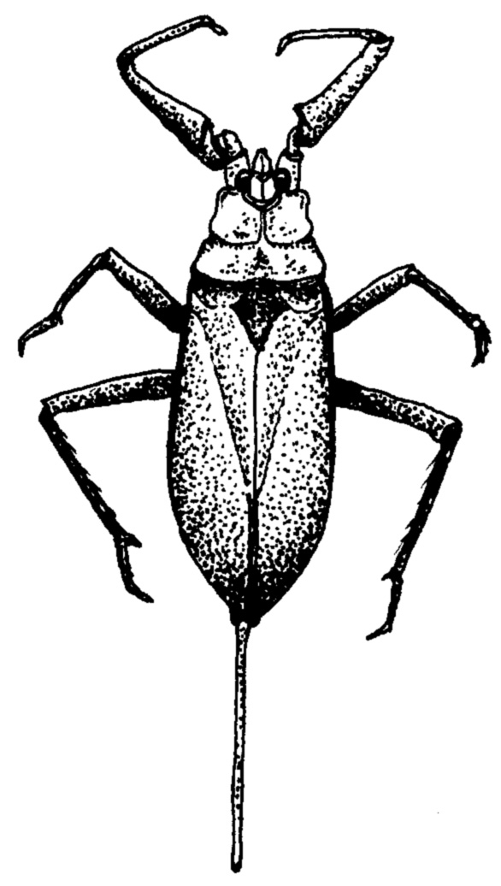
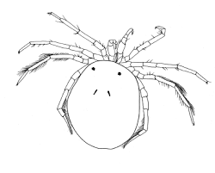
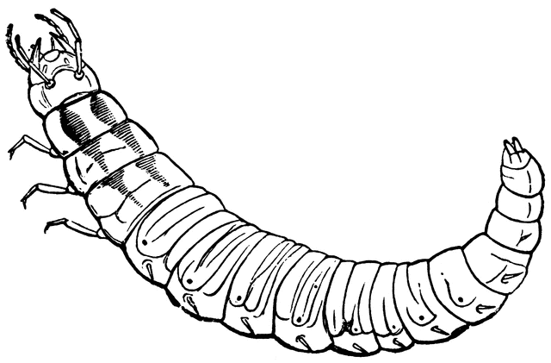
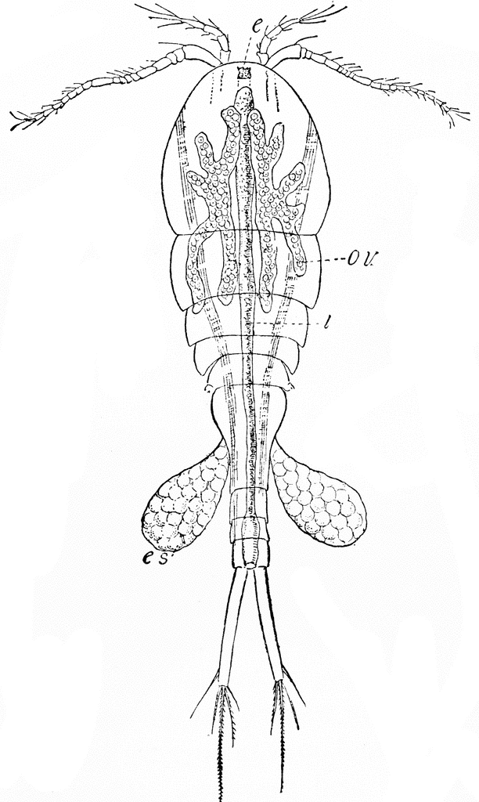
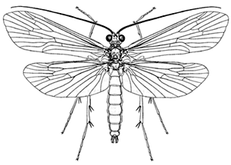
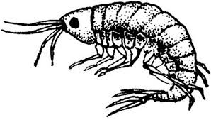
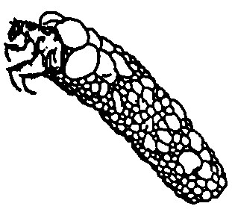
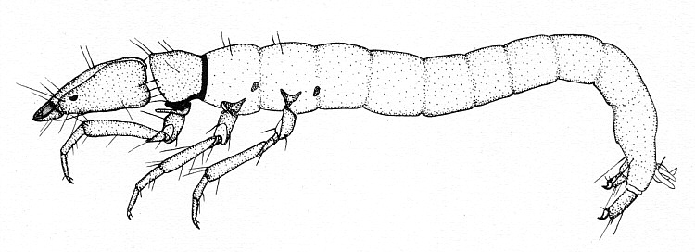
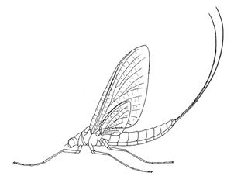
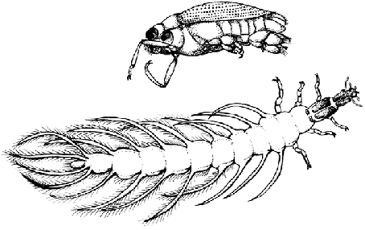
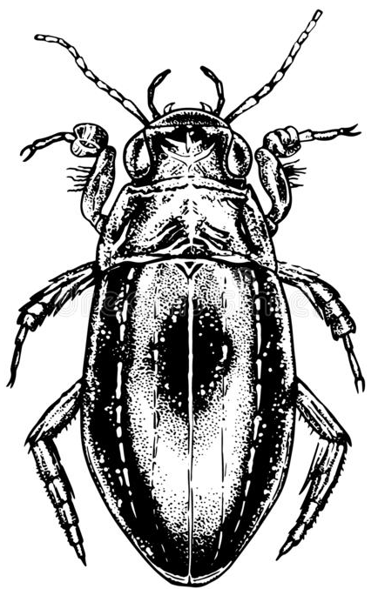
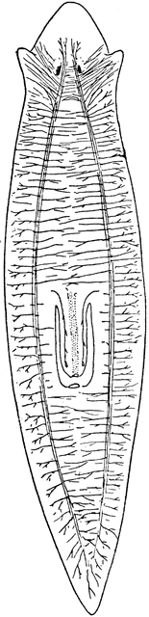
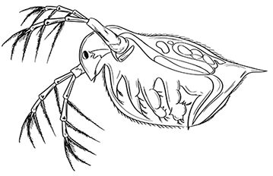
Assessment 1 Tutorial
Working out the BMWP (at family level) of a dataset
Find scores of all (if possible) families (not individual specimens) found in the sample dataset.
Add up all these scores.
This is your site’s BMWP score (at family level)
Working out the ASPT score of a dataset
Take the BMWP score you just worked out
Divide that score by the number of families in the sample dataset.

Slide 4
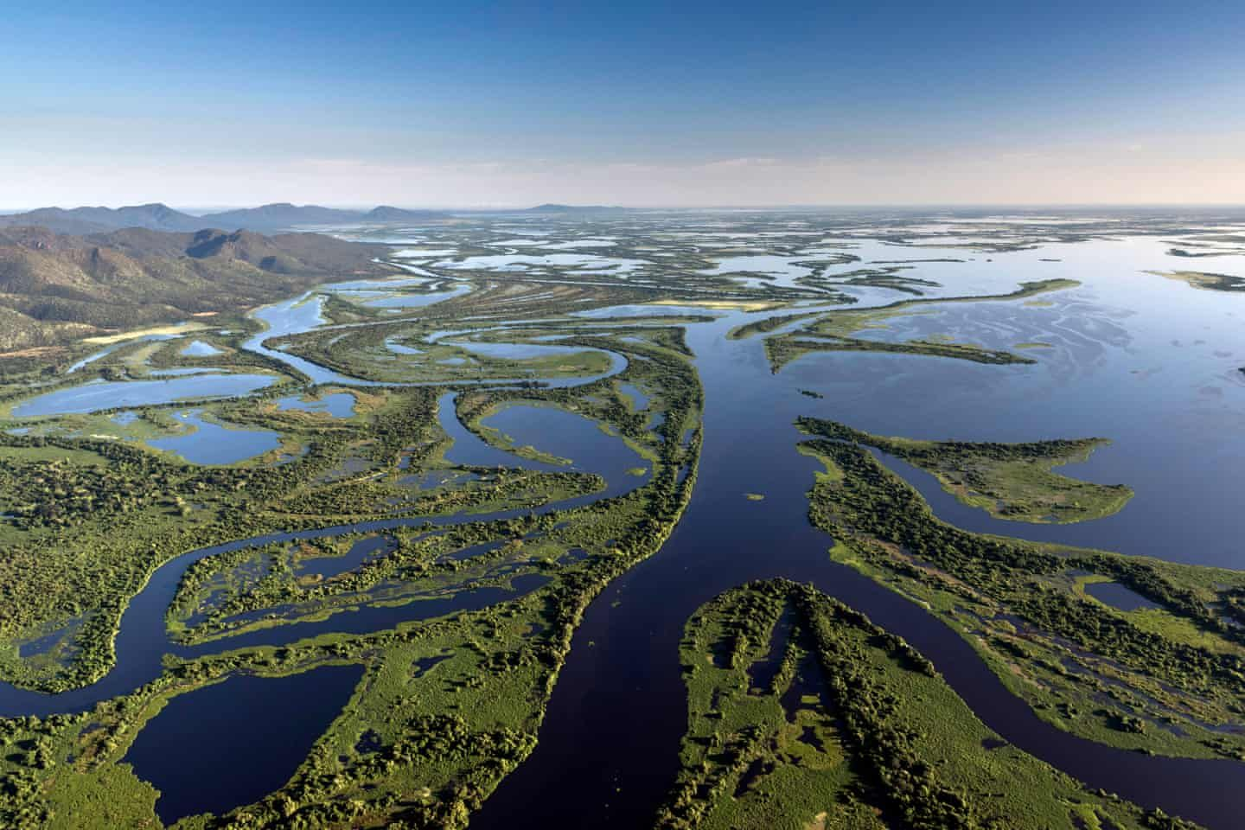
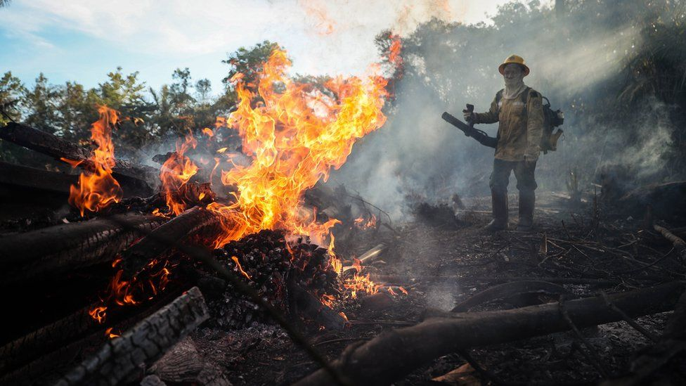
Exam Topic & Discussion
Date and Time – Wednesday 14th January, 11am-3pm
(Provisional date, will confirm soon)
Timeframe of exam – 4 hours
Question – Unseen question due to not being able to be in a physical exam.
What I can give you – relevant criterion & the overarching ‘topic’ of your exam, to encourage you to undertake personal research in preparation for the exam.
Topic – Importance of protecting & conserving freshwater habitats
The Pantanal Floodplain & Tropical Wetlands as a Case Study

Slide 5

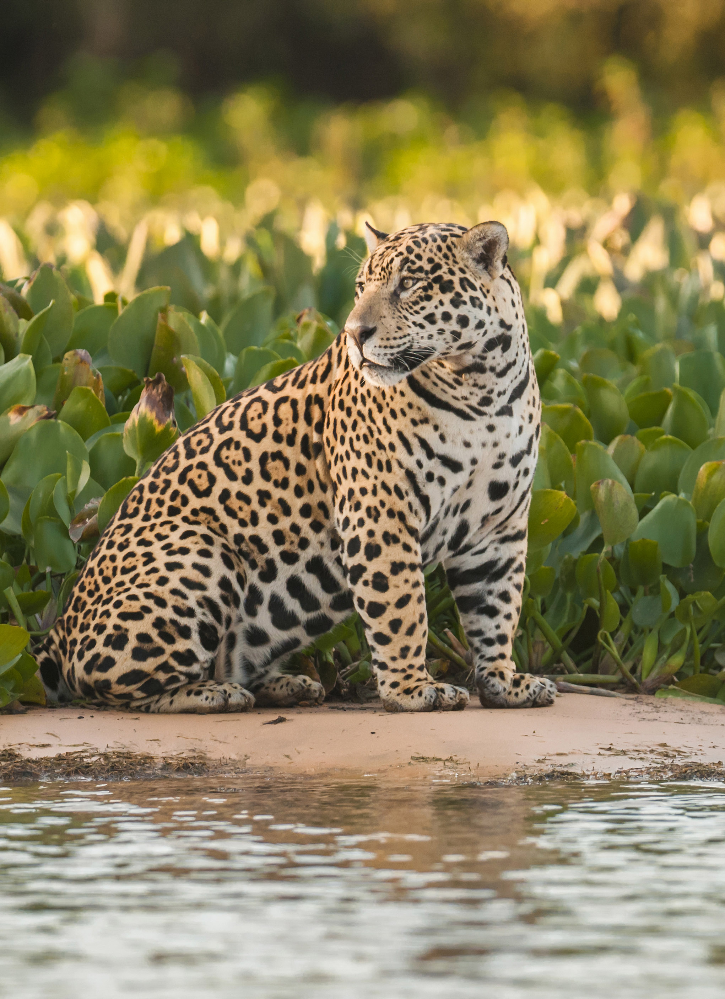
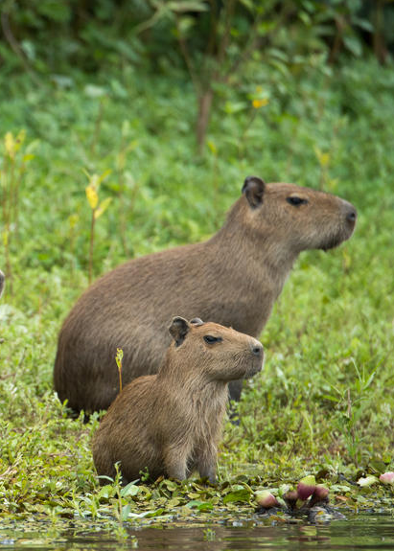
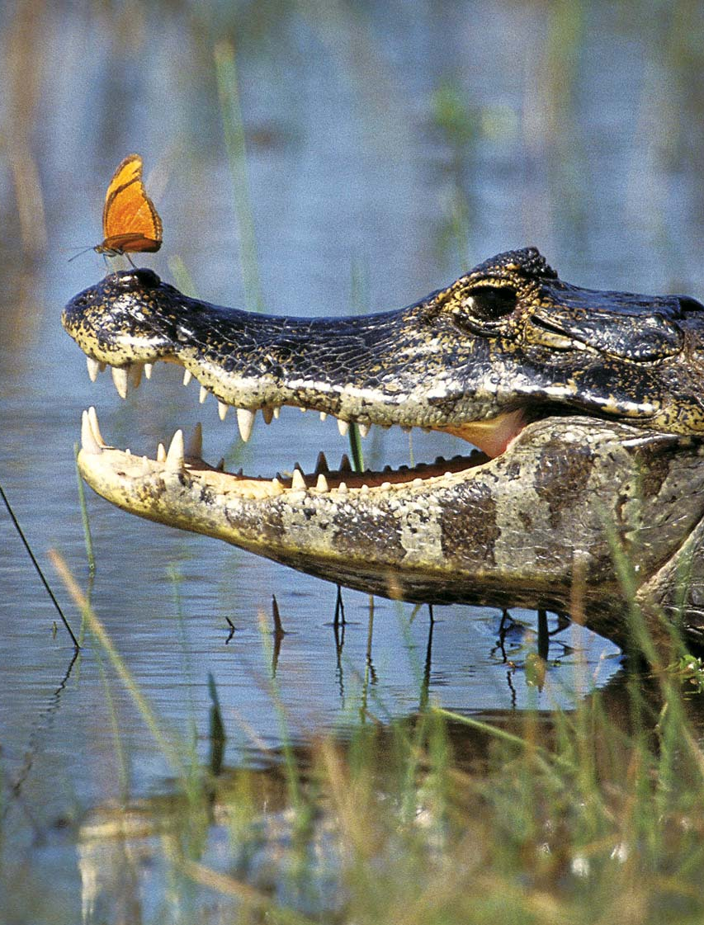
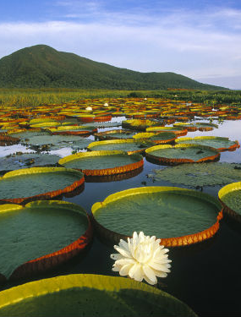
Importance of protecting & conserving freshwater habitats:
The Pantanal Floodplain & Tropical Wetlands as a Case Study
Importance/value of freshwater systems:
* Hydrological
* Biological
* Chemical
* Ecological
Geological, Economic, & Cultural importance of these systems, the habitats they house & wildlife they encompass.
Management of these systems, wetlands specifically and the Pantanal.
Content to consider researching…
Notes:
Content to consider researching…
Freshwater systems, their importance holistically within that working wetland, and how these can or have been affected by human activity.
When you’re talking about systems, of course we mean these…
Hydrological system – Water cycle, the natural flow of water through a geophysical space. The geographical lay of the land (watershed) contributing to the flow of water through water bodies and out of the basin.
Biological system – Distribution and composition of biota, nutrients or organic particles within an ecosystem (food webs and chains).
Chemical system – Natural chemical composition of freshwater habitats and environments. Remember this isn’t only due to human intervention (which is certainly notable here) but also climactic and natural environmental changes…
Ecological system – Habitats and their interaction with flora and fauna within them. E.g. keystone species that can alter the morphology of an area ecologically.
When there’s a discussion on the importance of conserving a landscape, a system, a habitat or even a specific species, remember this often translates to discussing the values of these too..!
Management processes and suggestions which have been put in place or actioned for the protection of the Pantanal wetlands.
Who are the key players that are or should be involved in freshwater management on a large scale such as in regard to the Pantanal? Have there been protections historically? Question the obvious here.
Have measures been working? If not, what else could be put in place? Constructive suggestions using backed up similar cases perhaps.
Evaluate issues & obstacles arising from increasing economic development, and the need to conserve water as a scarce natural resource.

