Slide 1

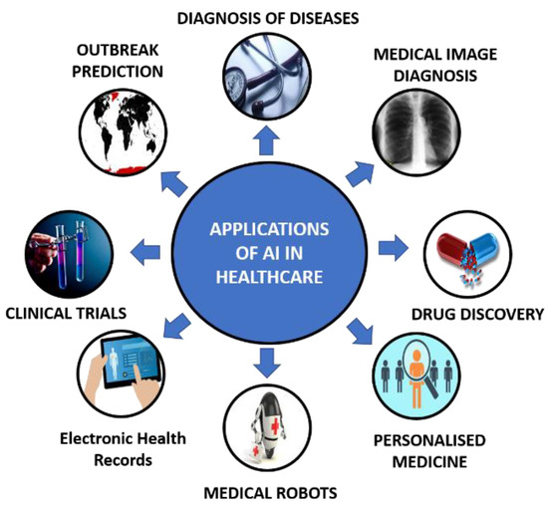
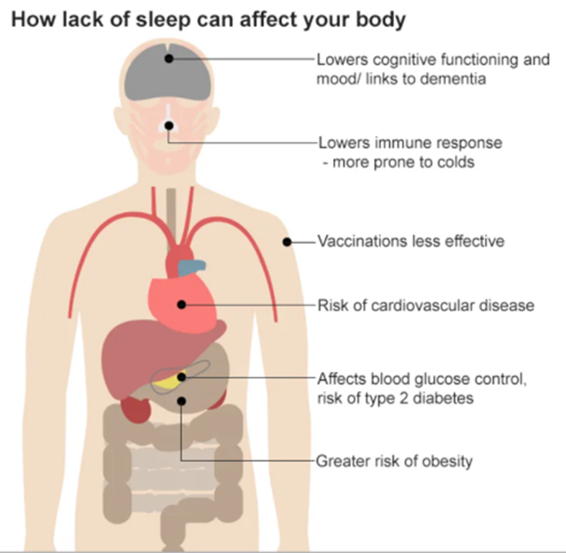
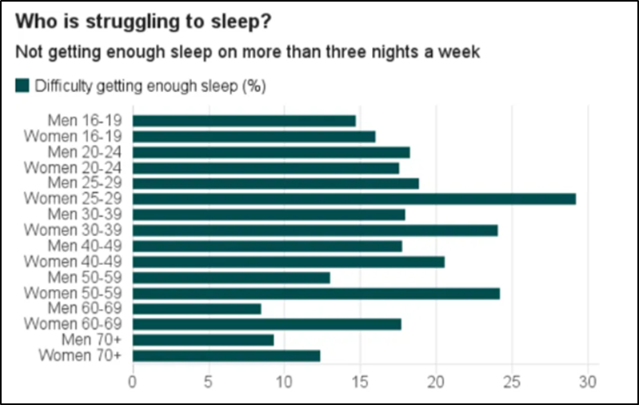
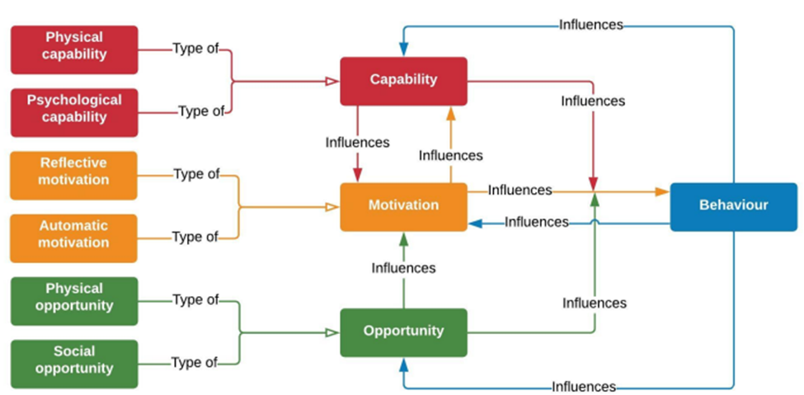
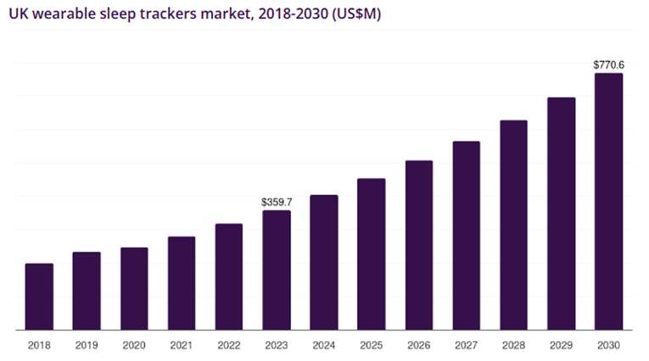
Programme: Msc Public Health And Social Care In Practice Module: Population Health And Digital Health Promotion Module Code: LCHS7009 Student Name: Bharatji Odedra
Lecturer: Dr Ping Wu Assignment Title: Component 2 Poster Student ID: 2522919
SleepWell AI+: Empowering Better Sleep Through AI-Driven Health Promotion
Background
Behavioural Change Theory
Conclusion
Sleep disorder is one of the fastest-growing public health issues, which negatively impacts health outcomes by causing several physical and mental health problems, such as heart diseases, obesity, chronic anxiety, and depression (Karna, Sankari and Tatikonda, 2020). Increasing the rate of this public health issue also creates a strong healthcare burden, where approximately 14 million people in the UK are suffering from this issue (The Sleep Charity, 2024). As of 2017, more than 25% of women, aged 25-29 are mostly facing difficulties in getting enough sleep (Schraer and D’Urso, 2017). Therefore, the statistical evidence indicates a strong burden scale of this public health issue, which needs proper intervention to reduce the impacts. Non-digital interventions, such as sleep education and behavioural interventions support sleep management among adults, but may be constrained due to facing difficulties in maintaining behavioural change and limited access (Grandner, 2019). Digital health technologies, including Oura Ring, significantly promote health and reduce the impact of sleep disorders by monitoring sleep cycles, daily activity, and heart rate, but due to high cost and a lack of accessibility, it faces limitations (Niela-Vilen et al., 2022). Therefore, the gap in this digital technology intervention needs to be mitigated by a proposed intervention discussed in Component 1, where SleepWell AI+ offers a combined sleep tracking feature to reduce the risk of sleep disorder.
This digital health technology contains several features, such as:
● Bedtime reminders
● Smart alarms
● Lifestyle recommendations
The proposed offerings of SleepWell AI+ strongly combined with an advanced AI-integrated approach, which will provide real-time feedback to people who are living with sleeping disorders, aligning with the concept of the COM-B Model. From the perspective of West and Michie (2020), as a behavioural change theory, applying this model is highly relevant to SleepWell AI+, as it allows to combine continuous monitoring, behavioural prompts, and personalised education for supporting users by taking suitable actions.
The capability element refers to an individual’s physical and psychological ability for performing a behaviour, where the intervention will empower the psychological ability of people with sleeping disorders by assessing wearable-generated sleep data (West and Michie, 2020). It will also address sleeping duration patterns and bedtime consistency through AI-powered predictive analytics, which can transform the daily lifestyle behaviours of people. Similarly, providing personalised feedback can also improve the physical capability of patients by making complex sleep information easier to understand and apply into practical situations (Bragazzi and Garbarino, 2024). Besides this, the digital technology intervention will create supportive opportunities through its advanced offerings, including smart alarms, bedtime reminders, and personal guidance, which will help users to establish a regular sleep routine across their everyday environments (Bragazzi and Garbarino, 2024). The wearable sleep tracker market in the UK is projected to reach USD 770.6 million by 2030, which indicates strong market growth (Grand View Research, 2026).
Thus, the statistical evidence highlights an opportunity for the intervention, where healthcare professionals can further provide better healthcare services by getting relevant sleep data, providing professional support. Furthermore, providing AI-generated personalised progress reports and feedback will also strengthen the motivation of patients by highlighting interconnections between behaviour of users and changes in their sleeping patterns (Gala et al., 2024; Olawade et al., 2024). Similarly, smart alarms and automated reminders may also empower motivation by inspiring people to maintain consistent routines while minimising reliance on conscious decision-making. Therefore, by aligning with this model SleepWell AI+ can support people’s behaviour change through enhancing capabilities, opportunities, and motivations, and integrating digital support. Rather than including advanced functions, this intervention will complement wider health promotion, along with supporting healthcare professionals by providing real-time sleep data and behavioural data of people.
The study has demonstrated the background of the digital technology intervention, which is proposed by aligning with health promotion values, principles, the behavioural change theory with expected outcomes. DiaLife AI highlights the potential of AI-powered digital health interventions for advancing personalised and equitable diabetes care.
The intervention implementation can support healthcare policies by reducing pressure on healthcare systems while promoting digital innovation through proactive disease management.
Also, its implementation can support the digital transformation of the NHS by fostering AI integration into chronic disease management, which can also improve service efficiency by minimising long-term healthcare costs. The platform may also enhance digital literacy through encouraging self-management and patient education.
From a research perspective, further studies are required to assess the cost-effectiveness, long-term clinical effectiveness, user acceptance, and scalability of AI-powered interventions across diverse populations.
Future research should consider the long-term clinical effectiveness, ethical considerations, and user engagement to ensure inclusive, safe, and sustainable integration into routine diabetes care.
Therefore, an innovative and sustainable digital solution is proposed through DiaLife AI with the potential for improving population health outcomes while supporting evidence-based and person-centric diabetes care.
Figure: Health promotion
(Source: World Health Organization, 2026)
Figure: AI in healthcare
(Source: Pandya et al., 2021)
References
Figure: Impact of sleep disorder
(Source: Schraer and D’Urso, 2017)
Figure: Percentage of difficulties in getting enough sleep
(Source: Schraer and D’Urso, 2017)
Bhattacharya, S., Bhattacharya, S., Vallabh, V., Marzo, R.R., Juyal, R. and Gokdemir, O. (2023) ‘Digital well-being through the use of technology–a perspective’, International Journal of Maternal and Child Health and AIDS, 12(1), p.e588. Available at: https://doi.org/10.21106/ijma.588
Bragazzi, N.L. and Garbarino, S. (2024) ‘The Complex Interaction Between Sleep-Related Information, Misinformation, and Sleep Health: Call for Comprehensive Research on Sleep Infodemiology and Infoveillance’, JMIR infodemiology, 4(1), p.e57748. Available at: https://doi.org/10.2196/57748
Gala, D., Behl, H., Shah, M. and Makaryus, A.N. (2024) ‘The role of artificial intelligence in improving patient outcomes and future of healthcare delivery in cardiology: a narrative review of the literature’, In Healthcare (Vol. 12, No. 4, p. 481). MDPI. Available at: https://doi.org/10.3390/healthcare12040481
Grand View Research (2026) UK Wearable Sleep Trackers Market Size & Outlook, 2023-2030. Available at: https://www.grandviewresearch.com/horizon/outlook/wearable-sleep-trackers-market/uk (Accessed: 20 July 2026).
Grandner, M.A. ed. (2019) Sleep and health. Academic Press.
Karna, B., Sankari, A. and Tatikonda, G. (2020) Sleep disorder. Available at: https://www.ncbi.nlm.nih.gov/books/NBK560720/ (Accessed: 20 July 2026).
Niela-Vilen, H.P., Azimi, I.P., Suorsa, K.P., Sarhaddi, F.M., Stenholm, S.P., Liljeberg, P.P. and Rahmani, A.M. (2022) ‘Comparison of Oura Smart Ring’, CIN: Computers, Informatics, Nursing: February, 28. Available at: https://www.utupub.fi/bitstream/handle/10024/164762/Comparison%20of%20Oura%20-final%20draft.pdf?sequence=1 (Accessed: 20 July 2026).
Olawade, D.B., Wada, O.Z., Odetayo, A., David-Olawade, A.C., Asaolu, F. and Eberhardt, J. (2024) ‘Enhancing mental health with Artificial Intelligence: Current trends and future prospects’, Journal of medicine, surgery, and public health, 3, p.100099. Available at: https://doi.org/10.1016/j.glmedi.2024.100099
Pandya, S., Thakur, A., Saxena, S., Jassal, N., Patel, C., Modi, K., Shah, P., Joshi, R., Gonge, S., Kadam, K. and Kadam, P. (2021) ‘A study of the recent trends of immunology: Key challenges, domains, applications, datasets, and future directions’, Sensors, 21(23), p.7786. Available at: https://doi.org/10.3390/s21237786
Quach, S., Thaichon, P., Martin, K.D., Weaven, S. and Palmatier, R.W. (2022) ‘Digital technologies: tensions in privacy and data’, Journal of the academy of marketing science, 50(6), pp.1299-1323. Available at: https://doi.org/10.1007/s11747-022-00845-y
Schraer, R. and D’Urso, J. (2017) 10 things to know about sleep as the clocks change. BBC. Available at: https://www.bbc.com/news/health-41666563 (Accessed: 20 July 2026).
The Sleep Charity (2024) Sleep Manifesto 2024. Available at: https://thesleepcharity.org.uk/get-involved/sleep-manifesto-2024/ (Accessed: 20 July 2026).
West, R. and Michie, S. (2020) ‘A brief introduction to the COM-B Model of behaviour and the PRIME Theory of motivation [v1]’, Qeios. Available at: https://discovery.ucl.ac.uk/id/eprint/10095640/1/WW04E6.pdf (Accessed: 20 July 2026).
World Health Organization (2026) Health promotion. Available at: https://www.who.int/health-topics/health-promotion#tab=tab_1 (Accessed: 20 July 2026).
Zhang, L., Zhao, S., Yang, Z., Zheng, H. and Lei, M. (2024) ‘An artificial intelligence platform to stratify the risk of experiencing sleep disturbance in university students after analyzing psychological health, lifestyle, and sports: a multicenter externally validated study’, Psychology research and behavior management, pp.1057-1071. Available at: https://doi.org/10.2147/PRBM.S448698
Values and principles of health promotion
Figure: COM-B Model
(Source: West and Michie, 2020)
Figure: UK Wearable sleep tracker market growth
(Source: Grand View Research, 2026)
The proposed intervention will align with health promotion, which refers to a structured process that allows people to enhance their health outcomes by focusing on establishing healthy public policies, education, and empowerment rather than just diagnosing diseases (World Health Organization, 2026). Considering the perspectives of the Ottawa Charter, health promotion has some key values and principles, which collectively help healthcare professionals to drive positive health outcomes across the healthcare industry. The values and principles are:
● Developing personal skills
● Strengthen community action
● Create supportive environments
● Reorganise and restructure health services (World Health Organization, 2026).
The intervention through SleepWell AI+ also prioritises the health promotion values and principles. For example, the intervention will develop personal skills of adults by providing them with AI-integrated personalised education, which can increase awareness of sleep hygiene and sleep quality (Zhang et al., 2024). Introducing this technology will also create a supportive healthcare environment by providing AI-based personalised guidance, continuous digital prompts, and reminders beyond traditional healthcare consultants. Combining these features with healthcare promotion values will enable to reduce the burden of sleep disorders by shifting healthcare treatment from generic advice to data-driven and customised interventions (Zhang et al., 2024).
It will encourage healthcare professionals by aligning with healthcare policy to restructure their health services and make community-oriented actions by offering proactive support through allowing users to share their sleep information during consultations, leading to more efficient health outcomes. However, as health promotion refers to more than technological availability, the implementation of this digital health technology requires digital literacy, sufficient financial resources, and internet access to effectively use the features to track health promotion. Therefore, the effectiveness of implementing SleepWell AI+ mainly depends on recognising inequalities while ensuring equitable access and enabling technology to support sustainable and inclusive health promotion.
Expected outcome
Introducing Sleepwell AI+ as a modified version of Oura Ring is expected to support healthier sleep-related behaviours through increasing sleep awareness, sleep hygiene practices, and knowledge across people who are living with sleep disorders.
In the short-term, the intervention can encourage people for healthier routines and consistent bedtimes by generating AI-powered personalised feedback, progress monitoring, and reminders (Olawade et al., 2024).
In the long-term, it is expected that this digital technology will contribute to improve physical and mental well-being of people by improving sleep quality through understanding their behavioural changes (Bhattacharya et al., 2023).
The proposed intervention may also help with early identification of sleep problems by providing longitudinal information to users and healthcare professionals, which can lead to improved healthcare service efficiency.
However, these outcomes are expected rather than guaranteed, as SleepWell AI+ is a proposed intervention and the effectiveness has not been established yet.
It may also include potential risks, such as data breach issues, inaccurate wearable measurements, reduced user engagement, and algorithmic bias recommendations, which may limit the effectiveness of this intervention (Quach et al., 2022).
Thus, to mitigate these issues, the intervention will establish a responsible ethical governance to promote transparency and fair AI practices.
Therefore, the effectiveness of this intervention will be assessed by measuring behavioural and clinical outcomes, such as sustained engagement, sleep quality, user acceptability, and digital inclusion.

