Slide 1
LCMB7000
MBA
Human Resource Management
Week 5
Performance management/ Appraisal

Slide 2
Learning outcomes
Understanding meaning of performance management / Appraisal
Understanding Effective systems for managing performance of employees
Identifying Issues related to performance appraisal of international employees

Slide 3
Performance Management Versus Performance Appraisal
Performance Management
  Identifying, measuring, managing, and developing HR performance; serves as systematic measurement of performance
Performance Appraisal
  Evaluating individual employee performance; vital component of performance management process

Slide 4
Importance of Performance Management Systems (1-2)
Translating strategy to individual behaviour is performance management
Three key areas
  Performance Measurement
  Performance Feedback
  Performance Improvement

Slide 5
Performance Measurement
Variety of ways of measuring performance include :
Job specific task performance
Behaviors (competencies)
Other approaches (Organizational Citizenship Behaviour)

Slide 6
Performance Management
Refers to the set of interconnected practices designed to ensure that a person’s overall capabilities and potential are appraised, so that relevant goals can be set for work and development, and so that, through assessment, data on work behaviour and performance can be collected and reviewed.”
  Bratton and Gold (2012, pg. 249)

Slide 7
Activity
You are going to evaluate a customer service person in a shop, what do you measure/care about?

Slide 8

Customer service representatives performance
Timekeeping
Absence
Knowledge of the business /sales/offer
Customer interaction
Complaints / compliments
Accuracy (sales/ bills)
Upselling
Teamworking
Flexibility
Attitude

Slide 9
Importance of Performance Management Systems (2-2)
Maintain productivity of employees
Increase capability of employees
Aids in continuous improvement

Slide 10
Accurate Performance Measures Must Be . . .
Valid and reliable
Acceptable and feasible
Specific and pertinent to the job itself
Based on the mission and objectives

Slide 11
Managing performance and management development
Links between managing performance and management development.
Extrinsic rewards - bonus, profit share, performance related pay, share issues are important motivators
Intrinsic rewards - encouragement, praise, positive feedback, particularly with younger less experienced managers. Also, important.
These need to be an integral part of a structured management development approach linked to overall corporate objectives, in successful organisations.

Slide 12
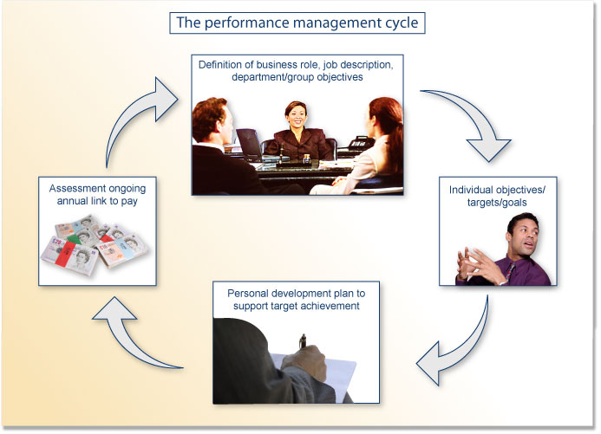
Performance management cycle

Slide 13
Performance management implantation issues and challenges
Lack of employee involvement in implementation of the performance management
Poor communication in performance planning
Performance review
Poor feedback on performance
Lack of policies supporting implementation

Slide 14
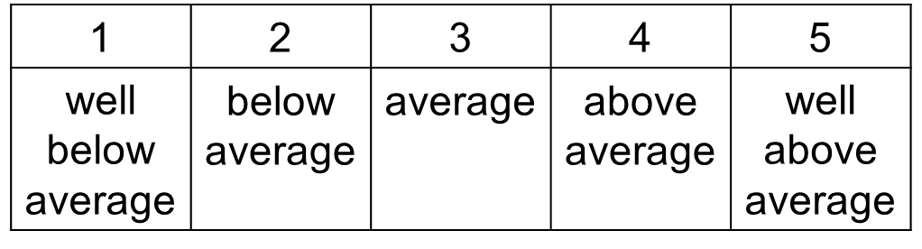
Activity
Compared to others in this class...
Rate yourself on each item using a 5-point scale
  Computer skills
  Writing skills
  Friendliness
  Promptness
  Interpersonal skills
  Energy level
  Level of responsibility
  Intelligence
Add up your score to get a total

Slide 15
Performance Feedback
Helpful vs harmful feedback
  Focus on behaviour
  One or two critical behaviours
  Desired rather than undesired behaviours
  Honest or hurtful
  Feedback without goals = no change
  Latham (2009)

Slide 16
Performance Improvement
Training and Development
Coaching / Mentoring
Disciplinary Proceedings

Slide 17
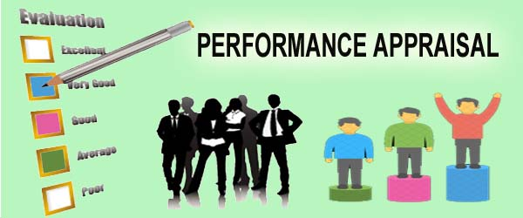

Slide 18
Performance Appraisal
Appraisal/Assessing Performance - What is it?
When we appraise something, we rate its worth, its usefulness and the degree to which it displays various qualities. We appraise ourselves and other people; we appraise behaviour, personality and systems. Organisational appraisal systems are an attempt to formalise these activities for the benefit of both the individual and the organisation.

Slide 19
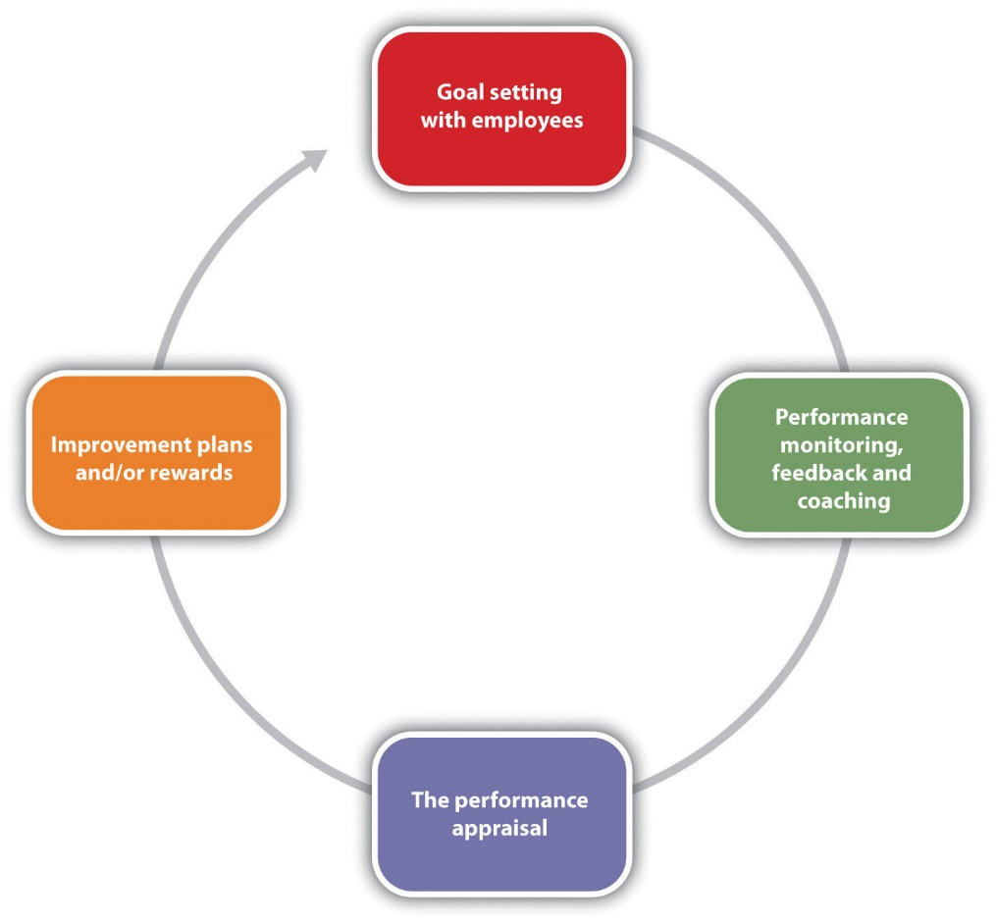
The Performance Appraisal Process

Slide 20
Performance Appraisal employees
An appraisal system that uses all three of these performance criteria is advocated :
  Hard goals: objective, quantifiable and can be directly measured.
  Soft goals: relationship or trait-based.
  Contextual goals: factors that result from the situation in which performance occurs.
There are a number of other factors affecting appraisal, e.g.
  Who conducts the performance appraisal?
  Use of a standardised or customised appraisal form.
  Frequency of appraisal?
  Performance feedback must be timely

Slide 21
Uses of Appraisal/Assessing Performance
Organisational Development - this can include:
Setting performance objectives.
Assessing past performance.
Helping improve current performance.
Assessing training and development needs.
Assessing salaries.
Assessing future potential.
Assisting in career planning decisions.

Slide 22
Uses of Appraisal/Assessing Performance
Personal Development - this can include:
Feedback on performance.
Reassurance, praise, encouragement - salary progression.
Help in performing better - training and development.
Guidance on future career.

Slide 23
How Do We Use Appraisal Methods and Forms?
The formal performance appraisal usually involves the use of a standard form developed by the HR department to measure employee performance.
Employees need to know the standards and understand what good performance looks like, and they need to be able to measure their own performance.

Slide 24
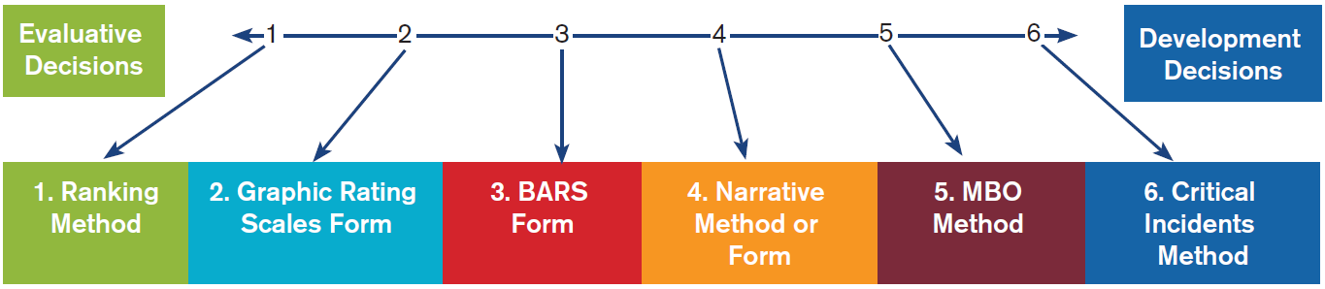
Performance Appraisal Measurement Methods and Forms

Slide 25
Critical Incident Method
A performance appraisal method in which a manager keeps a record of the positive and negative performance of employees throughout the performance period.
A list of documented critical incidents is especially important to have leading up the evaluative decision of firing employees.

Slide 26
Management by Objectives (MBO)
Managers and employees jointly set employee objectives.
Managers give feedback, evaluate performance, and reward as merited.
It is not unusual to see misappropriation of resources used to fulfill MBOs. Misuse of MBOs can foster a “me-first” mentality.

Slide 27
Narrative Method or Form
Managers keep written records about employees’ performance.
Used for ongoing feedback and employee development planning.
Narratives capture employees’ values and contributions.

Slide 28
Graphic Rating Scale Forms
Managers use appraisal checklists to rate employee performance, often expressed as a numerical scale.
Typically used for evaluative decisions, but should also steer development decisions.
An effective rating is possible using a 1–5 Likert-type scale, but examples provide greater clarity.

Slide 29
Behaviorally Anchored Rating Scales (BARS)
Managers use behaviorally based continuum to rate employee performance, often expressed as a numerical scale.
It’s perhaps the best and most effective appraisal measurement.
It is typically used for evaluative decision-making, but should also steer development decisions

Slide 30
Ranking Method
Managers rank employees by comparing best to worst.
Forced distribution ranking of best to worst is the most used measure when companies resort to downsizing and layoffs.
It is typically used for evaluative decision-making and development.

Slide 31
Which Option Is Best? (1 of 2)
Using a combination of the methods and forms is usually superior to using just one.
For developmental objectives, the critical incidents, MBO, and narrative methods work well.

Slide 32
Which Option Is Best? (2 of 2)
For administrative decisions, a ranking method based on the evaluative methods and especially graphic rating scales or BARS forms work well.
The success of the performance appraisal process depends on the manager’s human relations skills in ongoing critical-incidents coaching.

Slide 33
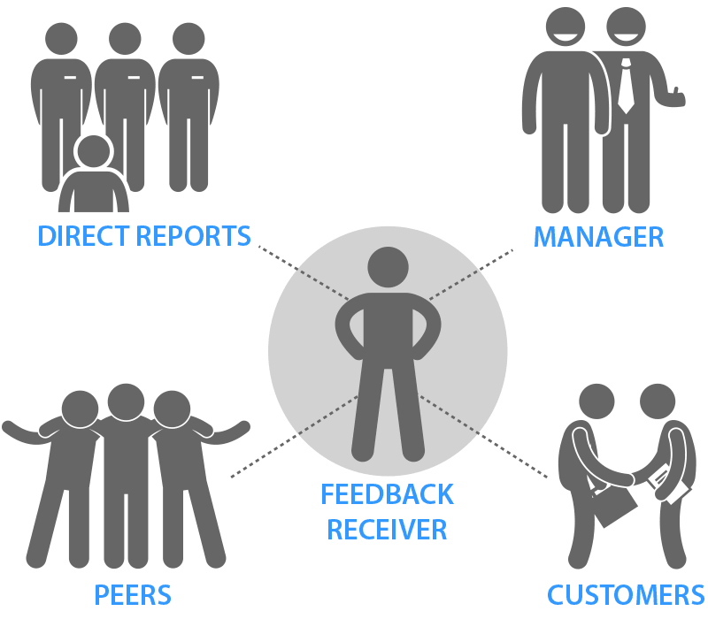
Who Should Assess Performance?
Supervisors
Peers
Subordinates
Self
Customers
360-Degree Evaluations

Slide 34
Seminar

Slide 35
Task
“HR duties and responsibility has become a challenge for HR manager to compete with competitors and to sustain in the diversified economy. As Human Resource is required and a very essential thing for each and every business irrespective of their size and nature of firm, optimum utilization of available employees is a very challenging task for every HR manager in this competitive era”
what are the challenges of HRM
Provide a practical recommendation for the issues discussed
Source (https://ijrar.org/papers/IJRAR1944832.pdf)

