Slide 1
ACCA7048
Data Analysis &
Visualisation:
Descriptive Statistics

Slide 2
Lecture Objectives
Understand what we mean by descriptive statistics
Mean
Median
Mode
Range
Standard Deviation
Variance

Slide 3
Descriptive Statistics
Frequency distributions are good for getting a graphical view of data.
Good for general ideas and to get a pattern.
The drawback is sometimes we need an actual number:
  What is the average MP’s salary?
  What is the average number of minutes spent on social media each day?

Slide 4
Descriptive Statistics
Single numbers can be misleading, as we also need to know how the scores vary within a dataset.
Where do you take the
average here?
Is that a true representation
of the average staff salary?
Staff | Salary per week
Ground staff | 650
Player | 45000
Player | 55000
Cleaner | 400
Player | 50000
Manager | 100,000

Slide 5
Descriptive Statistics
On average, the annual growth rate of stocks during the past 10 years has grown by 20 points.
You might stop smoking because, on average, non-smokers can expect to live longer than heavy smokers (by as much as 10 years, according to some researchers).
You might strengthen your resolve to graduate from college upon hearing that, on average, the lifetime earnings of college graduates are almost double those of high school graduates.

Slide 6
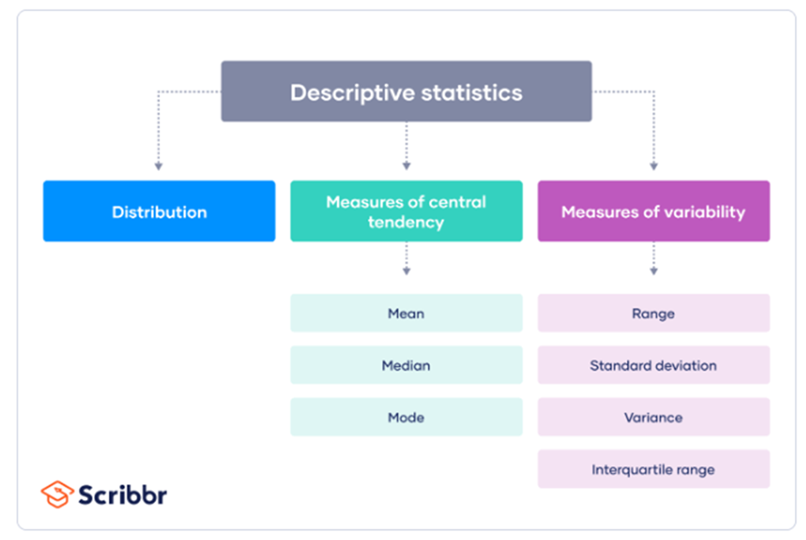
Descriptive Statistics
To do this we need to look at:
  Measures of central tendency.
  Selecting a measure of central tendency:
    Mean, median or mode.
  Measures of variability:
    Range, Variance (SD²) and Standard Deviation (SD)

Slide 7
Measures of Central Tendency
These provide an average or typical score that describes the level of a set of scores
  Useful when comparing individual scores with the group or an external standard

Slide 8


Measures of Central Tendency
The most commonly-used measure of centre is the mean.
    where X is the set of scores and N is the number of scores
  denotes the mean.
    That is we use that when talking about the mean of a set.
  𝜇 is used when talking about mean of the population from which a set is drawn (this difference is important later on)

Slide 9
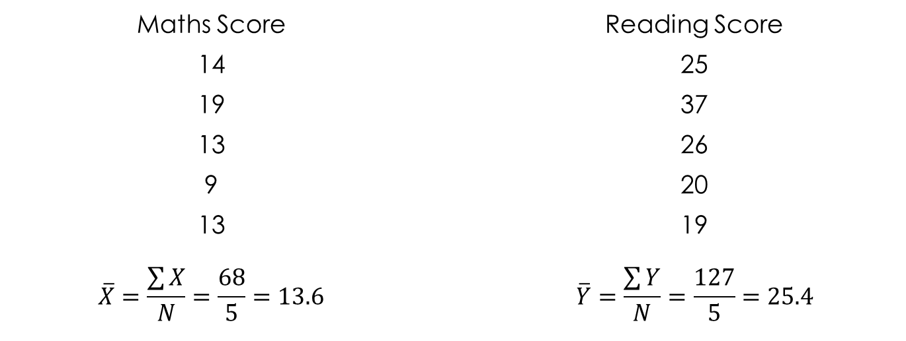
Example of mean:

Slide 10
Exercise
Mark Huntly
m.huntly@uwtsd.ac.uk

Slide 11
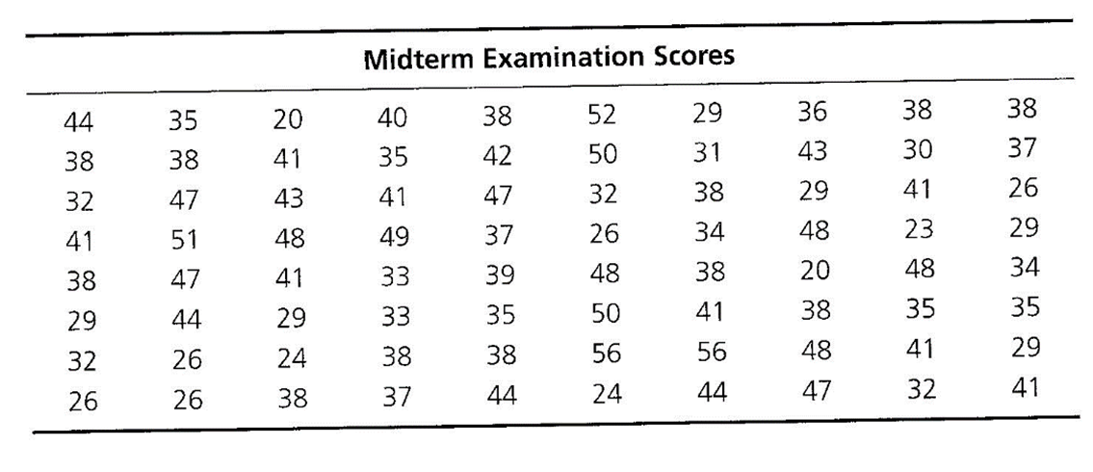
Exercise
Determine the mean of the midterm examination dataset (80 students)

Slide 12
Measures of Central Tendency
The median is the score that divides the frequency distribution in half.
  i.e. the middle score
  The easiest way to find this is to order the scores from lowest to highest and to find the middle score

Slide 13
Measures of Central Tendency
Given an odd set of scores: 113, 95, 94, 133, 112
  Rearrange in order: 94, 95, 112, 113, 133
  Take the middle value: 112
Given an even set of scores: 113, 95, 94, 133, 112, 102
  Rearrange in order: 94, 95, 102, 112, 113, 133
  Take the mean of the middle two values: (102 +112)/2 = 107

Slide 14
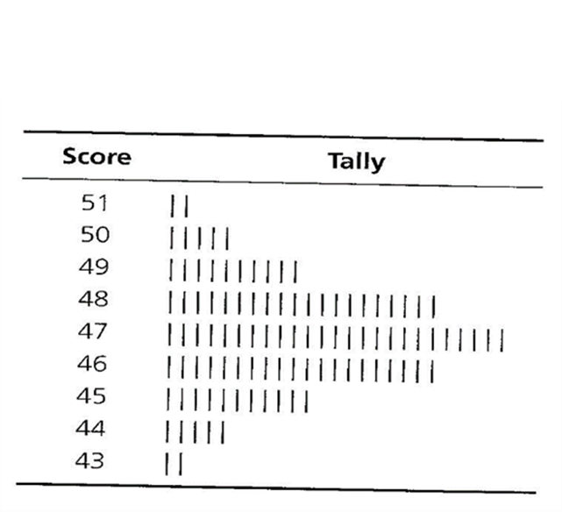
Measures of Central Tendency
The mode is the most frequently occurring score in a set of scores.
  This is the largest column on the frequency distribution.
Given a set of scores 110, 105, 100, 100,
100, 100, 99, 98
100 appears 4 times, more than any other
value, so is the mode.

Slide 15
Measures of Central Tendency
What about this?
Given a set of scores 110, 105, 105, 103, 100, 100, 99, 98
  105 and 100 both appear twice so we have two modes.
  Bimodal and multimodal distributions are possible.

Slide 16
Exercise
Mark Huntly
m.huntly@uwtsd.ac.uk

Slide 17
Exercise
Determine the median and mode(s) of the midterm examination dataset (80 students)

Slide 18
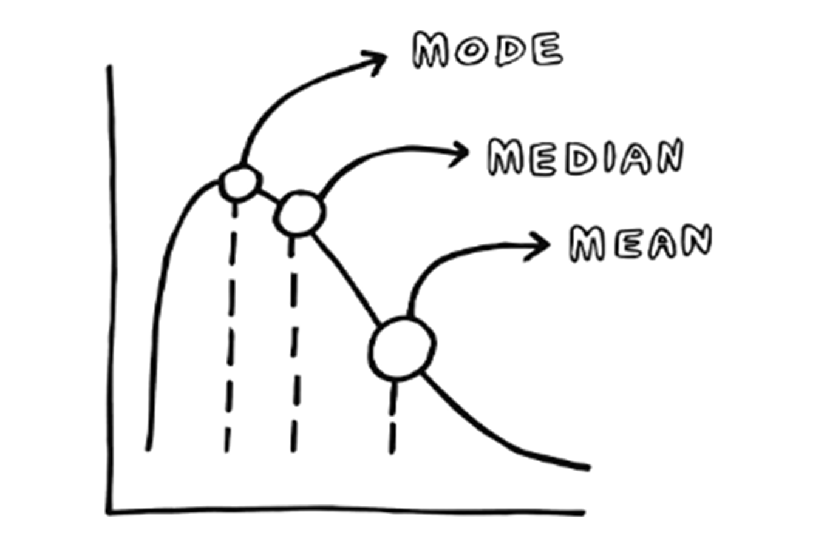
Selecting a measure of central tendency

Slide 19
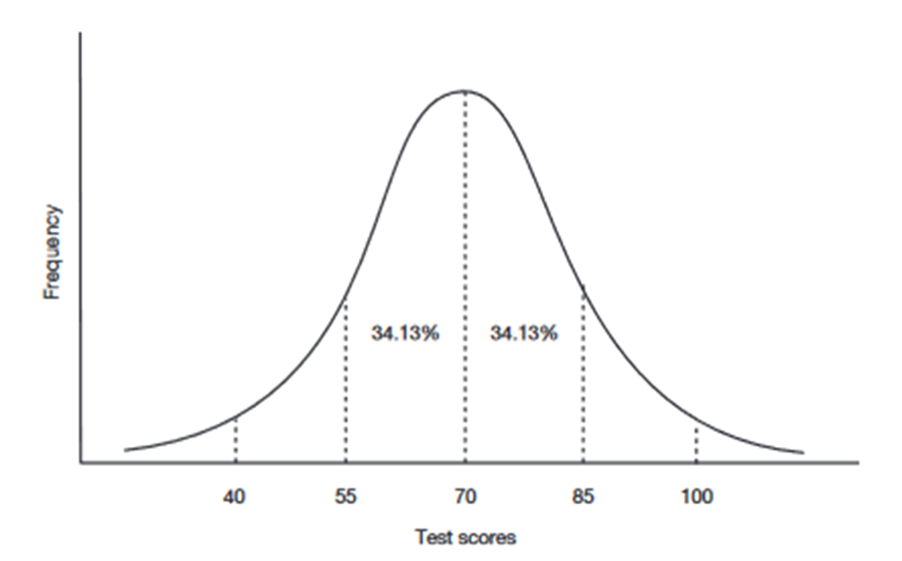
Selecting a measure of central tendency
In a symmetrical unimodal distribution the mean, median and mode will have the same values.
The mean is the ‘balance point’ of a distribution.
  It reflects the position of every score in a dataset.
  Its the most affected by any skewness in the dataset.
Mean == median == mode

Slide 20
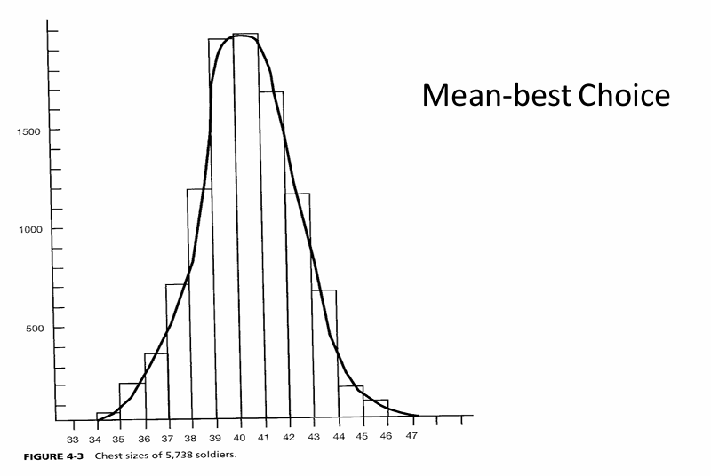
Selecting a measure of central tendency
A normal curve:
Best choice is mean
However, if a dataset is skewed then it is better to report the median than the mean.

Slide 21
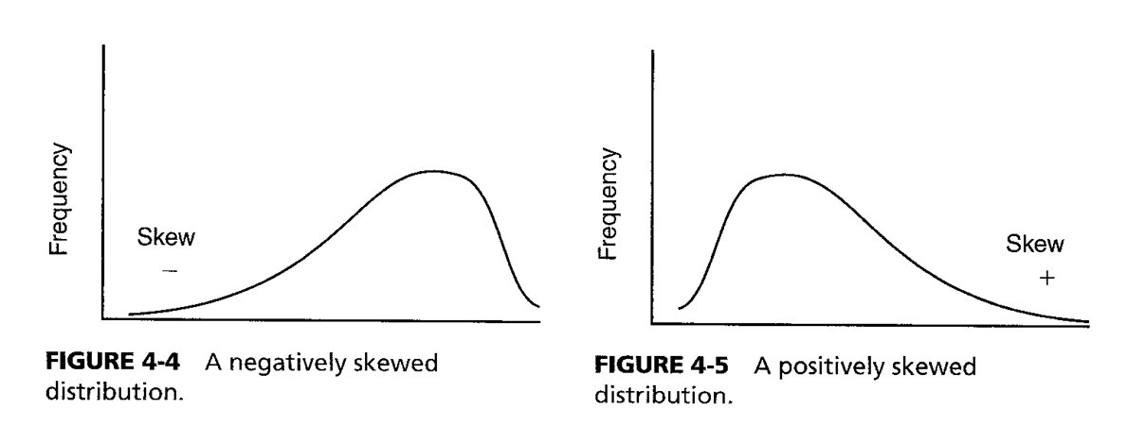
Skewed Distributions
The Normal distribution is symmetrical, but some frequency curves are not
  If a test is very easy most people get high scores
  If a test is very difficult most people get low scores
Depending on which way the bulk of the scores have shifted we can say if a curve is positively skewed or negatively skewed

Slide 22
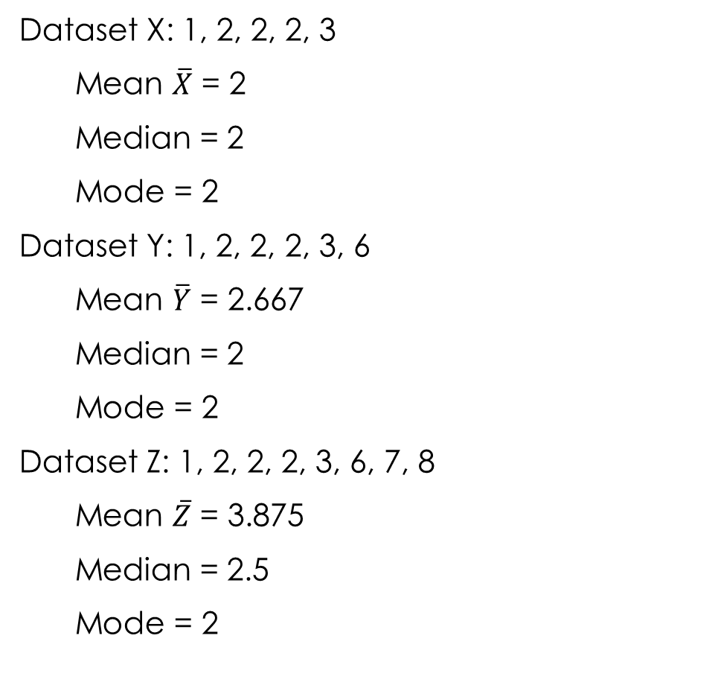
Variation with skewness
Normal Curve
Skewed Datasets

Slide 23
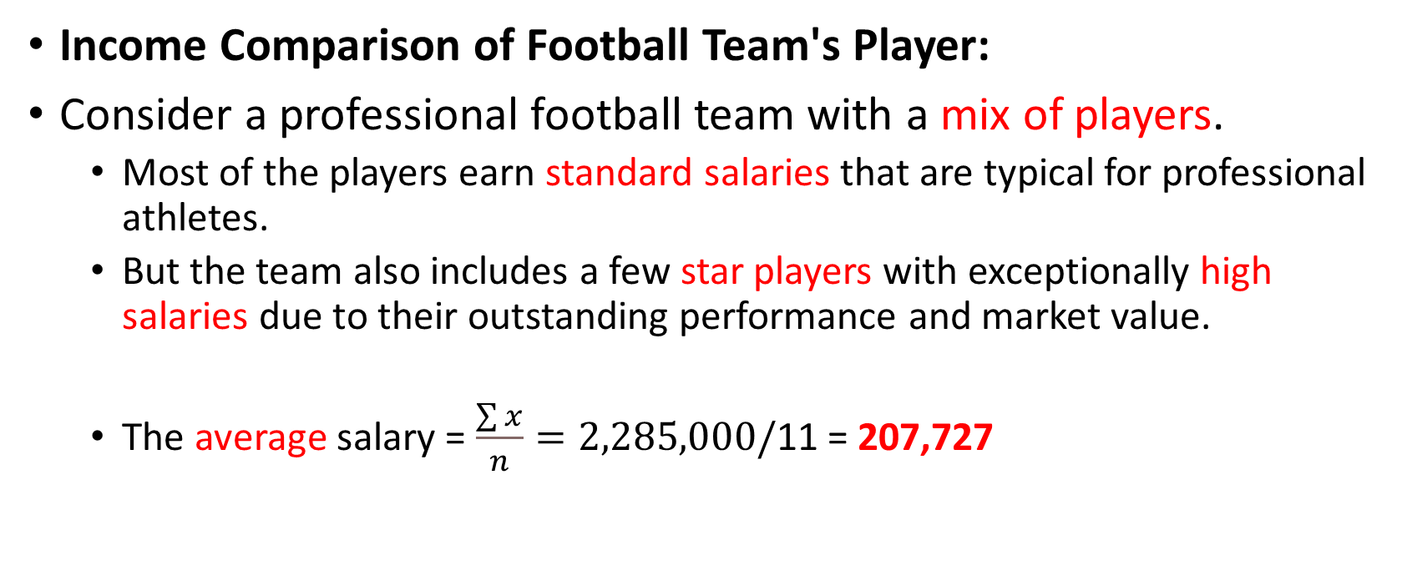
Why select a measure of central tendency?
Annual Salary
250,000
260,000
270,000
280,000
1,000,000
25,000
30,000
35,000
40,000
45,000
50,000
Income Comparison of Football Team's Player:
Consider a professional football team with a mix of players.
  Most of the players earn standard salaries that are typical for professional athletes.
  But the team also includes a few star players with exceptionally high salaries due to their outstanding performance and market value.
  The average salary = $\frac{\sum{x}}{n}=2,285,000/$11 = 207,727

Slide 24
Why select a measure of central tendency?
Annual Salary
250,000
260,000
270,000
280,000
1,000,000
25,000
30,000
35,000
40,000
45,000
50,000
Alternative Approach:
  In this scenario, using the median salary might offer a clearer picture of what the typical player earns. Represent the salary at the midpoint when arranged in ascending order, not affected by the extreme salaries of the star players.
  Salaries in order:
    25k, 30k, 35k, 40k, 45k, 50k, 250k, 260k, 270k, 280k, 1m
    Median = 47,500

Slide 25
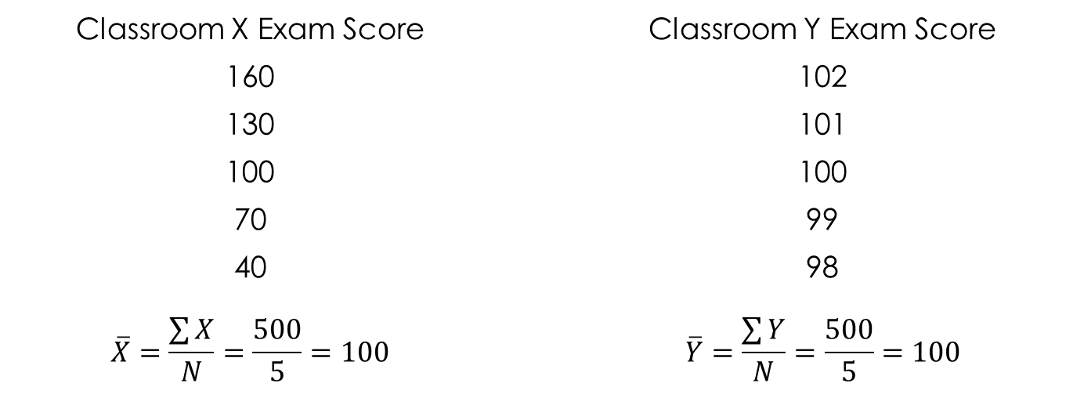
Measures of Variability
The mean, median and mode give us a single score to represent the level of an entire dataset.
Using the central measure alone can be misleading though:
  Consider the two score sets shown:
The means are the same but there is
clearly more variability in the
Classroom X scores.

Slide 26
Measures of Variability
So we use measures of variability:
  Range
  Standard Deviation
  Variance
These can represent the spread or dispersion of the data points around the measure of central tendency.

Slide 27
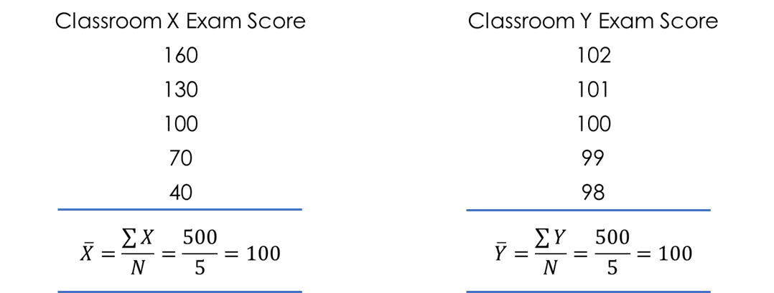
Measures of Variability
Range:
  The simplest measure of variability.
  Simply put, its the highest score (H) minus the lowest score (L): In classroom X
    Range = H – L = 160 – 40 = 120
  In classroom Y
    Range = H – L = 102 – 98 = 4
  This gives a very basic measure of
  overall variability as it doesn’t take
  any skewness into account.
Notes:
Better measures are the variance and the standard deviation

Slide 28
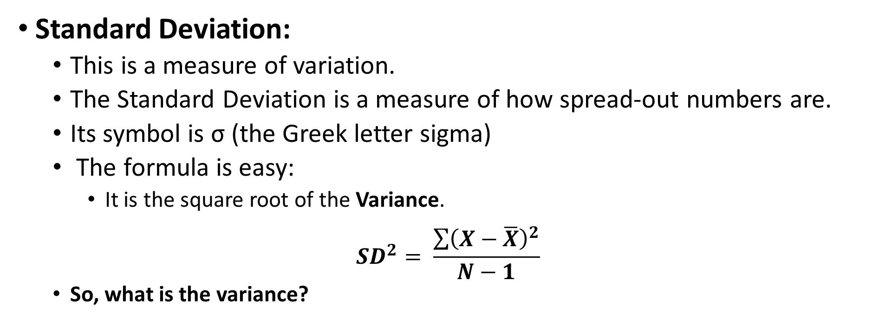
Measures of Variability
Standard Deviation:
  This is a measure of variation.
  The Standard Deviation is a measure of how spread-out numbers are.
  Its symbol is σ (the Greek letter sigma)
  The formula is easy:
    It is the square root of the Variance.
$${SD}^{2}= \frac{\sum{{\left(X−\overline{X}\right)}^{2}}}{N−1}$$
  So, what is the variance?

Slide 29
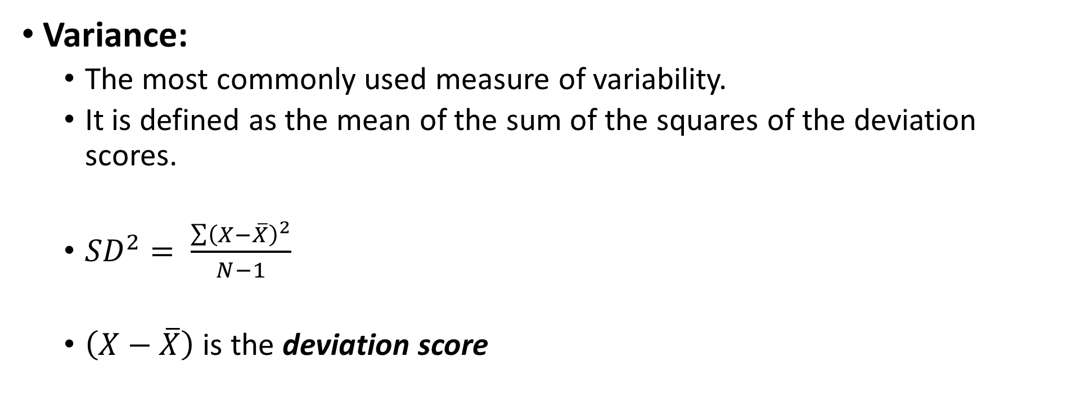
Measures of Variability
Variance:
  The most commonly used measure of variability.
  It is defined as the mean of the sum of the squares of the deviation scores.
  ${SD}^{2}= \frac{\sum{{\left(X−\overline{X}\right)}^{2}}}{N−1}$
  $\left(X−\overline{X}\right)$ is the deviation score

Slide 30
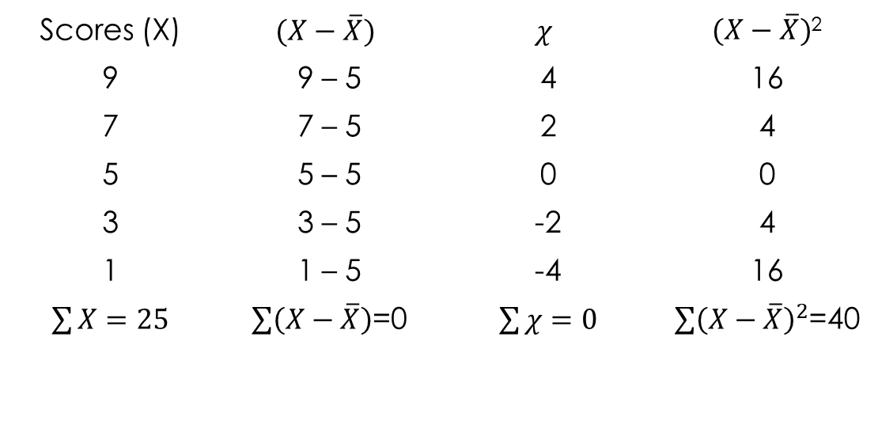
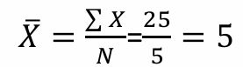

Variance
To calculate the variance first calculate the deviations x then square and sum them, then divide by N-1
$${SD}_{χ}^{2}= \frac{\sum{{\left(X−\overline{X}\right)}^{2}}}{N−1}=\frac{40}{5−1}=10$$

Slide 31
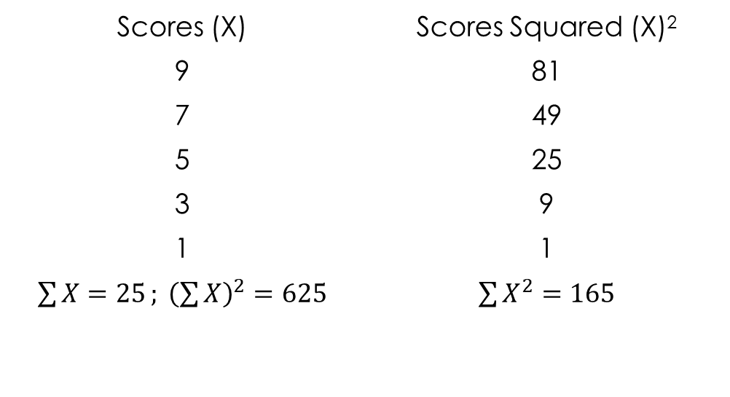
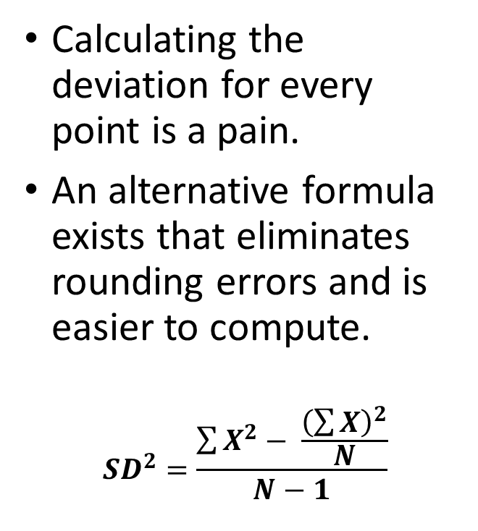
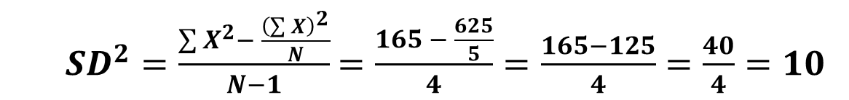
Variance
Calculating the deviation for every point is a pain.
An alternative formula exists that eliminates rounding errors and is easier to compute.
$${SD}^{2}=\frac{\sum{X^{2}− \frac{{\left(\sum{X}\right)}^{2}}{N}}}{N−1}$$
  ${SD}^{2}=\frac{\sum{X^{2}− \frac{{\left(\sum{X}\right)}^{2}}{N}}}{N−1}$ $=\frac{165 − \frac{625}{5}}{4}=\frac{165−125}{4}=\frac{40}{4}=10$

Slide 32
Measures of Variability
Variance:
  Positive scores are above the mean.
  Negative scores are below the mean.
  If we calculated the mean deviation these would cancel out, so we square them to change all negatives to positives (common statistical technique) then take the mean value of the squared scores.

Slide 33
Exercise
Mark Huntly
m.huntly@uwtsd.ac.uk

Slide 34
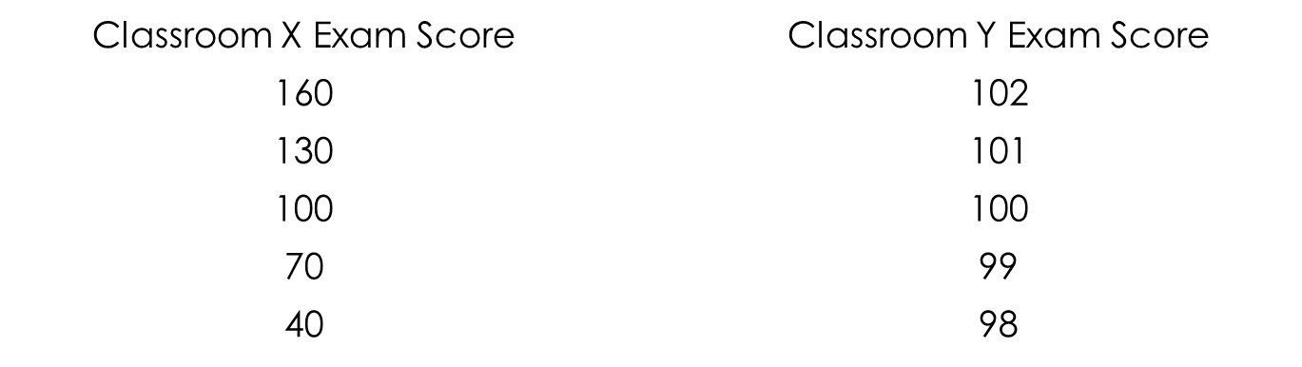
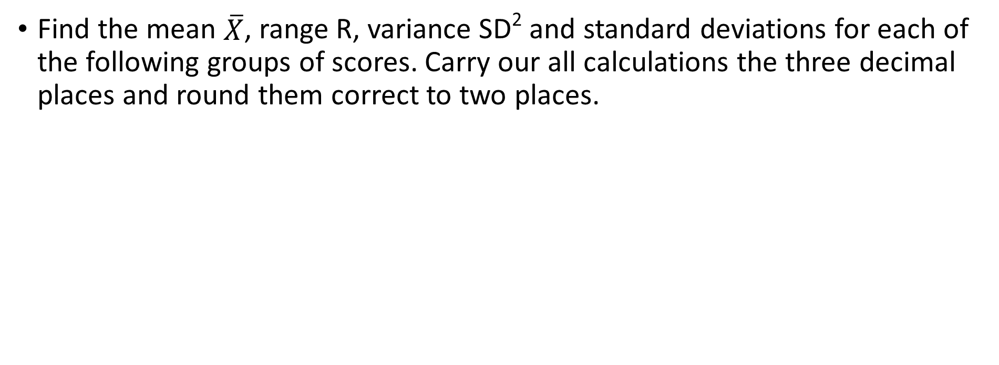
Exercise
Find the mean $\overline{X}$, range R, variance SD² and standard deviations for each of the following groups of scores. Carry our all calculations the three decimal places and round them correct to two places.

Slide 35
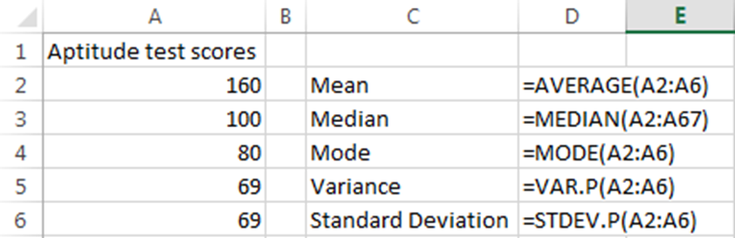
Using Excel
The five main Excel functions are:
  Mean: AVERAGE(range)
  Median: MEDIAN(range)
  Mode: MODE(range)
    If there is no mode then it will return the value #N/A
  Variance: VAR.P(range)
    This will ignore any non-numerical cells in the range
  Standard Deviation(range)
    This will ignore any non-numerical cells in the range

Slide 36
Exercise
Mark Huntly
m.huntly@uwtsd.ac.uk

Slide 37
Exercise
Download the file Midterms.xlsx and calculate the mean, median, mode, variance and standard deviation of the data therein.

Slide 38
Summary
Topics covered today, looking at descriptive statistics.
  Measures of central tendency
  Selecting a measure of central tendency
  Measures of variability
  Using Excel for statistics
Next session we’ll look at the Normal curve and how this can be used to tell us more about a dataset

Slide 39
Any Questions
Mark Huntly
m.huntly@uwtsd.ac.uk

