Slide 1


How do we use technology to collaborate at UWTSD?
Digital Skills and Research Methods (BMSW4003_BIRM)
Elaborated by:
Mariana Codreanu(2118364)
Maria Kirvejova(2120065)
Maria Pohlodkova(2123603)
Lecturer: Abdi Rahman

Slide 2
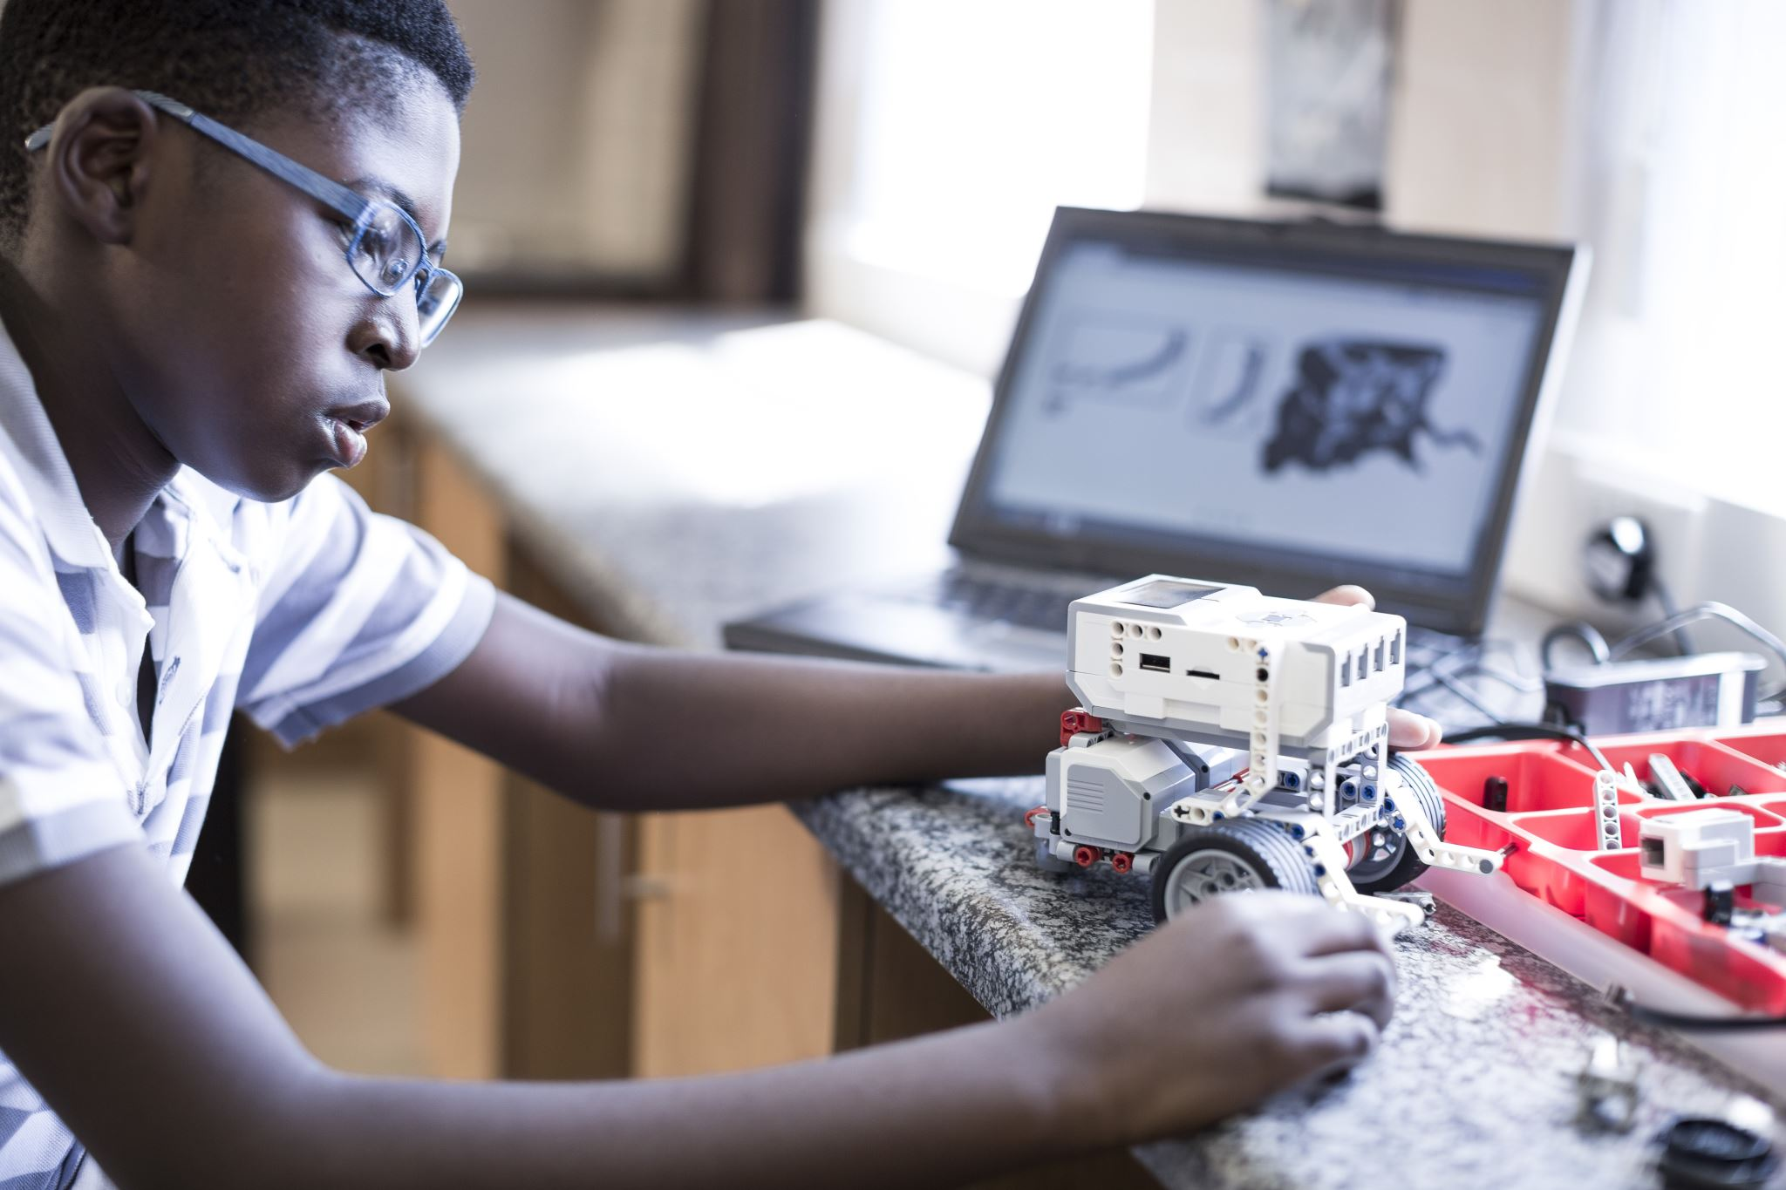
Introduction
Over the years technology has revolutionized our world and daily lives, opened up new opportunities and created amazing tools and resourses. Techonoly makes our collaboration today:
Easier
Effective
Faster
Comfortable
Research Question : Are staff and students confident in using technology to collaborate?
Mariana Codreanu(2118364)

Slide 3
Rationale
Our framework follows closely that of Sarma et al. (2010), listing technologies as communication, coordination, and information repositories, adding significant aspects of the computational environment(Working Together Apart: Collaboration over the Internet Judith S. Olson and Gary M. Olson 2013).
Future collaborative projects will be undertaken everywhere; globalisation is here .(Friedman, T. L. (2006). The World is Flat: The Globalized World in the Twenty-First century (Updated and expanded ed.). London: Penguin Books).
When using a questionnaire to collect data for the purpose of addressing the research problem, it is essential that it should generate reliable and valid information.(Designing research questionnaires for business and management students.,Ekinci Yuksel, 2015, SAGE publications ltd,London).
Mariana Codreanu

Slide 4
Proposed method
Proposed method have to be always first task in the process of research so your idea must be first on the paper.
It helps to understand the technique used behind the idea.
Use flowchart to present your idea. Use step by step procedure to present your idea.
The proposed method was found in literature.
There are 4 types of data that we can group based on methods: observational, experimental, simulation and derived.
Maria Kirvejova

Slide 5
Proposed Method
Research methods are the tools to collect your data. There can be different methods for research. We will be using the Questionnaire method.
closed
most common
quantitative research
open
more complex
qualitative research
combinated
most used
self-selecting participants
Likert scale questions
Questionnaires
Mariana Codreanu

Slide 6
What?
questionaire
Who?
UWTSD students
How?
Microsoft Teams
UWTSD lecturers
Mariana Codreanu

Slide 7
Ethical Considerations
Informed consent of those taking part
Integrity, fairness and open mindedness
Help them to decide if they want to take part
Treat everyone with the same level of respect
Voluntary nature of participation and right to withdraw
Have right to study
Respect for others
Avoidance of harm
Privacy of those taking part
Realise any harm that’s brought into force and it’s illegal
(Making nice compliments or being genial to others)
Taking care of their personal information
Maria Pohlodkova

Slide 8
Reaserch timeline
Week 4-5 | Week 6-7 | Week 8-9 | Week 10
In week 4-5 we are doing the quiz formulation. | Share the quiz with the participants. | Collecting Data and Analise | Hypothesis.
Maria Kirvejova
Maria Pohlodkova

Slide 9
Hypothesis
Collecting data
Finding a method to analyse our data
Final hypothesis
In our opinion, the research process is going well. In the final stage we will be able to answer to our proposed question,also to indentify all the advantages and disadvantages of collaboration using technology.
Mariana Codreanu

Slide 10
Reference list:
Working together apart: collaboration over the internet. Olson, Judith Reithman.,,Olson, Gary M.,, San Rafael, California(1537 Fourth Street), Morgan & Claypool, 2014.
Online collaboration and communication in contemporary organizations. Kolbaek, Ditte.,Hershey, Pennsylvania; IGI Global, 2018.
An introduction to Quatitative Research. Dyce, Jamie A.,Williams, Uzma. 2014
Etichcs in Qualitative Research. Birch, M and Mauthner, M (eds), London, 2002.
Mariana Codreanu

Slide 11
Thank You for your attention!

