Slide 1
Children’s sports coach
Erin Davies
2404320
BMPL5020

Slide 2

Introduction
Overview of volunteering
Connections to future studies and job goals
Emphasise skills that help you get hired and can be used in different jobs
(British Council, 2022)
(National careers service, 2023)
https://www.google.com/url?esrc=s&q=&rct=j&sa=U&url=https://passport.world.rugby/conditioning-for-rugby/introduction-to-conditioning-children/rugby-conditioning-for-the-child/&ved=2ahUKEwjwtqqr8ZeSAxUdUUEAHeaVHo8QqoUBegQIERAB&usg=AOvVaw0p7_ewsq6BNnkkHQ2l_IbO

Slide 3
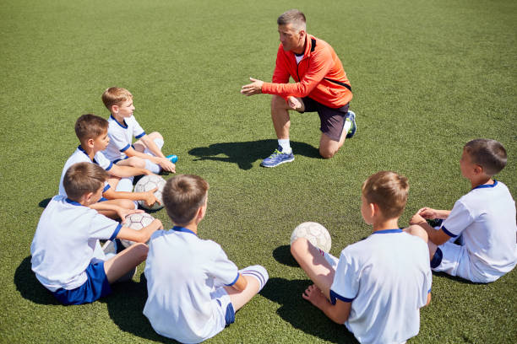
Why I chose this volunteering opportunity
A big interest in sports and working with kids
Important for jobs that involve team work
Opportunity to make positive impact
Learn new skills
(Team Grassroots, 2023)
(Youth sports trust, 2019)
https://www.istockphoto.com/photo/coach-talking-to-junior-football-team-gm836460458-136072525

Slide 4

Skills required for my future career
Communication skills
Leadership and responsibility
Safeguarding awareness
Emotional intelligence and adaptability
Transferability to policing
Empathy
(Welsh Government, 2022)
(College of policing, 2023)
https://www.google.com/url?esrc=s&q=&rct=j&sa=U&url=https://magazine.unison.org.uk/2022/05/20/pioneers-of-community-policing/&ved=2ahUKEwj7sdOa8peSAxViUkEAHVfiJgQ4FBCqhQF6BAgCEAE&usg=AOvVaw3Pe5QHoDwsOjvm3Hivf3R1

Slide 5
New experiences
Behavior management
Safeguarding and child protection
Adaptability and emotional intelligence
Resilience and professionalism
(Big Brothers of Greater Vancouver, 2025)

Slide 6

Contribution to the organisation
Support safe sessions
Encourage teamwork
Act as a role model
Support organisational values
(Musick and Wilson, 2008)
https://www.google.com/url?esrc=s&q=&rct=j&sa=U&url=https://www.dreamstime.com/illustration/teamwork.html&ved=2ahUKEwiV9-3B8peSAxVyU0EAHYeXATkQqoUBegQIARAB&usg=AOvVaw3Ldj9yAm6CP-Dq-aoLQZ7P

Slide 7
Volunteering and employability
Improving job skills for a police career
Develop important skills
Understand professional environments
Strong evidence for applications
(Royal Voluntary service, 2021)

Slide 8
Conclusion
Volunteering will help develop skills for a police career
Improve communication and confidence
Will gain leadership and responsibility
Better understanding of safeguarding
Increase patience and calmness
Prepare for police training and future work

Slide 9
Refrence list
Big brother of greater Vancouver (2025). How volunteering with children helps develop emotional intelligence – big brothers of greater Vancouver. Available at: https://www.bigbrothersvancouver.com/inspiring-stories/how-volunteering-with-children-helps-develop-emotional-intelligence/
British Counsil (2022) What is volunteering?/ British council. Available at: https://study-uk.britishcouncil.org/why-study/succeed-your-career/volunteering
College of Policing (2023) Competency and values framework. Available at: https://www.google.com/url?esrc=s&q=&rct=j&sa=U&url=https://www.college.police.uk/career-learning/competency-and-values-framework&ved=2ahUKEwjw8JWp9peSAxVWT0EAHQyYEq4QFnoECAkQAg&usg=AOvVaw1guvtK73phuY1FwGqXXHdO
Musick, M. and Wilson, J. (2008) Volunteers: A social profile. Indiana University press.
National Careers service (2023). Advice on volunteering/ careers advice/ national careers service. Available at: https://nationalcareers.service.gov.uk/careers-advice/advice-on-volunteering
Royal Voluntary service (2021). Volunteering key to improving job prospects. Royalvoluntaryservice.org.uk. Available at: https://www.royalvoluntaryservice.org.uk/news/volunteering/volunteering-key-to-improving-job-prospects/
Team Grassroots (2023). The winning formula: How being a volunteer sports coach benefits your career. Available at: https://www.teamgrassroots.co.uk/the-winning-formula-how-being-a-volunteer-sports-coach-benefits-your-career/
Welsh Government (2022). Job Information. Gov. wales. Available at: https://careerswales.gov.wales/job-information/police-officer/skills-and-qualities
Youth Sports trust (2019). Youth Sports trust/ we are a national charity passionate about creating a brighter future for children and young people through the power of sport. Available at: https://www.youthsporttrust.org

